Slide 1

TABLE OF CONTENTS
INTRODUCTION TO MINI VOTING SYSTEM.
CANDIDATE STRUCTURE.
CAST VOTE FUNCTION.
PRINT RESULTS FUNCTION.
MAIN FUNCTION.
DYNAMIC MEMORY ALLOCATION.
INITIALISATION OF CANDIDATES.
VOTING SYSTEM MENU.
MEMORY DEALLOCATION.
ENTIRE CODE.
OUTPUT.
CONCLUSION.

Slide 2

INTRODUCTION TO MINI VOTING SYSTEM:
A mini voting system is a simplified version of a larger-scale voting system that is designed to facilitate small-scale voting processes.
It is commonly used in small organizations, classrooms, or community groups to make decisions or elect representatives in a quick and efficient manner.
While it may not possess the complexity or features of a full-fledged electoral system, a mini voting system still follows the basic principles of fairness, transparency, and accuracy.

Slide 3
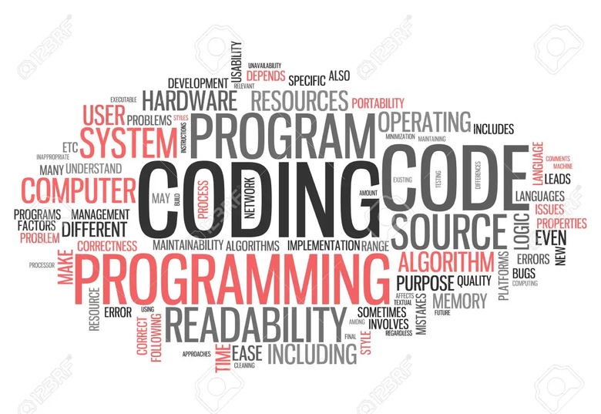
INTRODUCTION TO THE PROGRAM:
Various concepts ,structures and functions had been used in this c program which has been mentioned below,
.Candidate structure
Cast vote function.
Print Results function.
Main function
Dynamic memory allocation.
Initialisation of candidate.
Voting system menu.
memory deallocation.

Slide 4
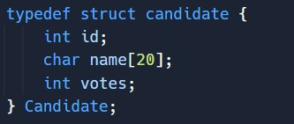
CANDIDATE STRUCTURE:
The Candidate structure is used to represent the attributes of a candidate in the voting system. It has three fields,
id: An integer to uniquely identify each candidate.
name: A character array to store the name of the candidate.
votes: An integer to keep track of the number of votes received by the candidate.
The Candidate structure allows you to organize the data related to each candidate in a single entity.

Slide 5
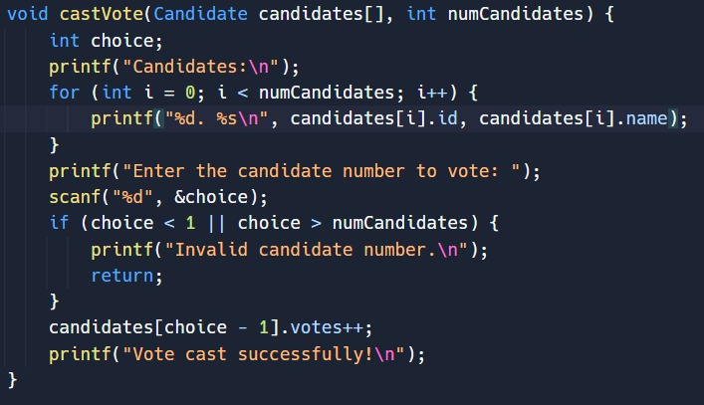
CAST VOTE FUNCTION:
The cast Vote function is used to handle the process of casting a vote for a candidate. Steps involved in casting a vote are,
Displays the list of candidates with their IDs and names.
Prompts the user to enter the candidate number they want to vote for.
Validates the user's choice and handle invalid inputs.
Increments the vote count for the selected candidate.
Displays a success message upon successful vote casting.

Slide 6
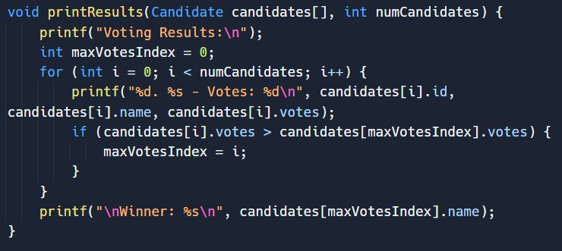
PRINT RESULTS FUNCTION:
The print Results function is responsible for displaying the voting results, including the number of votes each candidate received and the winner. It involves the following step,
Displays a header indicating that the following output represents the voting results.
Iterates through the array of candidates and display their IDs, names, and respective vote counts.
Identifies the candidate with the highest number of votes.
Displays the name of the winning candidate.

Slide 7

MAIN FUNCTION:
The main function consists of the program that is given the first priority during run time. In this case it consists of threemajor segments or blocks of code ;
Dynamically allocate memory for the candidates
Initialize candidate's data
Voting Process
The flow of the actual program begins from the main program (excluding the header files). It is then moved any function definition whenever it is called inside the main function

Slide 8
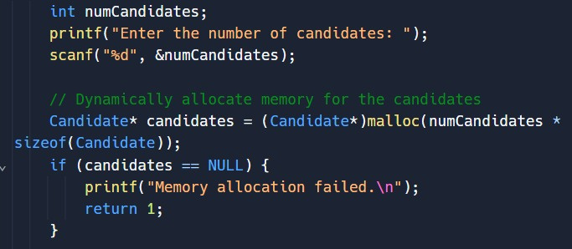
1)DYNAMIC MEMORY ALLOCATION:
Dynamic memory allocation is used to allocate memory for the candidates array based on the number of candidates entered by the user

Slide 9
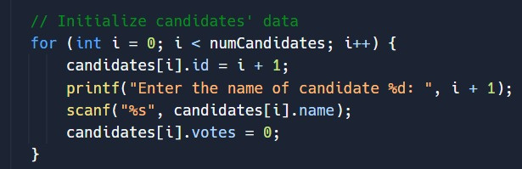
2)INITIALISATION OF CANDIDATES:
The initialization of the candidates array occurs within a loop after dynamically allocating memory.
By initializing each candidate's id, name, and votes fields within the loop, the code ensures that all the candidate data is properly set before proceeding to the voting process.
Each candidate is given a unique identifier, their name is collected from the user, and their vote count is set to 0 as the starting point.

Slide 10
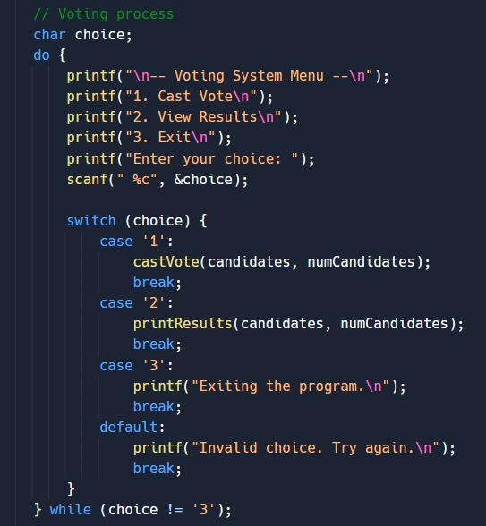
3)VOTING SYSTEM MENU:
The voting system menu provides a user-friendly interface to interact with the voting system.
It allows users to select various options such as casting a vote, viewing the results, or exiting the program.
Do while loop allows the user to choose multiple choices until they decide to exit the program.
Switch case statement is used that determines the action based on the user's choice.

Slide 11

MEMORY DEALLOCATION:
Memory deallocation is used to free the dynamically allocated memory for the candidates array. Here's how memory allocation is done,
The free function is called, passing the pointer candidates as the argument.
This deallocates the memory that was previously allocated using malloc.
It's important to free dynamically allocated memory to prevent memory leaks, which occur when memory is allocated but not freed, leading to a loss of available memory over time.

Slide 12
CODE:
#include <stdio.h>
#include <stdlib.h>
typedef struct candidate {
int id;
char name[20];
int votes;
} Candidate;
void castVote(Candidate candidates[], int numCandidates) {
int choice;
printf("Candidates:\n");
for (int i = 0; i < numCandidates; i++) {
printf("%d. %s\n", candidates[i].id, candidates[i].name);
}
printf("Enter the candidate number to vote: ");
scanf("%d", &choice);
if (choice < 1 || choice > numCandidates) {
printf("Invalid candidate number.\n");
return;
}
candidates[choice - 1].votes++;
printf("Vote cast successfully!\n");
}

Slide 13
void printResults(Candidate candidates[], int numCandidates) {
printf("Voting Results:\n");
int maxVotesIndex = 0;
for (int i = 0; i < numCandidates; i++) {
printf("%d. %s - Votes: %d\n", candidates[i].id, candidates[i].name, candidates[i].votes);
if (candidates[i].votes > candidates[maxVotesIndex].votes) {
maxVotesIndex = i;
}
}
printf("\nWinner: %s\n", candidates[maxVotesIndex].name);
}
int main() {
int numCandidates;
printf("Enter the number of candidates: ");
scanf("%d", &numCandidates);
// Dynamically allocate memory for the candidates
Candidate* candidates = (Candidate*)malloc(numCandidates * sizeof(Candidate));
if (candidates == NULL) {
printf("Memory allocation failed.\n");
return 1;
}

Slide 14
// Initialize candidates' data
for (int i = 0; i < numCandidates; i++) {
candidates[i].id = i + 1;
printf("Enter the name of candidate %d: ", i + 1);
scanf("%s", candidates[i].name);
candidates[i].votes = 0;
}
// Voting process
char choice;
do {
printf("\n-- Voting System Menu --\n");
printf("1. Cast Vote\n");
printf("2. View Results\n");
printf("3. Exit\n");
printf("Enter your choice: ");
scanf(" %c", &choice);

Slide 15
switch (choice) {
case '1':
castVote(candidates, numCandidates);
break;
case '2':
printResults(candidates, numCandidates);
break;
case '3':
printf("Exiting the program.\n");
break;
default:
printf("Invalid choice. Try again.\n");
break;
}
} while (choice != '3');
// Free dynamically allocated memory
free(candidates);
return 0;

Slide 16
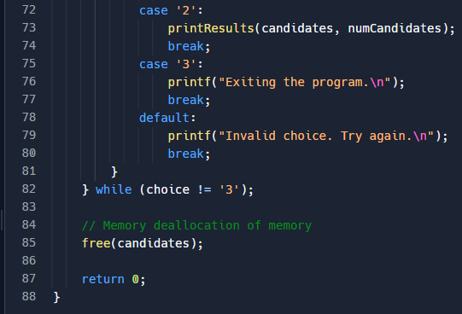

Slide 17

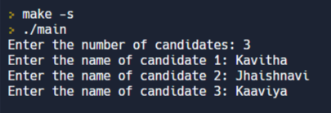
OUTPUT:
Firstly the program prompts us to enter the number of candidates
2. Enter the names of the candidates

Slide 18
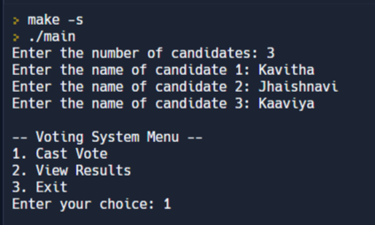
3. The program displays a "Voting System Menu", in which its various functionalities are listed.
In this case, we have chosen to cast a vote
Ithsi

Slide 19
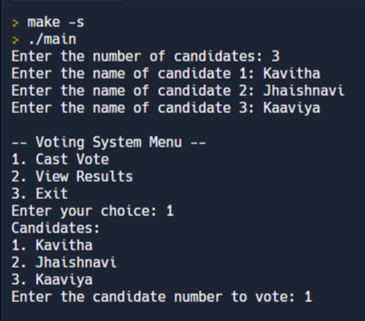
4. The various candidates are now enlisted and the user is required to make a choice between the given candidates
After casting your vote, "Vote cast successfully !" message is displayed

Slide 20
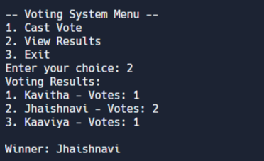
After repeating the process of voting multiple time, When the "View Results" functionality is used, The total vote count is shown.
Also the winning candidate is specified by the program

Slide 21

CONCLUSION:
The provided code implements a mini voting system in C. It allows users to add candidates, cast votes for those candidates, and view the voting results, including the winner.
Overall, the code provides a functional and modular mini voting system, demonstrating concepts such as dynamic memory allocation, user input handling, and menu-driven program design.
In case if you want a better look at the code,
visit https://github.com/tanush-em/Mini-Voting-System-in-C/blob/main/Mini-Voting-System.c

Slide 22
THANK YOU:)

