Slide 1



SMART INDIA HACKATHON - 2024
INQUEST.ai Semantic Search in Unstructured and Semi-Structured Data
Problem Statement ID: SIH1600
Problem Statement Title: Student Innovation from
Organization: Ministry of Education’s Innovation Cell (MIC)
Theme: Smart Automation
PS Category: Software
Team ID: 16841
Team Name: SLASH 6

Slide 2

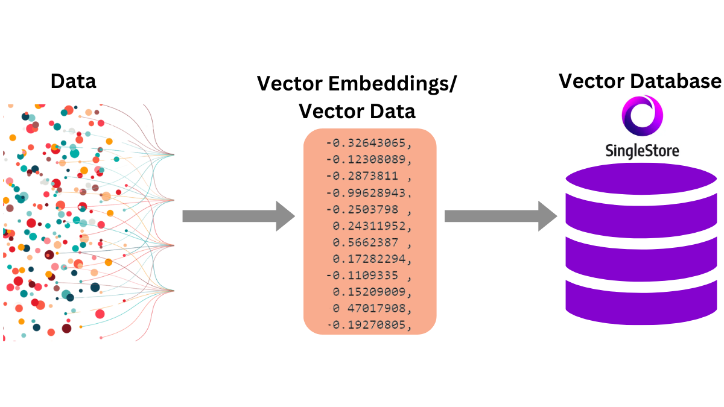
INQUEST.ai Semantic Search in Unstructured and Semi-Structured Data
PROPOSED SOLUTION
To build a generalized AI-driven research engine that can handle both structured and unstructured data and convert it into vector embeddings, allowing for powerful semantic search capabilities across domains.
In order to attain contextually relevant search we intend on using advanced technologies like FAISS or ElasticSearch.
PROTOTYPE
The prototype integrates raw data and builds a vector database.
It leverages FAISS/ElasticSearch for semantic search, ensuring fast and efficient retrieval of results based on embeddings.
The user interface allows for natural language querying, returning relevant and ranked results in real time.
This research engine will offer fast and accurate search results, making it a versatile tool for research in any field.
UNIQUENESS IN APPROACH?
Domain - Agnostic and usage across diverse databases
Contextually relevant and Semantic Search
Dynamic Schema of Databases
Scalable
User-Friendly and Customizable
Self Learning and Improving

Slide 3

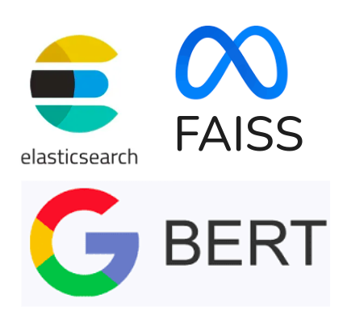
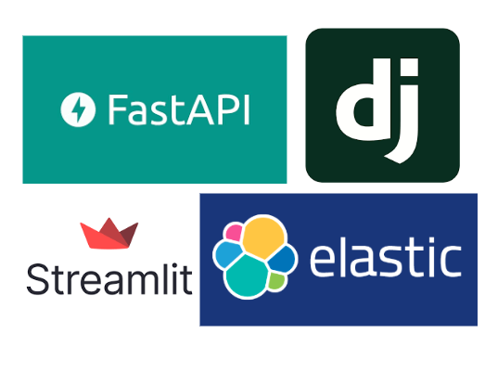
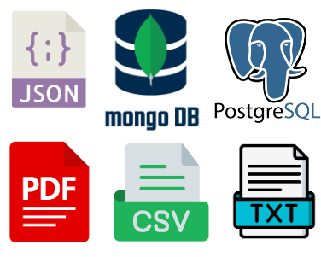
TECHNICAL APPROACH
TECHNOLOGIES USED:
- Primary Language will be Python with C++ build dependency for GPU (CUDA) support.
- Hardware component like GPU for vector embedding with CUDA support.
- Libraries such as PyTorch, Ultralytics, Torchvision .
- Databases such as PostgreSQL, MongoDB and ChromaDB.
- Frameworks to build Interfaces Django, FastAPI and Streamlit.
- Other core python dependencies and libraries such as NumPy, Pandas, SpaCy, NLTK etc

Slide 4





FEASIBILITY AND VIABILITY
WORKFLOW
Initial data setup from various structured and unstructured data sources.
Data is ingested and preprocessing is done and it is converted to a Vector Database.
Heuristic Configuration and Setup of domain specific custom preferences.
Execution of contextual search to obtain semantically relevant results.
Display results and refinement and filtering of desired results.
FEASIBILITY ANALYSIS
Data Agnosticism
HIghly Scalable Mechanism
Computationally affordable
Improved research and referencing
Saves TIme and Manual Labour
POTENTIAL CHALLENGES
Availability of quality, consistent and not noisy data
Multilingual Support
User Adoption
Data Privacy
Security threat handling with rigorous testing

Slide 5
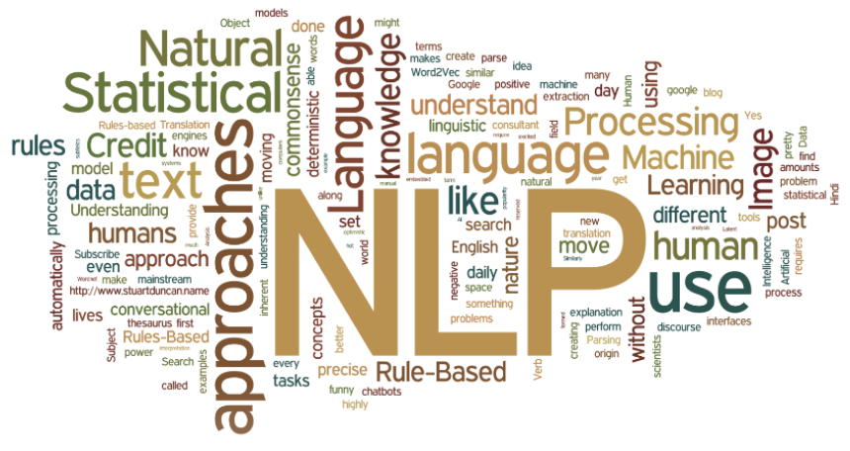

IMPACT AND BENEFITS
Domain Independent Application and Usecases
Enhanced Efficiency
Scalable and Inexpensive
Improved Decision Making
Widespread Adoption
Reduces manual work of citing, referencing and researching
Highly Adaptable and Versatile
Continuous Learning and Improvement of search results

Slide 6

RESEARCH AND REFERENCES
The following resources were referred:
Research paper titled “Sentence-BERT: Sentence Embeddings using Siamese BERT-Networks” - [link]
An open-sourced resource by Facebook Research- [link]
An open-sourced resource by elastic.co - Team of elastic search - [link]
Open Source templates for Interface and UI/UX Designs
Documentations of various technologies such as ChromaDB, FAISS, PostgreSQL etc

