Slide 1
Department of Artificial Intelligence
& Machine Learning
ESSENTIALS OF WEB PROGRAMMING (EWP) · PROJECT PRESENTATION
Kaboom's Kitchen
Mapped to Unit V – Angular
Roll No. | Team [No.] Members
[Roll No.] | [Student Name 1]
[Roll No.] | [Student Name 2]
[Roll No.] | [Student Name 3]
[Roll No.] | [Student Name 4]
UNDER THE GUIDANCE OF
[Faculty Name]
[Designation], Dept. of AI & ML
Notes:
Introduce the team and the project: Kaboom's Kitchen, a restaurant website built over the 14-week EWP lab, with an AngularJS single-page app for Unit V. Fill in the roll numbers, names, faculty and team number before presenting.

Slide 2

Abstract & Problem Statement
INTRODUCTION
Abstract
Kaboom's Kitchen is a restaurant website built across the 14-week EWP lab. Customers can browse the menu, register and book a table. The Unit V part is an AngularJS single-page app that lists the menu with live search, takes bookings through a validated form, and keeps them in a shared BookingService, all without reloading the page.
Problem Statement
Small restaurants often take bookings only by phone, which is slow and error-prone. Customers need a simple website to see the menu and book a table at any time.
Notes:
The problem is phone-only bookings. The solution is one website where customers see the menu and book a table themselves, with every input checked before it is saved.

Slide 3


Objectives & Proposed System
INTRODUCTION
Objectives
01
Show the full menu with live search and category filters
Proposed System
A single-page AngularJS app: three tabs (Menu, Book a Table, Reservations) swap in place, and the booking form checks every input before saving.
02
Take table bookings through a form that validates every field
Live menu search + category filter
03
Keep bookings in one shared service and list them instantly
Validated booking form with live preview
Reservations list updates instantly
Notes:
Three goals, one per tab of the app. The proposed system replaces phone bookings with a page that never reloads and catches bad input before it is saved.

Slide 4






Technologies & Architecture
SYSTEM DESIGN
User
Controller
Services
Fetch API
Data
Browser (Chrome)
RestaurantController + views
BookingService (DI)
GET text / JSON / XML, POST
JSON + XML files, test API
UI LIBRARY
TOOLS
ROUTER
Custom CSS (style.css), no UI framework
VS Code, Live Server, Chrome DevTools, tsc
Tabs switched with setTab() + ng-show
Notes:
A click in the browser reaches RestaurantController, which reads and writes data through the injected BookingService. The lab pages for Weeks 8-10 load data with the Fetch API from JSON and XML files and post bookings to a public test API. Styling is our own style.css; there is no router module, the tabs are switched with ng-show.

Slide 5

14 Weeks, One Website
LAB COVERAGE · WEEKS 1–14
Week | What we built | File(s)
W1–2 | Home, Login and Registration pages with HTML5 validation | index, login, register.html
W3 | Inline, internal and external CSS (shared style.css) | style.css
W4 | JavaScript validation: 5 checks on the registration form | script.js
W5 | Menu catalogue + table-booking form | menu.html
W6 | Menu data in XML, validated by a DTD | menu.xml, menu.dtd
W8–10 | Fetch API: load text, parse JSON / XML, send POST | fetch_*.html, booking_post.html
W11 | TypeScript interfaces, a class and typed functions | menu.ts → menu.js
W12–14 | AngularJS SPA: binding, directives, forms, service | angular_app.html
Notes:
The whole syllabus lives in one website. Week 7 was the review and Skill Test 1, so it has no page of its own. The next three slides show Weeks 1-11; after that we focus on Unit V, Angular.

Slide 6

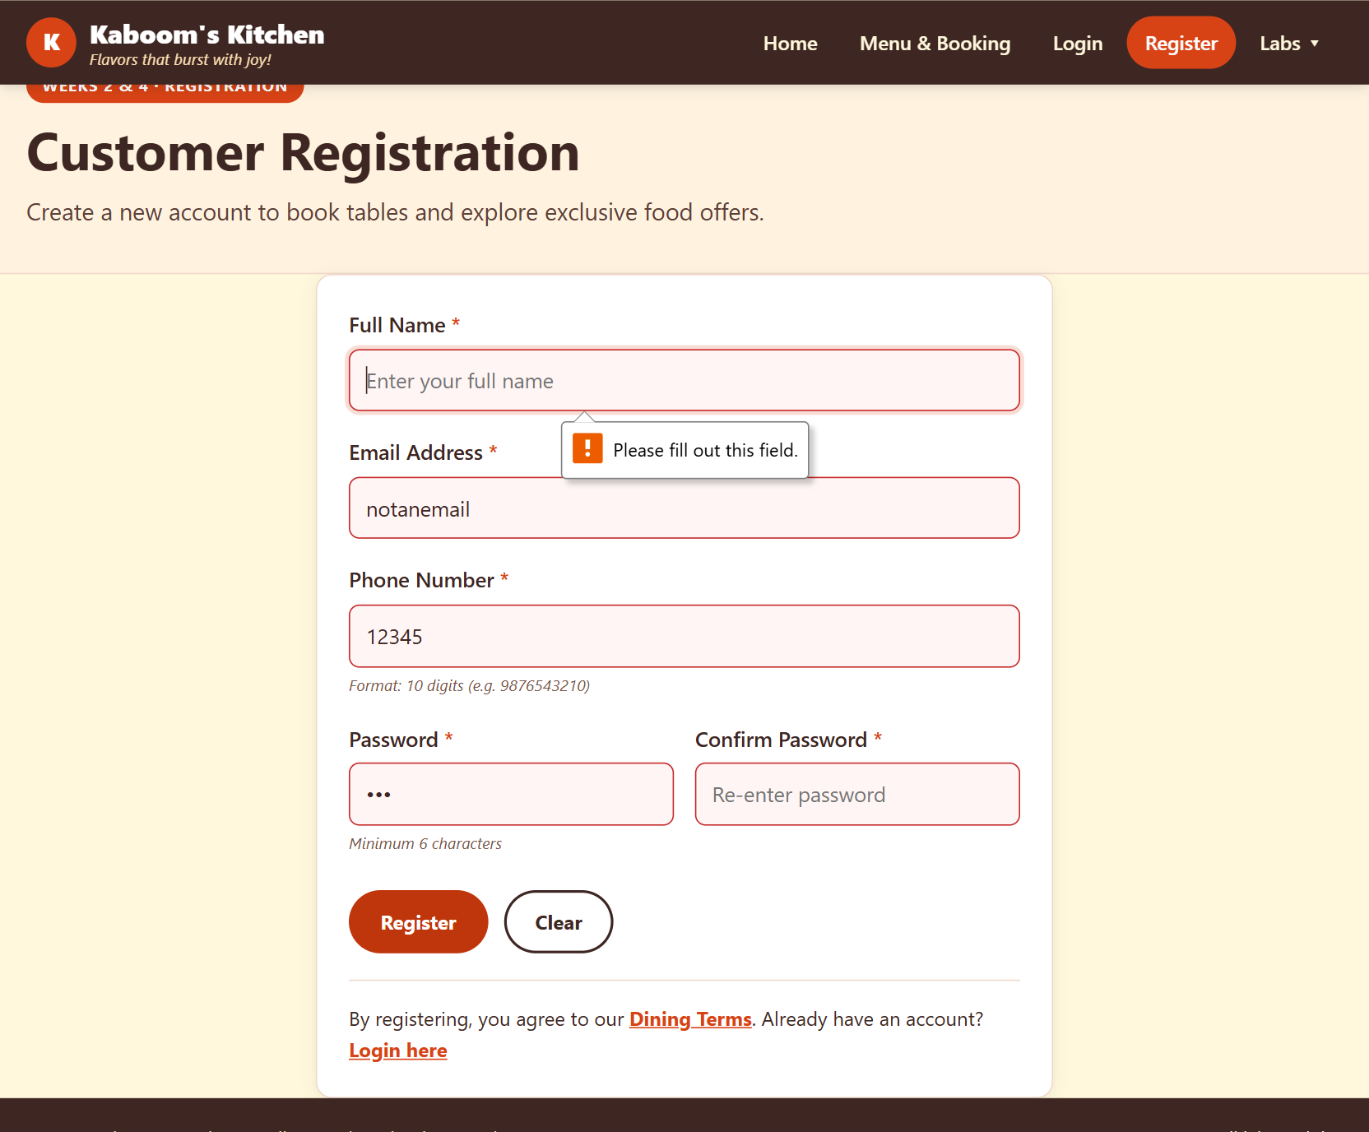
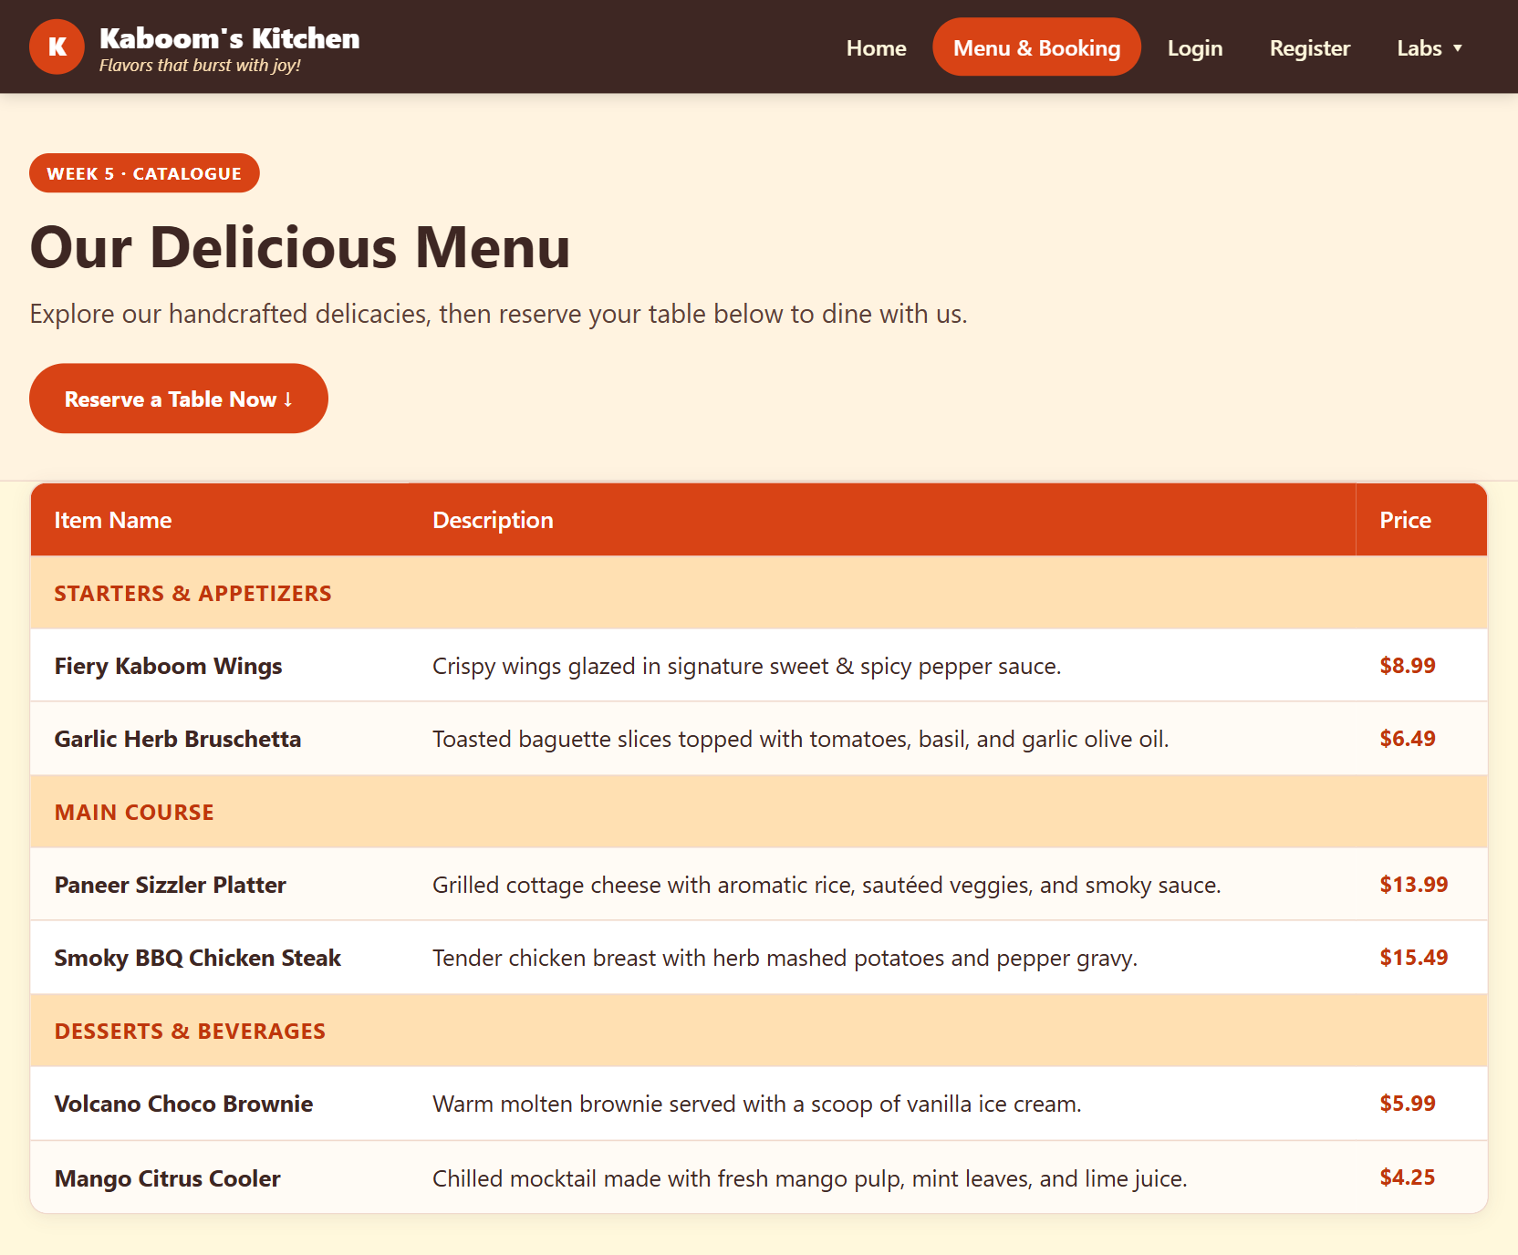
Pages, Style & Validation
LAB COVERAGE · WEEKS 1–5
What we built
Semantic pages, shared nav
3 CSS types on every page
HTML5 + 5 JS validations
Booking form with alerts
Registration: HTML5 + JS checks
Menu catalogue + booking
Notes:
Weeks 1-2: semantic HTML pages and a registration form checked by HTML5 attributes (required, type=email, pattern, minlength). Week 3: inline, internal and external CSS. Week 4: script.js adds five JavaScript checks, including password match, which HTML5 cannot do. Week 5: the menu catalogue and booking form.

Slide 7
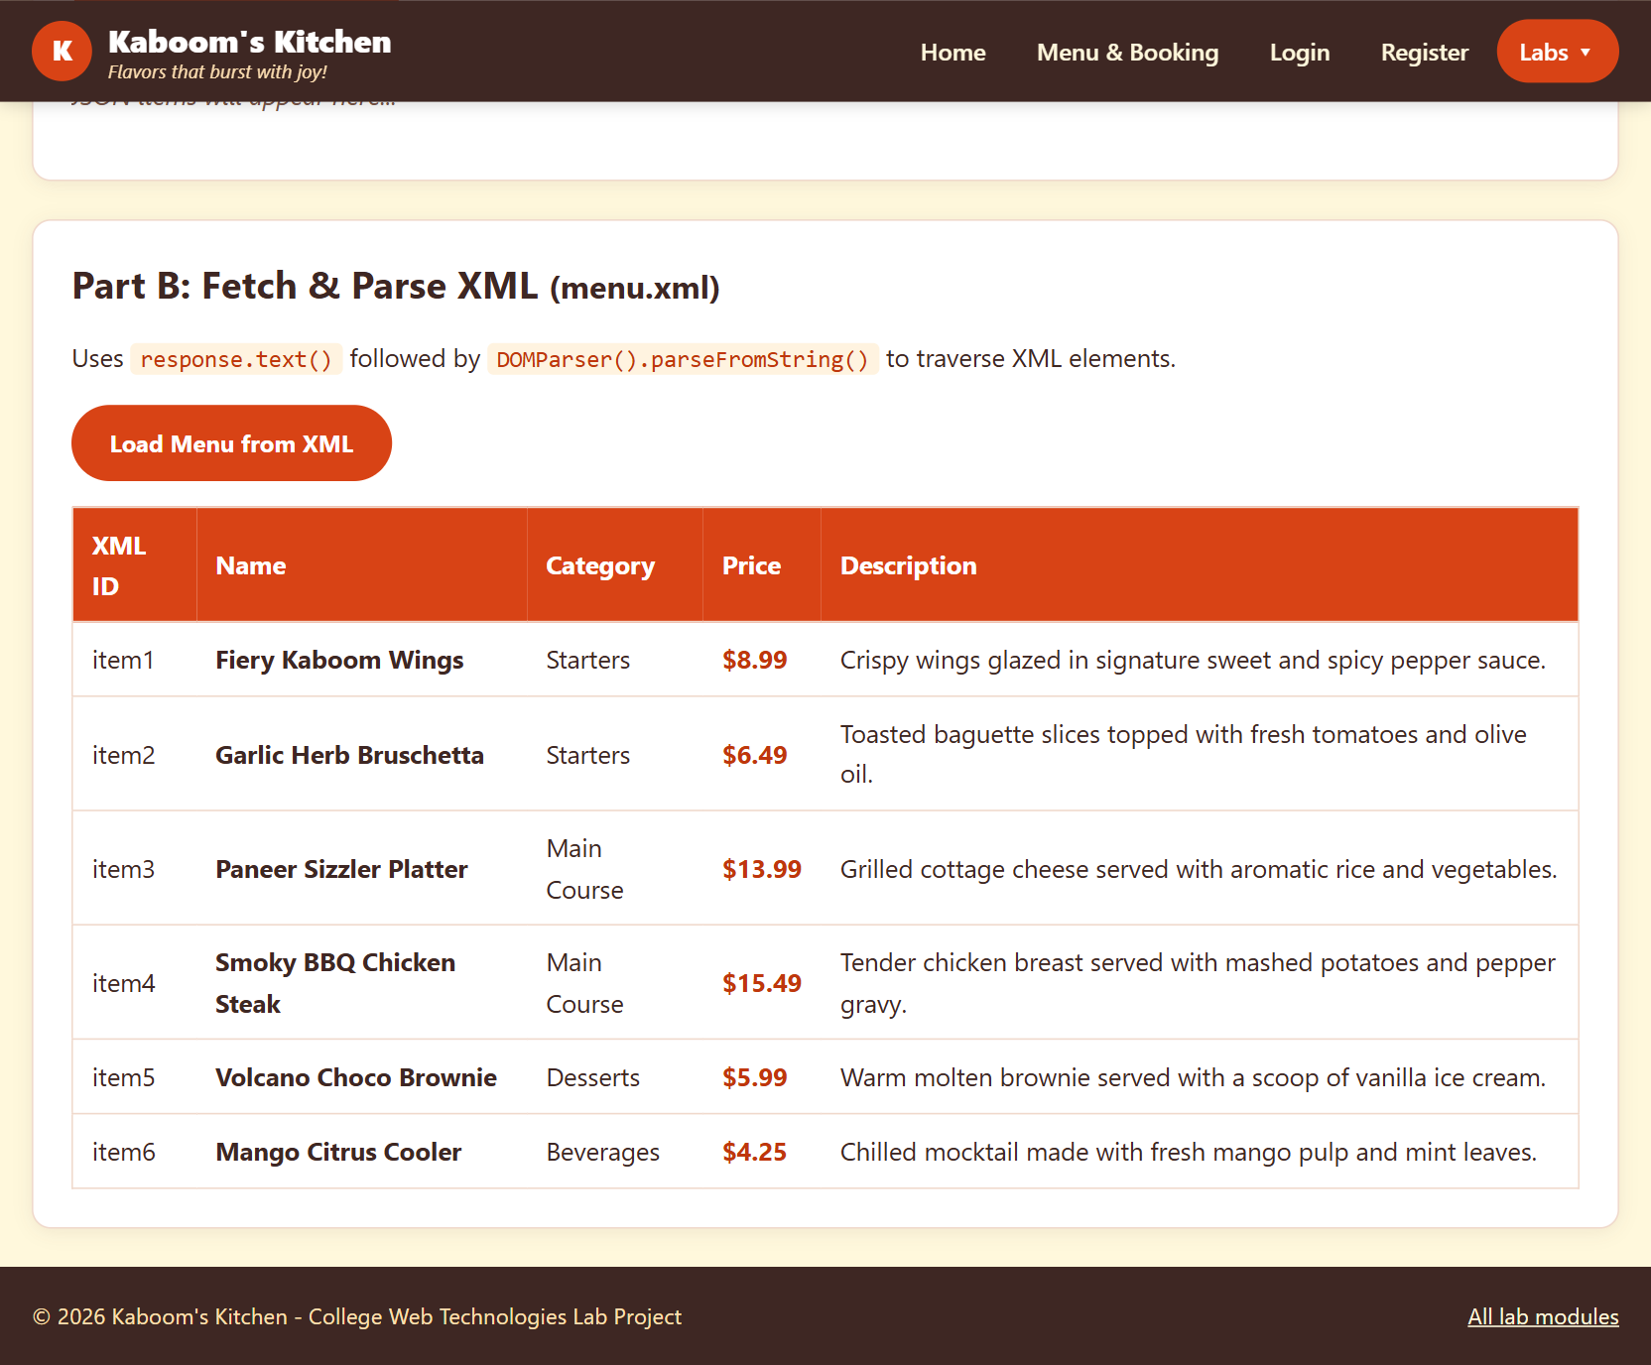
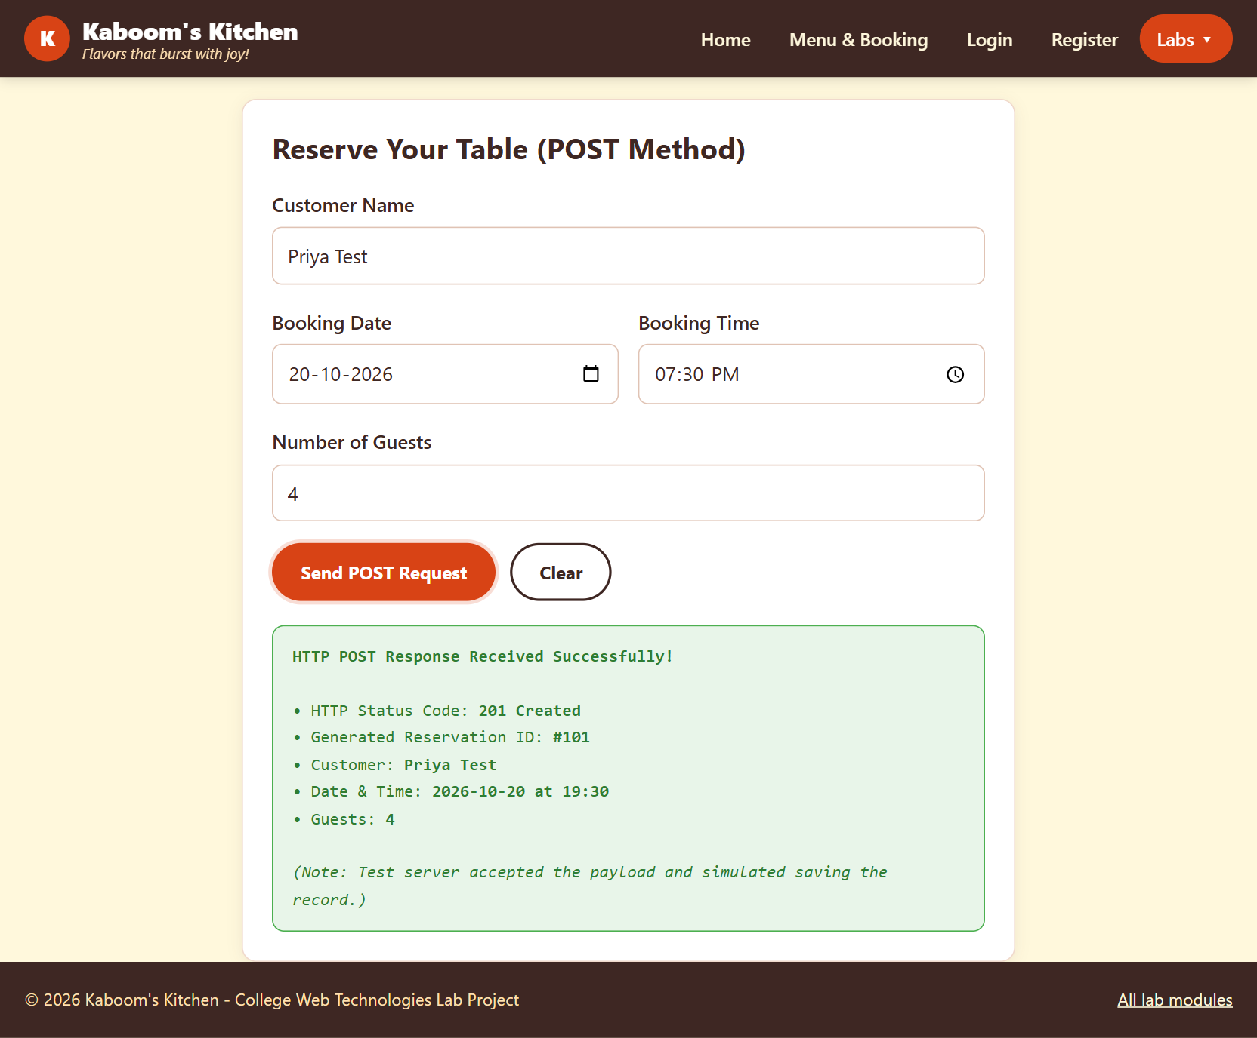
XML, DTD & the Fetch API
LAB COVERAGE · WEEKS 6, 8–10
What we built
DTD rejects broken XML
fetch() loads a text file
JSON + XML parsed to tables
POST returns 201 + id #101
menu.xml parsed with DOMParser
POST → 201 Created
Notes:
Week 6: menu.xml holds six items and menu.dtd sets the rules; a validator rejected copies with a missing price or a duplicate id. Weeks 8-10: fetch() loads restaurant_info.txt, menu_data.json and menu.xml without reloading the page, and booking_post.html sends a JSON booking with POST and gets 201 Created back.

Slide 8

TypeScript Classes & Interfaces
LAB COVERAGE · WEEK 11
In our project
interface MenuItem {
id: number; name: string;
category: string; price: number;
isSpicy: boolean;
}
class RestaurantMenu {
private items: MenuItem[];
public filterByCategory(c: string): MenuItem[] {
return this.items.filter(i => i.category === c);
}
}
function formatCurrency(amount: number): string {
return "$" + amount.toFixed(2);
}
Interfaces: MenuItem, TableBooking
Class RestaurantMenu: private items, 4 typed methods
Functions: formatCurrency(), createBookingSummary()
Compiled by tsc to menu.js (0 type errors)
Demo: 4 items, 2 starters, bill $22.98
Simplified from menu.ts
Notes:
TypeScript adds types that are checked at compile time. The interface describes a menu item, the class keeps its items private and exposes typed methods, and tsc compiles it to plain JavaScript (menu.js) that the demo page runs.

Slide 9
Project Mapping to Unit V Topics
UNIT V · ANGULAR
Unit V Topic | Where used in our project | Member
Angular CLI & Project Setup | Not used: AngularJS 1.8.2 loaded from a CDN <script> tag | [Name]
Components & Modules | Module kaboomApp + RestaurantController with its view | [Name]
Templates & Data Binding | {{ }} interpolation, ng-model two-way binding (search, form) | [Name]
Directives & Pipes | ng-repeat, ng-show, ng-if, ng-class, ng-disabled; filters: filter, date | [Name]
Services & Dependency Injection | BookingService, injected into RestaurantController | [Name]
Lifecycle Hooks & HTTP Client | No ngOnInit (controller runs on load); HTTP via Fetch API, Weeks 8–10 | [Name]
Template Driven & Reactive Forms | Template-driven booking form ($dirty, $invalid, ng-disabled); no reactive form | [Name]
Routing | Tabs switched with setTab() + ng-show (no router module) | [Name]
Notes:
Our Angular page uses AngularJS 1.8, so a few Unit V items appear in their AngularJS form: a controller and view instead of an @Component, filters instead of pipes, and tab switching instead of the Router. Rows marked 'Not used' or 'No ...' are honest gaps; be ready to explain the Angular 2+ equivalent in the viva.

Slide 10

Components & Data Binding
UNIT V · CLI, COMPONENTS, TEMPLATES, DIRECTIVES & PIPES
Components & Modules in our project
// angular_app.html
var app = angular.module("kaboomApp", []);
app.controller("RestaurantController",
function($scope, BookingService) {
$scope.menuItems = [ /* 6 dishes */ ];
$scope.bookings = BookingService.getAll();
});
Loaded from a CDN script (no ng new / CLI)
Module: kaboomApp · Controller: RestaurantController
Views: Menu, Book a Table, Reservations tabs
Data Binding
Directives
Pipes (AngularJS filters)
{{ }} · ng-model · ng-click
ng-repeat · ng-show · ng-class
filter · date
Used in: menu search, live preview
Used in: menu table, tab bar
Used in: menu search, booking preview
Notes:
ng-app starts the kaboomApp module and ng-controller attaches RestaurantController to the page. Typing in the search box updates $scope through ng-model and ng-repeat re-filters the menu instantly. The date filter formats the booking preview. In Angular 2+ these become an @Component, *ngFor and pipes.

Slide 11
Services & HTTP Client
UNIT V · SERVICES, DI, LIFECYCLE HOOKS & HTTP
In our project
app.service("BookingService", function() {
var reservations = [
{ customerName: "Rahul Sharma", ... },
{ customerName: "Ananya Iyer", ... }
];
this.getAll = function() {
return reservations;
};
this.add = function(booking) {
reservations.push(booking);
};
});
// in the controller (injected by name)
$scope.bookings = BookingService.getAll();
Service: BookingService – stores reservations
Injected into: RestaurantController
No ngOnInit: controller code runs once on page load
HTTP: Fetch API – GET text / JSON / XML, POST (201)
Code from angular_app.html
Notes:
Keeping the reservations in a service means any controller can share them. Angular injects BookingService into the controller just by naming it as a parameter. The Angular page keeps data in memory; real HTTP calls are made with the Fetch API on the Week 8-10 pages.

Slide 12

Forms & Routing
UNIT V · FORMS, VALIDATION & ROUTING
Forms & Validation
Routing & Navigation
Template driven (ng-model) – Book a Table form
Reactive (FormGroup) – not used
Views: Browse Menu · Book a Table · Reservations
setTab() + ng-show replace routerLink / router-outlet
<input name="name" required
ng-model="formData.customerName">
<span ng-show="bookingForm.name.$invalid">
<input type="submit"
ng-disabled="bookingForm.$invalid">
$scope.currentTab = 'menu';
$scope.setTab = function(tab) {
$scope.currentTab = tab;
};
<div ng-show="currentTab === 'book'">
Validations: required, 1–20 guests, $dirty, $invalid
Notes:
Demo: leave the name empty to show 'Name is required!' and the disabled Confirm button, then fill the form and watch the preview. Submitting saves the booking and switches to the Reservations tab without reloading the page.

Slide 13
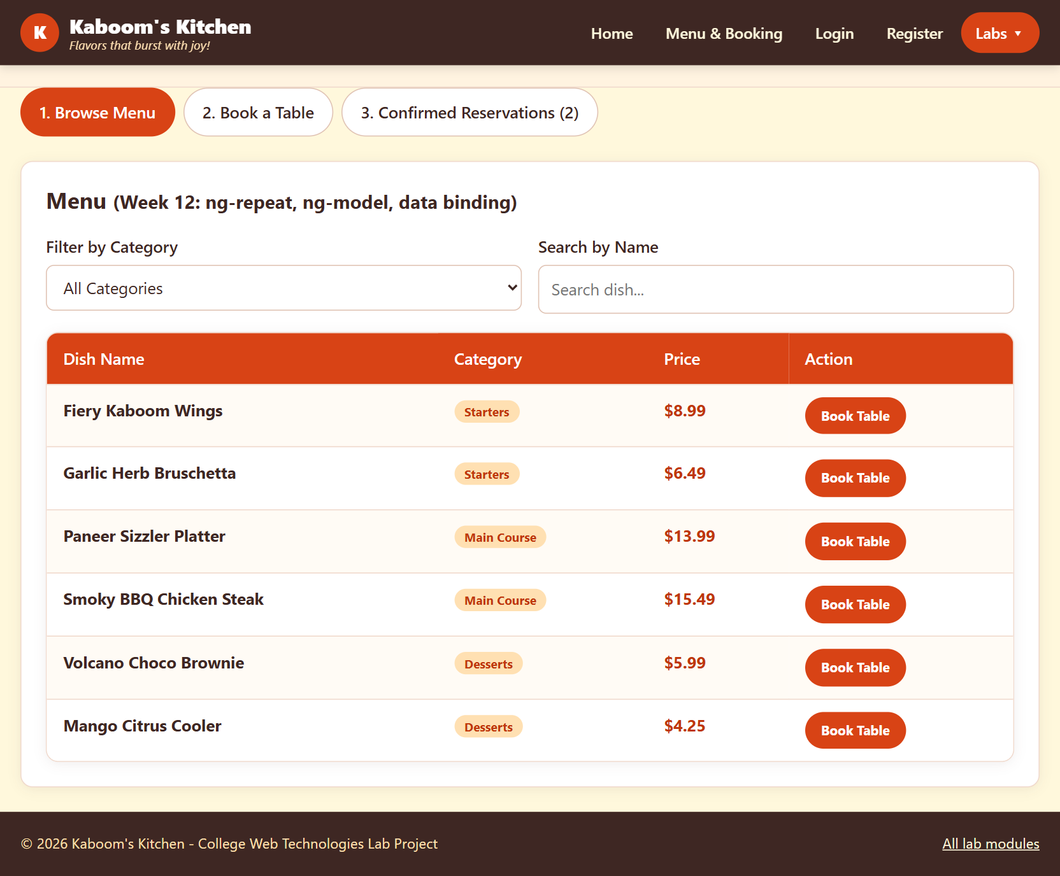
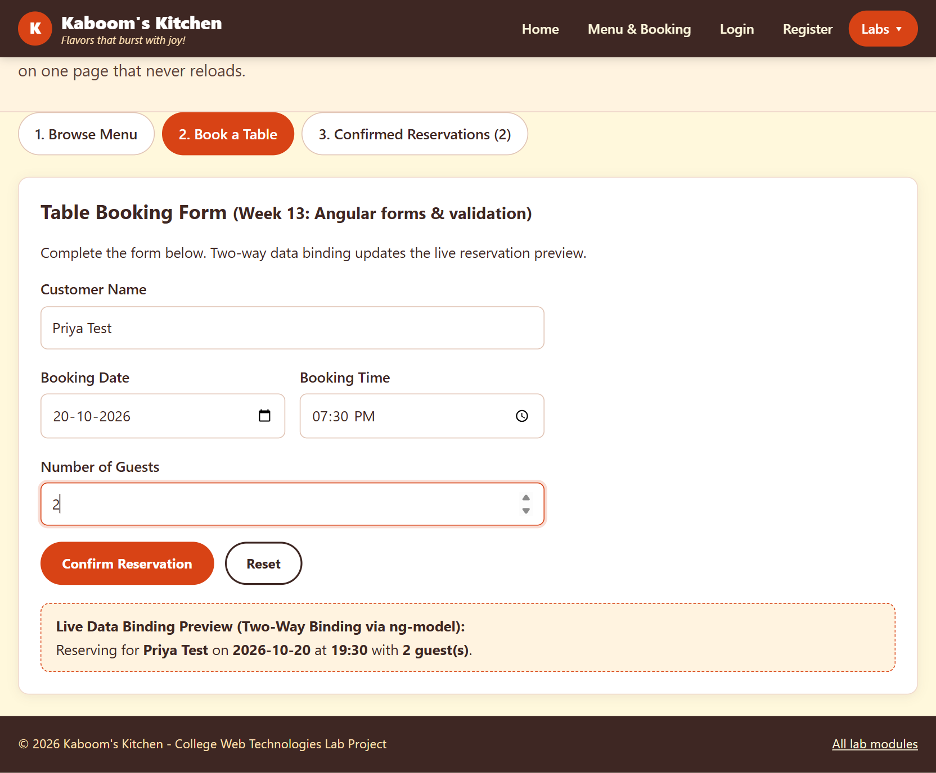
Output & Results
OUTPUT
Results
Live search & category filter
Form validation + preview
Bookings saved, tab switches
Tested: Chrome, desktop + mobile
Menu tab: ng-repeat + live filter
Booking form + live preview
Notes:
Every screen was tested in Chrome on desktop and phone widths: 47 of 49 automated checks pass. Known issue: a booking for 20 Oct is stored as 19 Oct because toISOString() converts to UTC; the fix is on the conclusion slide.

Slide 14

Individual Contribution
TEAM
Member | Modules built | Unit V concepts used
[Student Name 1] | Weeks 1–5: pages, CSS, JS validation | Templates & data binding
[Student Name 2] | Weeks 6, 8–10: XML / DTD, Fetch API | Services & dependency injection
[Student Name 3] | Week 11 TypeScript + Menu tab | Directives & filters
[Student Name 4] | Weeks 12–14: booking form + tabs | Template-driven forms, tab navigation
Notes:
This split is a suggestion; change it to match who actually built each part. Each member should be ready to answer viva questions on their own Angular concepts.

Slide 15

Conclusion & Future Scope
WRAP-UP
Conclusion
Future Scope
Kaboom's Kitchen covers all 14 lab weeks in one website. For Unit V we applied an AngularJS module and controller, two-way binding, directives, filters, a shared service with dependency injection and template-driven form validation.
Rebuild with Angular CLI: components, Router, Reactive Forms
Real backend (Node.js + MySQL) for logins and bookings
Fix booking date timezone; route guards for login
REFERENCES
1. Angular Documentation – angular.dev 2. AngularJS Documentation – docs.angularjs.org
3. TypeScript Documentation – typescriptlang.org 4. MDN Web Docs – developer.mozilla.org
5. [Textbook / other sources used]
Notes:
We built a working restaurant site and an AngularJS single-page app. The natural next step is moving to Angular 2+ with the CLI, a real backend, and fixing the timezone bug (format the date with $filter('date') instead of toISOString()).

Slide 16

Thank You
Questions?
Team [No.] · Kaboom's Kitchen
Notes:
Thank the audience and invite questions.

