Slide 1

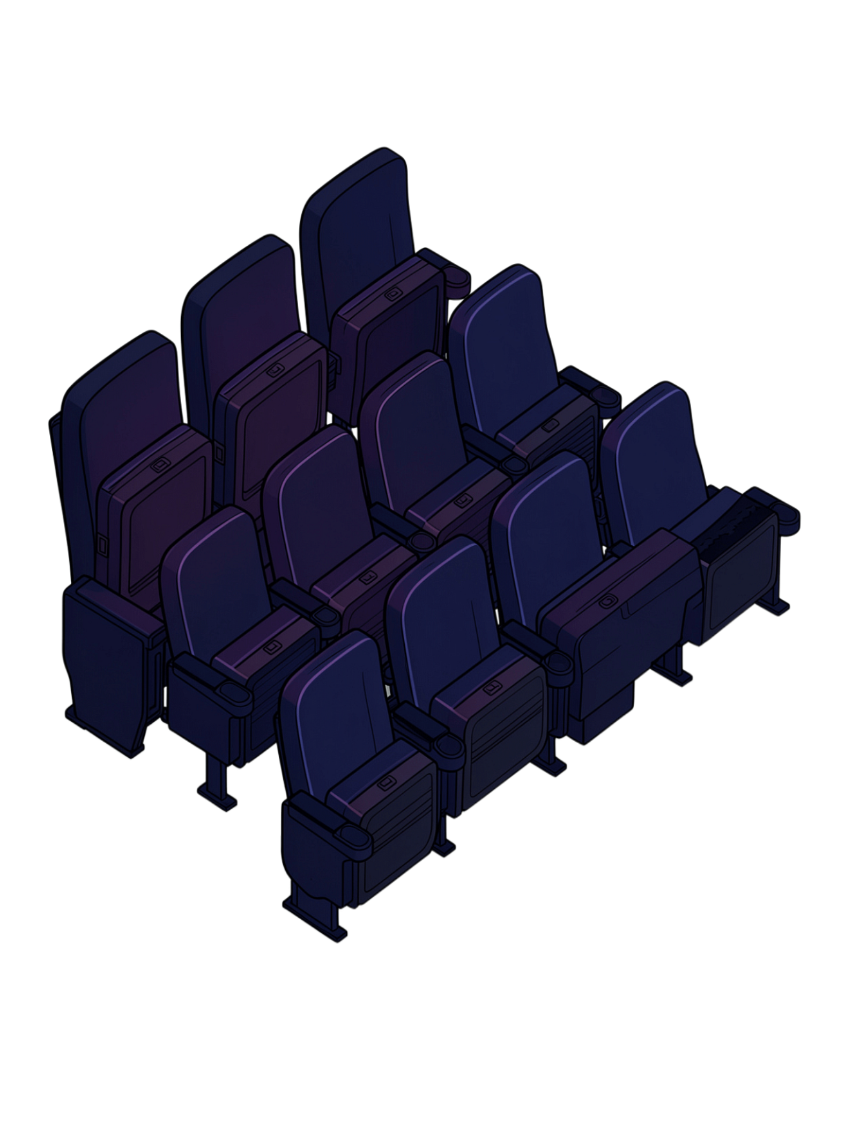
Cinema Seat Booking System
Team No: [Your Team Number] | Java Console Application Project
01
02
1.2620030028 - Saisree
2.2620030421 - Thanusha
Supervisor: Dr. K. Madhavi

Slide 2
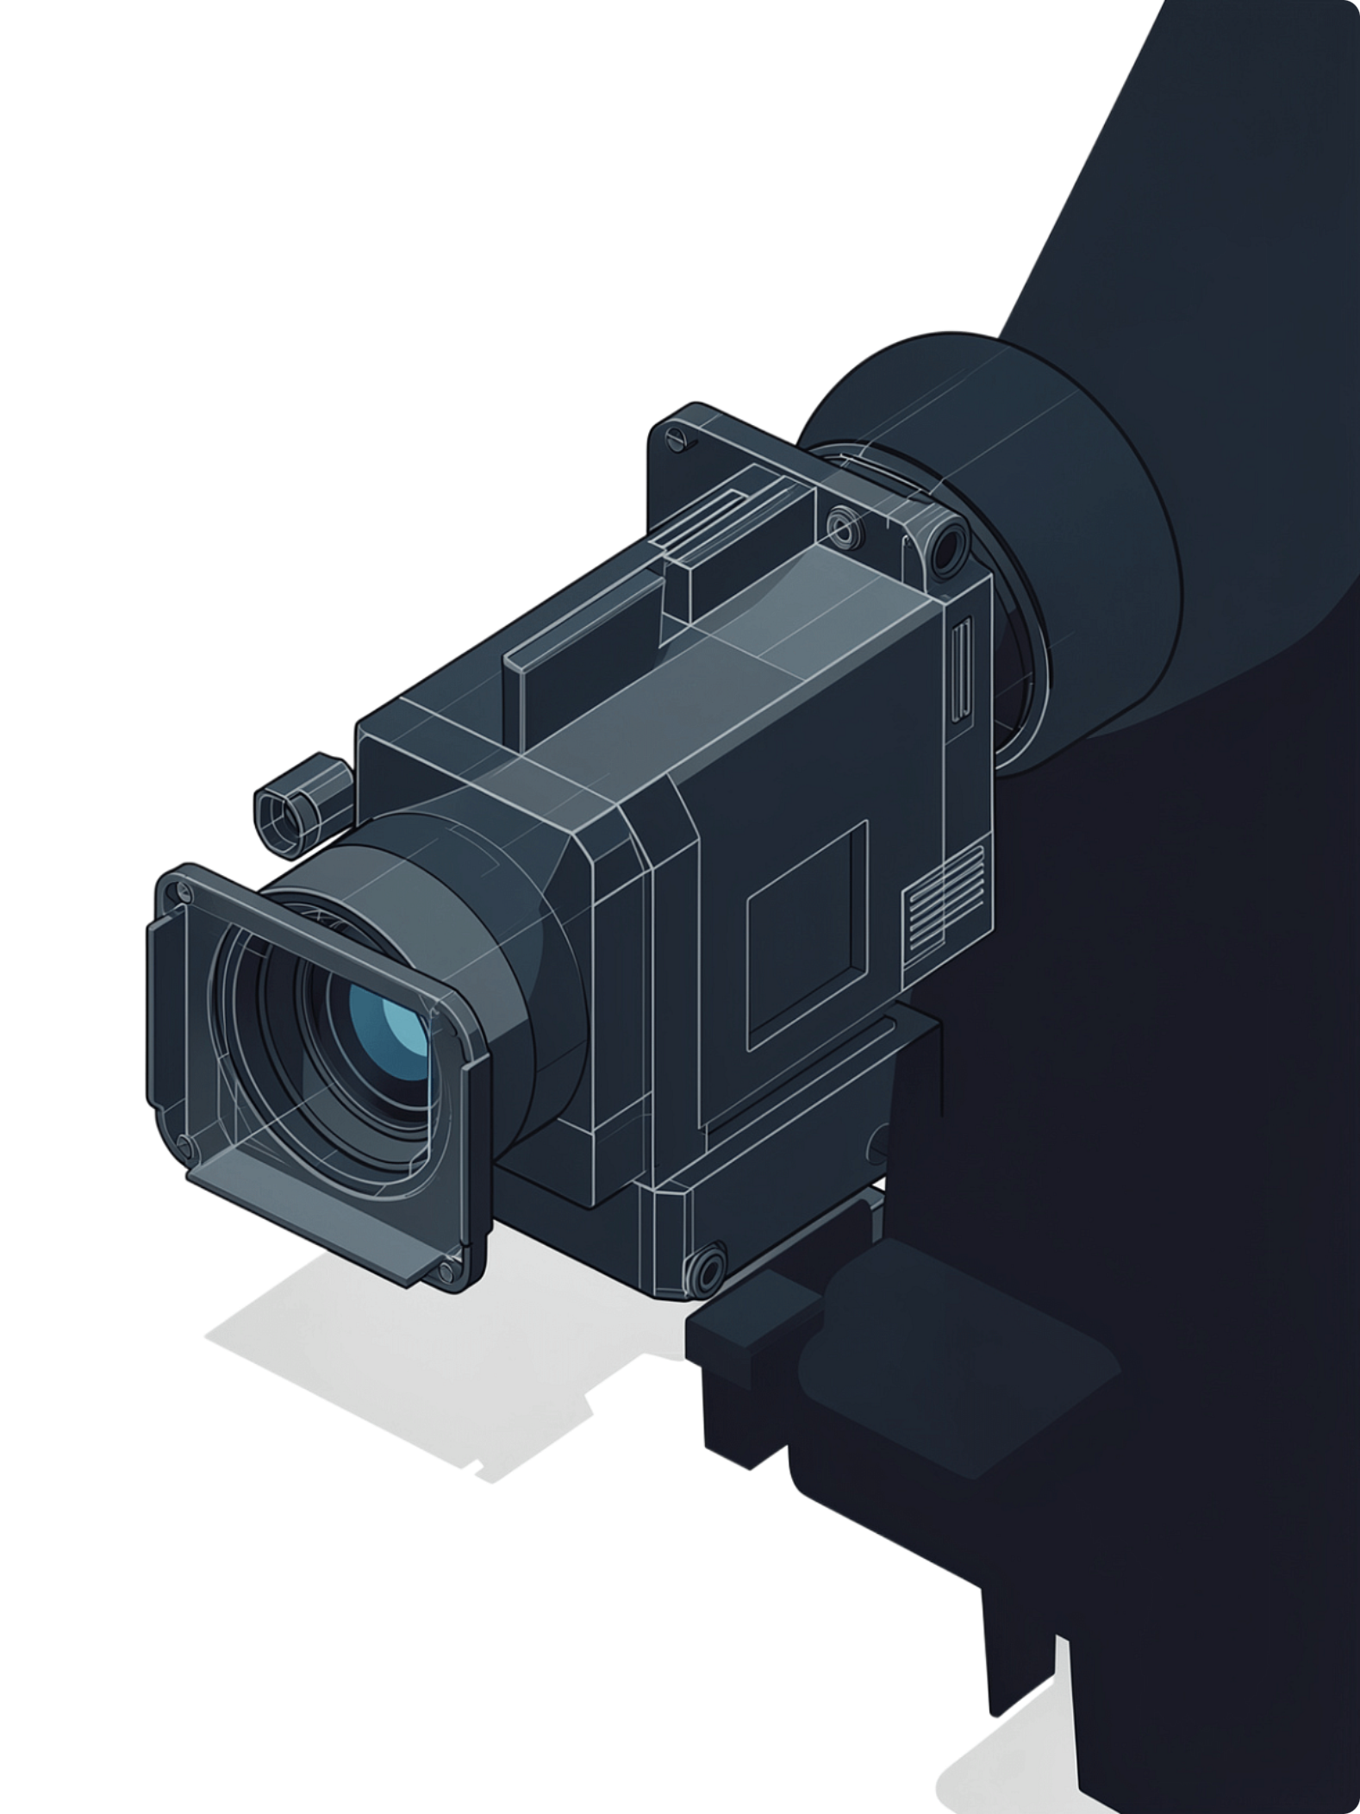
Abstract
A Java-based console cinema system that manages screens, screenings, and per-show seat maps with seat-level booking, class-based pricing, cancellations, and house reporting.
Live Seat Maps
Dynamic Pricing
Real-time per-screening seat availability without conflicts
Class-based and show-time-based price calculation
Performance Analytics
Comprehensive reporting per film and per show

Slide 3
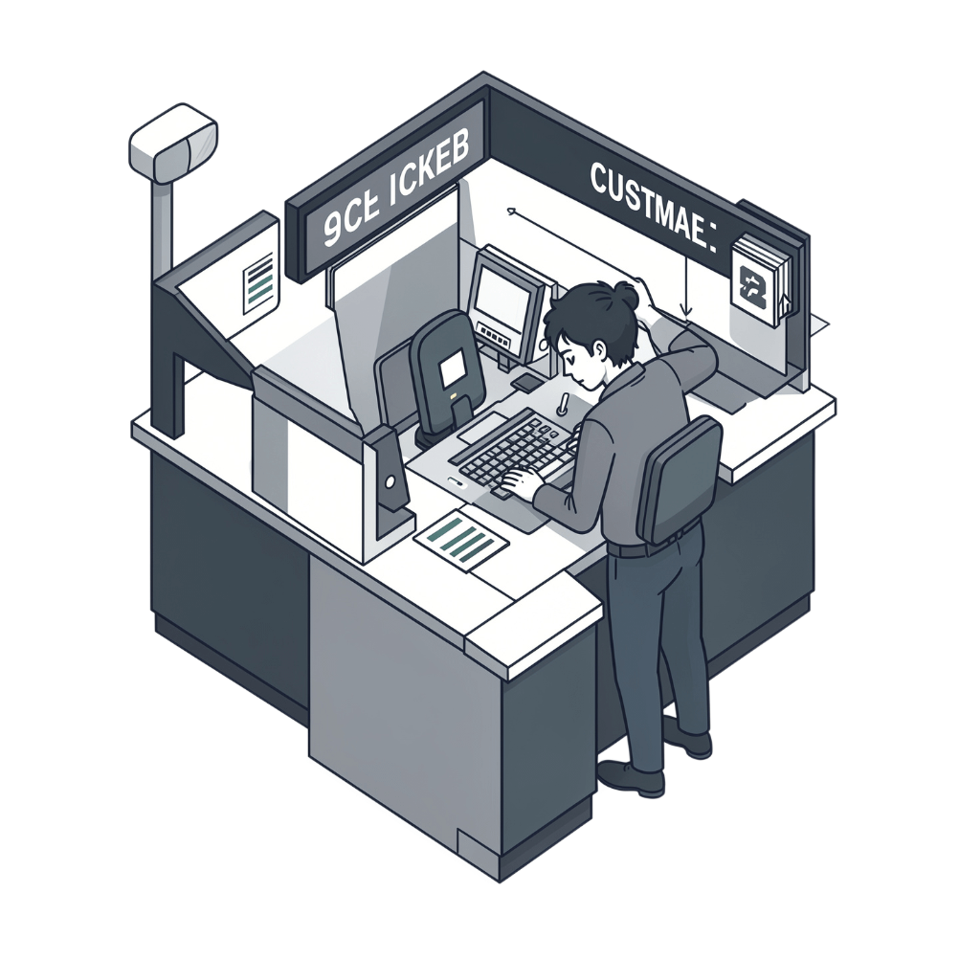

Understanding the Problem Statement
🎯 Problem
⚠️ Impact
✅ Solution
Cinema oversells shows and can't offer a clear seat map, causing groups to get split up.
Poor customer experience, booking conflicts, and inability to track seat availability in real time.
A system with live seat maps, conflict-free specific seat booking, class-based pricing, and house performance reporting.

Slide 4
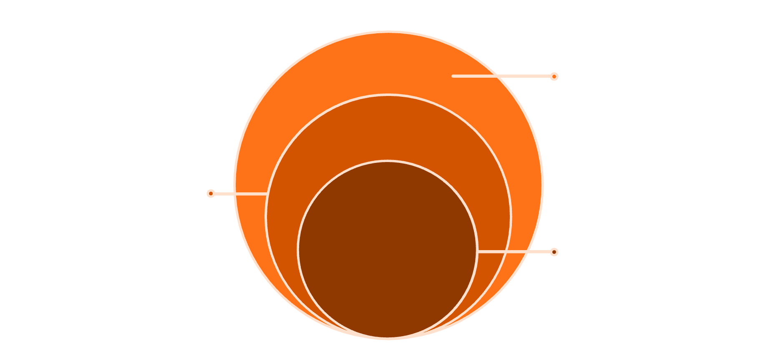
CO 1: System Architecture & Design
Core Design Principles
Console-Based Interface
Business Logic
Lightweight, accessible cinema management system
Booking, Pricing, Reporting rules
Core Entities
Data Layer
Screen, Screening, Seat, Booking, SeatClass
Screen, Screening, Seat, Booking, SeatClass
Storage
Persistent Storage
Central database for all records
Database design for shows and booking records
Real-Time Visualization
Live seat map rendered per screening
Java Concepts Used
Datatypes & Operators: int, double, boolean for seat counts and prices; arithmetic and logical operators
Methods: modular functions such as calculatePrice(), bookSeat(), cancelBooking()

Slide 5





CO 2: Seat Mapping & Availability
Live Seat Map
Real-time display of seat availability for each individual screening session.
Status Tracking
Each seat tracked as Available, Booked, or Reserved at all times.
Conflict Detection
Automatic prevention of double-booking during concurrent seat selection.
Seat Classes
Support for Premium, Standard, and Economy seat categories.
Java Concepts Used
Arrays: storing the seat grid and per-screening seat status
Control Structures: loops for iterating seat maps; if/else and switch for seat-status logic
Strings: seat IDs such as E5 and booking reference codes

Slide 6
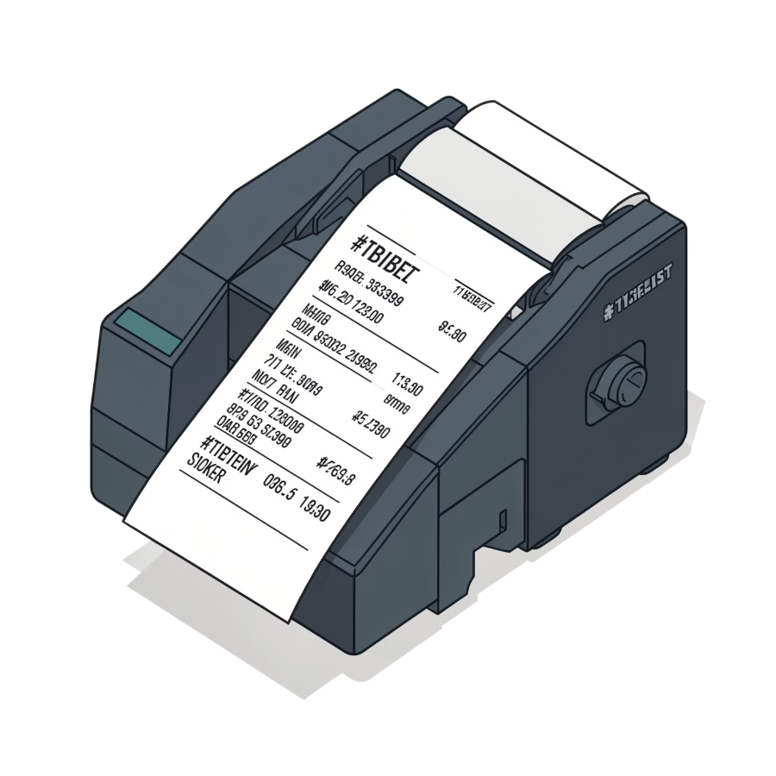
CO 3: Booking & Pricing Engine
Pricing Formula
Final Price = Base Price × Seat Class Multiplier × Time Multiplier
Show-time multipliers apply for peak evening and weekend screenings, enabling dynamic revenue optimization.
Premium
Standard
Economy
High multiplier
Mid multiplier
Base rate

Slide 7

CO 4: Cancellation & Refunds
Customer Cancels
Calculate Refund
Release Seat
Update History
Seat Release
Refund Policy
Audit Trail
Cancelled seats instantly return to Available status on the live map.
Refund amount calculated dynamically based on cancellation timing and policy rules.
Full booking history maintained for accountability and reporting purposes.

Slide 8
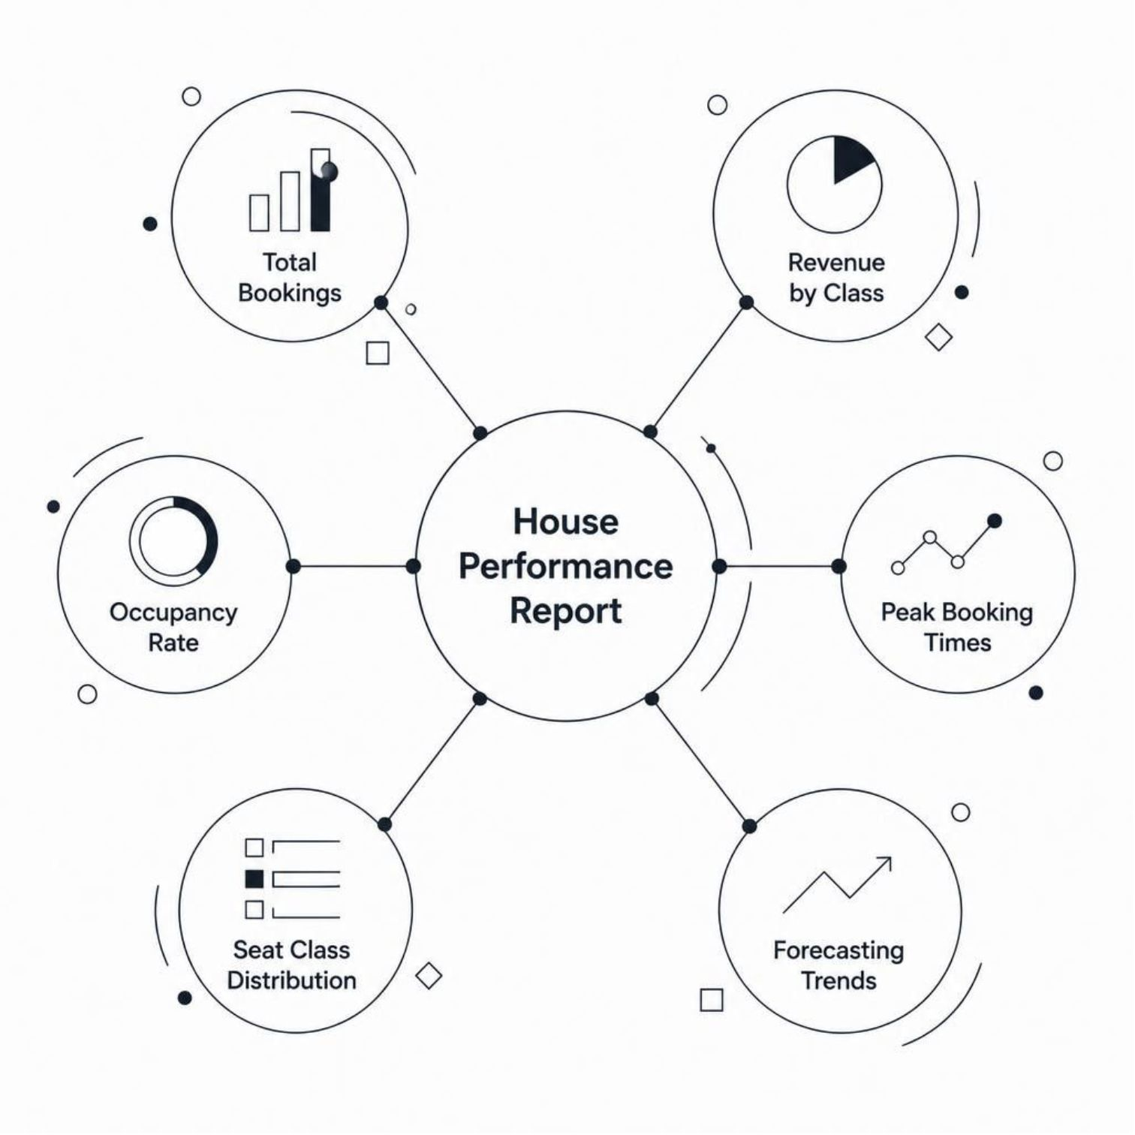
CO 5: House Performance Reporting
Per-Film Metrics
Total bookings and cumulative revenue
Occupancy rate per screening
Seat class distribution breakdown
Per-Show Analytics
Peak booking time identification
Revenue reports by seat class and show time
Occupancy trends and demand forecasting

Slide 9




CO 6: Implementation & Testing
Java OOP Implementation
Built using core Object-Oriented principles — encapsulation, inheritance, and polymorphism — across all system entities.
Unit Testing
Booking logic and pricing calculation validation
Integration Testing
Seat map rendering and conflict detection end-to-end
Performance Testing
Concurrent booking stress tests for reliability
Java Concepts Used
Inheritance: SeatClass base class with Premium, Standard, and Economy subclasses
Method Overloading / Overriding: overriding calculatePrice() in subclasses; overloading search methods by seat ID or booking reference
Exception Handling: try-catch for double-booking attempts

Slide 10
Sample Output
Sample code and the resulting console output from the Cinema Seat Booking System.
public class Booking {
private final String seatId;
private final SeatClass seatClass;
private final double basePrice;
public Booking(String seatId, SeatClass seatClass, double basePrice) {
this.seatId = seatId;
this.seatClass = seatClass;
this.basePrice = basePrice;
}
public double calculatePrice(double timeMultiplier) {
return basePrice * seatClass.getMultiplier() * timeMultiplier;
}
}
Screening: Inception - Screen 2 - 19:30
Seat: E5 (Premium)
Base Price: 12.00
Class Multiplier: 1.5
Time Multiplier: 1.2
Final Price: 21.60
Booking Confirmed: BK-20261016-0042
Seat E5 booked at the peak evening rate with Premium class pricing.

