Slide 1
0.761
Customer Booking
Prediction Model
ROC-AUC
73.1%
Accuracy
British Airways | Forage Data Science Virtual Experience
63.1%
Recall
50,000 flight records • 19 features • Random Forest + 5-fold CV
0.412
F1 Score

Slide 2
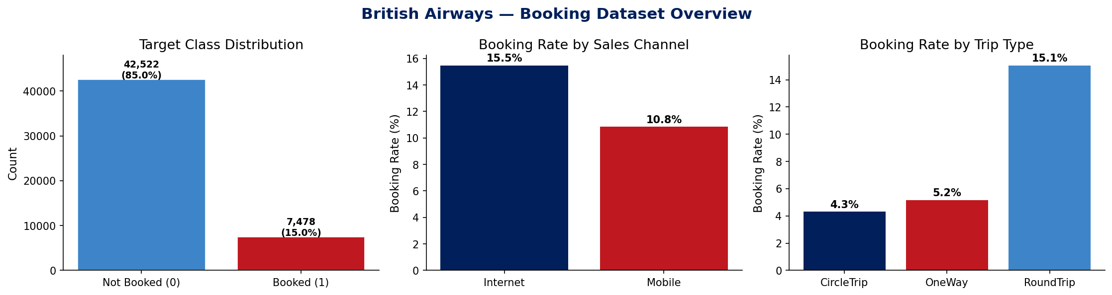
50,000 records • 13 features • 14.96% booking rate
Dataset Overview
✈
✓
◉
⚙
50,000
7,478 (14.96%)
Clean Dataset
19 (incl. engineered)
Total Records
Completed Bookings
No Missing Values
Features Used

Slide 3
Methodology & Feature Engineering
1
Data Exploration
Engineered Features
Analysed distributions, class balance (85/15 split), categorical variables across 50K records
log_purchase_lead
Log(1+purchase_lead) — reduces right skew
log_length_of_stay
Log(1+length_of_stay) — reduces right skew
2
Feature Engineering
route_freq
Route popularity as fraction of all flights
Created 11 new features: log transforms, frequency encoding, interaction terms, binary flags
origin_freq
Booking origin frequency encoding
total_addons
Sum of 3 add-on flags (0-3 scale)
is_weekend
Saturday or Sunday departure flag
3
Model Selection
is_mobile
Mobile vs Internet channel binary
Random Forest chosen for interpretability via feature importance & strong ensemble performance
is_roundtrip
Round trip vs one-way binary
is_peak_hour
06-09 or 17-20 departure flag
pax_lead_interaction
passengers × log(lead time)
4
Cross-Validation
flight_day_num
Day of week as 1–7 ordinal
5-fold stratified CV to handle class imbalance; class_weight='balanced' to equalise learning

Slide 4
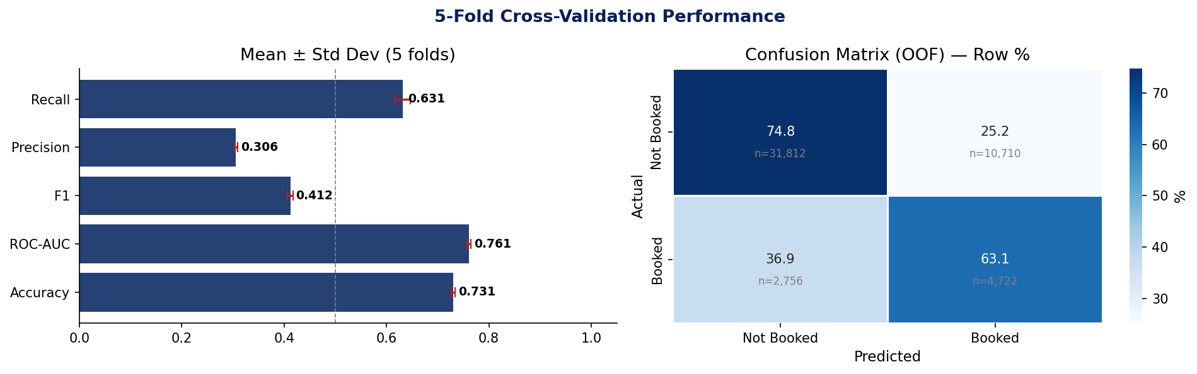
Model Performance — 5-Fold Cross-Validation
0.761
73.1%
63.1%
0.412
30.6%
ROC-AUC
Accuracy
Recall
F1-Score
Precision
±0.004
±0.4%
±1.6%
±0.005
±0.4%

Slide 5
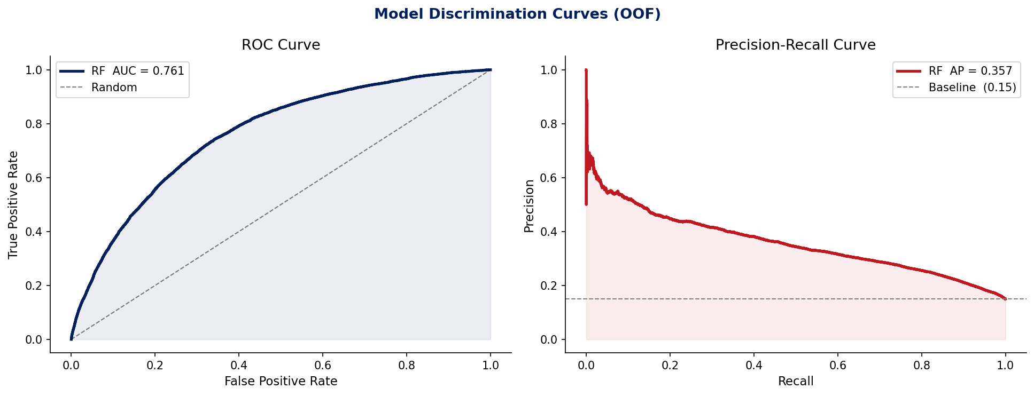
Discrimination Curves — ROC & Precision-Recall
ROC-AUC = 0.761
Avg Precision = 0.357
Class Imbalance Handled
Strong ability to rank booking vs non-booking customers. Significantly above 0.5 random baseline.
Given the 15% base rate, this represents ~2.4× lift over random guessing.
class_weight='balanced' corrects for 85/15 split; stratified CV maintains distribution.

Slide 6
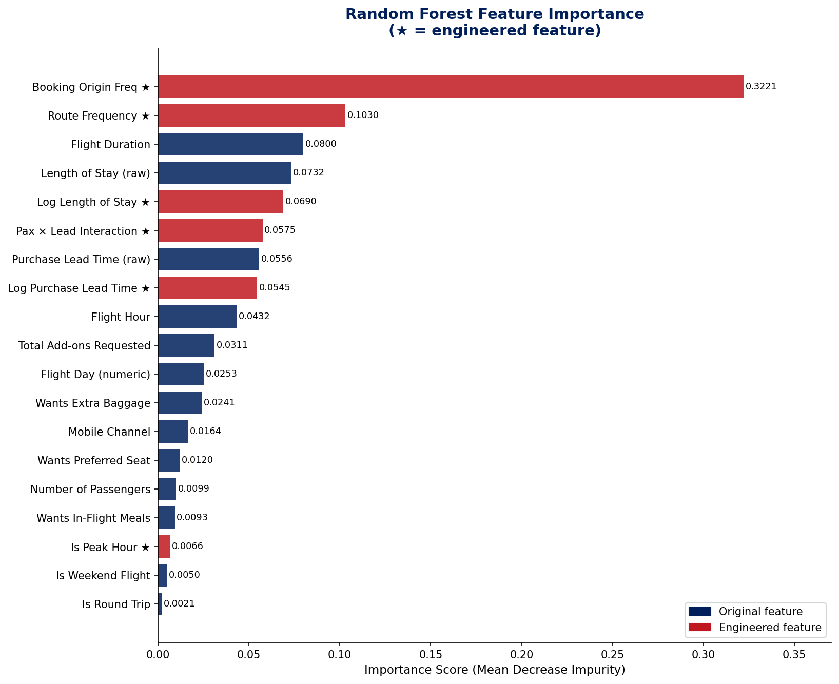
Feature Importance — What Drives Booking Completion?
Key Insights
#1
Booking Origin Freq (32.2%)
High-frequency origins show distinct completion patterns — target strategy by origin.
#2
Route Frequency (10.3%)
Popular routes have higher completion — tailor promotions to route-level behaviour.
#3
Flight Duration (8.0%)
Longer flights see higher completion — passengers are more committed.
#4
Length of Stay (7.3%)
Longer trips correlate with booking completion — leisure vs business signal.
#5
Purchase Lead Time (5.6%)
Earlier bookers more likely to complete — target mid-funnel abandoners.

Slide 7
Summary & Recommendations
Model Summary
Recommendations
Random Forest trained on 50,000 records with 19 features
5-fold stratified CV: ROC-AUC 0.761 ± 0.004
Recall of 63% — captures most genuine bookers
Engineered features (origin/route freq, log transforms, interaction terms) contributed significantly to model power
class_weight='balanced' handles 85/15 imbalance effectively
Target by Booking Origin
High-frequency origins are most predictive — build segmented re-engagement campaigns.
Route-Level Promotions
Popular routes have clearer completion patterns; personalise offers by route popularity.
Intervene at Lead Time Drop-off
Customers booking early but not completing need targeted mid-funnel nudges.
Leverage Add-On Signals
Customers requesting add-ons are high-intent — prioritise conversion messaging.
Mobile UX Improvement
Mobile channel shows different completion rate — audit and improve the mobile booking flow.
British Airways Forage Data Science | Task 2: Predictive Modelling | Random Forest + 5-fold CV | ROC-AUC: 0.761

