Slide 1


Med + Search for the medical stores
Android application
Made by: Guided by:Dipak Ramoliya
18DIT030-Tanushree Kurup
D19DIT082-Priyal Ramani
CHAROTAR UNIVERSITY OF SCIENCE & TECHNOLOGY
DEVANG PATEL INSTITUTE OF ADVANCE TECHNOLOGY AND RESEARCH

Slide 2
Contents
Introduction to application
Tools and Technologies used
Requirement
Working
Screenshots
Different Views used
Conclusion
Learning Outcome
Reference

Slide 3
Introduction to application
Med + is the android application that allows the user to search for the city from Gujarat and also the medical stores in them.
It also provides the information like the complete address,phone number and websites if any.

Slide 4
Tools and Technologies used
Here we have used android studio for developing the application.
Android Studio's apply changes feature lets you push code and resource changes to your running app without restarting your app and, in some cases, without restarting the current activity. This flexibility helps us control how much of our app is restarted when we want to deploy and test small, incremental changes while preserving our device's current state.

Slide 5
Hardware requirements for android studio:
Intel(R) core(TM) i3-3220
3 GB RAM minimum
2 GB of available disk space minimum
Software Requirement:
Operating System: Windows 7
Development Language: android

Slide 6
Working
On launching the application the user
Gets a the home page containing the application name and a start button
On clicking the start button the user is directed to a new page containing a list of cities from Gujarat.
This page also contains a search bar wherein the user can search for a city.

Slide 7
Working
On selecting a city the user is again directed to a new page which is linked with the database table containing the list of the medical stores in the particular city.
There are separate tables created in the database for each city and the corresponding information.
This page also contains a search bar to search for the medical stores, and this search bar also shows the previous search history to make it user friendly.

Slide 8
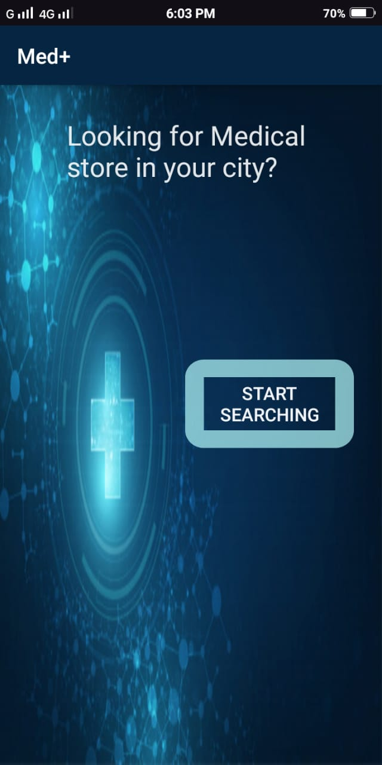
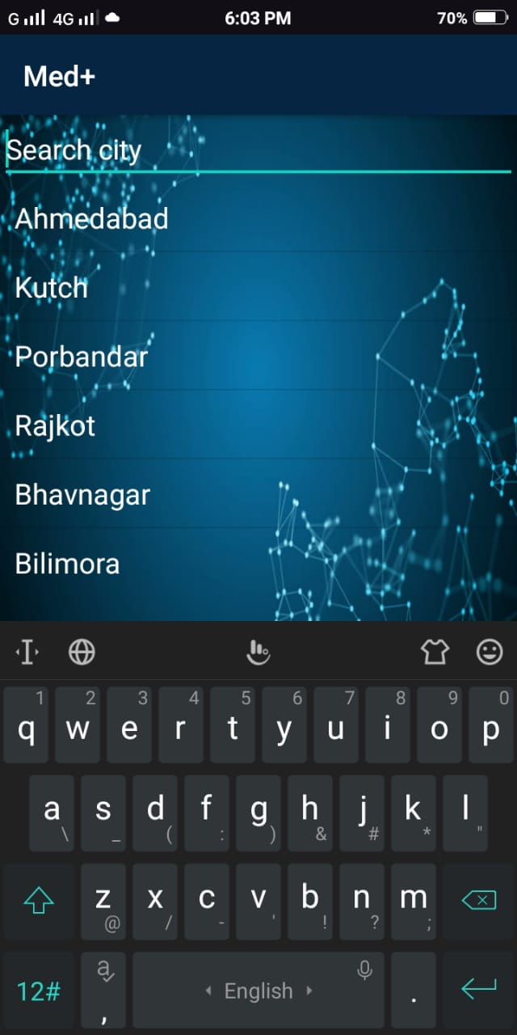
Screenshots
Home Page
List of cities

Slide 9
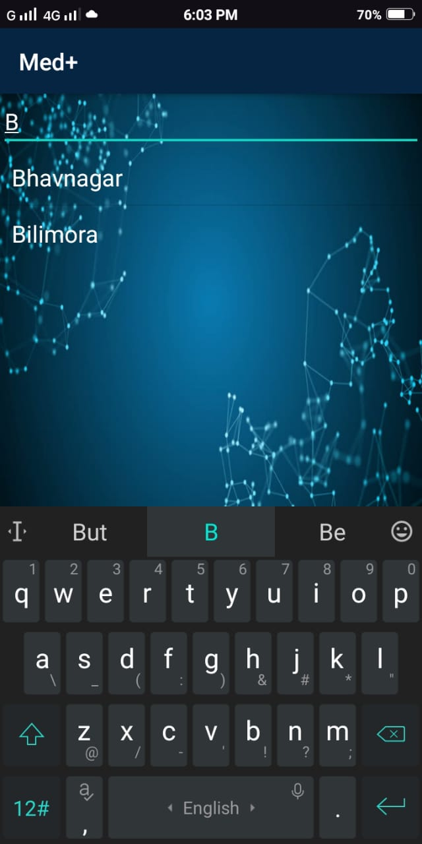
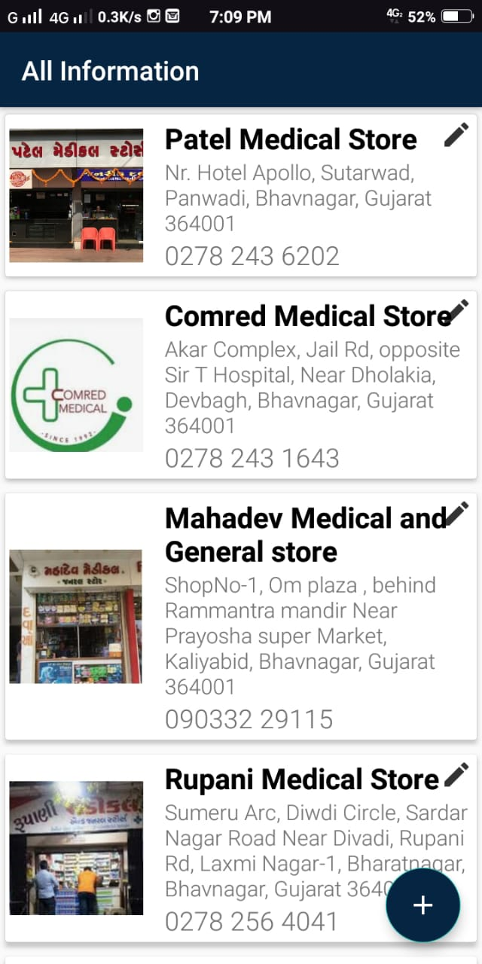
Search bar to search for city List of medical stores

Slide 10
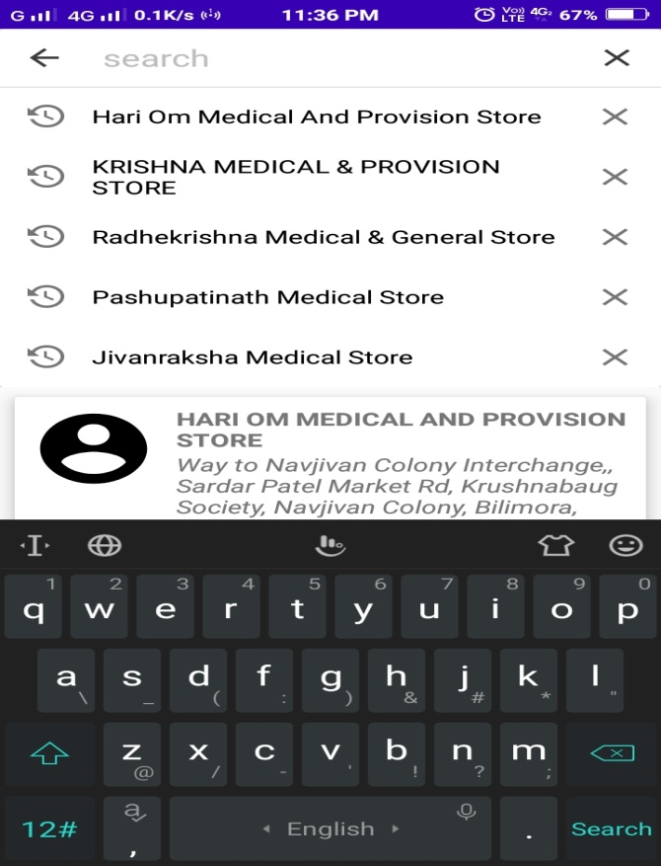
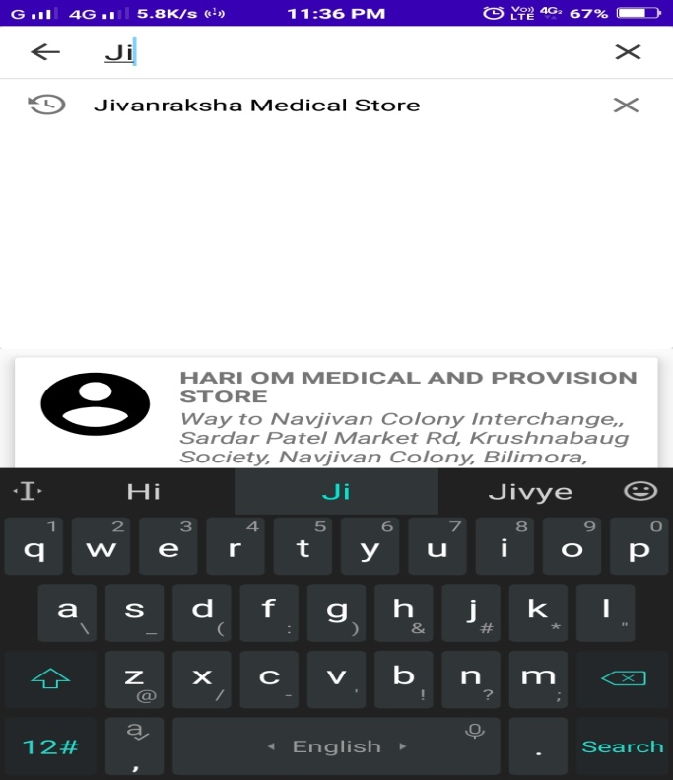
Search bar for medical store Previous search history

Slide 11
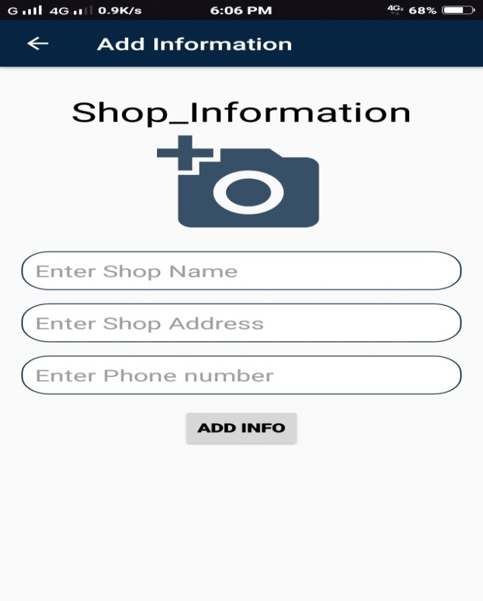
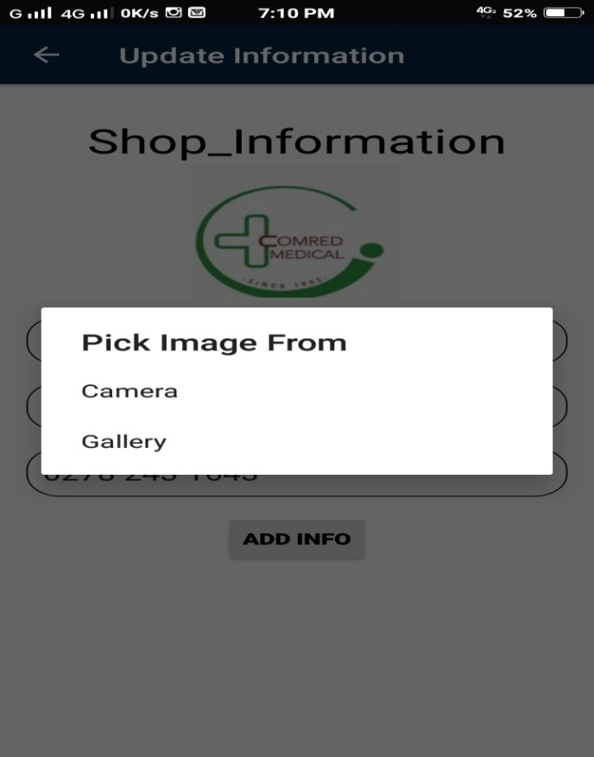
Add new Medical shop Pick Image

Slide 12
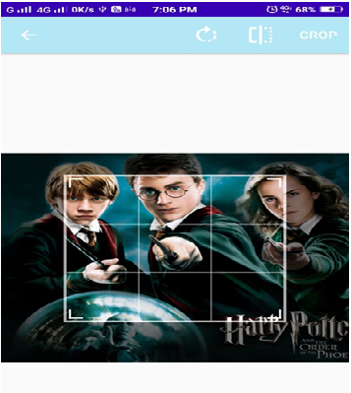
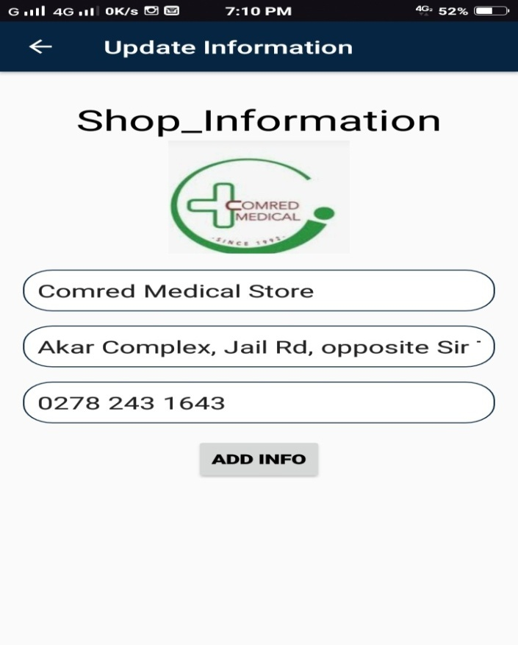
Crop Image Update Information

Slide 13
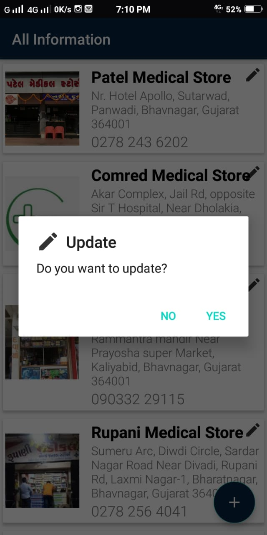
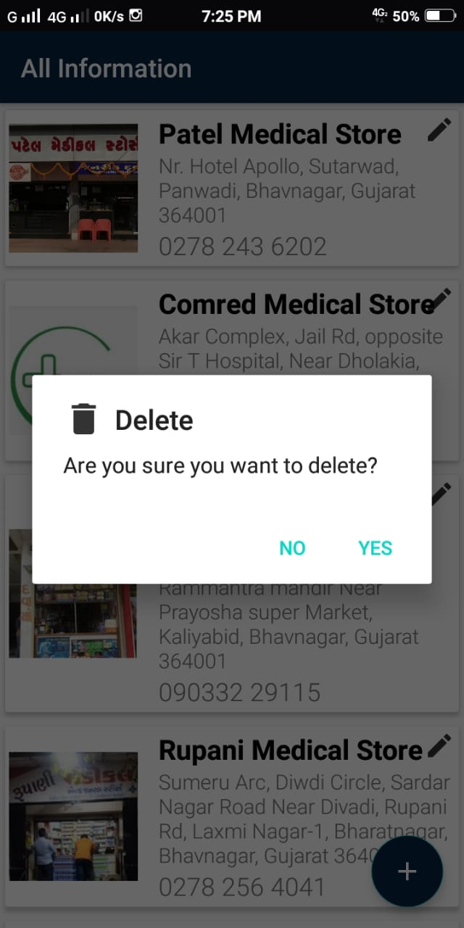
Update dialog box Delete dialog box

Slide 14
Views used
The main modules used in the project are listed below:
ListView:
Android ListView is a view which groups several items and display them in vertical scrollable list. The list items are automatically inserted to the list using an Adapter that pulls content from a source such as an array or database. In this application we have used the ListView for the list of the cities .

Slide 15
Continued…
RecyclerView:
RecyclerView is an advanced and flexible version of ListView and GridView. It is a container used for displaying large amount of data sets that can be scrolled very efficiently by maintaining a limited number of views.
Here we have used the RecyclerView in the list of cities.

Slide 16
Continued….
CardView:
CardView wraps a layout and will often be the container used in a layout for each item within a ListView or RecyclerView.
Here we have used the CardView in wraping the information like name,address,phone number and link of each shop in the list.

Slide 17

Continued….
We have also created a database using SQLite database browser,containing a separate table for each city,and each of the table contains the name ,address and phone number of the shops.
The application also contains a launching icon as shown below created using adobe creative cloud.

Slide 18
Learning from the project
We have learn to create an efficient application by incorporating many new modules like recylerview, cardview and listview,the differences between these views and how too use them efficiently.
We have also learnt to make some attractive app icons in a way that describes the application effectively,and using these icons in the android studio.
Hence we have got a deep understanding of android studio.

Slide 19
Conclusion
Finally we would conclude that our application will be helpful to the people who are new in Gujarat and so would have minimum knowledge of the stores around them.
So they do not have to waste their energies searching for the medical shops in emergencies as the Med+ app will provide the the entire list in one click without even the internet connection.

Slide 20
Reference
https://developer.android.com/guide/topics/ui/layout/recyclerview
https://guides.codepath.com/android/using-the-cardview
https://datacarpentry.org/sql-socialsci/02-db-browser/index.html
https://www.youtube.com/watch?v=KvpulitmjbM

Slide 21
Thank You

