Slide 1
Project Title: Customer Segmentation & CLV (Customer Lifetime Value) Engine
Product Brand Name: "Consumer360"
Business Problem:
1.Retail companies generate large volumes of customer transaction data, but lack clear visibility into customer behavior.
2.They struggle to identify loyal customers, customers at risk of churn, and cross-selling opportunities.
3.Marketing strategies are mostly generic and not data-driven.
4.There is a need for an automated system that provides actionable insights in real time.

Slide 2
Data Sources (SQL + CSV):
SQL Database:
Retail_Transactions table
Customer, Product, Revenue, Region data
CSV File:
consumer360_detailed_retail.csv
Key Fields:
InvoiceNo, CustomerID, ProductName
Category, Quantity, UnitPrice
InvoiceDate, Country, Revenue

Slide 3
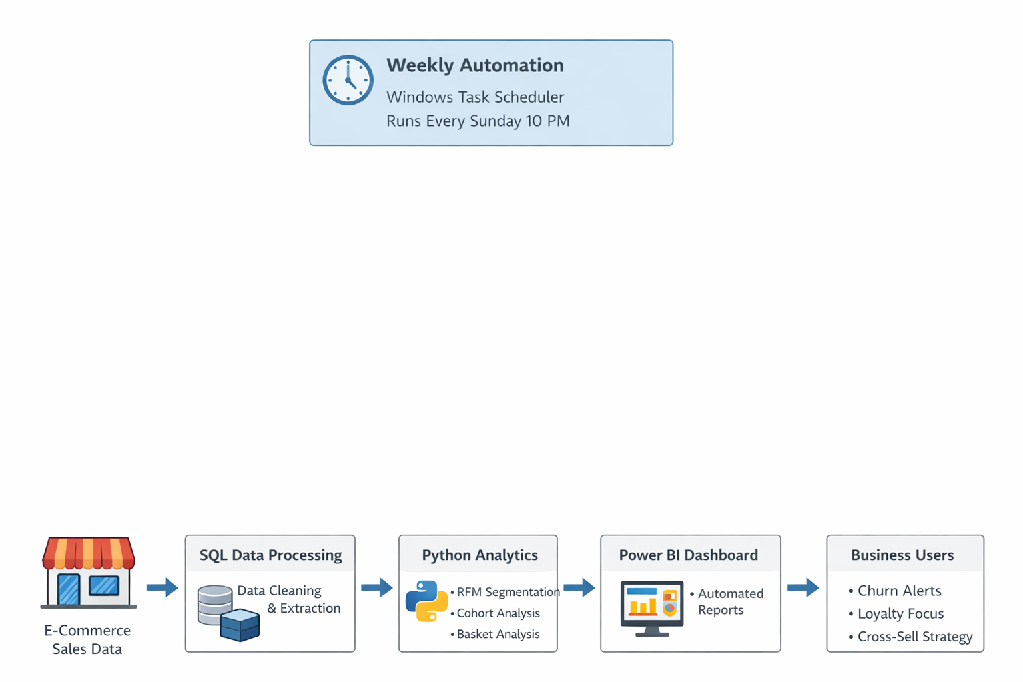

Slide 4
CUTOMER BEHAVIOUR ANALYSIS:
Imported customer and transaction data into Power BI and cleaned it for analysis.
Calculated key metrics like total revenue, total customers, average CLV, and average frequency.
Applied RFM analysis to understand customer purchasing behavior.
Created visuals to track monthly revenue and country-wise customer distribution.
Built a churn risk table using recency to identify inactive customers.
Added product, brand, and category filters to make the dashboard interactive.

Slide 5
RFM AND BASKET ANALYSIS USING PYTHON:
RFM analysis segments customers based on:
Recency: How recently they purchased
Frequency: How often they purchase
Monetary: How much they spend
Insight:
A large portion of customers fall into the At-Risk group, indicating potential churn.
Basket Analysis – Cross-Sell Opportunities
Basket analysis identifies products that are frequently purchased together using the Apriority algorithm.
These associations help the business design product bundles and personalized recommendations.
Example:
Customers who buy Product A are also likely to buy Product B.

Slide 6
Customer Behavior & RFM Sales Performance Dashboard
Created an interactive Power BI dashboard to analyze customer behavior and sales performance.
Used RFM analysis to segment customers based on their purchase activity.
Added monthly revenue trends and country-wise customer distribution for business insights.
Built visuals to compare revenue across different customer frequency groups.
Identified churn risk customers using recency and purchasing history.
Included product, brand, and category filters to allow dynamic analysis.

