Slide 1
Process-to-Process Delivery
UDP, TCP

Slide 2
PROCESS-TO-PROCESS DELIVERY
The transport layer is responsible for process-to-process delivery—the delivery of a packet, part of a message, from one process to another. Two processes communicate in a client/server relationship, as we will see later.
The transport layer is responsible for process-to-process delivery.

Slide 3
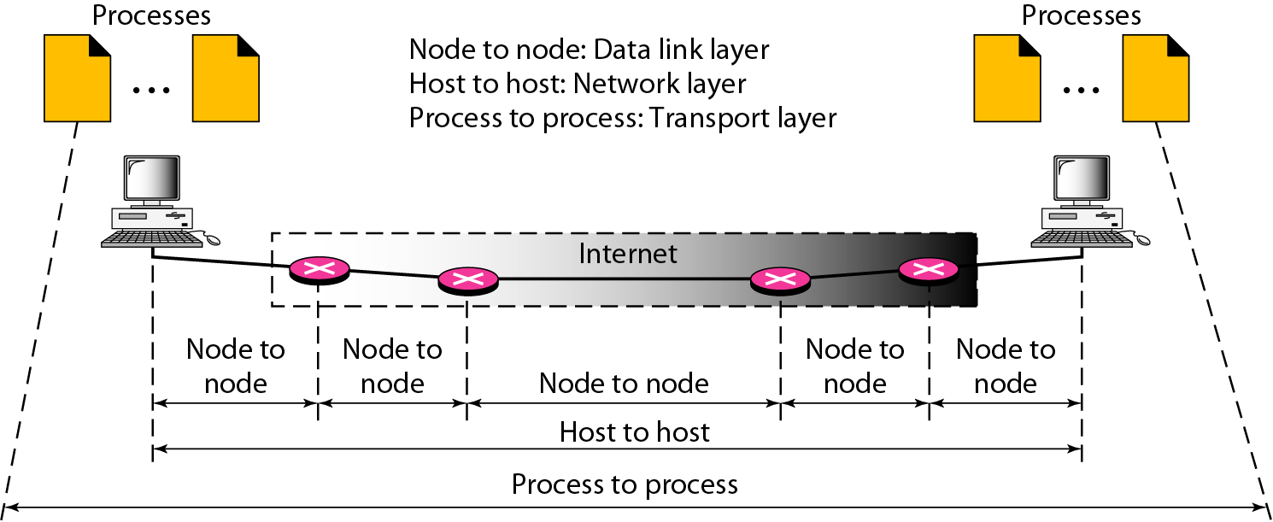
Types of data deliveries

Slide 4
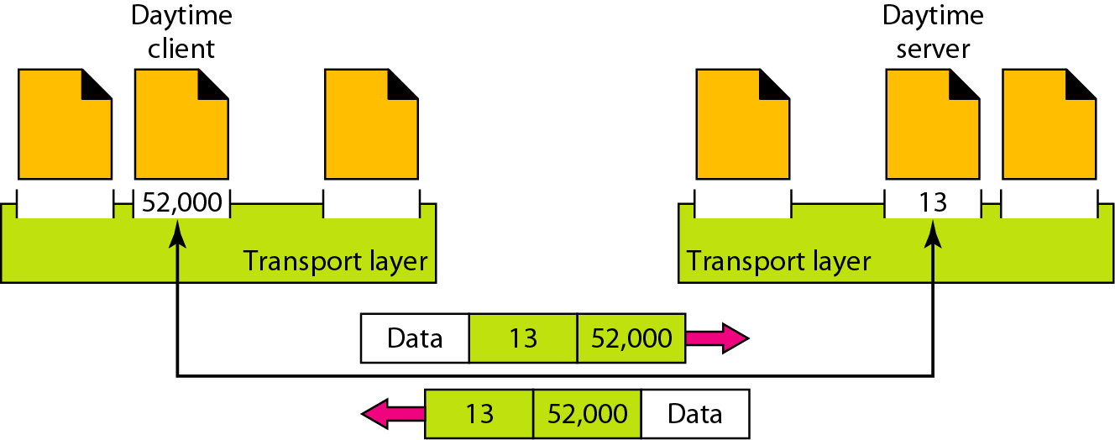
Port numbers

Slide 5
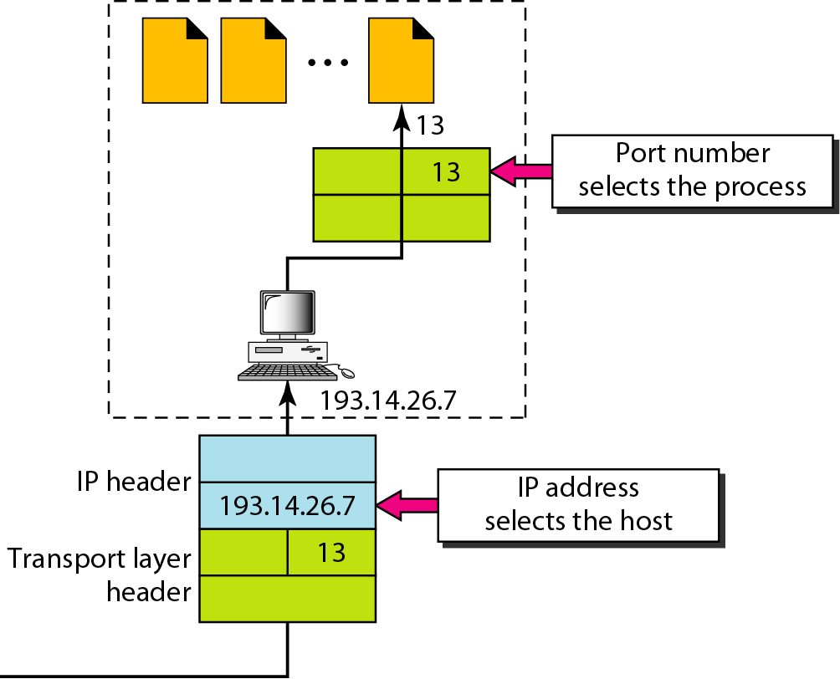
IP addresses versus port numbers

Slide 6
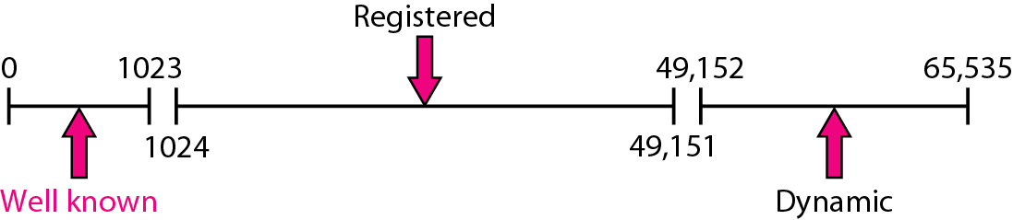
IANA ranges

Slide 7
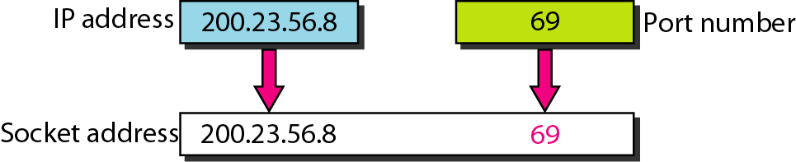
Socket address

Slide 8
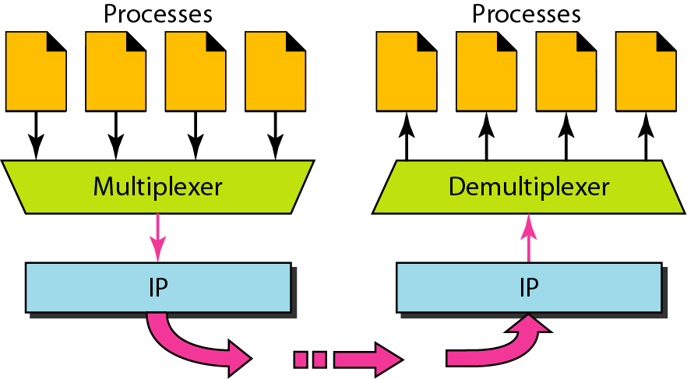
Multiplexing and demultiplexing

Slide 9
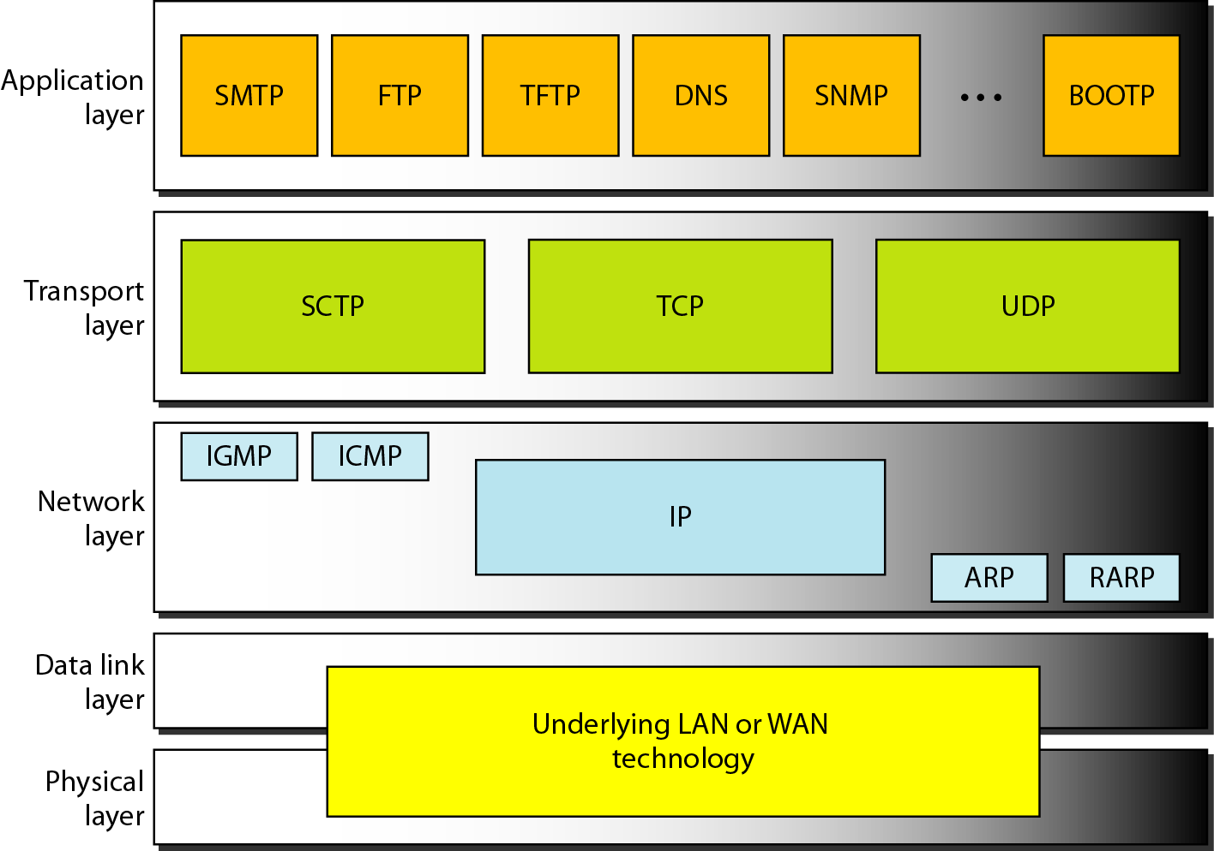
Position of UDP and TCP in TCP/IP suite

Slide 10
USER DATAGRAM PROTOCOL (UDP)
The User Datagram Protocol (UDP) is called a connectionless, unreliable transport protocol. It does not add anything to the services of IP except to provide process-to-process communication instead of host-to-host communication.

Slide 11
Well-known ports used with UDP

Slide 12
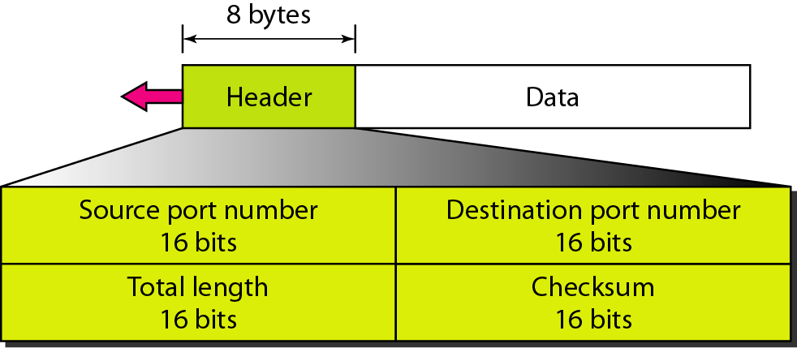
User datagram format

Slide 13
UDP
UDP length = IP length – IP header’s length

Slide 14
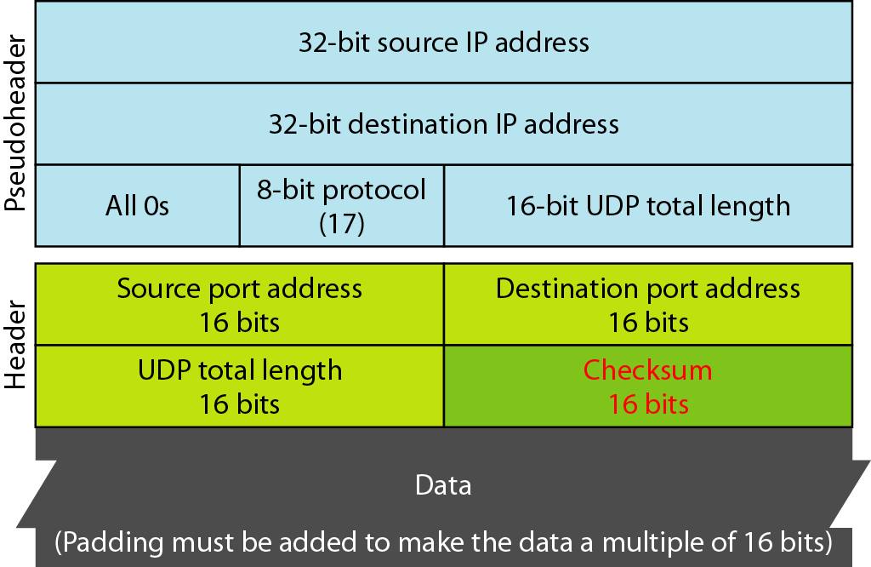
Pseudoheader for checksum calculation

Slide 15
TCP
TCP is a connection-oriented protocol; it creates a virtual connection between two TCPs to send data. In addition, TCP uses flow and error control mechanisms at the transport level.

Slide 16
Well-known ports used by TCP

Slide 17
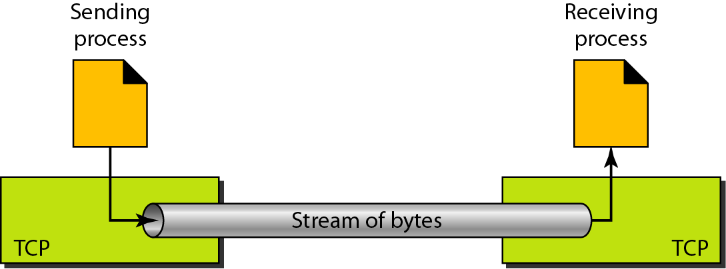
Stream delivery

Slide 18
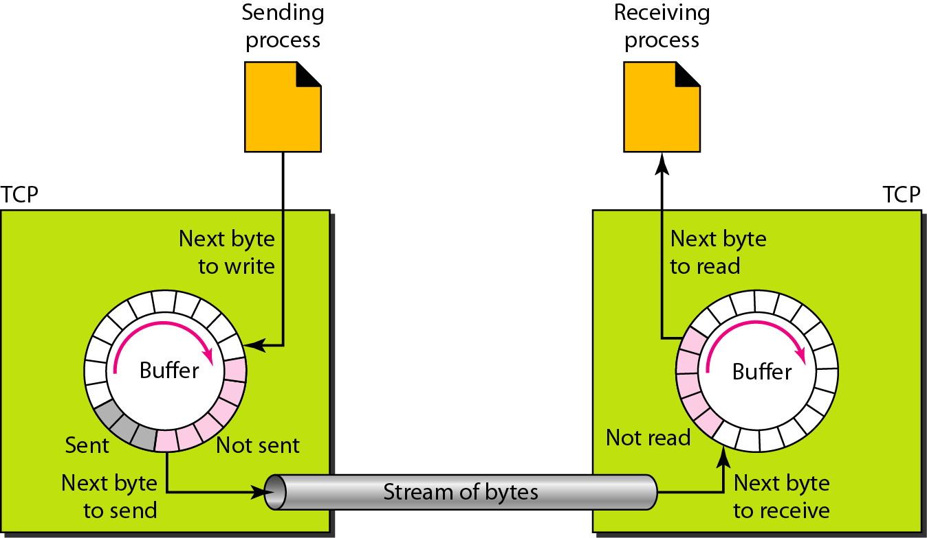
Sending and receiving buffers

Slide 19
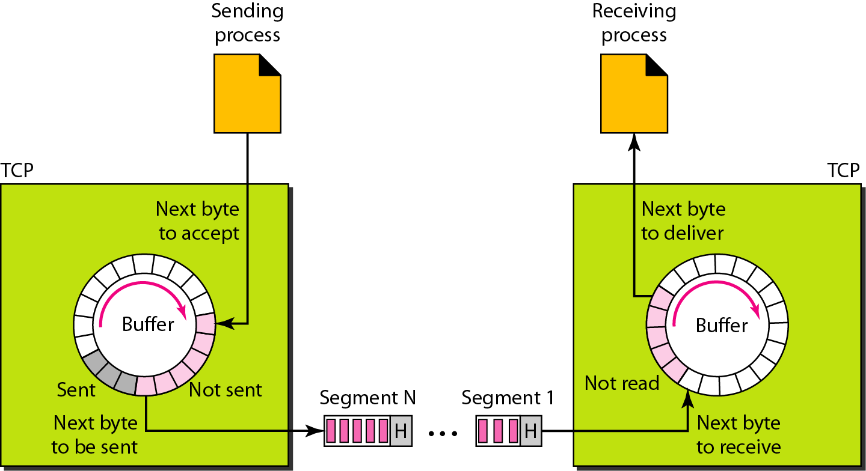
TCP segments

Slide 20
TCP
The bytes of data being transferred in each connection are numbered by TCP.
The numbering starts with a randomly generated number.
The value in the sequence number field of a segment defines the number of the first data byte contained in that segment.
The value of the acknowledgment field in a segment defines the number of the next byte a party expects to receive.
The acknowledgment number is cumulative.

Slide 21
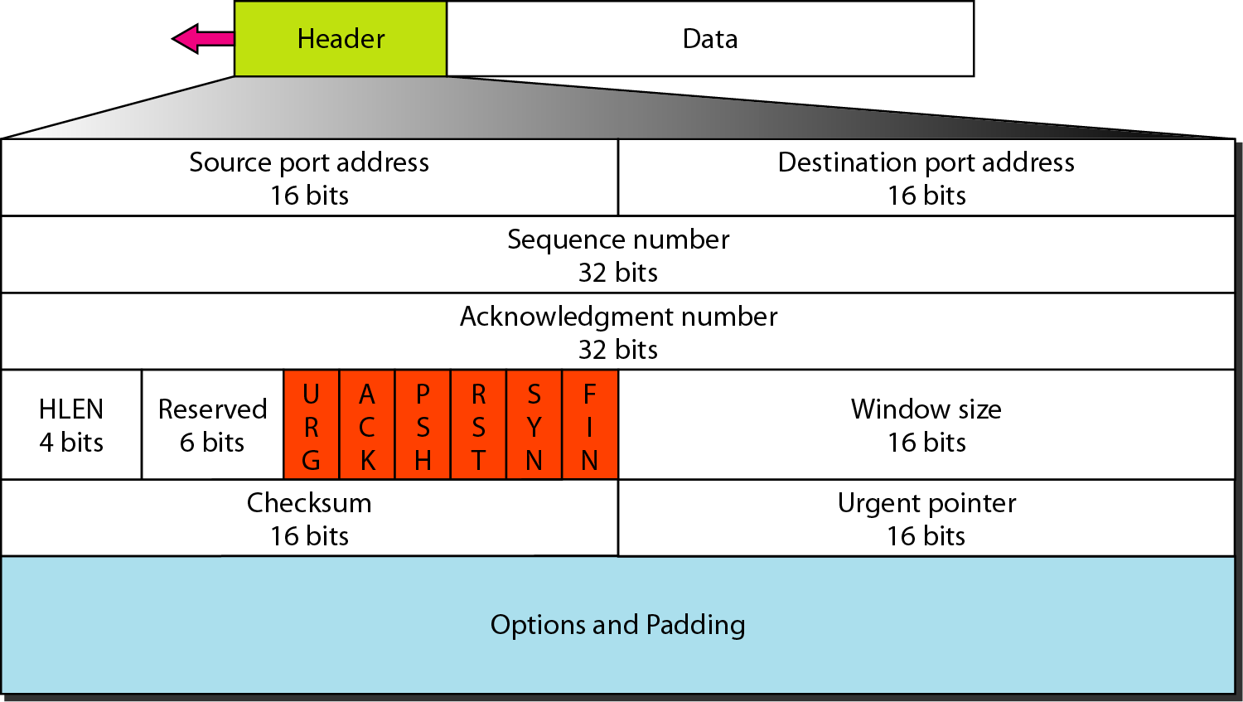
TCP segment format

Slide 22
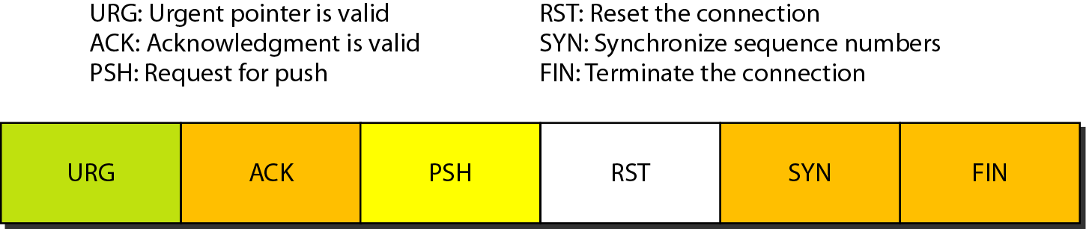
Control field

Slide 23
Description of flags in the control field

Slide 24
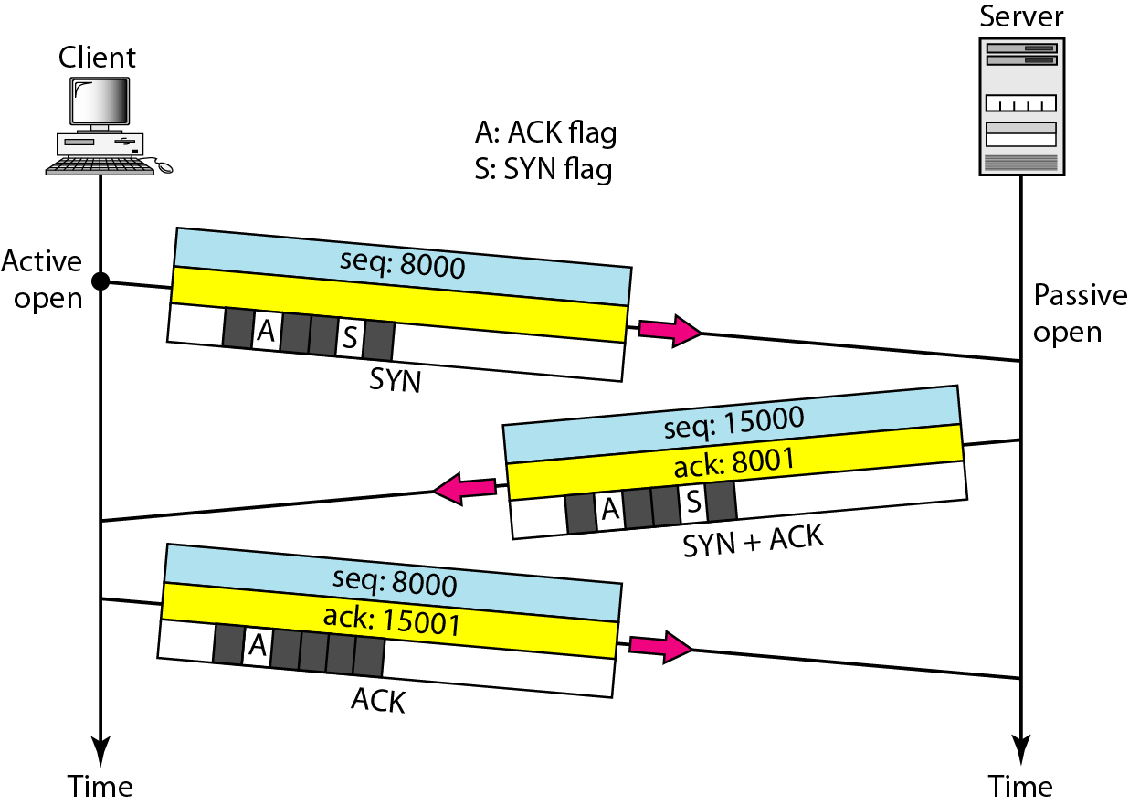
Connection establishment using three-way handshaking

Slide 25
TCP
A SYN segment cannot carry data, but it consumes one sequence number.
A SYN + ACK segment cannot carry data, but does consume one sequence number.
An ACK segment, if carrying no data, consumes no sequence number.

Slide 26
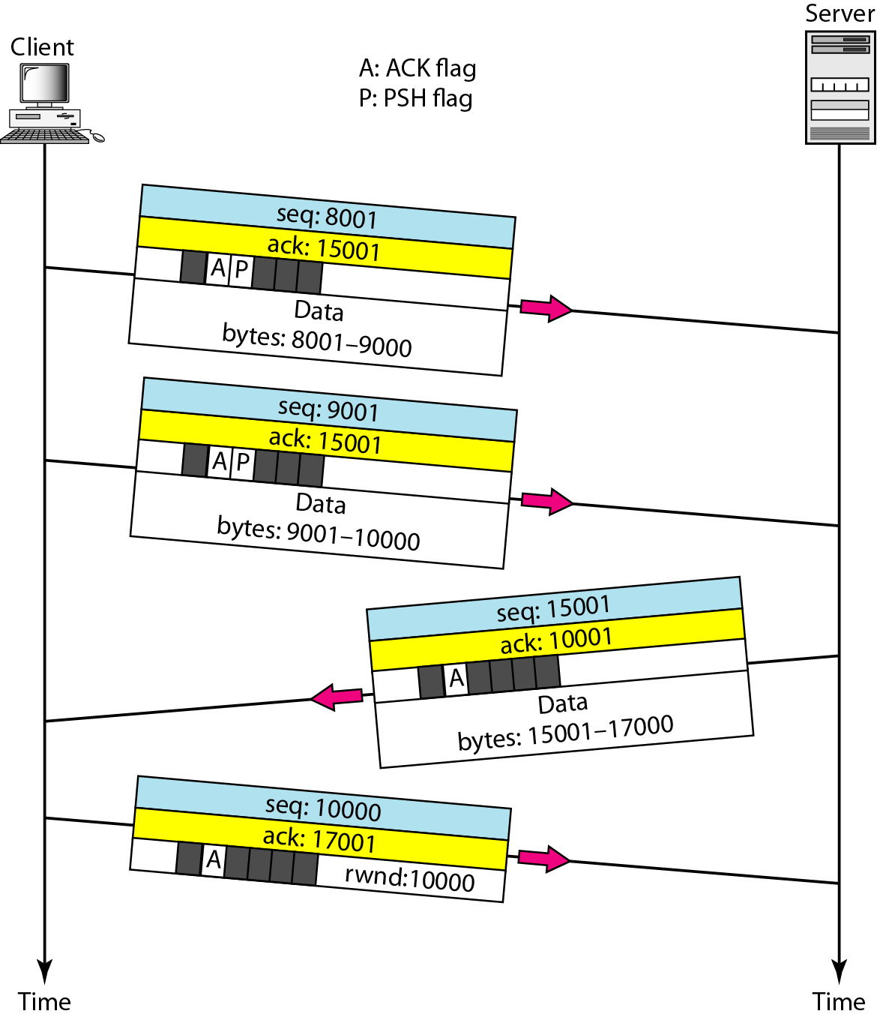
Data transfer

Slide 27
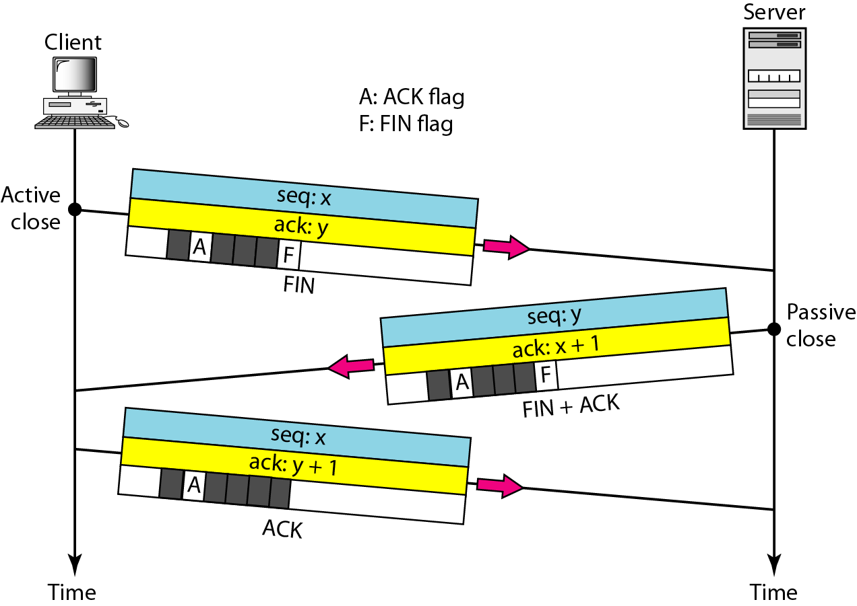
Connection termination using three-way handshaking

Slide 28
TCP
The FIN segment consumes one sequence number if it does not carry data.
The FIN + ACK segment consumes one sequence number if it does not carry data.

Slide 29
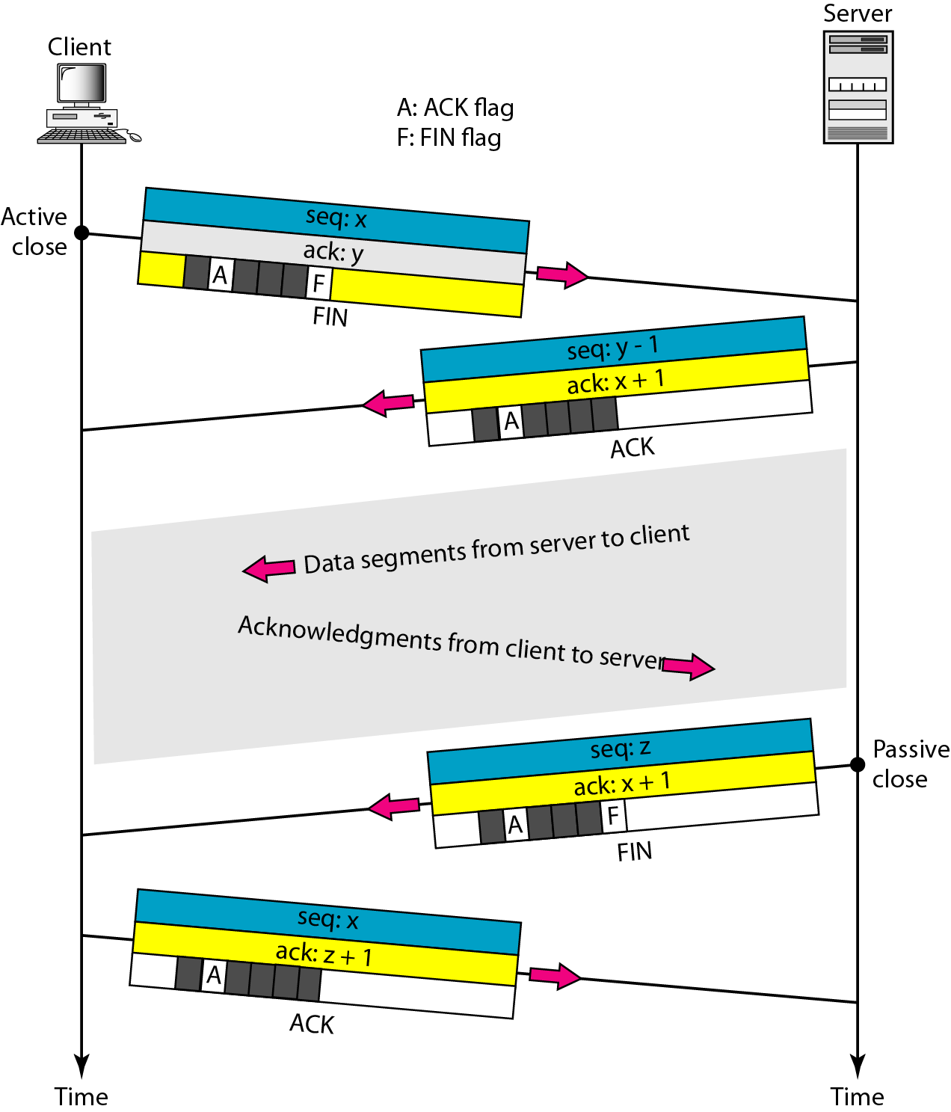
Half-close

Slide 30
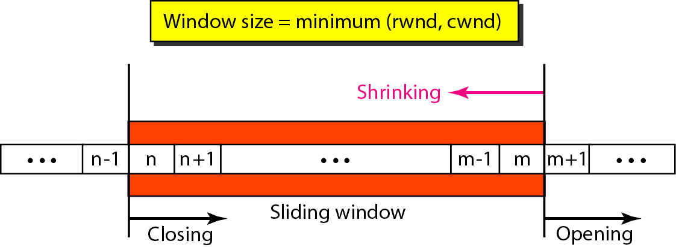
Sliding window

Slide 31
TCP
A sliding window is used to make transmission more efficient as well as to control the flow of data so that the destination does not become overwhelmed with data.
TCP sliding windows are byte-oriented.
The size of the window is the lesser of rwnd and cwnd.
The source does not have to send a full window’s worth of data.
The window can be opened or closed by the receiver, but should not be shrunk.
The destination can send an acknowledgment at any time as long as it does not result in a shrinking window.
The receiver can temporarily shut down the window; the sender, however, can always send a segment of 1 byte after the window is shut down.

Slide 32
TCP
ACK segments do not consume sequence numbers and are not acknowledged.
In modern implementations, a retransmission occurs if the retransmission timer expires or three duplicate ACK segments have arrived
No retransmission timer is set for an ACK segment.
Data may arrive out of order and be temporarily stored by the receiving TCP, but TCP guarantees that no out-of-order segment is delivered to the process.

Slide 33
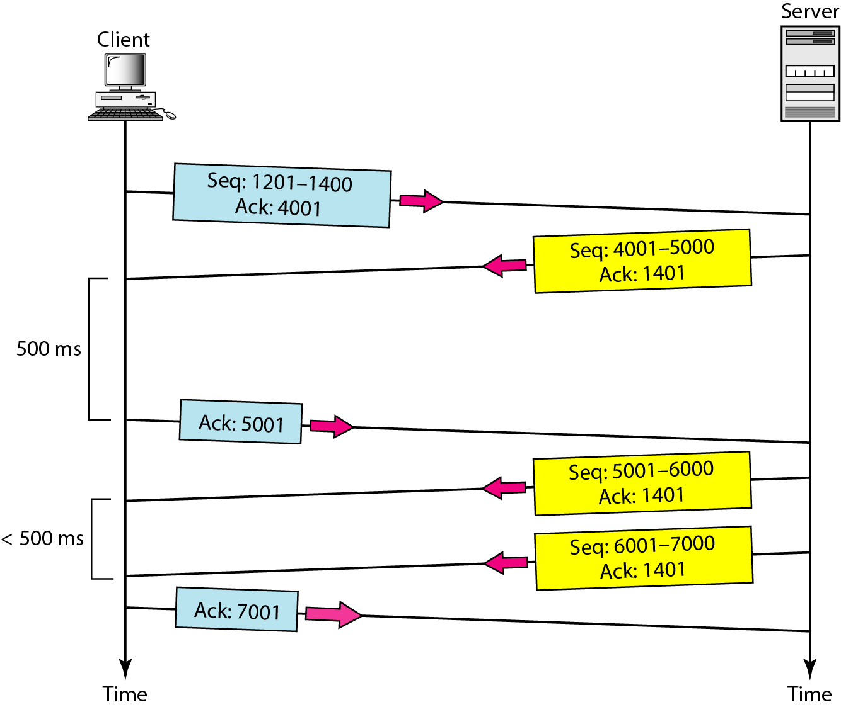
Normal operation

Slide 34
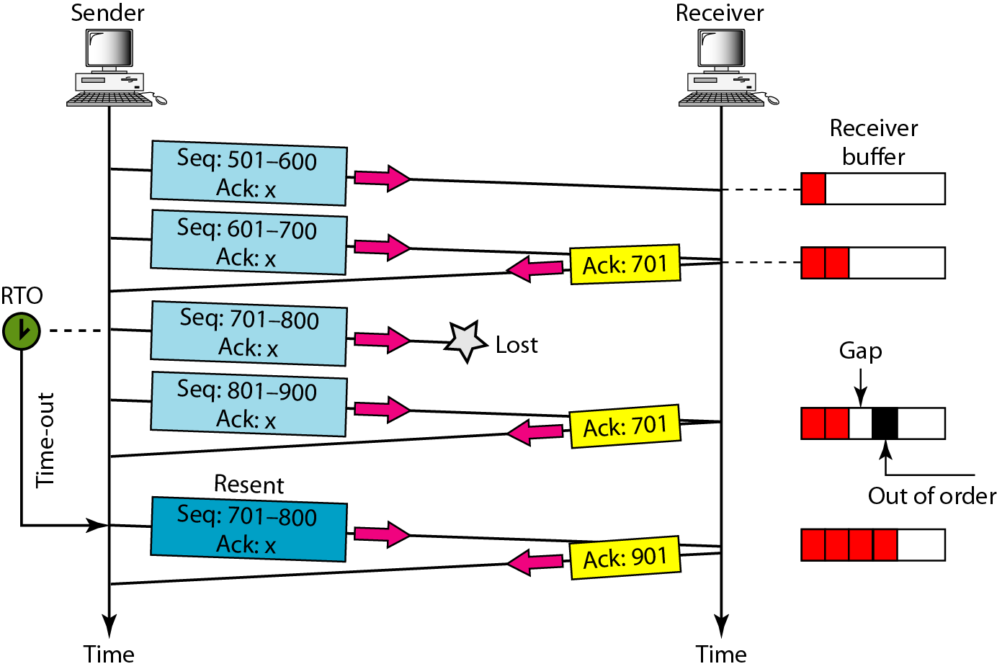
Lost segment

Slide 35
TCP
The receiver TCP delivers only ordered data to the process.

Slide 36
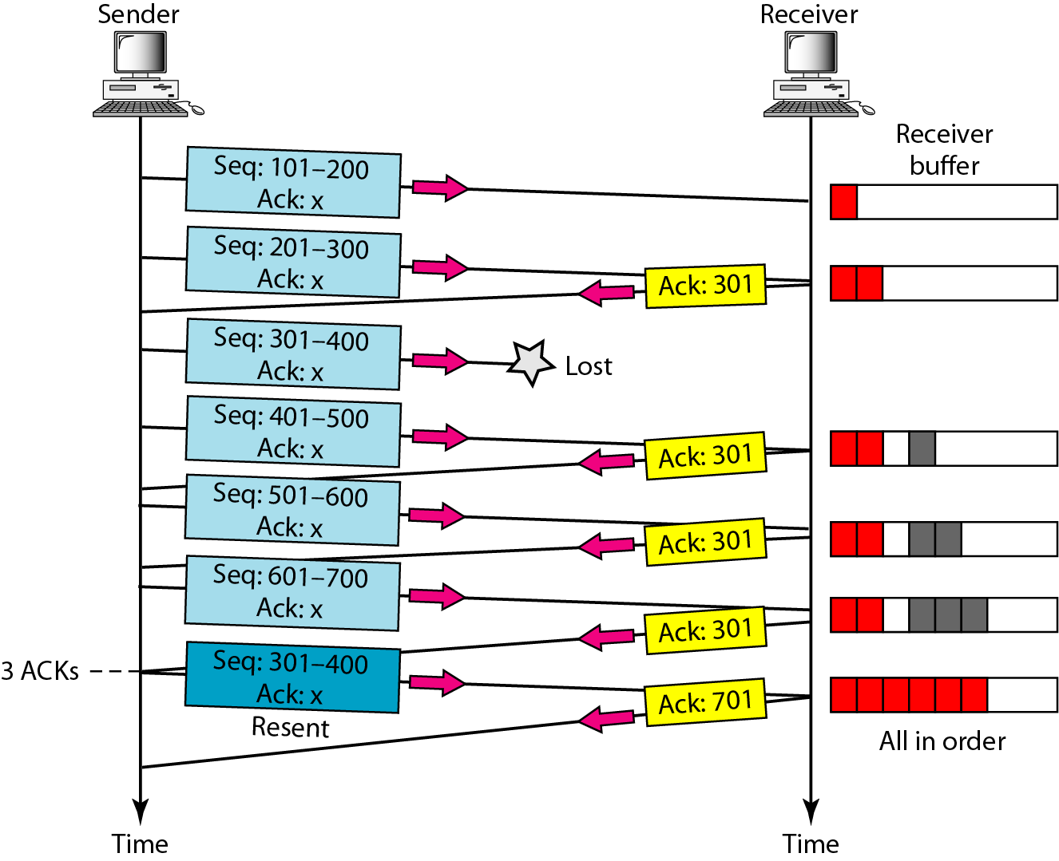
Fast retransmission

Slide 37
TCP
Congestion Control and
Quality of Service

Slide 38
DATA TRAFFIC
The main focus of congestion control and quality of service is data traffic. In congestion control we try to avoid traffic congestion. In quality of service, we try to create an appropriate environment for the traffic.

Slide 39
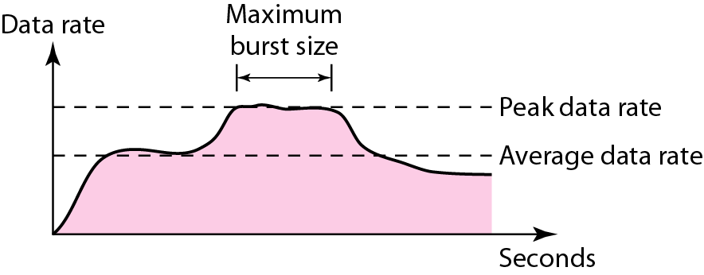
Traffic descriptors

Slide 40
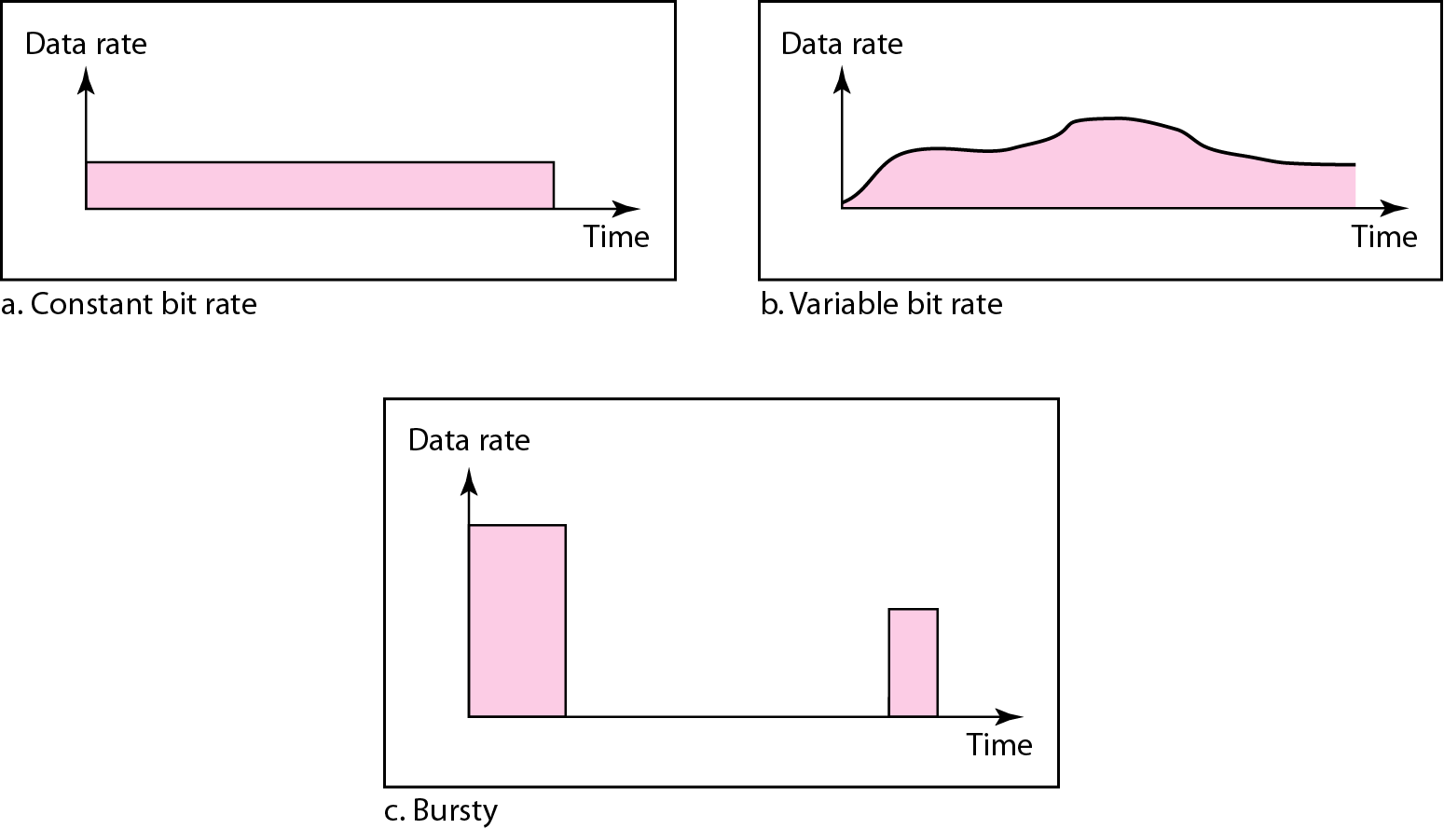
Three traffic profiles

Slide 41
CONGESTION
Congestion in a network may occur if the load on the network—the number of packets sent to the network—is greater than the capacity of the network—the number of packets a network can handle. Congestion control refers to the mechanisms and techniques to control the congestion and keep the load below the capacity.

Slide 42
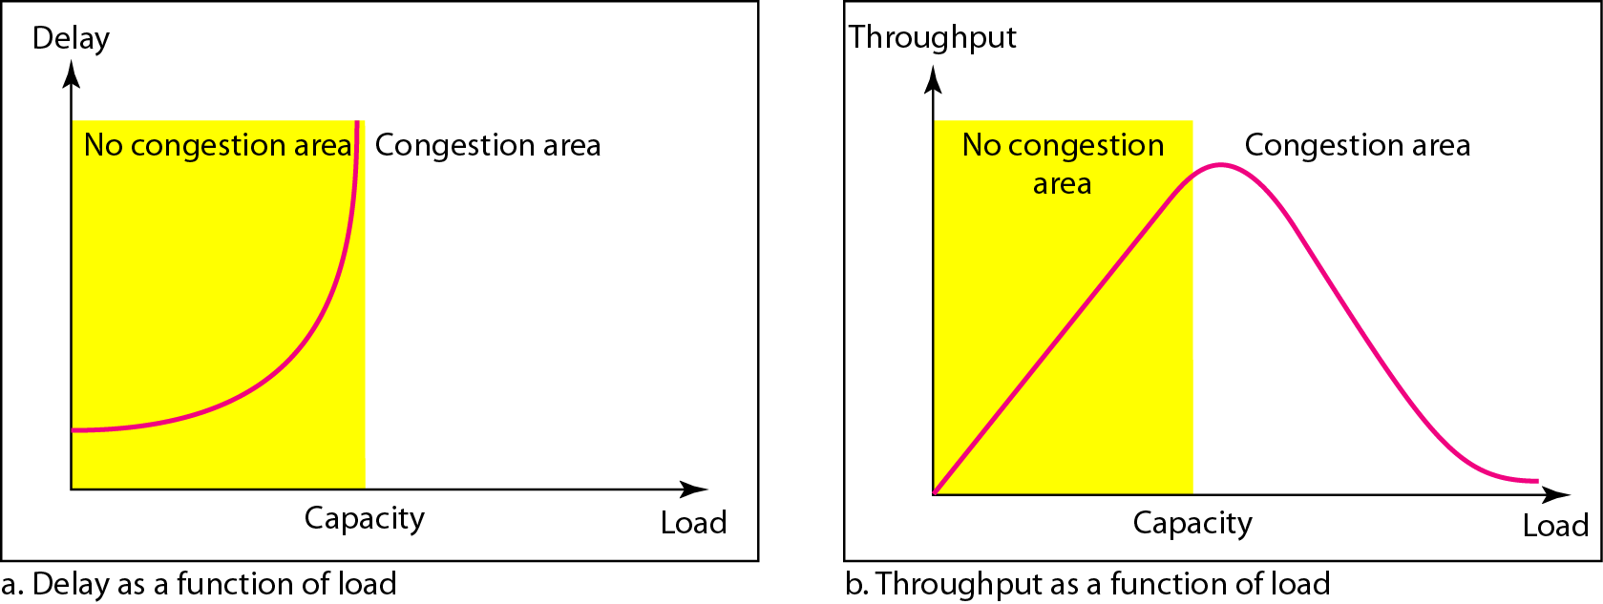
Packet delay and throughput as functions of load

Slide 43
CONGESTION CONTROL
Congestion control refers to techniques and mechanisms that can either prevent congestion, before it happens, or remove congestion, after it has happened. In general, we can divide congestion control mechanisms into two broad categories: open-loop congestion control (prevention) and closed-loop congestion control (removal).

Slide 44
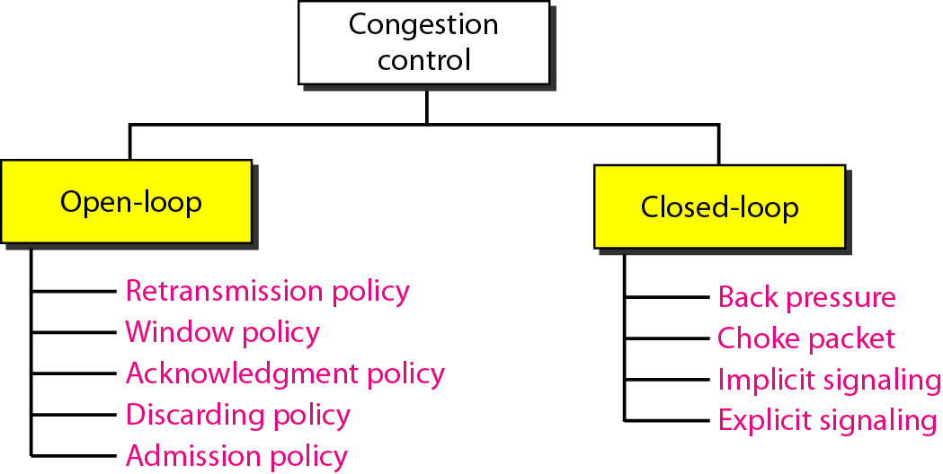
Congestion control categories

Slide 45
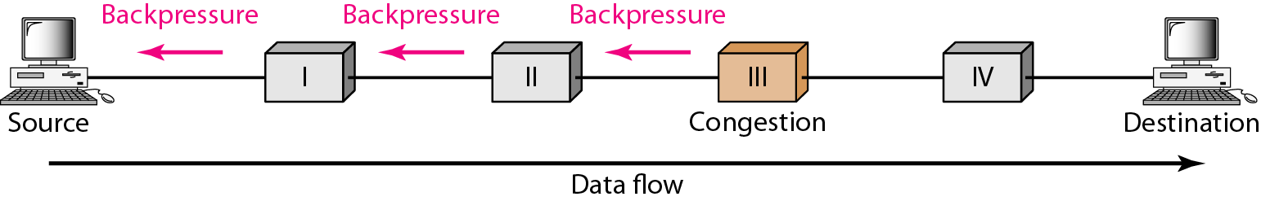
Backpressure method for alleviating congestion

Slide 46
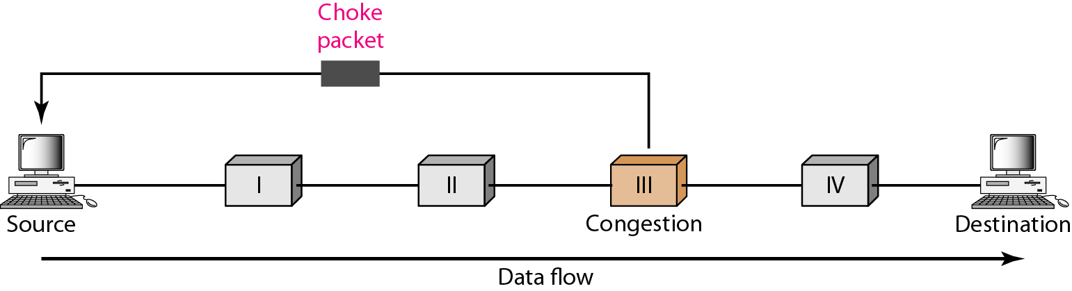
Choke packet

Slide 47
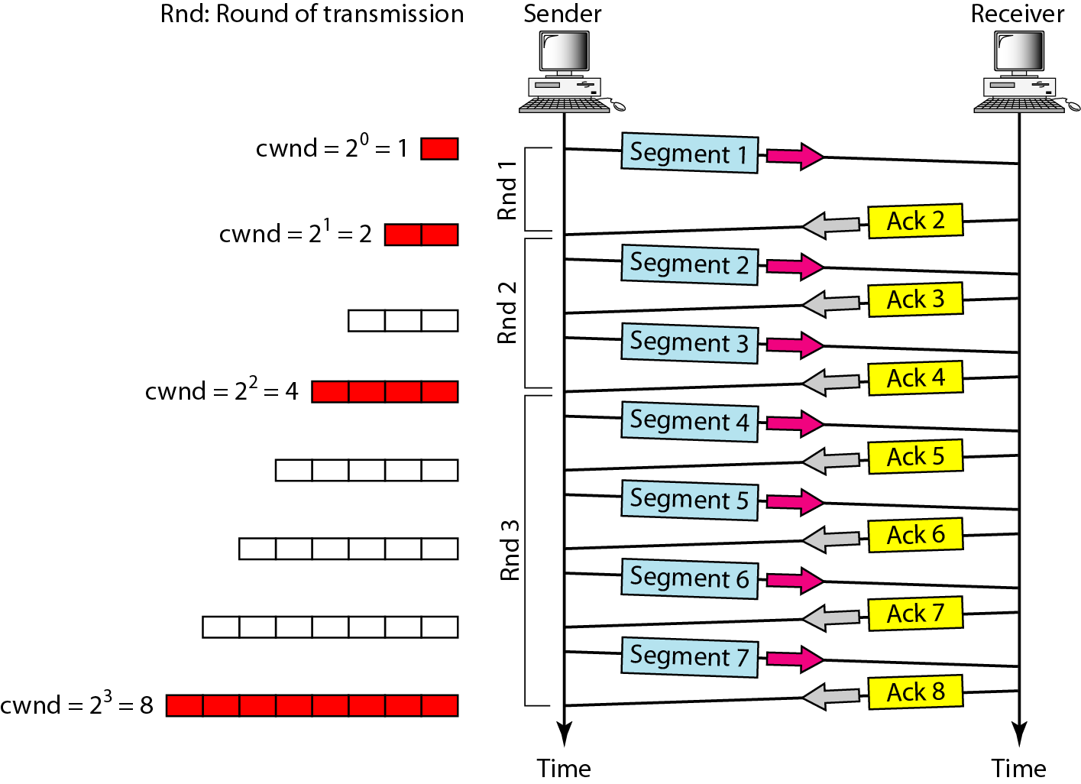
Congestion Control in TCP

Slide 48
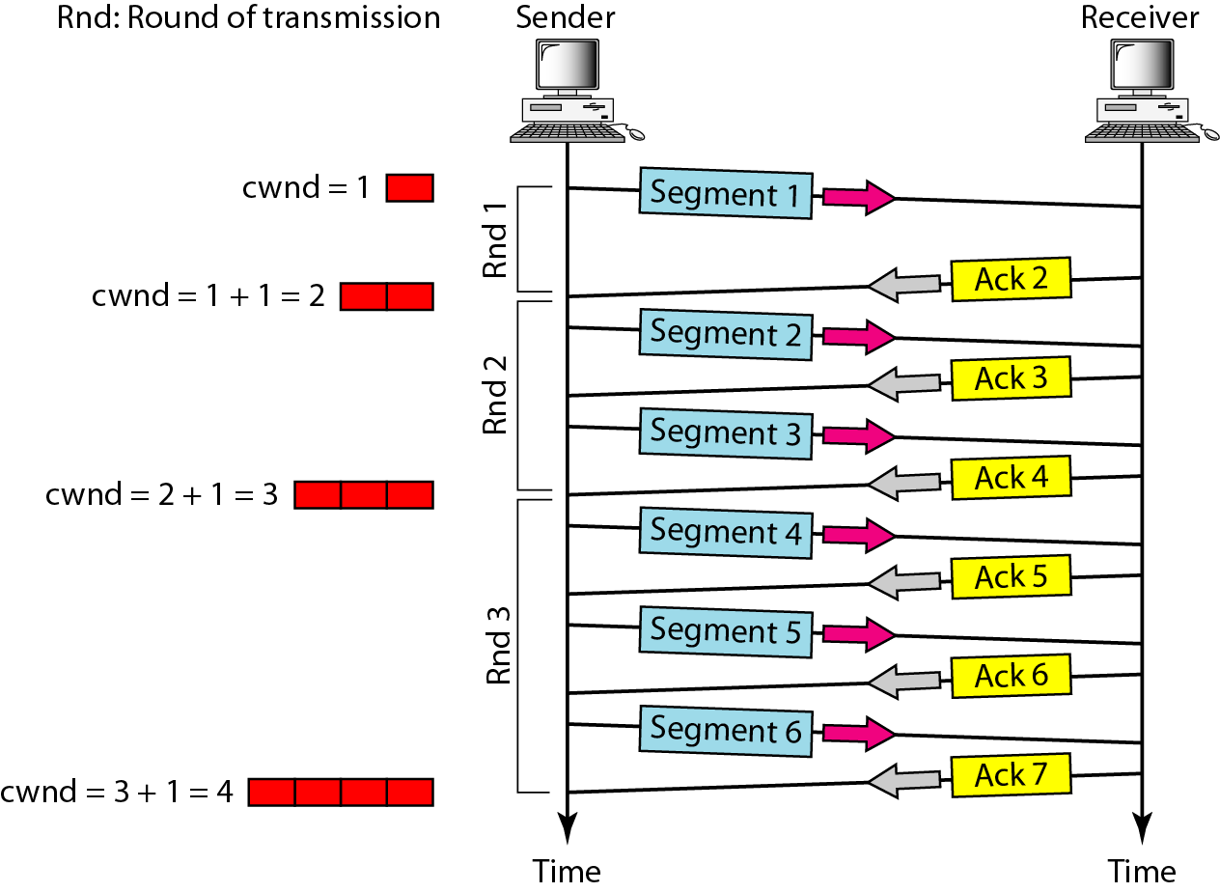
Congestion avoidance, additive increase

Slide 49
Congestion Control in TCP
In the slow-start algorithm, the size of the congestion window increases exponentially until it reaches a threshold.
In the congestion avoidance algorithm, the size of the congestion window increases additively until congestion is detected.
An implementation reacts to congestion detection in one of the following ways:
If detection is by time-out, a new slow start phase starts.
If detection is by three ACKs, a new Congestion avoidance phase starts.

Slide 50
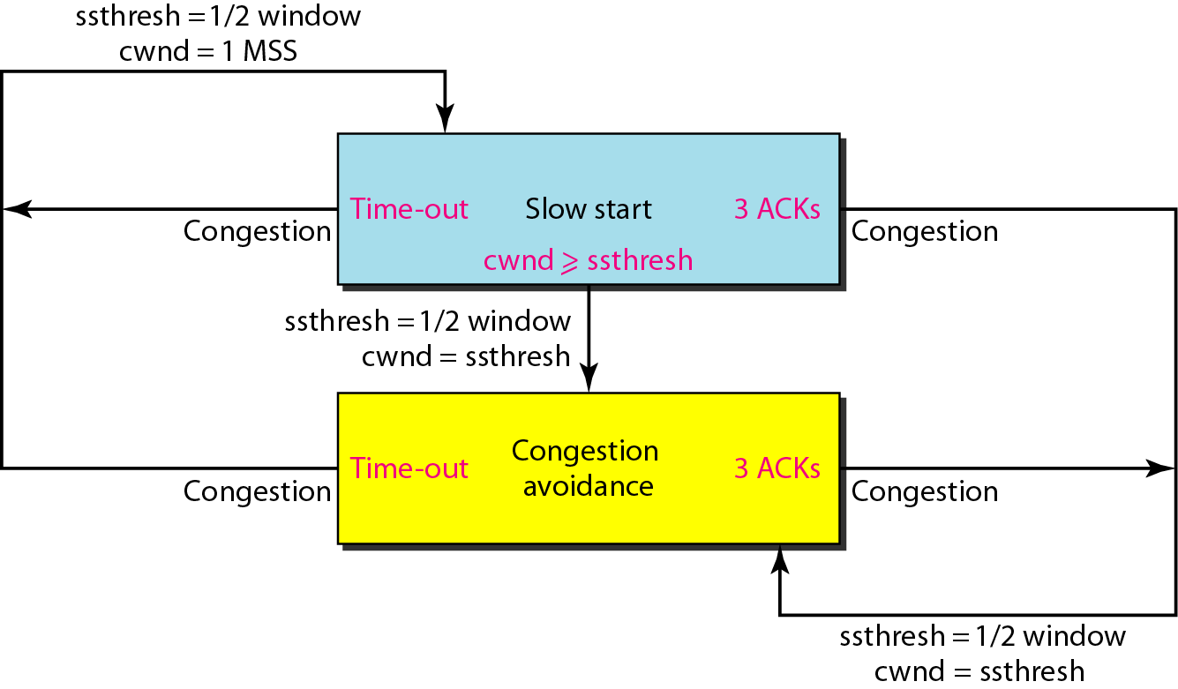
TCP congestion policy summary

Slide 51
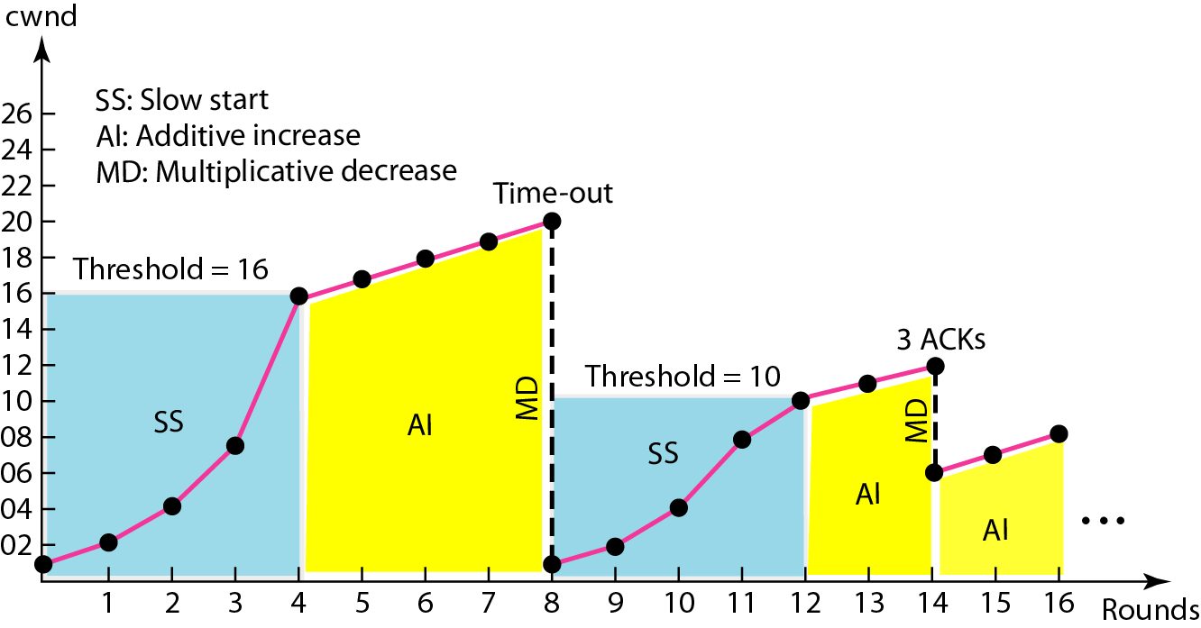
Congestion example

Slide 52
QUALITY OF SERVICE
Quality of service (QoS) is an internetworking issue that has been discussed more than defined. We can informally define quality of service as something a flow seeks to attain.

Slide 53
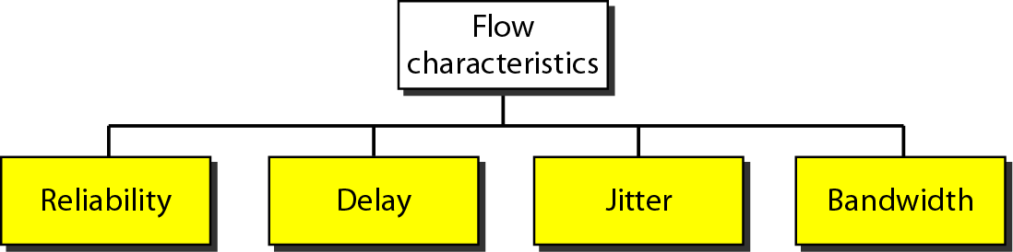
Flow characteristics

