Slide 1
Fraud Detection in Social networks
Tanushree Sarkar
23352079
MCA(Batch 2)

Slide 2
Problem Statement
Social networks are increasingly exploited for fraudulent activities, such as fake accounts, phishing, spamming, and financial fraud. Detecting such activities is challenging due to:
The high-dimensionality of data, which includes user interactions, textual content, and graph structures.
The complex relationships between entities that are difficult to model with traditional approaches.

Slide 3
Social media platforms have become essential communication tools, but they also face challenges from fake accounts that spread misinformation, conduct financial fraud, and manipulate public opinions.
Traditional rule-based and machine learning approaches to fake account detection struggle with scalability, adaptability.
This project aims to develop an intelligent fraud account detection system using machine learning and deep learning models, leveraging user behavior, network activity, and content-based features to accurately detect fake accounts while minimizing false positives.

Slide 4
Literature survey

Slide 5
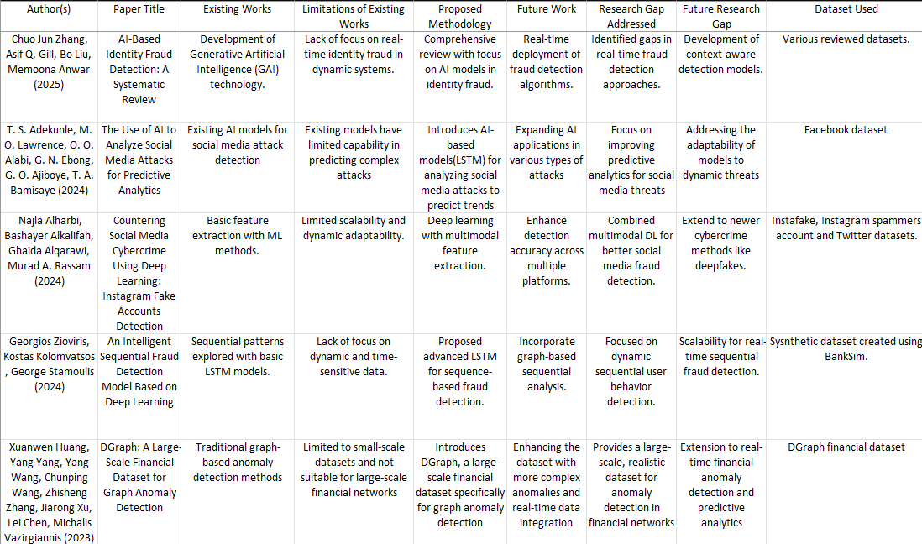

Slide 6
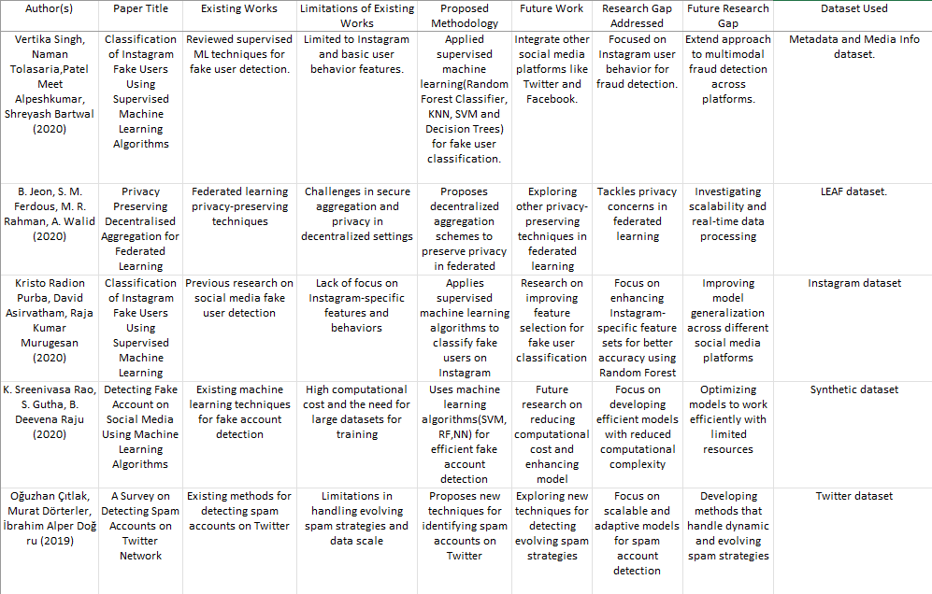

Slide 7
Model architecture

Slide 8
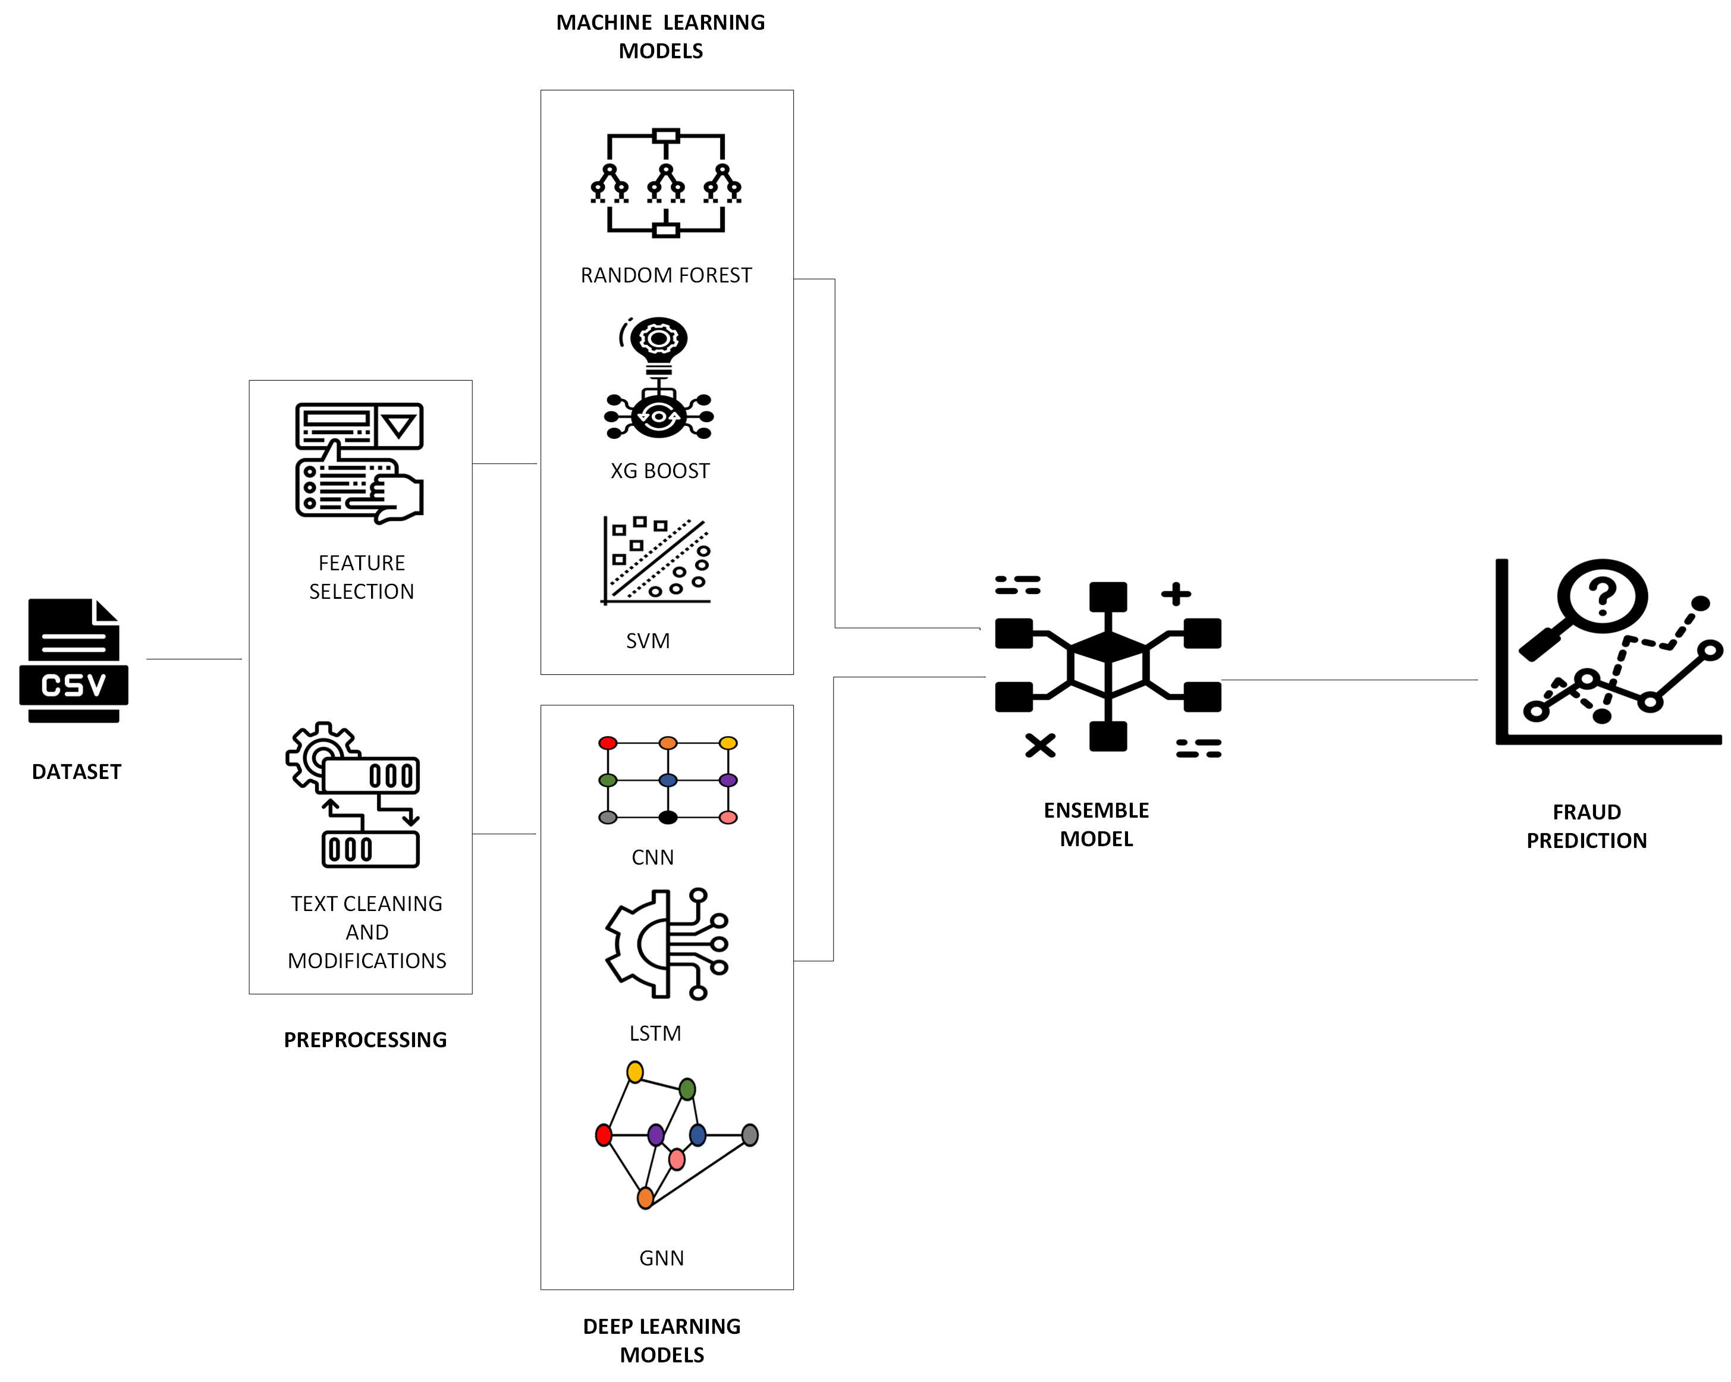

Slide 9
Algorithm Used | Objective
Random Forest | Identify fake accounts based on multiple decision trees using behavioral & profile-based features.
XGBoost | Enhance detection accuracy by focusing on misclassified cases and handling imbalanced datasets.
Support Vector Machine (SVM) | Detect fraudulent accounts based on high-dimensional feature separation.
Long Short-Term Memory (LSTM) | Detect fake accounts through deep learning-based temporal sequence analysis of activities.
Convolutional Neural Network (CNN) | Extract visual and text patterns for fake profile detection.
Graph-Based Approach (GNN) | Identify fake accounts based on their network connections and activity relationships.

Slide 10
Approach
Develop a hybrid deep learning architecture that integrates graph-based and sequence-based models.
Implement a framework to analyze multi-modal data, including graph relationships, user behavior patterns, and textual content.
Introduce dynamic fraud detection using temporal graph models to track evolving fraud patterns.
Ensure the model is interpretable and explainable, increasing its trustworthiness and usability in real-world applications.

Slide 11
dataset 1
profile_pic: Indicates whether the user has a profile picture (Yes/No).
ratio_numlen_username: Represents the ratio of numeric characters to total characters in the username.
len_fullname: Refers to the length of the user's full name.
ratio_numlen_fullname: Denotes the ratio of numeric characters to total characters in the full name.
sim_name_username: Describes how similar the user's full name is to their username, ranging from "Full match" to "No match."
len_desc: Shows the length of the user's description or bio.
extern_url: Indicates whether the user has an external URL linked to their profile (Yes/No).
private: Represents whether the user's account is private (Yes/No).
num_posts: The number of posts the user has made.
num_followers: The number of followers the user has.
num_following: The number of users the profile is following.

Slide 12
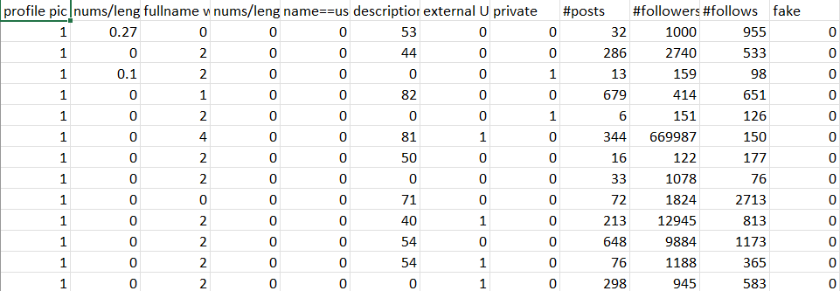

Slide 13
dataset 2
COMMENT_ID : A unique identifier for each comment, likely auto-generated by YouTube.
AUTHOR : The username or alias of the person who posted the comment.
DATE : The timestamp (ISO 8601 format) showing when the comment was posted.
CONTENT : The actual text of the comment. This can include links, self-promotion, or general commentary.
CLASS : The label or classification of the comment(0 for genuine and 1 for fraud)

Slide 14
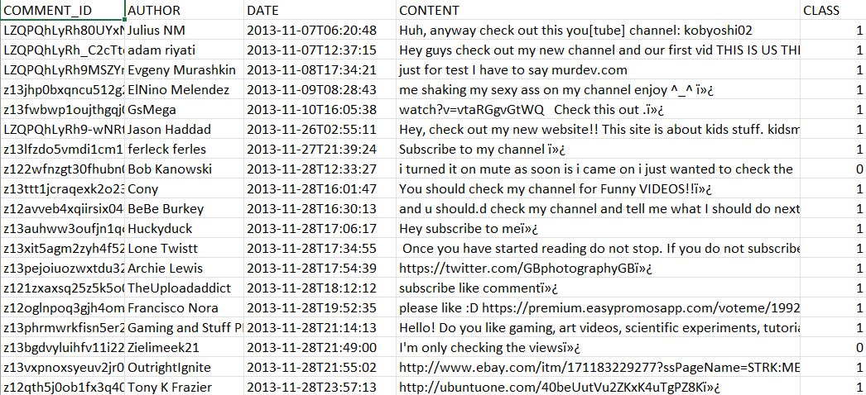

Slide 15
dataset 3
video_id: Unique identifier of the video on YouTube.
title: The video’s title (may include special characters or symbols).
description: Full video description.
channel_id: Unique ID of the channel that uploaded the video.
channel_title: Name of the YouTube channel.
publish_time: Date and time when the video was published (in ISO 8601 format).
tags: A list of keywords or hashtags related to the video.
category_id: Numerical ID representing the video’s category.
thumbnail_url: URL of the video’s thumbnail image.
thumbnail: HTML tag showing the video’s thumbnail.
view_count :Total number of times the video has been viewed.
like_count: Total number of likes on the video.
comment_count: Total number of user comments under the video.
duration: Length of the video.
definition: Video quality: sd (standard definition) or hd (high definition).
caption_status : Whether the video has captions: TRUE or FALSE.
title_clean: The title field, cleaned of symbols and special characters for analysis.
description_clean: The description field, similarly cleaned of non-standard characters and links.
label: Likely a binary label (0 or 1), used for supervised learning tasks.

Slide 16
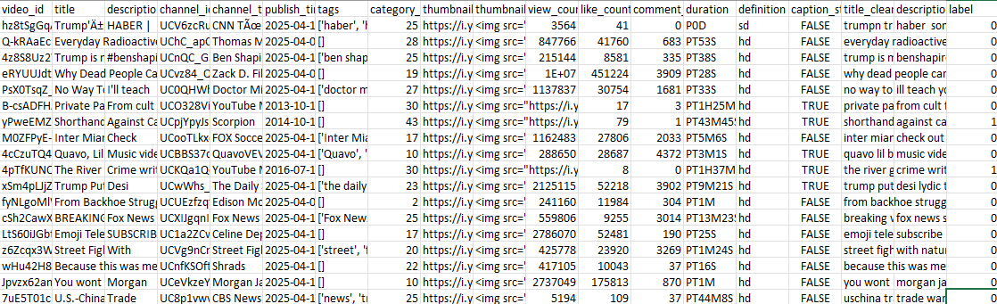

Slide 17
Platforms for Implementation
Google Colab: For training and experimentation with hybrid models, leveraging GPU/TPU resources using Python Programming.
Kaggle and GitHub: For accessing datasets
Youtube Data API: To extract real-time data through web scraping

Slide 18
code

Slide 19
dataset 1
Machine Learning Models
https://colab.research.google.com/drive/1feBiG5-6ShX69YqwmoPZ4D__1EwT2R6O
Deep Learning Models
https://colab.research.google.com/drive/1lg7xMWDi4gFnf_9d4zmEMYgRKF4rCeqj
Hybrid Model
https://colab.research.google.com/drive/1CGhUrq5otPWL4lTEqkbmabTvI3WzoAIE#scrollTo=JBDj3kYMkqhX

Slide 20
dataset 2
https://colab.research.google.com/drive/1lvjBybCorwUtwULtuLxmh31lOuiIefUE?usp=sharing

Slide 21
dataset 3
https://colab.research.google.com/drive/1ppIOUlaS07IfmtXLtsRafPrVRrzb26rI?usp=sharing

Slide 22
Future Enhancement
Advanced Cybersecurity Features
Cross-Platform Integration
Blockchain Security Enhancement
Advanced Cybersecurity Features
Privacy-Focused Learning

Slide 23
references
[1] B. Austin-Gabriel, A. I. Afolabi, C. C. Ike, and N. Y. Hussain, "AI and Machine Learning for Detecting Social Media-Based Fraud Targeting Small Businesses," Procedia Computer Science, 2024.
[2] Soorya Ramdas, Agnes Neenu N. T., "Leveraging Machine Learning for Fraudulent Social Media Profile Detection," International Journal of Engineering Research & Technology (IJERT), vol. 13, no. 3, pp. 45–52, Mar. 2024.
[3] Farooqui, Faisal and Usman Khan, Muhammed,” Automatic Detection of Fake Profiles in Online Social Network Using Soft Computing”, (July 18, 2022). International Journal of Engineering and Management Research, Volume-13, Issue 3 (June 2023), https://ssrn.com/abstract=4513674
[4] Ahmad, Shamim & Tripathi, Dr. (2023). A Review Article on Detection of Fake Profile on Social-Media. International Journal of Innovative Research in Computer Science and Technology. 11. 44-49. 10.55524/ijircst.2023.11.2.9.
[5] Prabhu Kavin, B., Karki, S., Hemalatha, S., Singh, D., Vijayalakshmi, R., Thangamani, M., Haleem, S. L. A., Jose, D., Tirth, V., Kshirsagar, P. R., & Adigo, A. G. (2022). Machine learning‐based secure data acquisition for fake accounts detection in future mobile communication networks.
[6] Pombal, J., Cruz, A. F., Bravo, J., Saleiro, P., Figueiredo, M. A. T., & Bizarro, P. (2022). Understanding unfairness in fraud detection through model and data bias interactions.
[7] Partha Chakraborty, Mahim Musharof Shazan, Mahamudul Nahid, Md. Kaysar Ahmed, Prince Chandra Talukder, “Fake Profile Detection Using Machine Learning Techniques”, Journal of Computer and Communications > Vol.10 No.10, October 2022, DOI: 10.4236/jcc.2022.1010006
[8] Meshram, P., Bhambulkar, R., Pokale, P., Kharbikar, K., & Awachat, A. (2021). Automatic detection of fake profile using machine learning on Instagram.
[9] Archna Goyal, Surbhi Singh, Saurabh Sharma, "Fraud Detection on Social Media using Data Analytics," International Journal of Scientific Research in Computer Science, vol. 8, no. 2, pp. 112–118, 2020.
[10] Vertika Singh, Naman Tolasaria, Patel Meet Alpeshkumar, Shreyash Bartwal, "Classification of Instagram Fake Users Using Supervised Machine Learning Algorithms," International Journal of Computer Applications, vol. 182, no. 32, pp. 1–6, 2020.

Slide 24
THANK YOU!

