Slide 1







DEEP LEARNING-BASED YIELD FORECASTING FOR RICE VARIETIES
Team Members:
Tanushri E (211423104684)
Thiruselvi Thirunavukkarasu (211423104698)
Guide Name: Dr. Sathiya V
Project Co-ordinator Name: Dr.Subedha V & Mrs.Sharmila
Batch No: 07

Slide 2
Base Paper Details
Title : Accurate Wheat Yield Prediction Using Machine Learning and Climate-NDVI Data Fusion.
Authors : Muhammad Ashfaq , Imran Khan, Abdulrahman Alzahrani , Muhammad Usman Tariq , Humera Khan And Anwar Ghani.
Journal/Conference: IEEE Access
Year: 2024
Publisher: IEEE

Slide 3
Abstract
In many agricultural regions, farmers face significant yield losses due to unpredictable climate conditions, lack of localized forecasting systems and absence of planning tools tailored to specific rice varieties. These challenges result in poor crop selection, unstable productivity , reduced income, threatening food security and rural livelihoods. This introduces a deep learning–based rice yield prediction model that integrates NDVI time-series data, daily climate parameters and rice variety characteristics to generate localized & variety-specific forecasts. The model leverages Long Short-Term Memory (LSTM) networks to learn temporal patterns from vegetation and weather trends, offering adaptive and accurate predictions. NDVI data is sourced from Sentinel-2 satellite imagery via Google Earth Engine, while climate inputs such as rainfall, temperature and humidity are

Slide 4
obtained from NASAPOWER. Rice variety data is collected from agricultural institutions and farm records to account for genetic and phenotypic differences. The model focuses on the Thanjavur district of Tamil Nadu, a major rice-producing region with diverse cultivated varieties. Experimental results show that the proposed model achieves promising prediction accuracy, effectively modelling the complex interactions between crop health, climate variability and varietal behaviour. The LSTM-based pipeline provides actionable insights to farmers, helping them choose optimal varieties and plan for upcoming seasons. Overall, the proposed approach contributes to data-driven agriculture by offering a transparent, scalable and farmer-friendly decision support tool.

Slide 5
Social Relevance
This project addresses a real-world problem faced by farmers in Tamil Nadu — uncertain rice yields due to climate variability and lack of variety-specific planning.
By providing accurate and explainable yield predictions based on local climate and crop variety, the model empowers farmers to make informed decisions, reduce losses and increase food production.
The project directly supports UN SDG 2: Zero Hunger, particularly Target 2.4, which focuses on sustainable and resilient food systems.
Besides directly supporting SDG-2 (Zero Hunger), the system indirectly aids SDG-1 stabilising farmer income and reducing poverty, SDG-9 by introducing AI-driven innovation in agriculture and SDG-13 by enabling climate-resilient crop planning.

Slide 6
Introduction
Rice is a critical staple and income source in India, especially in Thanjavur “Rice Bowl of Tamil Nadu”, where yields fluctuate due to climate instability and delayed monsoons, causing financial risk for farmers. Traditional and earlier ML-based forecasting methods are slow and lack precision as they ignore daily climate variation and varietal differences. To overcome this, a deep learning-based LSTM model is proposed that combines NDVI (Sentinel-2), daily climate data (NASA POWER) and rice variety to produce localized, variety-specific yield forecasts, supporting climate-resilient crop planning and aligning with SDG-2 on food security. The system acts as a decision-support tool for both farmers and policymakers. It ultimately helps reduce uncertainty, improve planning and stabilize rural income.

Slide 7
Literature Survey
No. | Title | Approach / Model | Data & Region | Performance Metrics / Key Findings
1 | Rice yield estimation using LSTM with meteorological data, IEEE Access, 2022 | LSTM using meteorological inputs | Not specified | LSTM surpasses classical ML models in yield prediction
2 | Indian Crop Yield Prediction using LSTM Deep Learning Networks | LSTM-based model | India (climate, soil, rainfall data) | Used LSTM to capture temporal patterns for accurate crop yield prediction in India.
3 | Advanced Rice Yield and Soil Prediction using Deep Learning | Deep learning (architecture unspecified) | Not specified | Demonstrated that a deep learning framework effectively predicts both rice yield and soil characteristics
4 | Paddy Yield Forecasting using Regression Techniques | Regression modelling | Regional (possibly Tamil Nadu) | Regression model predicted paddy yield with ±12% forecast accuracy.
5 | Mapping Indian Rice Yields through Statistical Modeling using Satellite and Climatic Data | Regression + DSSAT with satellite & climate data | Cauvery Delta, Tamil Nadu | RMSE ≈ 11.7%; accuracy 81–93%
6 | Enhancing Rice Yield Prediction using Vision Transformer and Regression Models | Vision Transformer with regression models | Not specified | Vision Transformer boosts rice yield prediction accuracy from images.
7 | A Time‑Series Based Yield Forecasting Model Using Stacked LSTM... Cauvery Delta, Tamil Nadu | Stacked LSTM time-series forecasting | Cauvery Delta, Tamil Nadu | Stacked LSTM accurately forecasts paddy yield in Cauvery Delta.

Slide 8
8 | Exploring Crop Yield Prediction with Remote Sensing Imagery and AI (Kavipriya & Vadivu, ACCAI 2024) | DNN leveraging remote sensing imagery | Not specified | Achieved ~90% prediction accuracy
9 | Predicting crop yield with NDVI and Backscatter values using Deep Neural Networks (MECON 2022) | DNN using NDVI + backscatter | India (Madhya Pradesh districts) | NDVI and backscatter data improve crop yield prediction accuracy.
10 | Rice Modeling Using Long Time Series of High Temporal Resolution Vegetation Indices in Nepal | NDVI time-series modelling | Nepal | Time-series vegetation indices improve rice yield prediction in Nepal.
11 | Hybrid LSTM and SVM Method Rice Yield Prediction in Densely Populated Areas | Hybrid LSTM + SVM model | Urban/densely populated regions | Hybrid LSTM-SVM model accurately predicts rice yield in urban areas.
12 | BORO RICE YIELD ESTIMATION MODEL USING MODIS NDVI DATA FOR BANGLADESH | Regression model using MODIS NDVI | Bangladesh (district-level, 2007–2012) | Strong R² (0.76–0.86), RMSE 0.21–0.29 Mton/ha, ±~10% error
13 | Automated Rice Crop Yield Prediction using Sine Cosine Algorithm with Weighted Regularized Extreme Learning Machine | WRELM optimized via Sine Cosine Algorithm | Not specified | SCA-WRELM model improves rice yield prediction accuracy and efficiency.
14 | Deep learning‑enhanced remote sensing‑integrated crop modeling for rice yield prediction (Ecological Informatics, 2024) | Feed‑forward NN, LSTM, GRU, Bi‑LSTM integrated with remote sensing and process-based crop models | Not specified | Achieved extremely high predictive performance (Nash–Sutcliffe model efficiency: 0.954–0.996), with LSTM performing best
15 | Rice yield prediction using radar vegetation indices from Sentinel‑1 data and multiscale Conv1D‑LSTM network (Journal of Applied Remote Sensing, 2024) | Multiscale 1D Conv‑LSTM processing radar vegetation indices (RVIs) | Guangdong Province, China (2017–2021) | Outperformed LSTM—early prediction: R² = 0.67 (ubRMSE 217.8 kg/ha); late prediction: R² = 0.61 (ubRMSE 456.5 kg/ha

Slide 9
Proposed System
We propose a deep learning-based rice yield prediction system that leverages time-series NDVI satellite data, daily climate variables and crop variety information. The model focuses on the Thanjavur district, aiming to provide localised and accurate forecasts.
The core of the architecture is an LSTM (Long Short-Term Memory) model, which is well-suited for learning from sequential data like weekly NDVI and weather trends. By incorporating rice variety as a separate input, the model can generate variety-specific predictions that reflect real-world agricultural differences.

Slide 10
Hardware/Software Specifications
Hardware Requirements
Processor: Intel i5 or higher
RAM: 8 GB
Storage: Minimum 10 GB (for datasets and model files)
GPU: Optional (e.g., Google Collab GPU)
Software & Tools Used
Programming Language: Python
Deep Learning Library: TensorFlow / Keras
Satellite Data Access: Google Earth Engine (Sentinel-2)
Climate Data Source: NASA POWER
Data Format: CSV, JSON, Excel

Slide 11
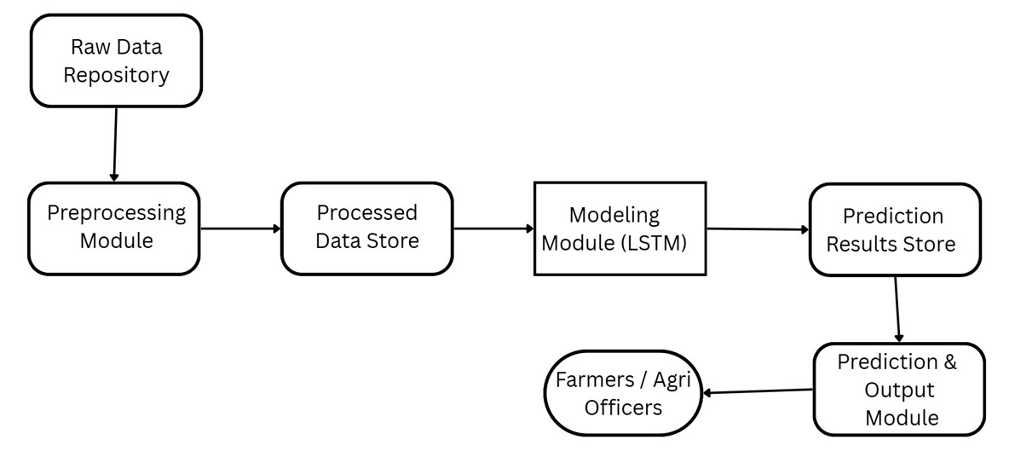
System Architecture
Fig. Functional Block Diagram Of The Prediction Model

Slide 12




Modules Used & Explanation
1. Data Collection Module
2. Modelling Module
4. Prediction & Output Module
3. Preprocessing Module

Slide 13
Data Collection Module – Multi-Source Integration
Core Function:
Acquires and integrates all essential data sources for the rice yield prediction system.
Key Data Sources:
NDVI Data: Retrieved from Sentinel-2 via Google Earth Engine (GEE) to monitor vegetation health.
Climate Data: Temperature, rainfall, and humidity sourced from NASA POWER.
Crop Variety & Yield History: Collected from regional agricultural records and historical datasets.
Features:
Centralizes multi-source datasets into a single pipeline.
Ensures region- and variety-specific data collection for model relevance.

Slide 14
Modelling Module – LSTM Based Prediction
Core Function:
Utilizes LSTM (Long Short-Term Memory) neural networks to process time-series data effectively.
Data Sources Integrated:
NDVI (Normalized Difference Vegetation Index): Tracks vegetation health from satellite imagery.
Climate Data: Includes rainfall, temperature, humidity and seasonal factors.
Rice Variety Data: Ensures predictions are variety-specific for each region.
Key Features:
Captures long-term dependencies and seasonal patterns.
Learns complex relationships between climate, crop growth and variety.
Generates accurate and explainable yield predictions.

Slide 15
Preprocessing Module – Data Preparation
Core Function:
Cleans, organizes and structures raw agricultural datasets for deep learning.
Key Steps:
Data Cleaning: Removes missing, inconsistent, or noisy entries.
Time-Series Alignment: Converts all data into a weekly format to match growth stages.
Rice Variety Encoding: Transforms rice variety information into a machine-readable format (e.g., one-hot encoding).
Sequence Preparation: Creates structured input sequences for the LSTM model.
Significance:
Ensures consistency across climate, NDVI, and variety data, allowing the model to learn accurate and meaningful patterns.

Slide 16
Prediction & Output Module – Yield Forecasting
Core Function:
Generates final rice yield predictions in tons per hectare (t/ha).
Key Outputs:
Predicted Yield: Provides region and variety-specific forecast values.
Variety Recommendation: Suggests the best-performing rice variety for the upcoming season based on model insights.
Features:
Displays predictions in an interpretable format for farmers and Agri-officers.
Supports data-driven decision-making for crop planning and resource allocation.
Significance:
Helps reduce yield uncertainty, improves planning and enhances food security by aligning cultivation with seasonal performance data.

Slide 17
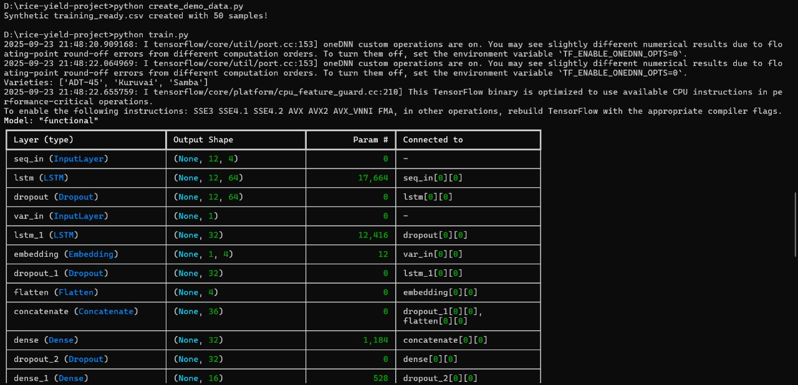
Screenshots
Fig. Model Training Using The Datasets

Slide 18
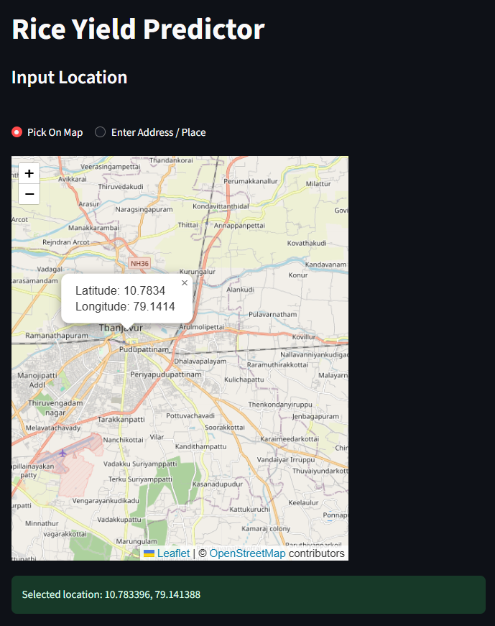
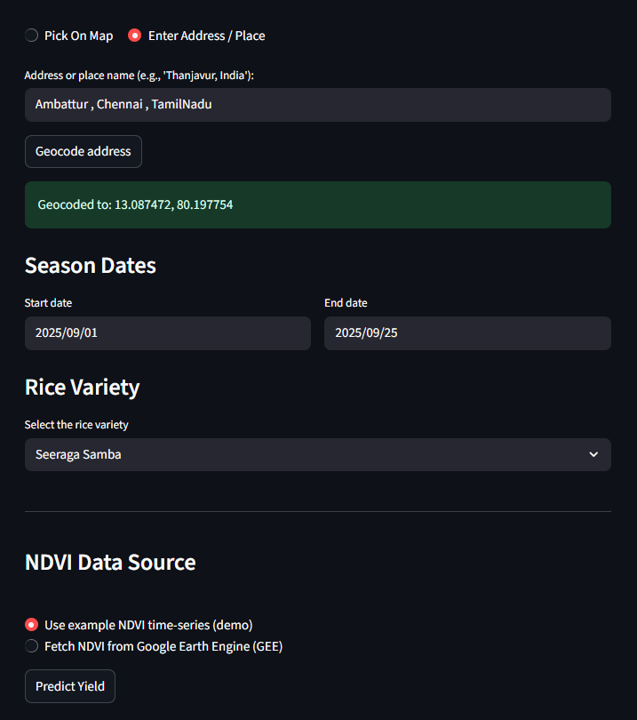
Fig. Input Location Through Map
Fig. Manual Input Location

Slide 19
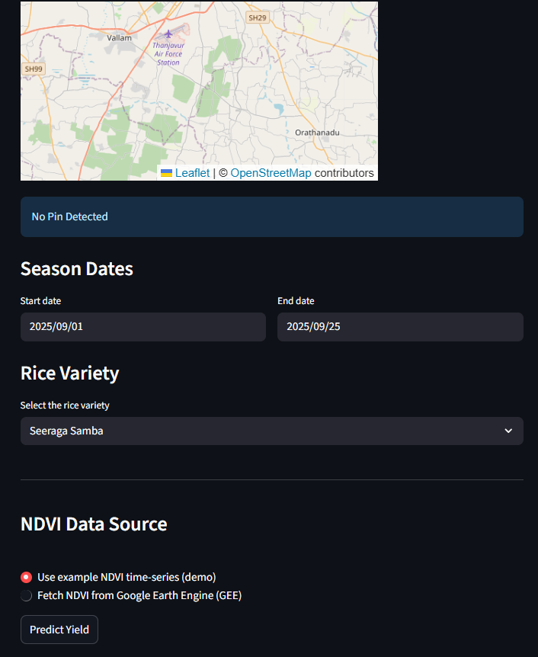
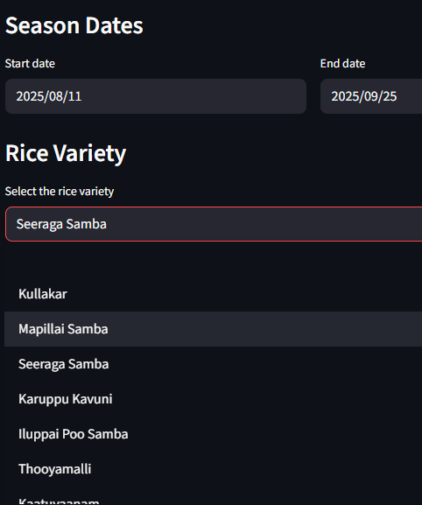
Fig. Input of Date & Rice variety

Slide 20
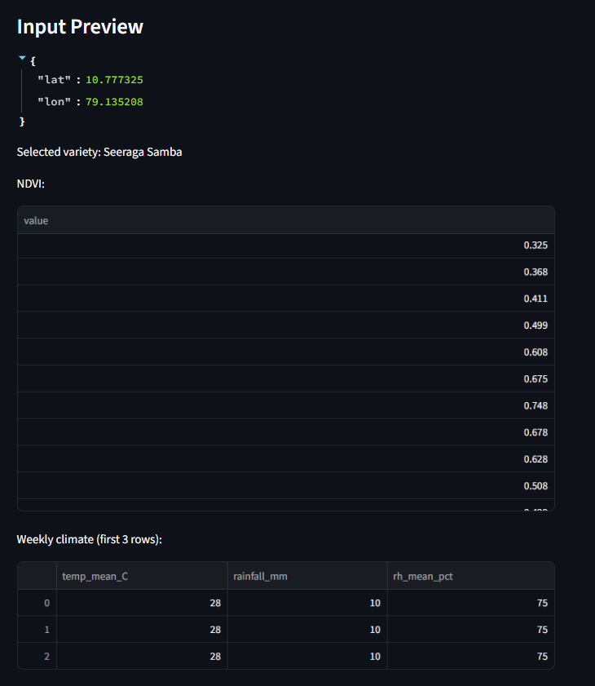
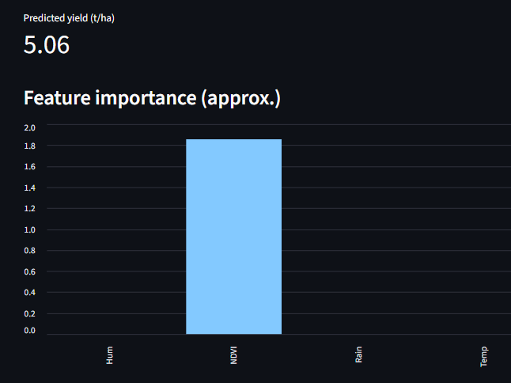
Fig. Predicted Yield Shown

Slide 21
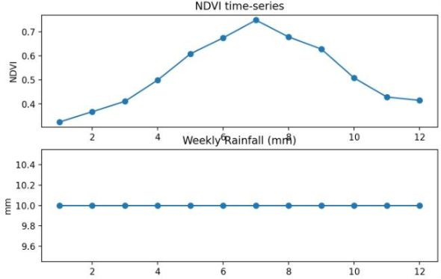
Fig. Sample Output

Slide 22
Future Scope
Integration with Real-Time Data
Support for Multiple Crops
Mobile/Web App Interface
Use of Attention Mechanisms
Localized Recommendations

Slide 23
Conclusion
This presents a deep learning-based rice yield forecasting model for Thanjavur that integrates NDVI time-series, weather data and rice variety information to generate localized, variety-specific predictions using LSTM networks, with variety embeddings capturing varietal differences. Results show that the model performs well and identifies NDVI during the reproductive phase and rainfall variability as key determinants of yield. The inclusion of interpretability builds confidence for real-world agricultural use, offering an advantage over conventional models by capturing temporal dynamics and varietal diversity and thus providing actionable insights for farmers and policymakers. Future work includes integrating soil, pest and management data and deploying the model as a mobile app for real-time decision support. Overall, the system supports sustainable agriculture, enhances food security and aligns with UN SDG-2 (Zero Hunger).

Slide 24
References
1. Rice Yield Estimation using LSTM with Meteorological Data, IEEE Access, 2022
2. Indian Crop Yield Prediction using LSTM Deep Learning Networks
3. Advanced Rice Yield and Soil Prediction using Deep Learning
4. Paddy Yield Forecasting using Regression Techniques
5. Mapping Indian Rice Yields through Statistical Modelling using Satellite and Climatic Data
6. Enhancing Rice Yield Prediction using Vision Transformer and Regression Models
7. A Time‑Series Based Yield Forecasting Model Using Stacked LSTM... Cauvery Delta, Tamil Nadu

Slide 25
8. Exploring Crop Yield Prediction with Remote Sensing Imagery and AI (Kavipriya & Vadivu, ACCAI 2024)
9. Predicting Crop Yield with NDVI and Backscatter Values using Deep Neural Networks (MECON 2022) 10. Rice Modelling Using Long Time Series of High Temporal Resolution Vegetation Indices in Nepal
11. Hybrid LSTM and SVM Method Rice Yield Prediction in Densely Populated Areas
12. BORO Rice Yield Estimation Model Using MODIS NDVI Data for Bangladesh
13. Automated Rice Crop Yield Prediction using Sine Cosine Algorithm with Weighted Regularized Extreme Learning Machine
14. Deep Learning‑Enhanced Remote Sensing‑Integrated Crop Modelling for Rice Yield Prediction (Ecological Informatics, 2024)
15. Rice Yield Prediction using Radar Vegetation Indices from Sentinel‑1 Data and Multiscale Conv1D‑LSTM Network (Journal of Applied Remote Sensing, 2024)

