Slide 1
CONTOSO FINANCE & ANALYTICS: BIG DATA MODERNIZATION

Slide 2



HELLO!
I am Tanushri Nayak
14+ Years of Experience | Software Development, Architecture & Consulting | Data Analytics and ML Enthusiast | Traveler | Hiker | Reader | Painter |
You can look me at:
: https://www.linkedin.com/in/tanushri-nayak-a518645b/
: https://github.com/tanushrin/

Slide 3
AGENDA
QUESTIONS
Any Questions Please ?
SUMMARY
Solution Design Conclusion
MIGRATION STRATEGY
Proposed Approach and Guidelines for Migration
BOM & PRE-REQUISITES
Bill of Material and Pre-Requisites
AZURE SERVICES
Equivalent Azure Services In Comparison to In-House Technology
ALL DETAILS
Requirements, Goals and Questions

Slide 4
ALL DETAILS
1

Slide 5
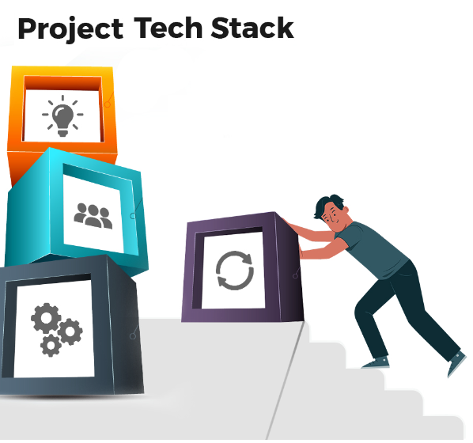
IN-HOUSE TECHNOLOGY STACK
Hadoop Cluster with 200 Nodes.
Oracle.
SQL Server.
PostgreSQL.
Tableau.
Alteryx.
Talend.
Informatica.
PowerBI.
Python and R.

Slide 6

GOAL OF CONTOSO
Strategic Plan to move to Cloud.
Interest in findings on the ability of Azure or a Multi-Cloud Solution to host all their tools.
Primary Requirement - Hadoop Cluster to Azure.
What is the Hadoop Equivalent Azure Service?
How to Migrate Data?
Possibility to Operate in Hybrid Infrastructure?
Develop a Phase Plan. 1st Phase - Migrate Hadoop Cluster to Azure, 2nd Phase - Migrate rest of the Spoke Applications.
Data Ops Team is Linux and Open-Source Oriented.

Slide 7

DETAILS NOT FOUND
Purpose of Each Data Technologies in Spoke.
Workflow of all Data Technologies in On-Premises.
Volume of Data and Growth Rate.
Timelines.
Costs.
Problem Statement.
Motivation to Move to Azure.

Slide 8
AZURE SERVICES
2

Slide 9
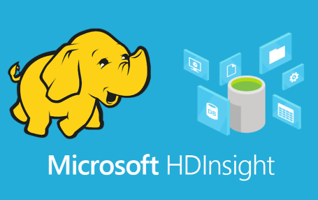
HADOOP CLUSTER
Azure HDInsight (Cluster Type: Hadoop)
Platform: PaaS
Details: Head Nodes, Zookeeper and Worker Nodes. Workloads run on Worker Nodes. Storage Account is also Deployed as Part of the Cluster.
More Information: https://docs.microsoft.com/en-us/azure/hdinsight/hdinsight-overview

Slide 10
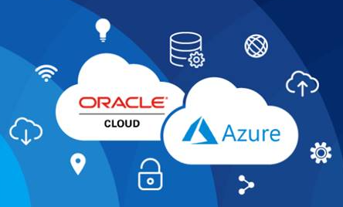
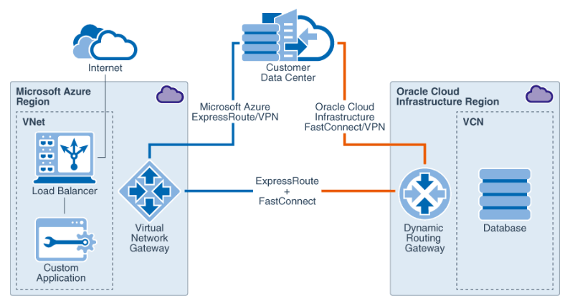
ORACLE
There are 2 Proposed Options:
Option #1: Oracle Database in Azure VM
Platform: IaaS
Details: Oracle databases can be run on Azure Infrastructure using Oracle
Database on Oracle Linux Images available in the Azure Marketplace.
More Information: https://docs.microsoft.com/en-us/azure/virtual-machines/workloads/oracle/oracle-database-quick-create
Option #2: OCI and Azure
Platform: Multicloud (Oracle Cloud Infrastructure - OCI) and Microsoft Azure
Details: Oracle Database Service for Microsoft Azure is an Oracle-managed service for Azure customers to easily provision, access, and operate Oracle Database services in Oracle Cloud Infrastructure (OCI). Low-latency connectivity between Microsoft Azure and OCI and provides metrics on Azure. No charges for Oracle Interconnect for Microsoft Azure ports or data ingress/egress over the Interconnect. Billed normally for the consumption of Oracle Database services.
More Information: https://www.oracle.com/cloud/azure/oracle-database-for-azure/

Slide 11
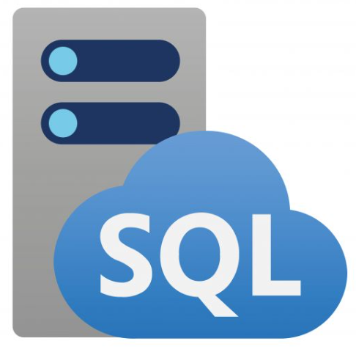
SQL
Azure SQL Managed Instance
Platform: PaaS
Details: Azure SQL Managed Instance is Microsoft's intelligent, scalable, cloud database service. It allows you to use the full power of SQL Server without any hassle of setting up the infrastructure. This includes Machine Learning Services which contains Microsoft R and Python packages for high-performance predictive analytics and machine learning.
More Information: https://docs.microsoft.com/en-us/azure/azure-sql/managed-instance/sql-managed-instance-paas-overview?view=azuresql

Slide 12

POSTGRESQL
Azure Database for PostgreSQL
Platform: PaaS
Details: Azure Database for PostgreSQL is a relational database service in the Microsoft cloud based on the PostgreSQL open source relational database.
More Information: https://docs.microsoft.com/en-us/azure/postgresql/single-server/overview

Slide 13

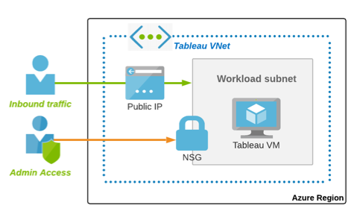
TABLEAU
Tableau in Azure
Platform: IaaS
Details: Specializes in Data Visualization.
More Information: https://www.tableau.com/learn/whitepapers/next-generation-cloud-bi-tableau-server-hosted-microsoft-azure
https://www.tableau.com/about/blog/2019/8/introducing-tableau-server-linux-azure-quickstart

Slide 14
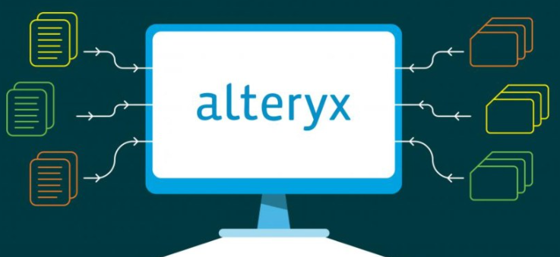
ALTERYX
There are 2 Proposed Options:
Option #1: Alteryx Server on Azure
Platform: IaaS
Details: Used for Analytics and Specializes in Data Preparation.
More Information: http://downloads.alteryx.com/Documentation/Alteryx%20Server%20on%20Azure.pdf
https://community.alteryx.com/t5/Alteryx-Server-Knowledge-Base/Alteryx-Server-on-Azure/ta-p/24395
Option #2: Alteryx APA(Analytic Process Automation) Platform
Platform: SaaS
More Information: https://azuremarketplace.microsoft.com/en-us/marketplace/apps/alteryx.alteryx-analytics-platform?tab=Overview

Slide 15
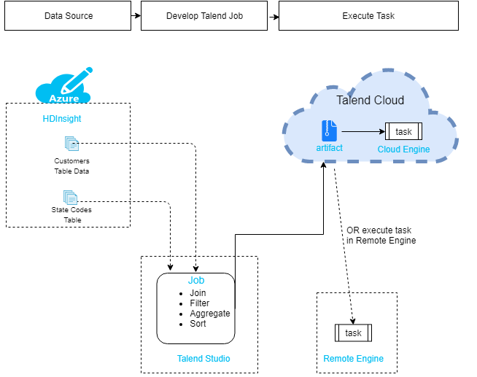
TALEND
Talend Remote Engine for Microsoft Azure
Platform: Integration Platform-As-A-Service (iPaaS)
Details: An open-source data integration platform. By pairing a Talend Remote Engine created from Talend Cloud with a Talend Remote Engine for Azure, you can execute tasks and plans easily with minimal configuration steps.
More Information:
https://www.talend.com/resources/talend-microsoft-azure-together/
https://azuremarketplace.microsoft.com/en-us/marketplace/apps/talend.talendremoteengine?tab=Overview
https://help.talend.com/r/en-US/Cloud/remote-engine-azure-user-guide/talend-remote-engine-for-microsoft-azure

Slide 16
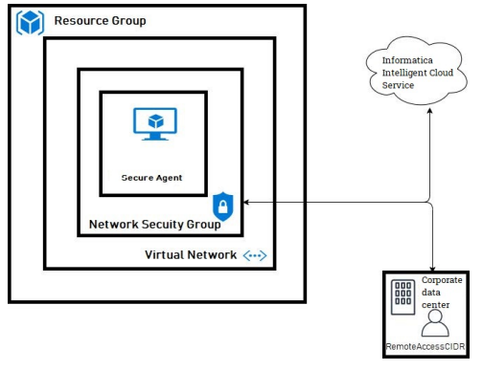
INFORMATICA
Secure Agents Connecting IICS (Informatica Intelligent Cloud Services)
Platform: Integration Platform-As-A-Service (iPaaS)
Details: A Cloud-Based Data Integration Platform. Secure Agents enables secure communication across the firewall between your organization and Informatica Intelligent Cloud Services(IICS).
More Information:
https://www.informatica.com/content/dam/informatica-com/en/collateral/solution-brief/informatica-intelligent-cloud-services-for-microsoft-azure_3999en.pdf
https://azuremarketplace.microsoft.com/en-au/marketplace/apps/informatica.annualiics?tab=Overview

Slide 17
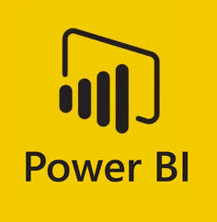
POWERBI
PowerBI
Platform: SaaS
Details: To Prepare and Deliver Reports.
More Information:
https://docs.microsoft.com/en-us/power-bi/

Slide 18
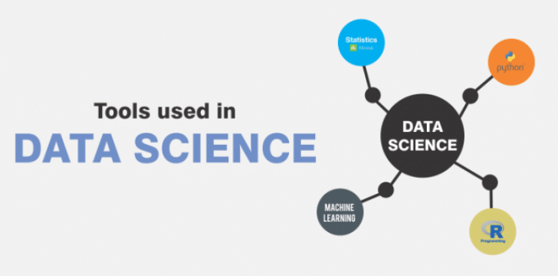
PYTHON AND R IN AZURE
There are 4 Proposed Options:
Option #1: Data Science Virtual Machine
Platform: IaaS
More Information: https://docs.microsoft.com/en-us/azure/architecture/data-guide/technology-choices/r-developers-guide#data-science-virtual-machine
Option #2: ML Services on HDInsight
Platform: PaaS
More Information: https://docs.microsoft.com/en-us/azure/architecture/data-guide/technology-choices/r-developers-guide#ml-services-on-hdinsight
Option #3: Azure Machine Learning
Platform: PaaS
More Information: https://docs.microsoft.com/en-us/azure/architecture/data-guide/technology-choices/r-developers-guide#azure-machine-learning
Option #4: Azure SQL Managed Instance
Platform: PaaS
More Information: https://docs.microsoft.com/en-us/azure/architecture/data-guide/technology-choices/r-developers-guide#azure-sql-managed-instance

Slide 19
BOM & PRE-REQUISITES
3

Slide 20
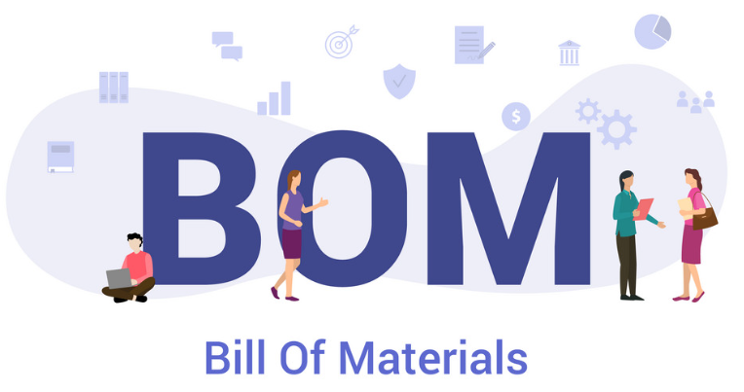
BILL OF MATERIALS
Resource Group
Azure Key Vault
Log Analytics
Storage Account
Virtual Network, Subnet, DDoS, Peering, Network Security Group(NSG), Route Table, Global DNS and Private DNS
HDInsight (Cluster Type: Hadoop): PaaS
Oracle: IaaS or Multi-Cloud
Azure SQL Managed Instance: PaaS
Azure Database for PostgreSQL: PaaS
Tableau on Azure: IaaS
Alteryx: IaaS or SaaS
Talend Remote Engine on Azure + Talend Cloud: IaaS/Multi-Cloud
Informatica Secure Agents + Informatica Intelligent Cloud Services (IICS): IaaS/Multi-Cloud
PowerBI: SaaS
OPTIONAL AZURE SERVICES UNDER BILL OF MATERIAL (BOM):-
Data Science VM: IaaS
ML Services on HDInsight: PaaS
Azure Machine Learning: PaaS

Slide 21

PRE-REQUISITES
Contoso should have Robust Network Infrastructure - Azure HUB AND SPOKE. Building Hub and Spoke is OUT OF SCOPE.
Contoso should have Resilient Bandwidth connecting Azure and In-House Datacenter. Setting up this connectivity is OUT OF SCOPE.

Slide 22
MIGRATION STRATEGY
4

Slide 23

PROPOSED APPROCH
Proof of Concept(POC): Functional Test.
Non-Production: Functional and Performance Test.
Production: Functional and Performance Test.
Cutover (On-Prem) and Golive (Cloud).

Slide 24
PROPOSED GUIDELINES
POC (Proof-of-Concept) based on the above requirement gathering.
Focus on Functional Testing rather than Performance Testing during POC Phase.
Primary task to Evaluate - HDInsight (Hadoop Cluster).
This will then be followed by Each Spoke Data Technology Equivalent Azure Service mentioned in BOM.
Approach will be One Azure Service at a time as there might be issues related to Setup and Connectivity which needs to be addressed. If Any Data Technologies are tightly coupled, we then take the Approach of Setting the Services Together in Azure by calling out an Exception.
When POC of all Recommended Azure Services is complete, we move to Next Phase - Non-Prod Environment. The Setup should be seamless as we have all our learnings in POC.
Performance Testing will be done in the Non-Prod Environment.
Based on the success criteria defined for Performance Testing in Non-Prod, an equivalent like-to-like Production environment will be deployed.
Non-Prod and Prod will have a like-to-like configuration with the sole purpose that if there is any issue in production, it can be reproduced in UAT.

Slide 25
SUMMARY
5

Slide 26
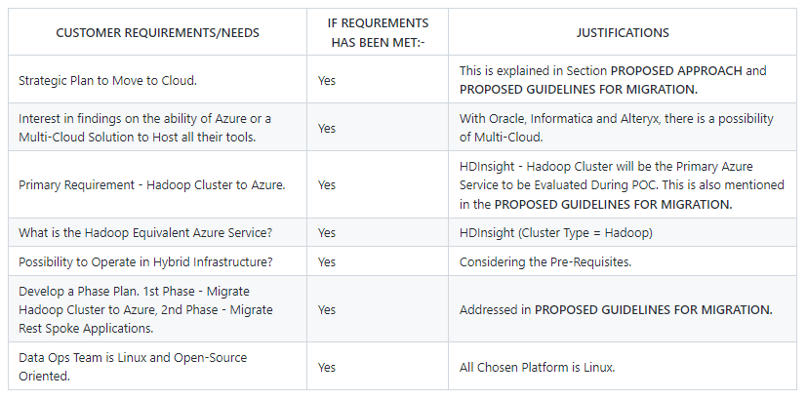

WAS REQUIREMENTS MET ?

Slide 27
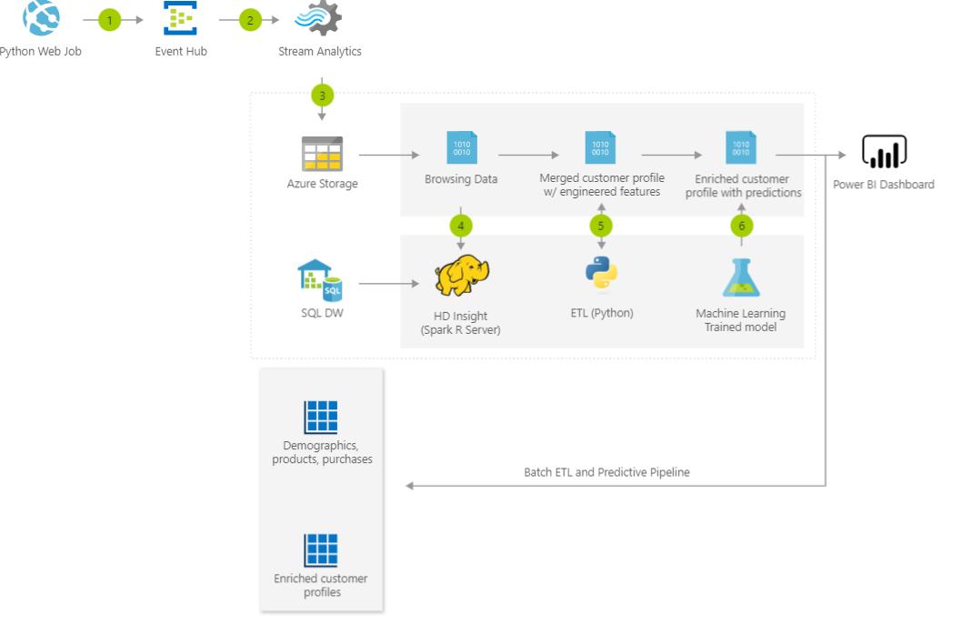
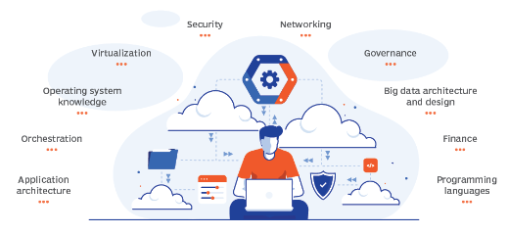
REFERENCE ARCHITECTURE
Details:-
https://docs.microsoft.com/en-us/azure/architecture/solution-ideas/articles/product-recommendations

Slide 28
QUESTIONS
6

Slide 29
Happy to answer any questions to the best of my knowledge.

Slide 30

THANK YOU!!!
You can reach me at:
tanushri0310003@gmail.com

