Slide 1
EdgeProbe
Investigating Binary Neural Network Acceleration on a Constrained FPGA
From Knowledge Distillation to Streaming Hardware Inference
27230 Tanushri Naik
26514 Mehuli Chatterjee
26020 Rayaan Ghosh
25887 Ayush Sagar
EDGE AI

Slide 2
The Problem
⚡ Edge AI requires ultra-low power and minimal latency
🧮 Standard CNNs rely on heavy multiply-accumulate (MAC) operations
💸 MAC units are expensive in area and power on FPGAs
🎯 Need highly efficient models without sacrificing usability

Slide 3
The Key Idea
Replace expensive float operations with binary equivalents
Multiply →
Add →
XNOR
Popcount
1-bit logic gate
Count 1-bits
Weights
Benefit
{–1, +1}
100× faster*
Binary values only
FPGA-friendly
*Our results show 10 times faster but its due to the pipeline being I/O bound and not compute bound.

Slide 4
End-to-End Pipeline
Dataset
Teacher
Student
Binarize
RTL
Rock Paper Scissors
32×32 Grayscale
MobileNetV2
Float32
Tiny BCNN
STE + KD
±1 Weights
BN Folding
Verilog
Quartus II
Software: Training → STE Binarization → KD Loss → Weight Export
Hardware: RTL Manifest → Verilog Modules → Quartus Synthesis → FPGA Deploy

Slide 5
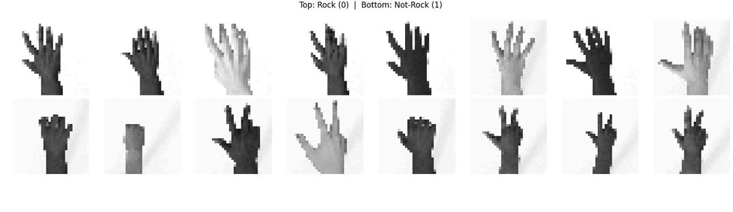
Dataset
Rock Paper Scissors — from TensorFlow Datasets
Resized to 32×32 grayscale (single channel)
Binary labels: Rock = 0, Not-Rock = 1
2,892 total samples — 70/15/15 split
Sample dataset images

Slide 6
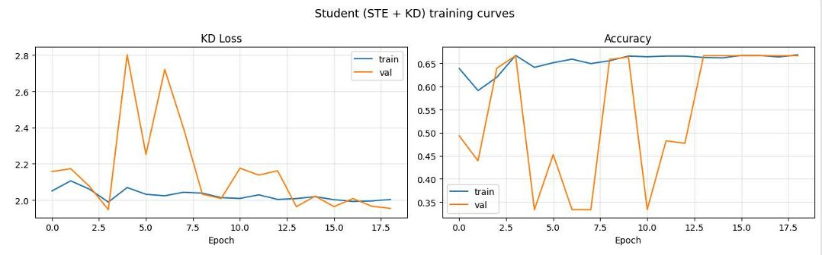
Training Strategy
Teacher: MobileNetV2 fine-tuned on RPS (~99.77%)
Student: Tiny BCNN with STE binary activations & weights
Knowledge Distillation: KD loss = KL(soft) + CE(hard)
Temperature T=3.0, Alpha=0.3 for stable binary learning
Student (STE + KD) training curves

Slide 7
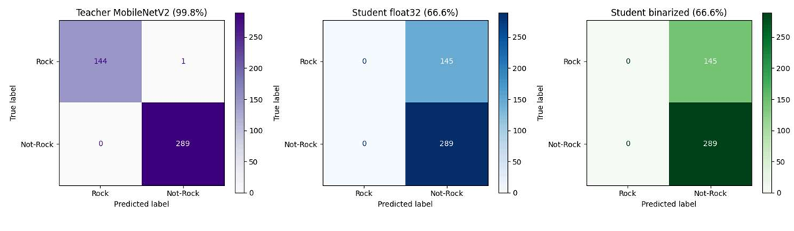
Results
99.8%
66.6%
0.00 pp
Teacher (MobileNetV2)
Student (Binary CNN)
Float→Binary Drop
Binarization preserves accuracy — zero degradation vs float student
Three-way confusion matrix comparison

Slide 8
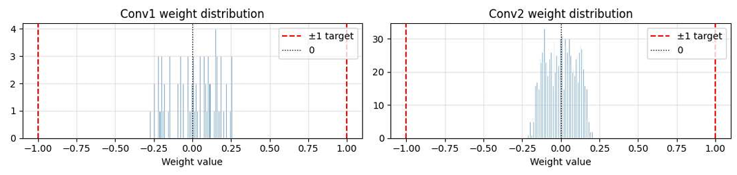
Weight Distribution
STE training pushes weights to cluster near ±1
Post-training binarization causes minimal information loss
Contrast with post-hoc binarization: random float weights
BatchNorm folded into per-filter popcount thresholds
Conv1 & Conv2 STE-trained weight distributions

Slide 9
Hardware Overview
Target FPGA
Input Path
Cyclone IV EP4CE115F29C7
Quartus II 13.0
SPI serial input
→ 32×32 pixel FIFO buffer
Compute Core
Output Stage
Two binary conv layers
XNOR + popcount
GAP → Q8.8 dense layer
→ Rock / Not-Rock class

Slide 10
Verilog Dataflow
01
SPI → FIFO Serial pixel stream buffered into 32×32 FIFO
02
Pixel Binarization Threshold at 128/255 → {0,1} binary pixels
03
3×3 Window Generator Sliding window over padded binary image
04
XNOR + Popcount Binary dot product → compare vs BN threshold
05
Pooling + Dense Layer GAP → Q8.8 fixed-point classifier → argmax

Slide 11
FPGA Inference Flowchart
SPI Input
Conv Layer 2
FIFO Buffer
Pooling
Thresholding
Classifier
Window Generator
Output
Conv Layer 1

Slide 12
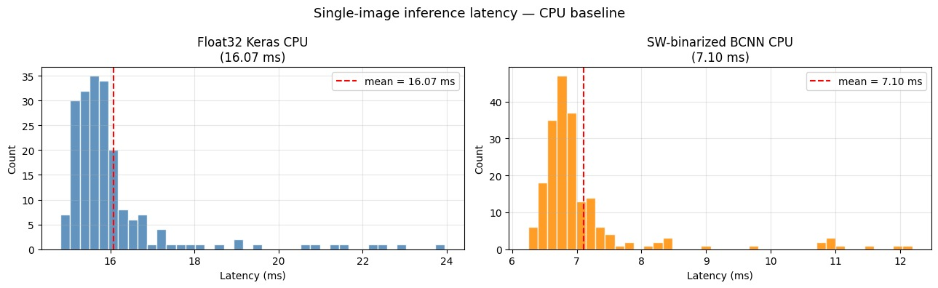
FPGA vs Software BCNN Performance — Key Insights
FPGA latency (~400 µs) is input-bound, not compute-bound
SPI transfer dominates runtime (20 MHz, serial input)
Image size = 32×32 → 1024 pixels, each 8 bits
SPI transfer time ≈ 1024 × 8 × 50 ns ≈ 400 µs
Actual FPGA compute time ≈ 20 µs (only ~1%)
Pipeline is highly parallel but starved by slow input
CPU float baseline is already highly optimized (SIMD/BLAS)
Binary speedup (2.26×) is limited by unoptimized NumPy implementation

Slide 13
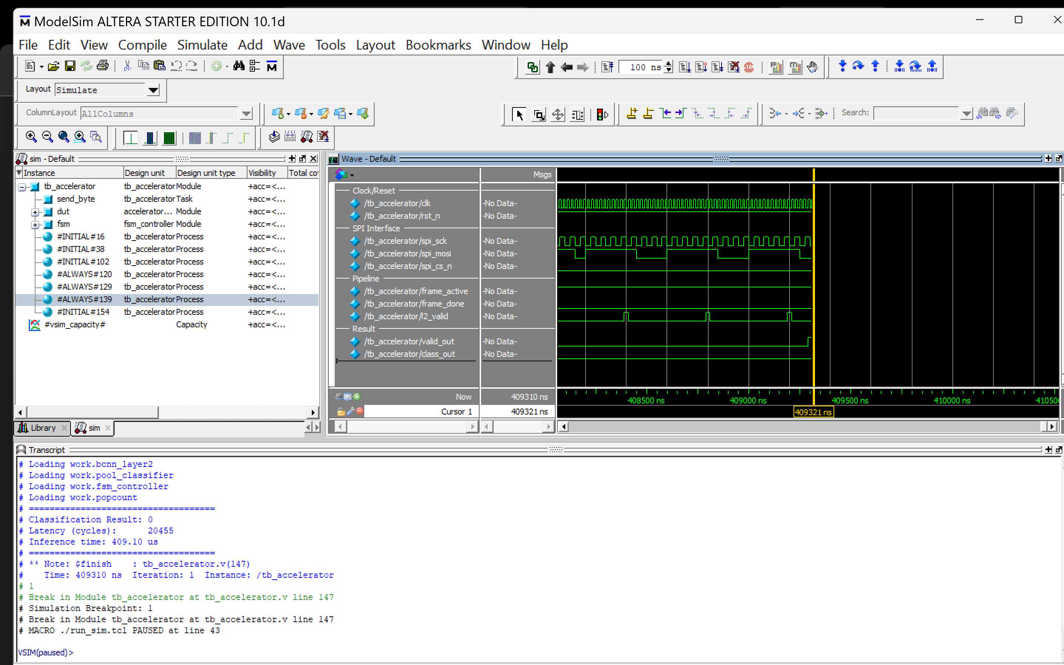

Slide 14
Conclusion
EdgeProbe demonstrates a complete ML → FPGA workflow
✦ Binary CNN enables efficient edge AI with minimal hardware cost
✦ XNOR + popcount replaces MAC — orders-of-magnitude speedup on FPGA
✦ STE training ensures weights cluster at ±1, binarization is lossless
✦ End-to-end pipeline: dataset → KD training → RTL → streaming inference

