Slide 1
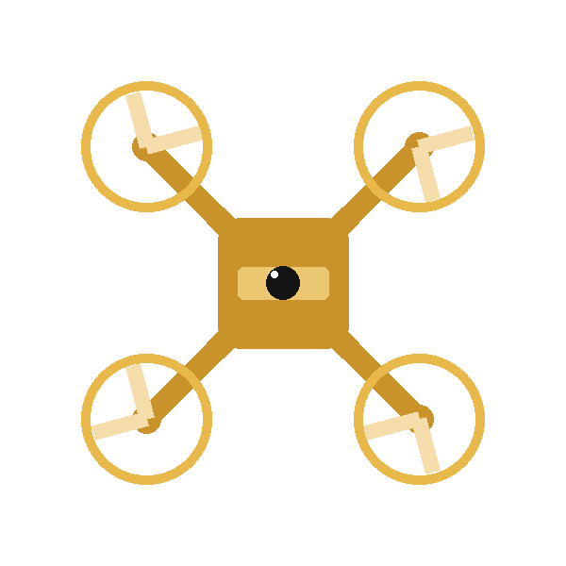
May 4, 2026
Confidence-Triggered
Lifelong Adaptation
for Drone Swarms
Under Post-Training Surprises
Tanush Vijayakumar Savadi · Deveshi Singh · Ron Kleinhause-Goldman
UMass Amherst · COMPSCI 590NN / 690NN
Thesis A clean-trained PPO drone swarm policy can detect post-deployment surprises via entropy + MC-dropout confidence, adapt between episodes with anti-forgetting safeguards, and retain clean-task performance while partially recovering from distributional shift.

Slide 2

MOTIVATION
The Deployment Gap
The Problem
Our Approach
RL drone policies are trained in idealized simulators. At deployment, real conditions diverge:
①
DETECT
Dual-signal confidence monitor — policy entropy + Monte Carlo dropout variance, calibrated on clean episodes
💨
Wind gusts & turbulence
②
ADAPT
📡
Sensor noise & dropout
Between-episode reward-weighted fine-tuning, gated by quality check (≥30 steps, mean reward ≥ −5)
⚙️
Actuator degradation
③
PROTECT
🎯
Shifting mission waypoints
KL anchoring to frozen policy + clean replay mixing (20%) + EWC regularization
Retrain = expensive · Unconstrained adapt = catastrophic forgetting
Goal: retain clean skill · partially recover from surprise · no retraining

Slide 3
TASK & ENVIRONMENT
FormationAviary — Two-Drone Formation in PyBullet
2
450
75
CF2X Drones
Shared-policy IPPO
Control Steps
(15 s simulated)
Obs. dims / drone
Kinematics + waypoint
Post-Training Surprise Suite
Reward Components
Severity | Wind (N) | Sensor σ | Actuator | Goal shift
Clean | 0.00 | 0.00 | 1.00 | none
Mild | 0.02 | 0.01 | 1.00 | none
Moderate | 0.05 | 0.02 | 0.85 | none
Severe | 0.10 | 0.05 | 0.70 | p=0.001
📍
Waypoint tracking
max(0, 2−2·dist) + 10 bonus/drone
📐
Formation keeping
penalty ∝ spacing deviation
💚
Alive bonus
+0.2 per timestep
⚠️
Boundary penalty
low-alt/tilt ramp; truncation OOB

Slide 4
METHOD
Confidence-Triggered Adaptation Loop
①
Deploy & Monitor
②
Confidence Check
Policy initialized from the clean baseline runs episodes in surprised env
Policy entropy computed per-step
MC-dropout variance estimated (10 forward passes)
Rolling confidence tracked over a 30-reading window
Episode usable if ≥ 30 steps AND mean reward ≥ −5
Adaptation fires when rolling OR episode confidence is low AND replay buffer is populated
Otherwise: skip (avoid learning from crashes)
③
Adaptation Update
④
Anti-Forgetting
Reward-weighted behavior cloning on recent buffer
Higher-rewarded transitions → larger gradient weight
5 epochs, LR = 1×10⁻⁴, applied between episodes only
KL anchoring to frozen clean policy (β = 0.5)
Clean replay mixing (20 % of every minibatch)
EWC: penalise changes to high-Fisher parameters (λ = 1000)

Slide 5
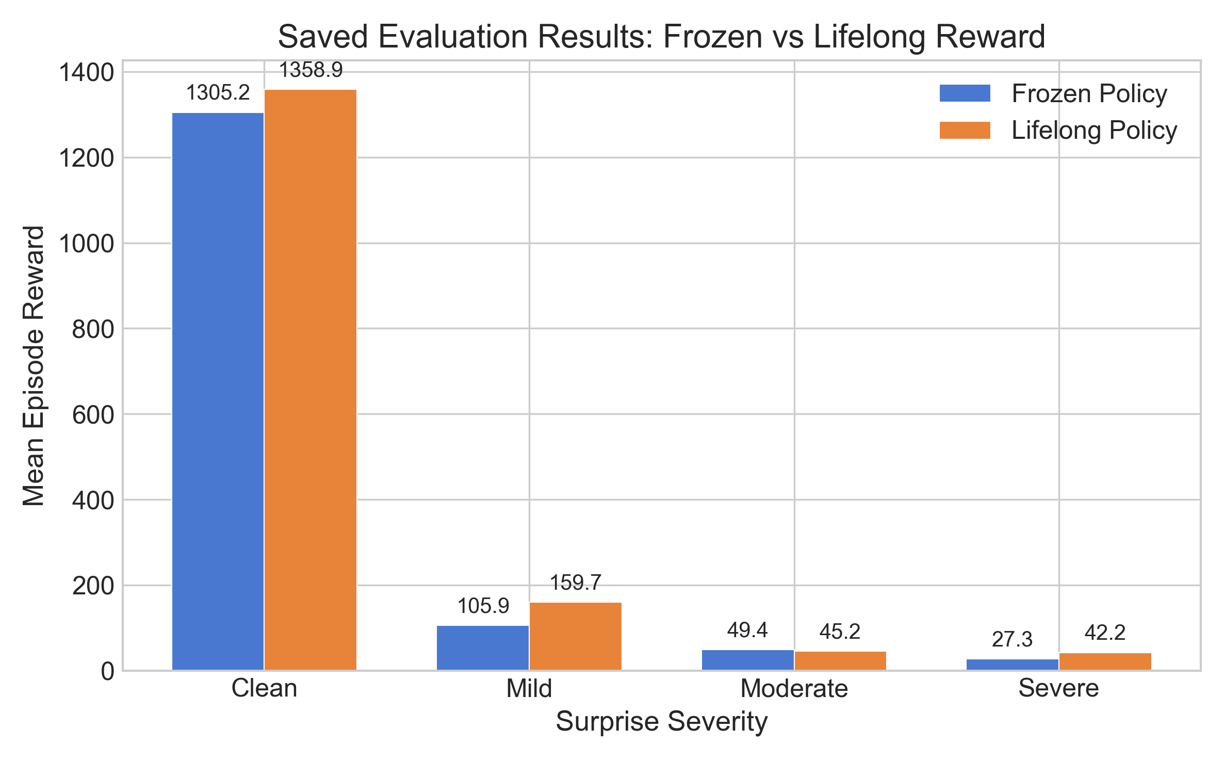
RESULTS
Lifelong vs. Frozen Baseline — Partial Robustness
Clean
Frozen
Lifelong
+4.1%
1305.2
1358.9
Mild
Frozen
Lifelong
+50.8%
105.9
159.7
Moderate
Frozen
Lifelong
−8.5%
49.4
45.2
Severe
Frozen
Lifelong
+54.7%
27.3
42.2

Slide 6
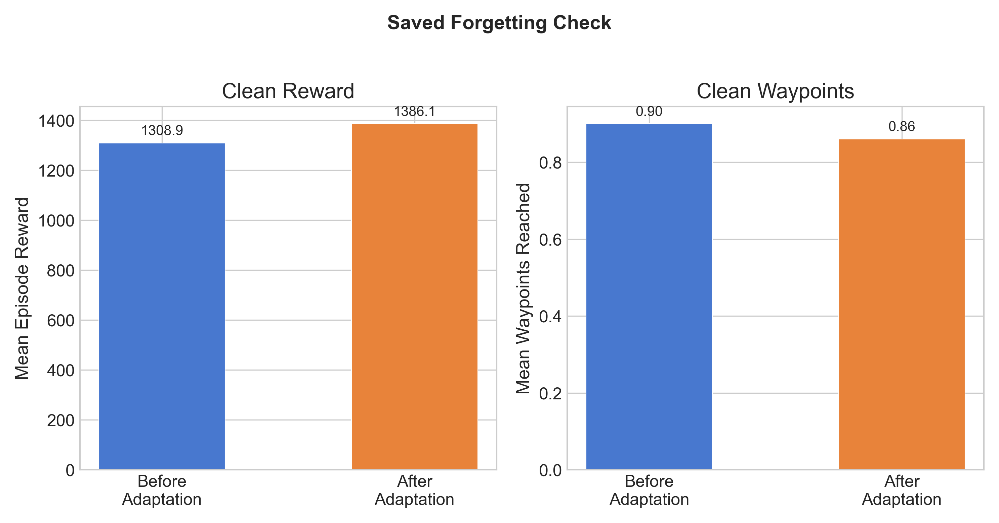
FORGETTING ANALYSIS
No Catastrophic Forgetting After Severe Adaptation
Before Adaptation
1308.9
clean reward
After Severe Adaptation
1386.1
clean reward (+5.9%)
With KL anchoring, clean replay, and EWC active, clean performance was retained even after adapting to the hardest surprise condition
forgetting_detected: false

Slide 7
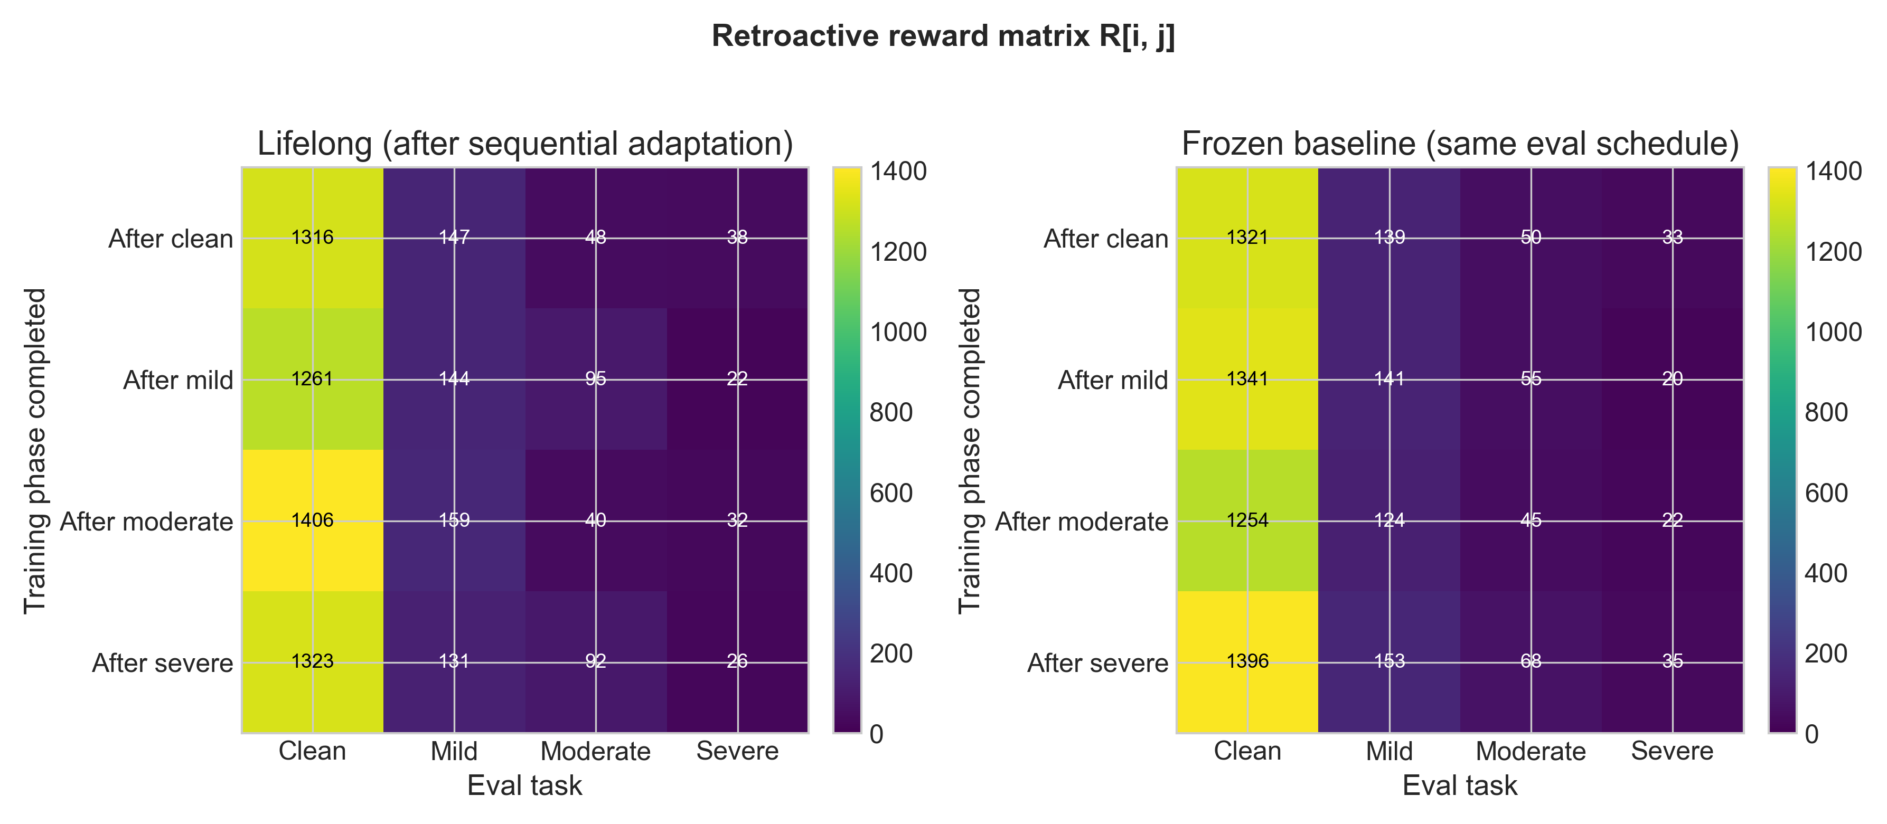
CONTINUAL LEARNING
Sequential Adaptation Matrix — Clean Re-Tested at Every Phase
CL Metrics
BWT
Backward Transfer
+15.4
FWT
Forward Transfer
+17.2
REM
Remembering
1.00
Phase → | Clean | Mild | Moderate | Severe
After Clean | 1316.0 | 146.9 | 48.1 | 38.5
After Mild | 1261.3 | 143.5 | 94.9 | 21.5
After Moderate | 1406.2 | 159.2 | 40.3 | 31.8
After Severe | 1322.9 | 131.2 | 92.0 | 26.1
FAR
Final Avg Reward
393.1
FRZ
Frozen Reference
412.9
Clean column stable across all phases — the core forgetting test.

Slide 8
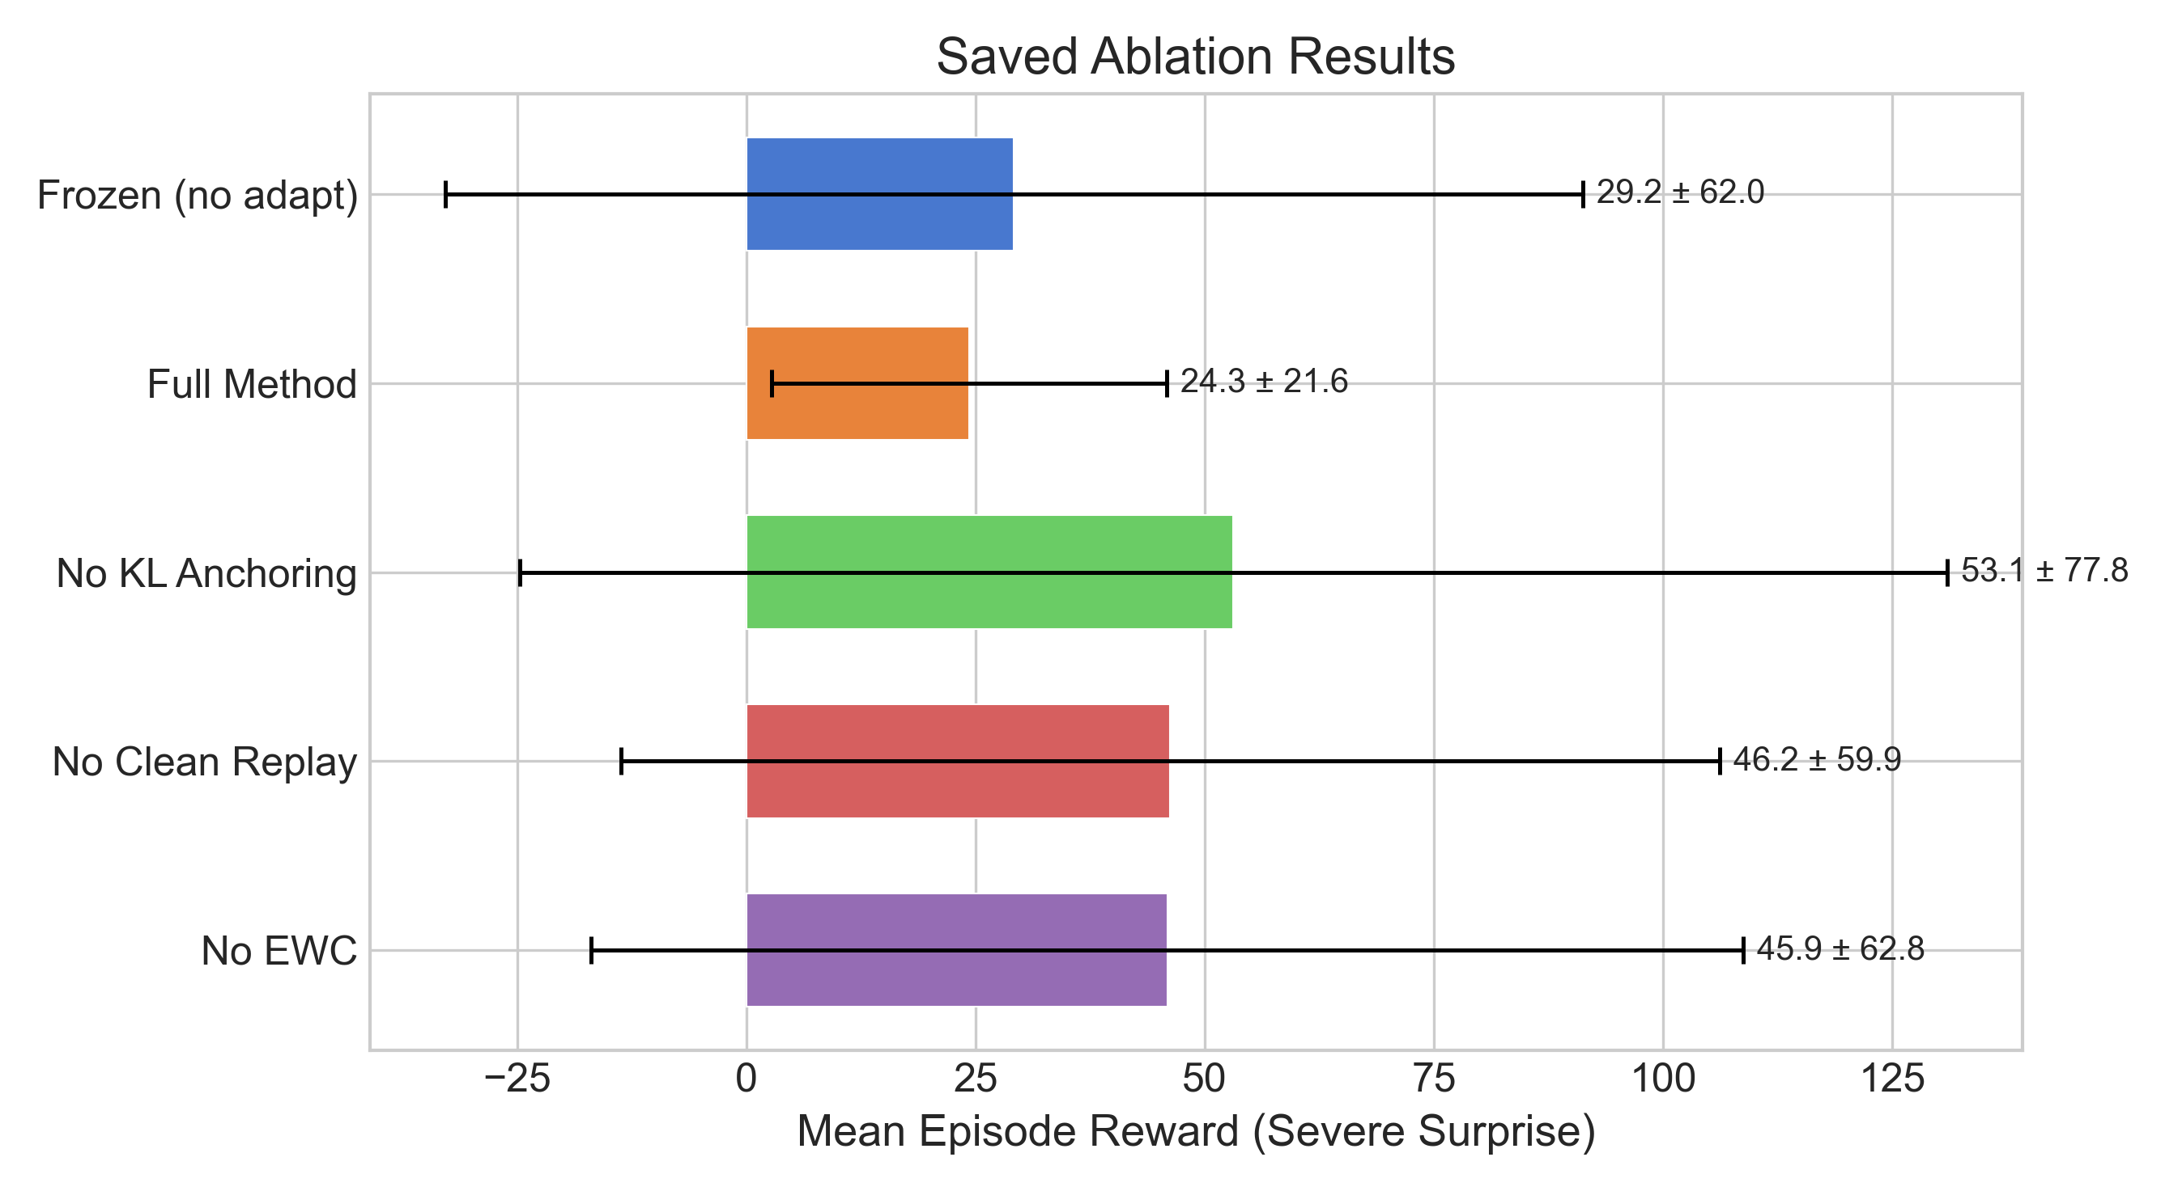
ABLATION STUDY
Safeguards: Stability vs. Peak Reward
Full Method
Lowest variance under severe surprise. Clean guardrails remain active.
No EWC
Higher mean, higher variance. Weakens the intended forgetting guardrail (not directly measured).
No KL Anchor
Can spike mean reward, but weakens the intended forgetting guardrail.
No Replay
Mid-range variance. Less stable than full method.
Takeaway Safeguards reduce variance at the cost of peak reward. The true bottleneck is adaptation trigger sensitivity and episode-quality gating, not the choice of safeguard.

Slide 9
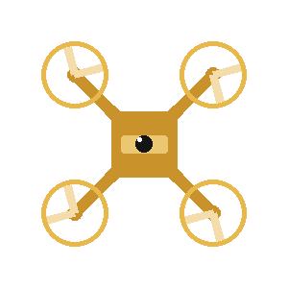
TEAM
Author Contributions
Tanush Vijayakumar Savadi
Deveshi Singh
Ron Kleinhause-Goldman
tsavadi@umass.edu
deveshisingh@umass.edu
rkleinhauseg@umass.edu
Role: Implementation, experiments, and analysis
Role: Proposal and report support
Role: Report and presentation support
Built the codebase, including the environment setup, surprise wrapper, PPO/IPPO training, and evaluation scripts.
Implemented the confidence monitor, between-episode adaptation loop, and anti-forgetting safeguards.
Ran the main experiments, ablations, continual-learning evaluation, generated figures, and prepared the final slide deck.
Made the check-in video and presentation
Helped with project framing during the proposal stage.
Contributed to proposal/final-report writing and review.
Gave feedback on presentation organization and final project narrative.
Helped with proposal/final-report writing and review.
Contributed feedback on how to explain the method and results clearly.
Helped refine the final presentation narrative.

Slide 10
CONCLUSION
What We Built & Learned
✅ Achieved
⚠️ Limitations
Full pipeline: train → surprise-test → adapt → audit
Clean-skill retention in the forgetting probe and continual matrix
Partial robustness: +50.8% mild, +54.7% severe
Sequential CL matrix (BWT +15.4, FWT +17.2, Remembering 1.0)
Novelty: post-training surprise benchmark + dual-signal confidence trigger
Single seed (seed = 42) — no statistical confidence
Only 2 drones — scalability unknown
Moderate severity regresses −8.5%
Conservative trigger: ~2% adaptation rate in main run
Simplified PyBullet physics, not real hardware
Future Work
Multi-seed validation · Larger swarms (4+ drones) · Stronger adaptation objectives · Peer-help mechanisms between drones · Sim-to-real transfer

