Slide 1
FINAL PRESENTATION | MAY 4, 2026
Confidence-triggered lifelong adaptation for drone swarms
A 10-12 minute graduate-level talk on clean-trained PPO, post-training surprise, confidence-triggered adaptation, and forgetting audits.
We train clean first, then test whether confidence-triggered adaptation can recover under surprise without forgetting clean flight.
The claim is retention plus partial robustness, not a universal win over frozen PPO.
12 slides
Clean only
8 figures
Seed 42
10-12 minute deck
baseline training
report/deck artifacts
canonical results
target talk time: 11 minutes
no surprise during training
generated from canonical JSONs
multi-seed validation is future work
CS 590NN/690NN final project | Confidence-triggered swarm adaptation

Slide 2
PROJECT ARC
The work built a full clean-train, surprise-test, adapt-and-audit loop.
This slide is the whole process in one view: training code, surprise wrapper, confidence monitor, lifelong updates, and evaluation artifacts.
1
Train clean IPPO
2
Deploy to surprises
3
Trigger on confidence
4
Audit forgetting
FormationAviary only; no wind/noise/failure
Wind, sensor noise, actuator weakness, goal shift
Policy entropy plus MC-dropout variance
Clean replay, EWC, KL, ablations, continual matrix
Environment values
Training values
2 CF2X drones, PyBullet `PYB`, velocity control, kinematic observations plus waypoint offset.
1e6
1e-4
2x256
240 Hz physics, 30 Hz control, 15 second episodes, 0.5 m target formation spacing.
timesteps
PPO LR
MLP
seed 42
gamma 0.99
tanh
Default waypoints: [0.15, 0.15, 0.5], [0.4, 0.4, 0.5], [0.6, 0.0, 0.7].
CS 590NN/690NN final project | Confidence-triggered swarm adaptation
Source: confidence_triggered_swarm/configs/default.yaml

Slide 3
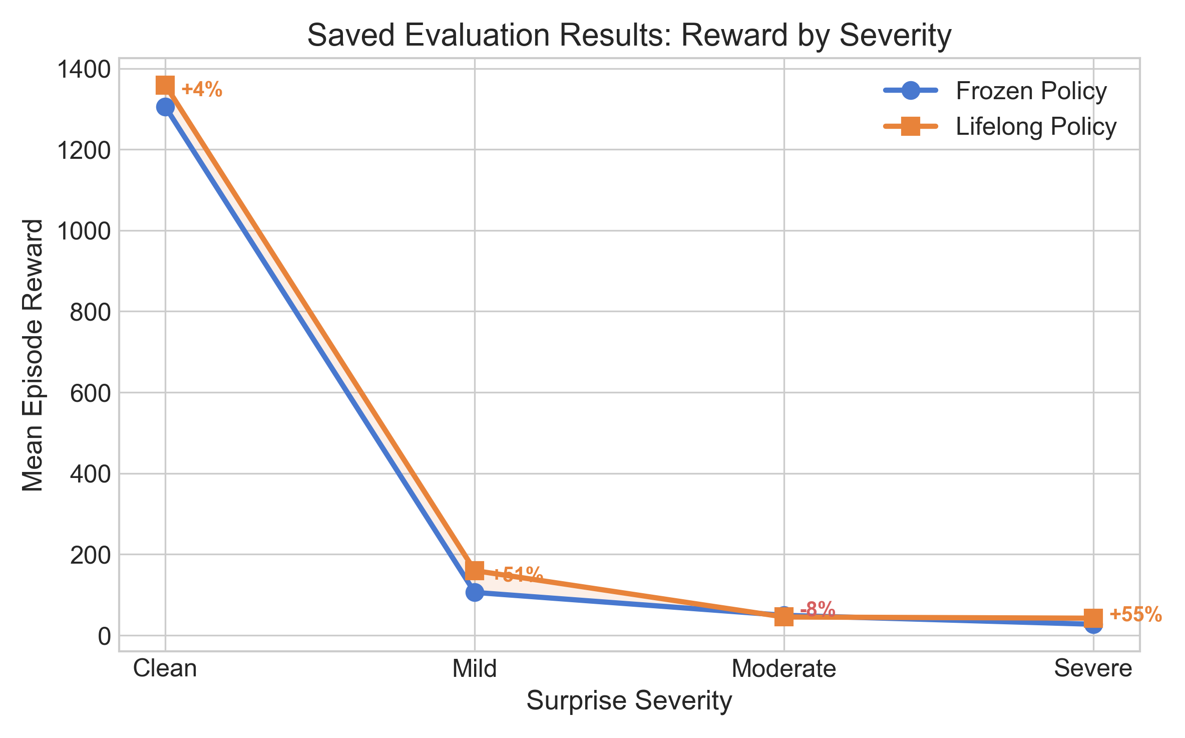
BRITTLENESS
The clean policy collapses under even mild post-training surprise.
Frozen evaluation isolates the deployment-shift problem before any adaptation.
Why this matters
Clean reward is 1305.2, but mild surprise drops frozen reward to 105.9.
Moderate/severe stay low; clean training does not transfer.
This motivates a post-training adaptation layer.
CS 590NN/690NN final project | Confidence-triggered swarm adaptation
Source: runs/full_eval/evaluation_results.json

Slide 4
ADAPTATION LOOP
The adaptation layer is conservative by design.
It adapts only between episodes and uses three safeguards against catastrophic forgetting.
Confidence trigger
Entropy and MC-dropout variance are calibrated on clean episodes.
Episode quality gate
Short or very low-reward episodes are rejected before replay.
Reward-weighted update
Usable transitions are weighted toward better-rewarded behavior.
Anti-forgetting
KL anchor, clean replay, and EWC constrain drift from clean skill.
Default adaptation values
threshold 0.5, window 30, 5 adaptation epochs, LR 1e-4, EWC lambda 1000, clean replay ratio 0.2, KL anchor 0.5.
CS 590NN/690NN final project | Confidence-triggered swarm adaptation
Source: default.yaml, confidence.py, lifelong_trainer.py

Slide 5
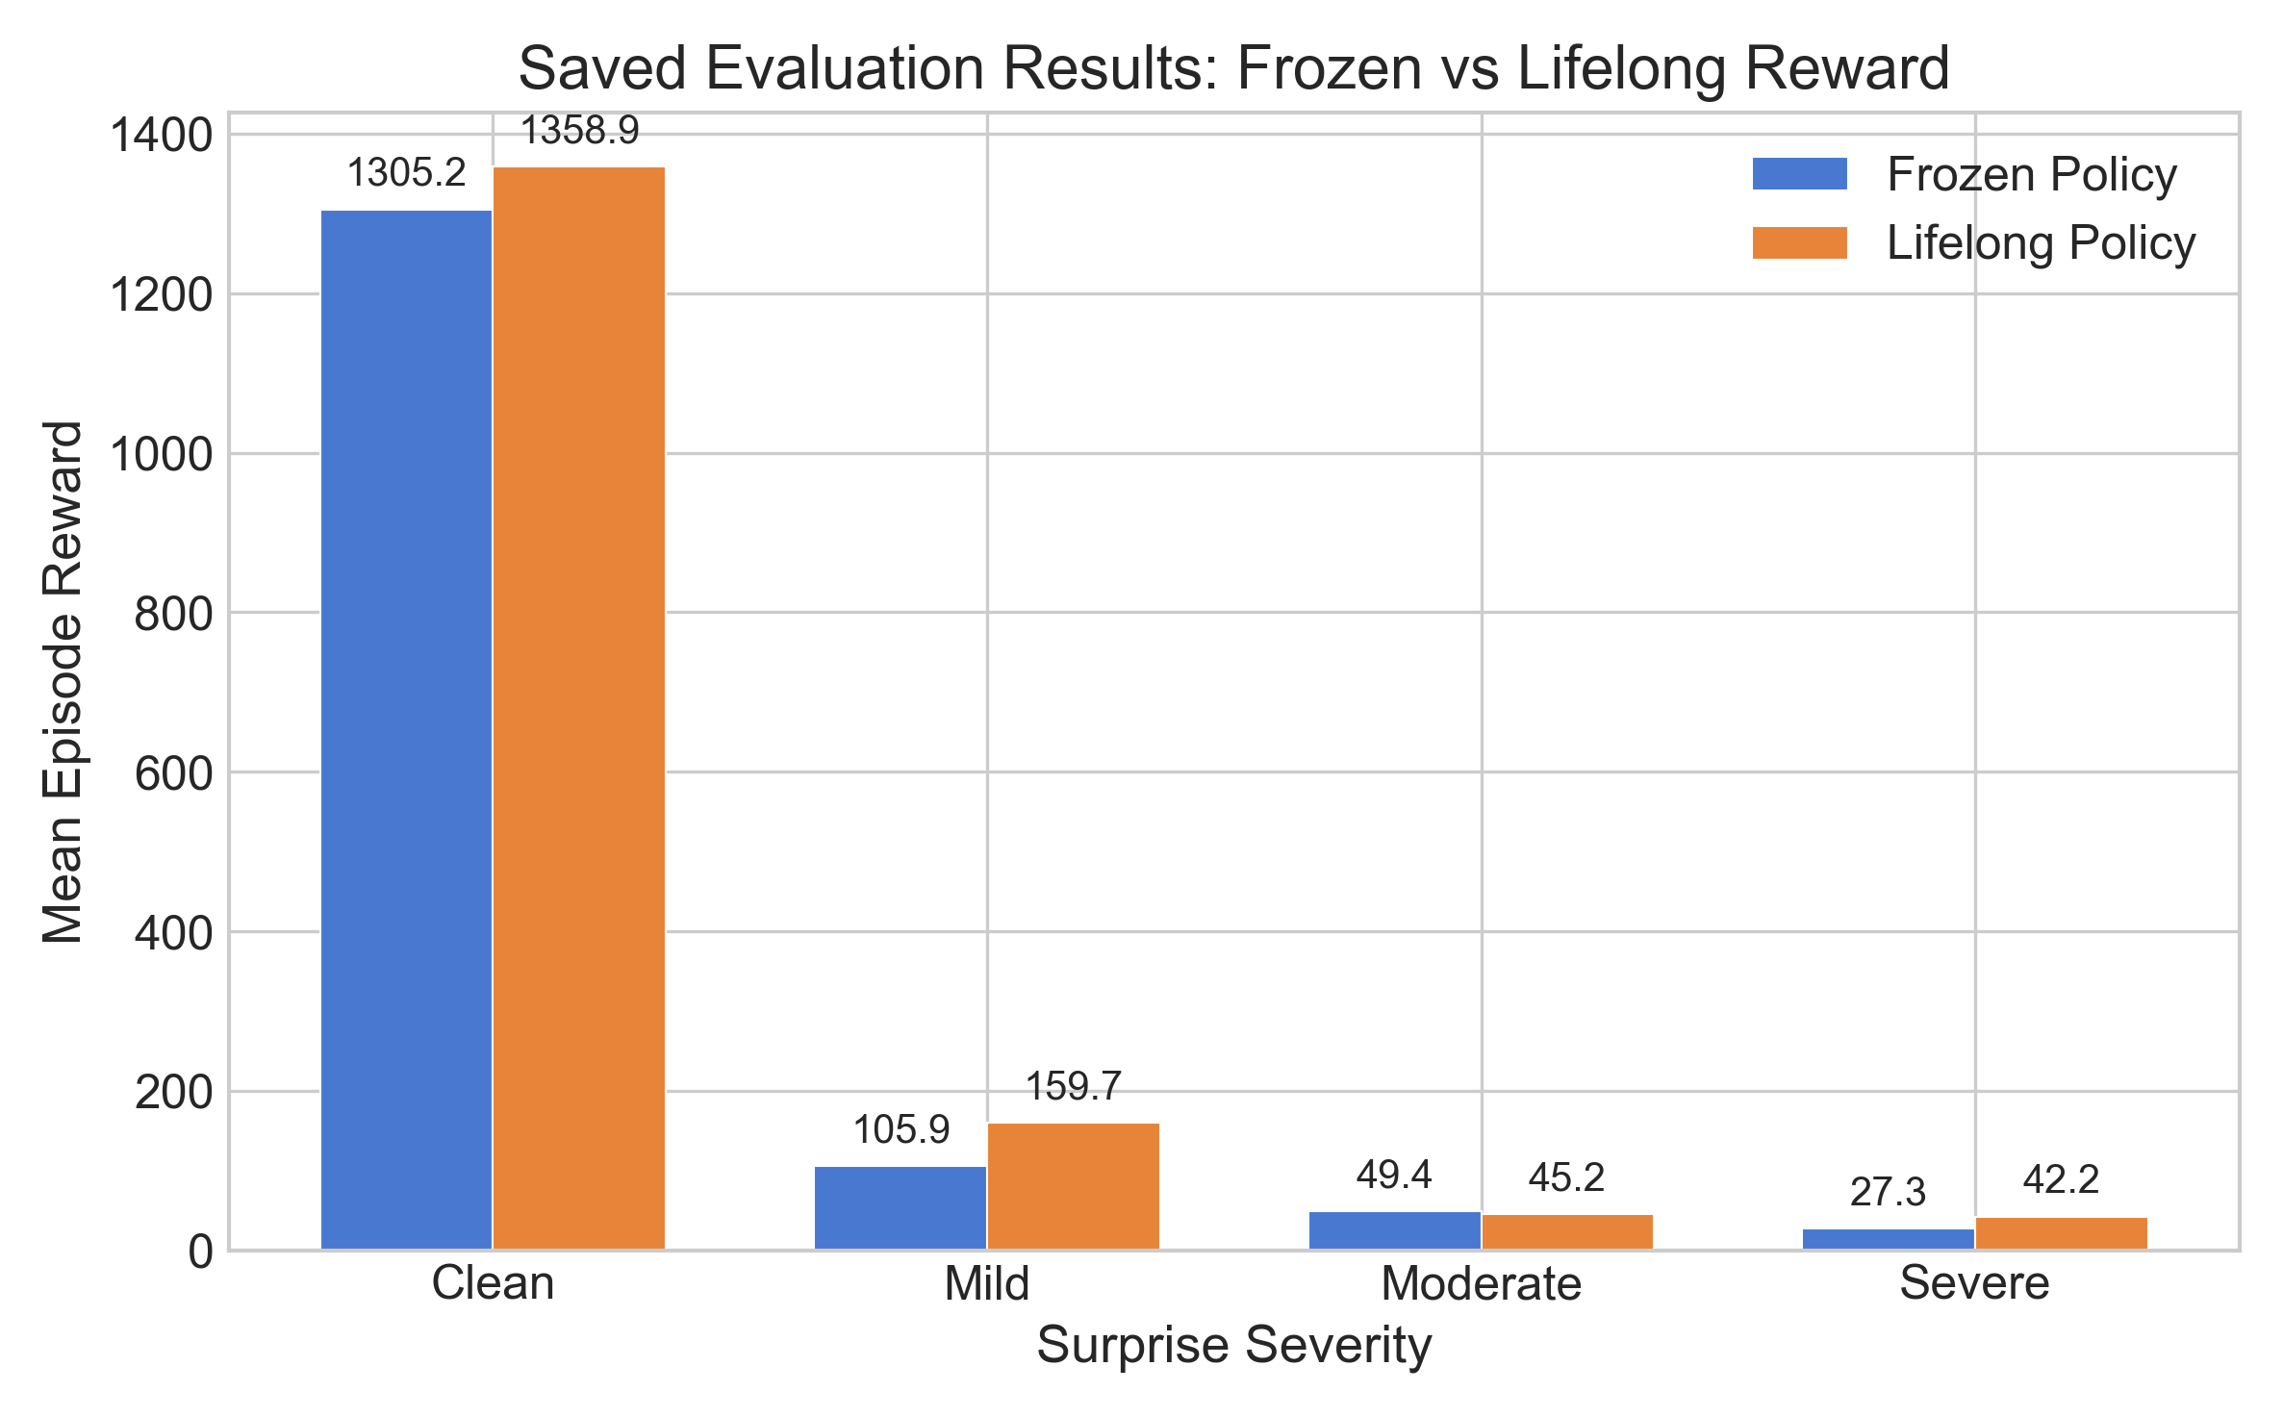
MAIN RESULT
Lifelong adaptation helps in mild and severe, but moderate remains mixed.
The honest story is partial robustness with clean retention, not a monotonic win.
+4.1%
+50.8%
clean
mild
1358.9 vs 1305.2
159.7 vs 105.9
-8.5%
+54.7%
moderate
severe
45.2 vs 49.4
42.2 vs 27.3
Presentation phrasing: adaptation recovers some reward under surprise while preserving clean behavior in this seed.
CS 590NN/690NN final project | Confidence-triggered swarm adaptation
Source: runs/full_eval/evaluation_results.json

Slide 6
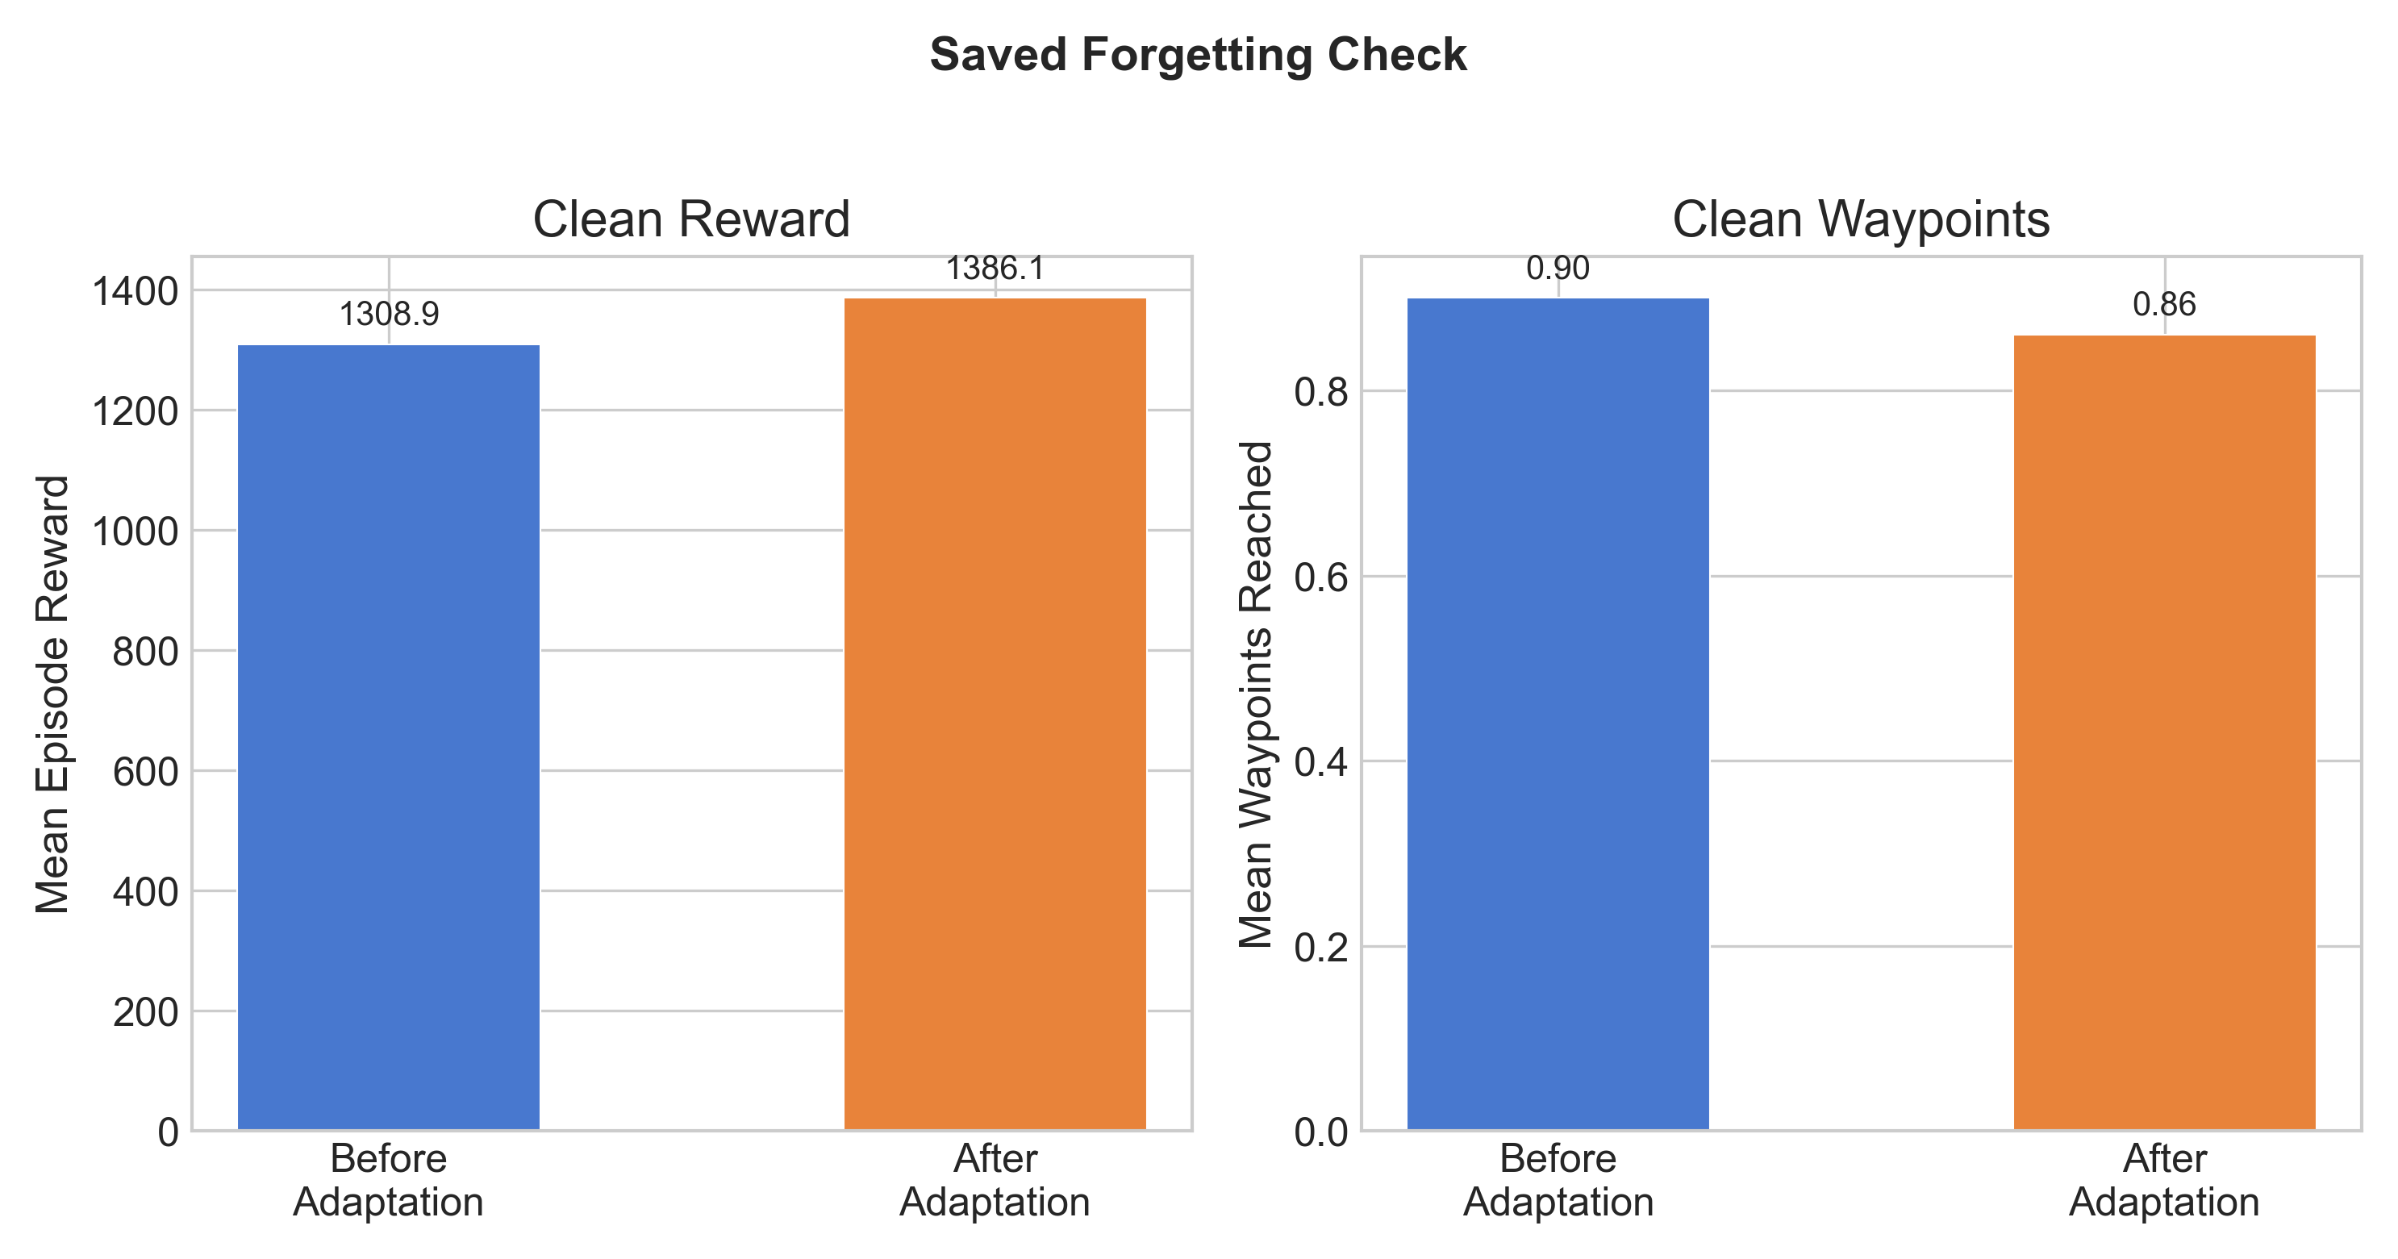
FORGETTING CHECK
After severe adaptation, clean performance is retained in the saved run.
This is the simplest clean-before versus clean-after probe.
1308.9
1386.1
baseline clean
post-adapt clean
before severe adaptation
after severe adaptation
Evaluator output: forgetting_detected = false
Waypoints decrease slightly, so frame this as retention, not perfect improvement.
CS 590NN/690NN final project | Confidence-triggered swarm adaptation
Source: runs/full_eval/evaluation_results.json

Slide 7
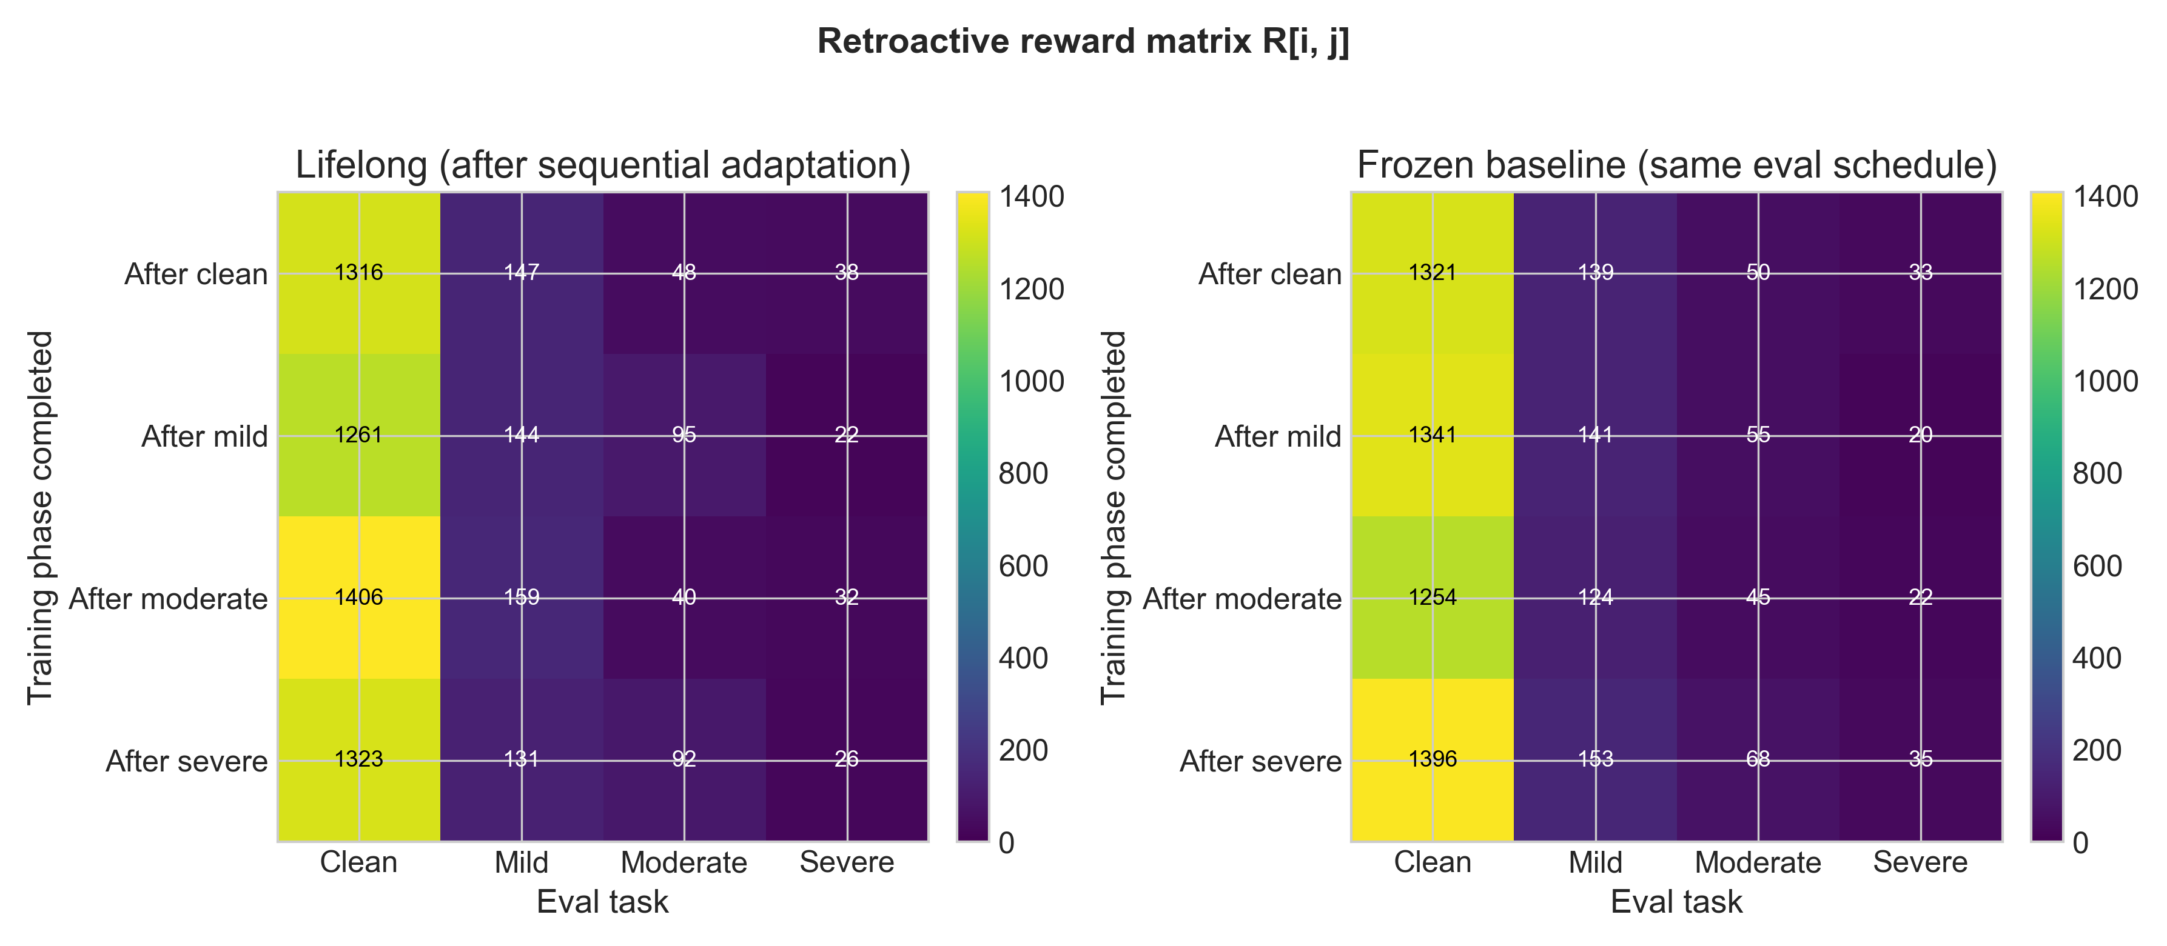
CONTINUAL EVIDENCE
The matrix directly re-tests clean after later adaptation phases.
Rows are completed training phases; columns are evaluation tasks.
Clean retention column
After clean: 1316.0
After mild: 1261.3
After moderate: 1406.2
After severe: 1322.9
Use this slide to answer: did we go back and test clean?
CS 590NN/690NN final project | Confidence-triggered swarm adaptation
Source: runs/continual_run/continual_results.json

Slide 8
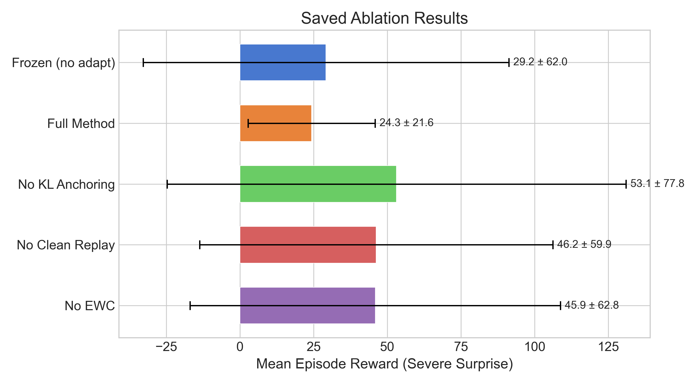
ABLATION EVIDENCE
The safeguards change the severe-surprise tradeoff, but the trigger is still conservative.
This is the graduate-level caveat: the method has mechanisms for stability, but adaptation frequency and data quality still bottleneck the result.
0
1
full-method adapts
ablated adapts
15 severe episodes
looser behavior appears
Ablations can raise severe reward but relax clean guardrails.
Improve triggers and objectives before deleting safeguards.
CS 590NN/690NN final project | Confidence-triggered swarm adaptation
Source: runs/ablations/ablation_results.json

Slide 9
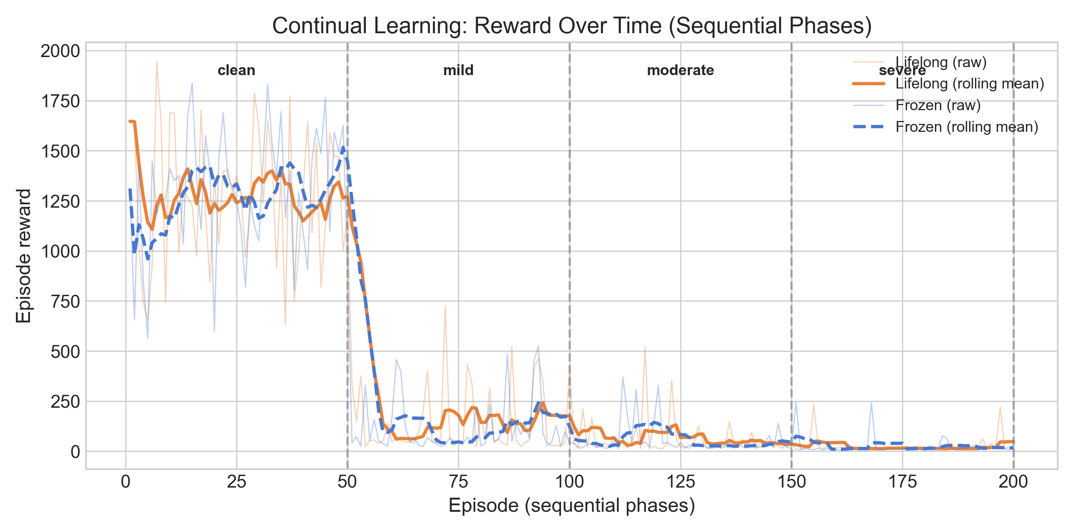
TRAINING OVER TIME
The sequential run exposes where adaptation helps and where it remains noisy.
The same lifelong policy moves through clean, mild, moderate, and severe phases, then is re-evaluated after each phase.
clean
severe
phase 1
phase 4
high-reward behavior
still low and noisy
The work includes per-episode traces plus after-phase matrix evaluation.
Severe remains difficult even when adaptation recovers some reward.
CS 590NN/690NN final project | Confidence-triggered swarm adaptation
Source: runs/continual_run/continual_results.json

Slide 10
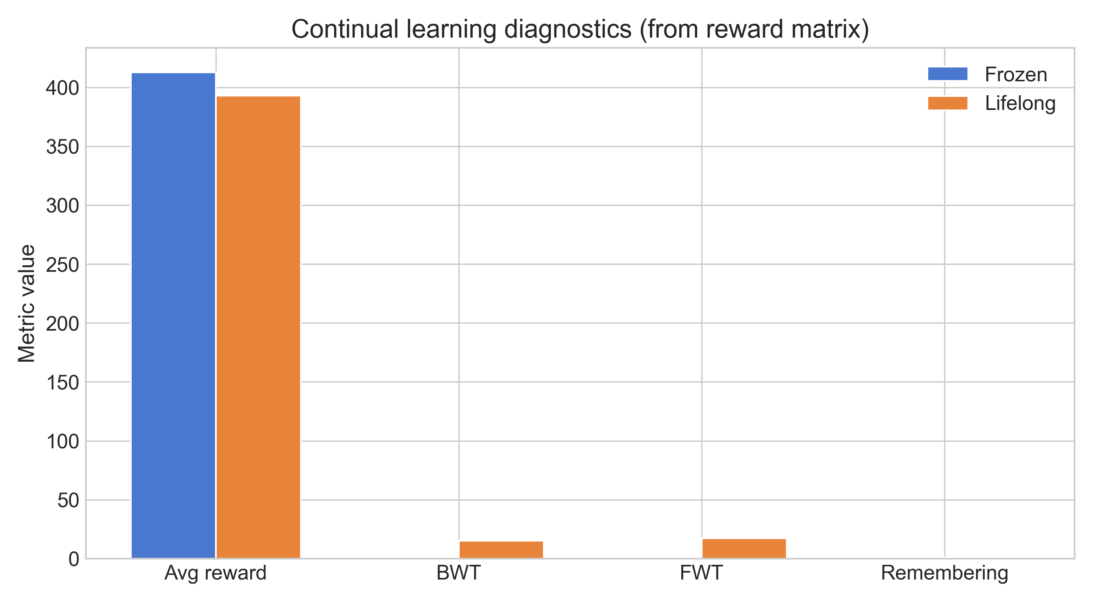
CONTINUAL-LEARNING METRICS
The result is retention and transfer, not a final-average reward win.
This is the cleanest way to connect the project to lifelong learning and catastrophic-forgetting evaluation.
393.1
+15.4
lifelong final avg
BWT
below frozen 412.9
positive in seed 42
+17.2
1.0
FWT
remembering
positive in seed 42
no clean forgetting
Backward/forward transfer are positive in this seed.
Final average is lower, so the honest claim stays limited.
CS 590NN/690NN final project | Confidence-triggered swarm adaptation
Source: runs/continual_run/continual_results.json

Slide 11
WORK COMPLETED
The final repo contains the implementation, experiments, audit trail, and submission artifacts.
Use this slide to quickly cover what was done across the whole process before the closing claim.
Policy and environment
Adaptation system
Shared PPO/IPPO, FormationAviary task, surprise wrapper, clean baseline checkpoint.
Entropy/dropout confidence, replay buffers, reward-weighted updates, KL, clean replay, EWC.
Evaluation suite
Submission package
Frozen vs lifelong evaluation, severe ablations, forgetting checks, continual matrix.
NeurIPS-style report draft, generated figures, editable PPTX, speaker notes, readiness checker.
4 JSONs
8 figs
12 slides
1 check
canonical result sources
PNG + PDF outputs
editable PPTX
readiness script
baseline/full/ablation/continual
professor-ready
10-12 minute deck
flags manual items
CS 590NN/690NN final project | Confidence-triggered swarm adaptation
Source: README.md, docs/artifact_guide.md, final_submission/

Slide 12
CLOSING CLAIM
The system demonstrates clean retention and partial robustness.
The remaining gap is stronger validation and a better adaptation objective.
+50.8%
+54.7%
A clean-trained policy can be monitored for low confidence, adapted after deployment shift, and audited for forgetting.
mild reward
severe reward
lifelong vs frozen
lifelong vs frozen
false
seed 42
forgetting flag
scope
severe then clean
single canonical seed
Novelty: integrated post-training surprise benchmark, confidence-triggered lifelong adaptation, and explicit clean-after-surprise forgetting audits.
Future work: multi-seed validation, larger swarms, stronger confidence triggers, better adaptation objectives, and peer-help mechanisms.
CS 590NN/690NN final project | Confidence-triggered swarm adaptation
Source: canonical saved results and final report draft

