Slide 1

Resume Analyzer & Job Role Matcher (Final Year Project-2025)
Presented by-
Adrija Ghosh
Tanusree Dutta
Nisha Das
Under the guidance of
Mr. Dipankar Basu
Assistant Professor
(Department of Computer Science
& engineering)

Slide 2
Introduction
Students often struggle to identify the right job category that matches their resume and skills.
Manually reviewing resume-job fit is time-consuming and lacks direction for freshers.
This project introduces an intelligent system to analyze resumes and suggest the best-fit job category.
It also recommends real companies in Kolkata hiring in that category, bridging the gap between education and employment.

Slide 3
Problem Statement
Fresh graduates lack tools to evaluate if their resumes are aligned with their desired job roles.
Manual career counseling is not scalable for all students, especially in large institutions.
Many students apply for mismatched jobs due to lack of role awareness.
There is a need for an automated, intelligent resume analyzer that can guide students toward the most suitable job roles and companies.

Slide 4
Objective
To build a machine learning model that can analyze resume content and classify it into predefined job categories like Data Science, HR, Developer, etc.
To develop a web-based platform where users can upload their resumes and get intelligent feedback.
To help students identify the best-fit job role and also recommend real companies within Kolkata that hire for those roles

Slide 5
Dataset Description
Dataset 1:
“UpdatedResumeDataSet.csv”
Contains labeled resumes across multiple job categories.
Dataset 2: “final_kolkata_job_roles_resume_dataset.csv”
Supplementary labeled resume data from Kolkata region.

Slide 6
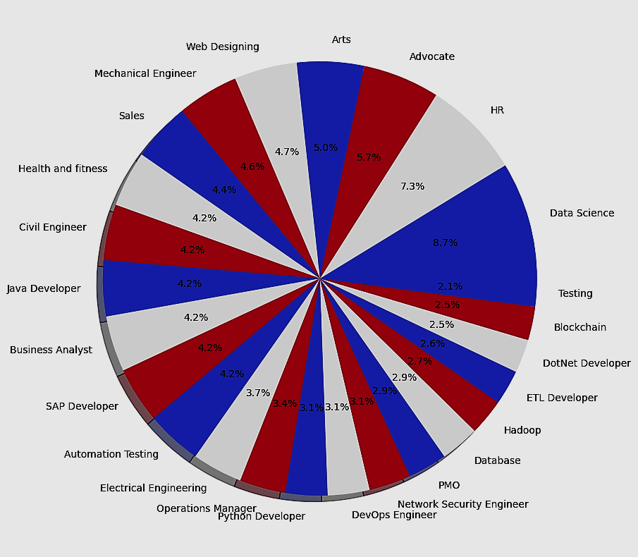

Slide 7
Technologies Used
Python:
Streamlit:
Core language used for data preprocessing, ML modelling , and back-end logic.
An open-source Python library used for Web application development and frontend framework
Matplotlib & WordCloud :
Pandas and NumPy :
For cleaning and transforming raw resume data into structured format.
Scikit -learn:
Provides models like Logistic Regression, Naive Bayes, SVC, and tools for vectorization and evaluation.
Used to visualize model results (e.g., accuracy graphs, skill clouds) for better insights.

Slide 8
System Architecture
• End-to-end flow of the application:
1. Resume Upload (PDF or Text format)
2. Text Extraction using Python (e.g., PyPDF2, textract)
3. Preprocessing and Cleaning
4. Feature Extraction (TF-IDF Vectorizer)
5. ML Model Prediction (using Logistic Regression).
6. Result Displayed on Web Interface.

Slide 9
Resume
Input Module
Preprocessing
Module
Vectorization Module
Job category
Classifier Module
Company & Job Role
Mapping Module
Web-Interface Module
User-friendly format

Slide 10
Data Exploration
Resumes are distributed across 25 categories such as Data Science, HR, Java Developer, DevOps, etc. Some roles like Java Developer and Testing have higher frequencies. Visualizations such as bar charts and pie charts help us understand category distribution.

Slide 11
Data Preprocessing
Text cleaning steps:
• Removal of URLs, hashtags, special characters, and extra whitespace.
• Lowercasing and conversion to ASCII text.
• Label Encoding of categories using sklearn's LabelEncoder.
These steps helped normalize data for consistent model input.

Slide 12
Model Building
Built and evaluated both Support Vector Classifier (SVC) and Logistic Regression models for resume classification using TF-IDF features.
SVC provided higher accuracy (~98.5%) and better performance on multi-class classification compared to Logistic Regression.

Slide 13
Feature Extraction Technique (TF-IDF)
TF-IDF (Term Frequency-Inverse Document Frequency):
Captures the importance of a word in a document compared to the entire corpus.
Higher TF-IDF score means a word is important to a specific document.
Why TF-IDF?
Helps focus the model on unique keywords in resumes.
Reduces influence of common terms that appear in all resumes.
Converts raw text into a numeric matrix for ML input.

Slide 14
Train-Test Split
Dataset split:
• 80% training set (769 samples)
• 20% testing set (193 samples)
This ensures the model learns general patterns and is validated on unseen data.
Train and test matrices were of shape (769, 7351) and (193, 7351) respectively.

Slide 15
Model Evaluation Metrics
Accuracy: Measures how often the model correctly predicts the job role. It achieved 99.4%.
Precision: Indicates how many resumes predicted as a role (e.g., 'Data Scientist') were actually correct.
Recall (Sensitivity): Shows how many actual resumes of a role were correctly identified.
F1 Score: Balanced metric useful when there is class imbalance (some roles may have fewer examples).
• Precision, Recall, F1-score: All above 99%
Evaluation was done using scikit-learn’s metrics.
These results indicate a very effective resume classification model.

Slide 16
Confusion Matrix Visualization
The confusion matrix heatmap confirms that the model predicts most categories correctly with minimal confusion. Only a few misclassifications occurred among similar roles. This supports the model’s high reliability. Visualizes where the model makes errors, helping improve classification strategy.

Slide 17
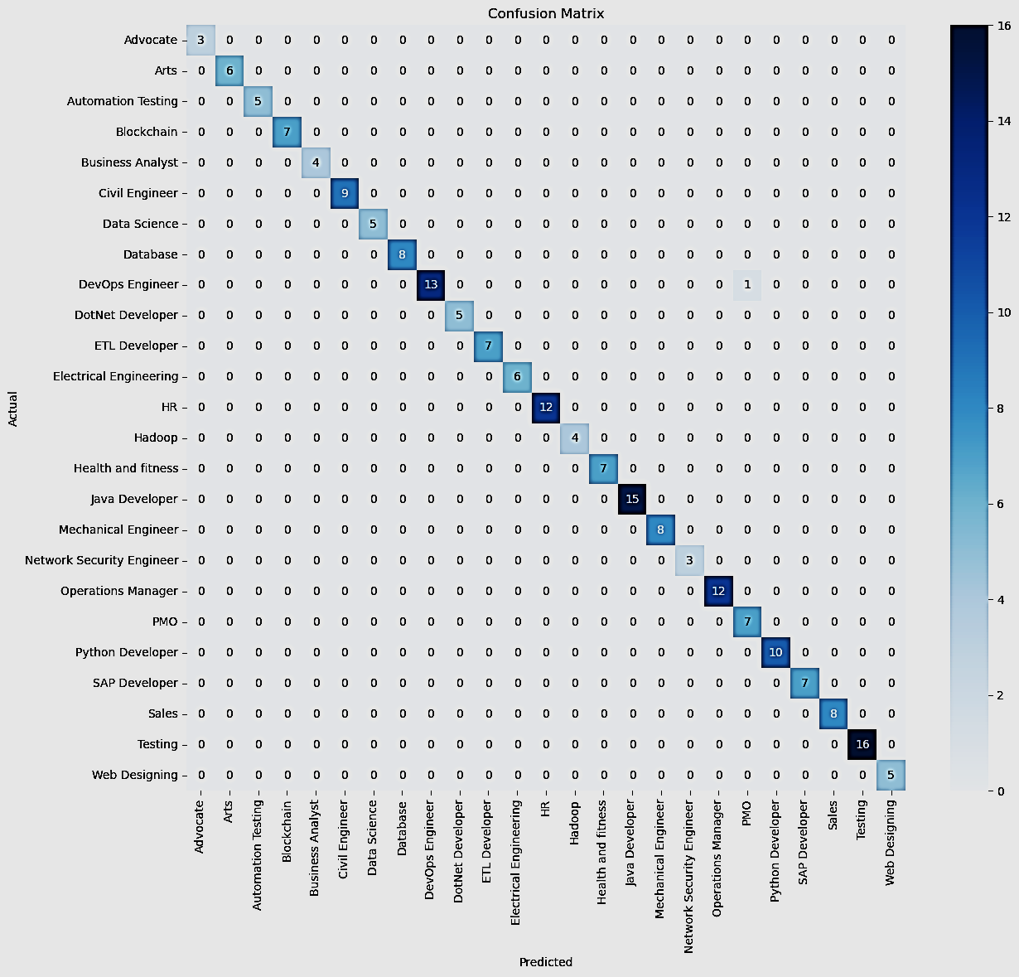

Slide 18
Prediction and Mapping
Predicted category is matched to a company and role using a custom dictionary:
Examples:
• Data Science → TCS → Junior Data Scientist
• HR → Infosys → HR Executive
• Java Developer → Cognizant → Backend Developer
This mapping helps job seekers understand real-world opportunities.

Slide 19
Application Interface
Developed a user-friendly web app using Python and Streamlit, integrating ML predictions with real-time resume analysis.
Backend model trained in Jupyter Notebook, and application logic structured in PyCharm for modular development.
Used key Python libraries like scikit-learn, pandas, pickle, PyPDF2, and docx for ML, data handling, and file parsing.

Slide 20
Results
• Model Performance:
Achieved 98.5% accuracy using Support Vector Classifier (SVC) with TF-IDF vectorized resume data.
Precision, Recall, and F1-Score all averaged above 0.99, showing strong classification across 25 categories.
Visualized performance using confusion matrix heatmaps and classification reports for robust evaluation.
• Insights:
Most common job roles: Data Science, HR, Developer.
Feature importance analysis shows skill keywords like 'Python', 'Recruitment', 'Java' were key indicators.

Slide 21
FLOWCHART
Data Acquisition and Inspection
Data cleaning and preprocessing
Label Encoding
Vectorization
Model selection and Training
Model Evaluation and Validation
Web Application Development
Serialization
Role & Company mapping integration
Testing and Feedback

Slide 22
Challenges Faced
• Varied resume formats and quality
• Class imbalance among categories
• Special character handling in text
• File compatibility issues (e.g., scanned PDFs)
These were managed with thorough cleaning and balanced training.

Slide 23
Conclusion
• A functional resume analyzer has been successfully developed.
• It efficiently classifies resumes into job roles using machine learning.
• The system helps job seekers to find suitable jobs according to their potentials .
• Real-world datasets were used for practical performance evaluation.

Slide 24
Future Work
• Improve classification using advanced NLP models (e.g., BERT, GPT-based embeddings).
• Expand system to support image-based resumes using OCR.
• Integrate database for storing resume history and analytics.
• Add multi-language resume processing support.
• Deploy on cloud (AWS/Azure) for real-time scalable use.

Slide 25
THANK YOU

