Slide 1
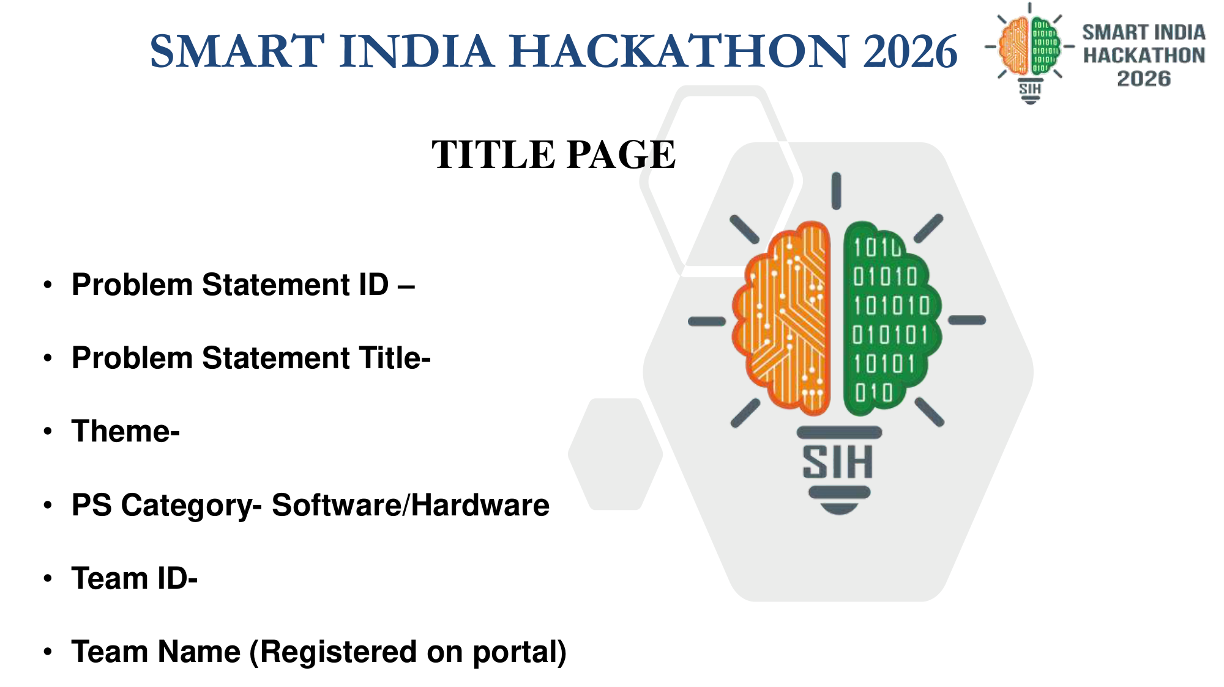
• Problem Statement ID - SIH1234
• Problem Statement Title - Real-time Flash Flood Intelligence
• Theme - Disaster Management
• PS Category - Software
• Team ID - 123456
• Team Name - Code Mavericks

Slide 2
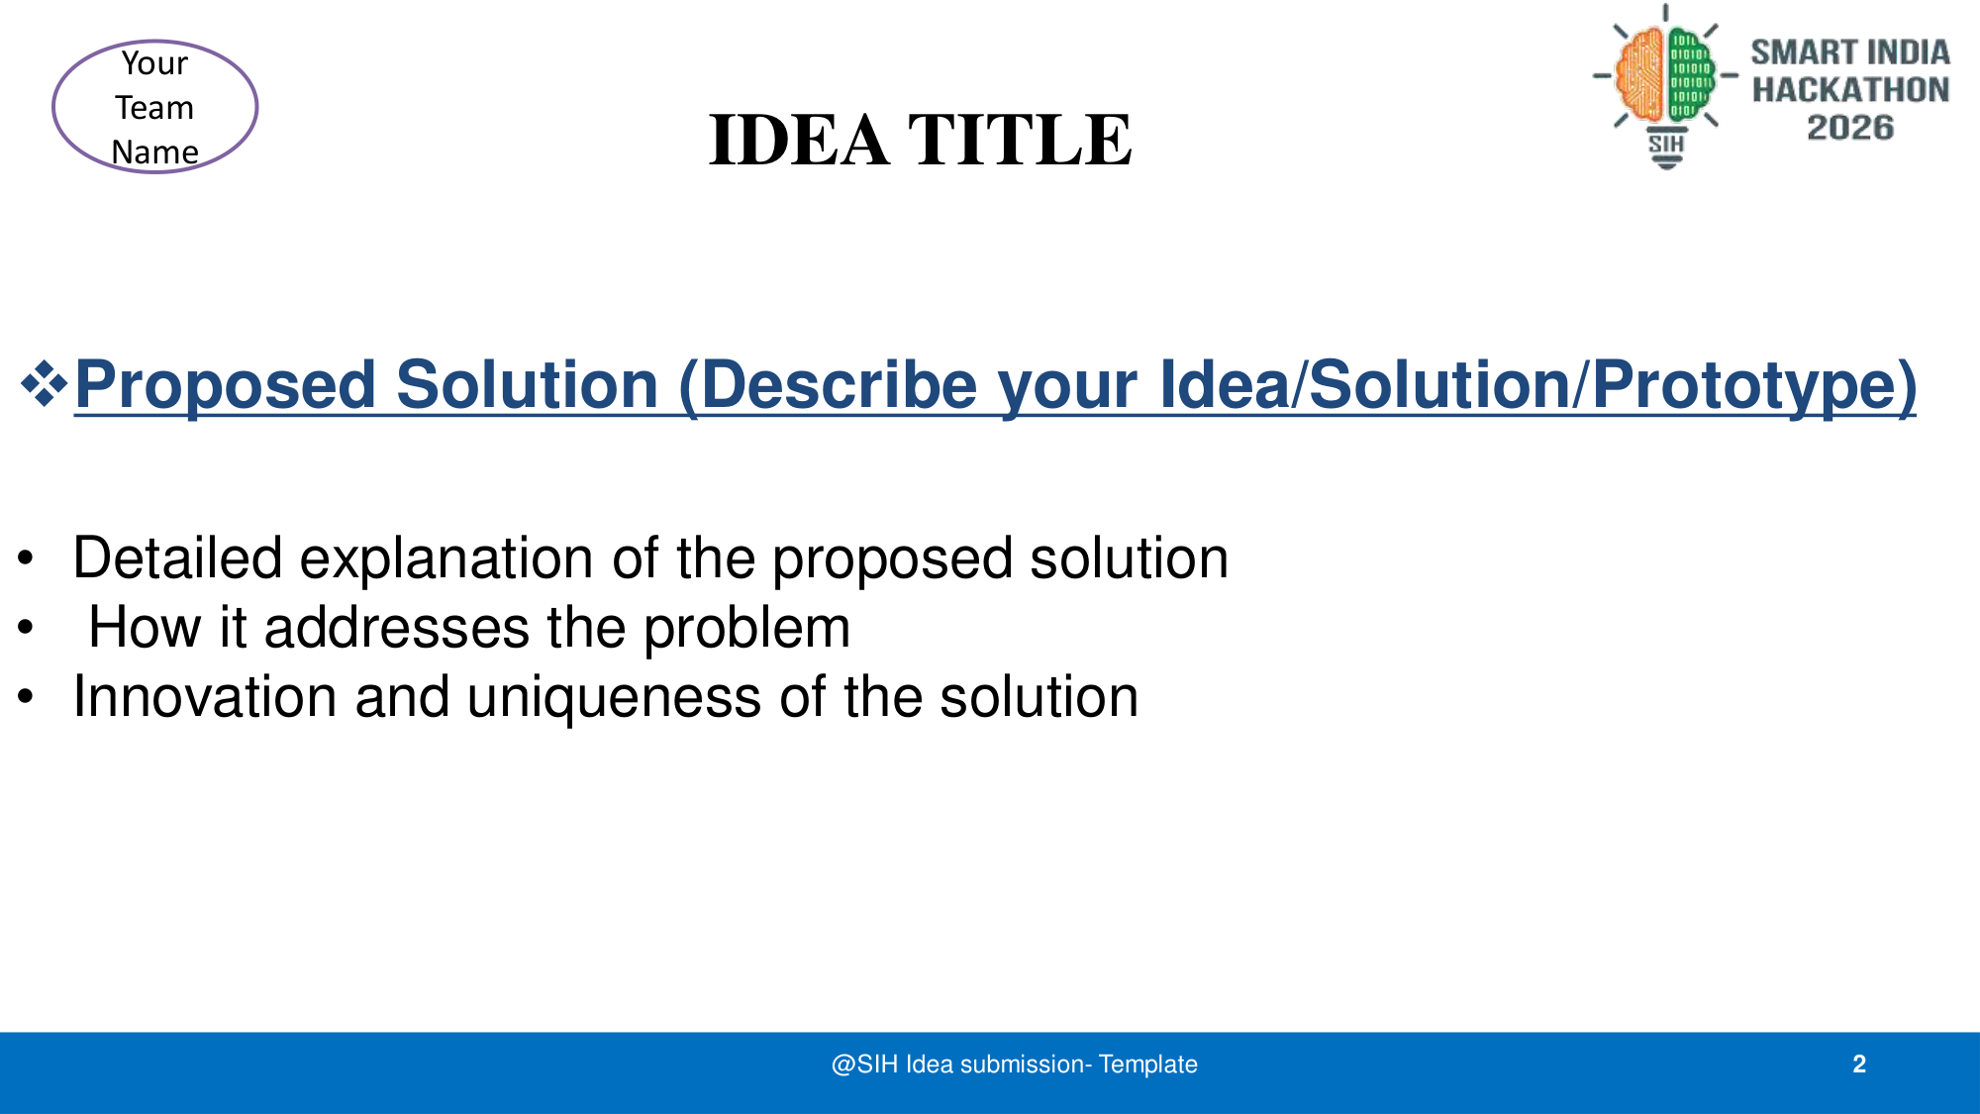
APADA MITRA - Next-Gen Disaster Intelligence Command
A military-grade, real-time command center leveraging predictive LSTM hydrological AI and instant automated Telegram dispatch protocols.
• Eliminates communication latency between central monitoring (CWC) and ground-level authorities (NDRF/SDRF) during flash floods.
• Bypasses traditional SMS bottlenecks by using direct Telegram bot API integrations and a low-latency React radar interface.

Slide 3
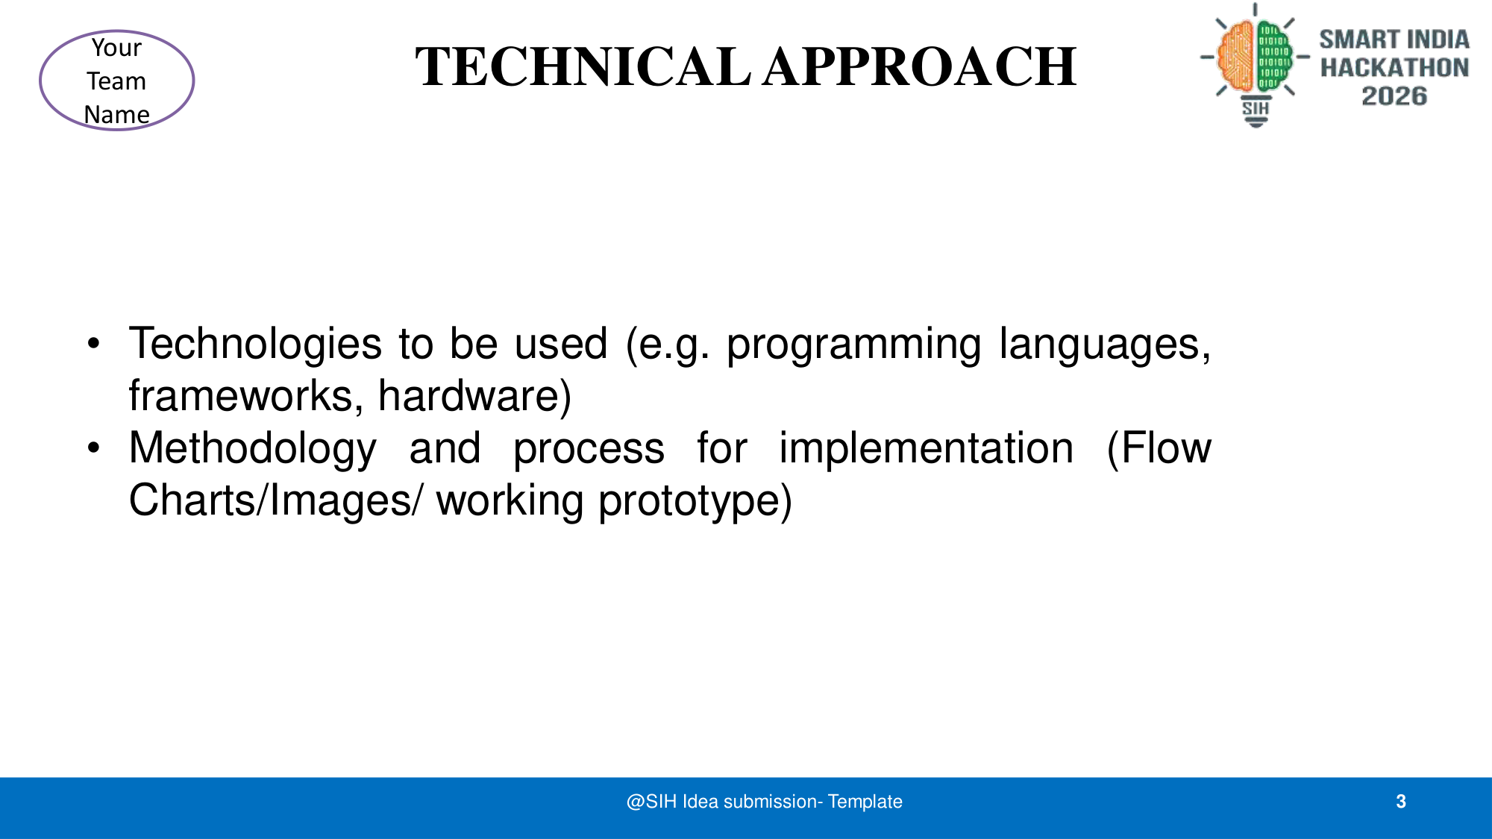
• Frontend: React + Vite, Tailwind CSS (Glassmorphism UI)
• Backend: Python FastAPI, Custom Hydro-LSTM Engine
• Integration: Telegram Bot API, Vercel
Methodology & User Flow:
1. Sensors -> LSTM Engine -> JSON Payload
2. Radar Dashboard Visualizes Threat Levels
3. Command Officer initiates One-Click Dispatch
4. Telegram API broadcasts instant alerts to NDRF.

Slide 4
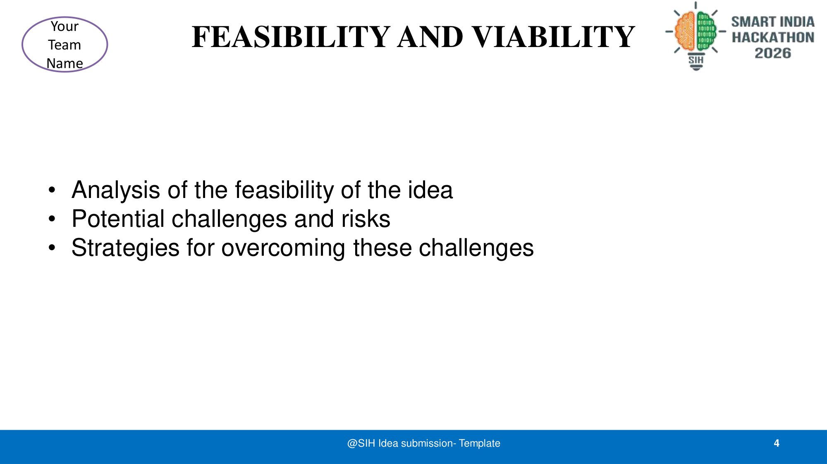
• Feasibility: B2G (Business to Government) SaaS model. Low operational overhead due to Serverless Edge architecture (Vercel) and free-tier Telegram API.
• Challenges: High-latency in remote areas with 2G/3G connectivity.
• Strategies: Fallback browser-direct dispatch bypasses backend failures. Telegram uses minimal bandwidth for text alerts, surviving on 2G.

Slide 5
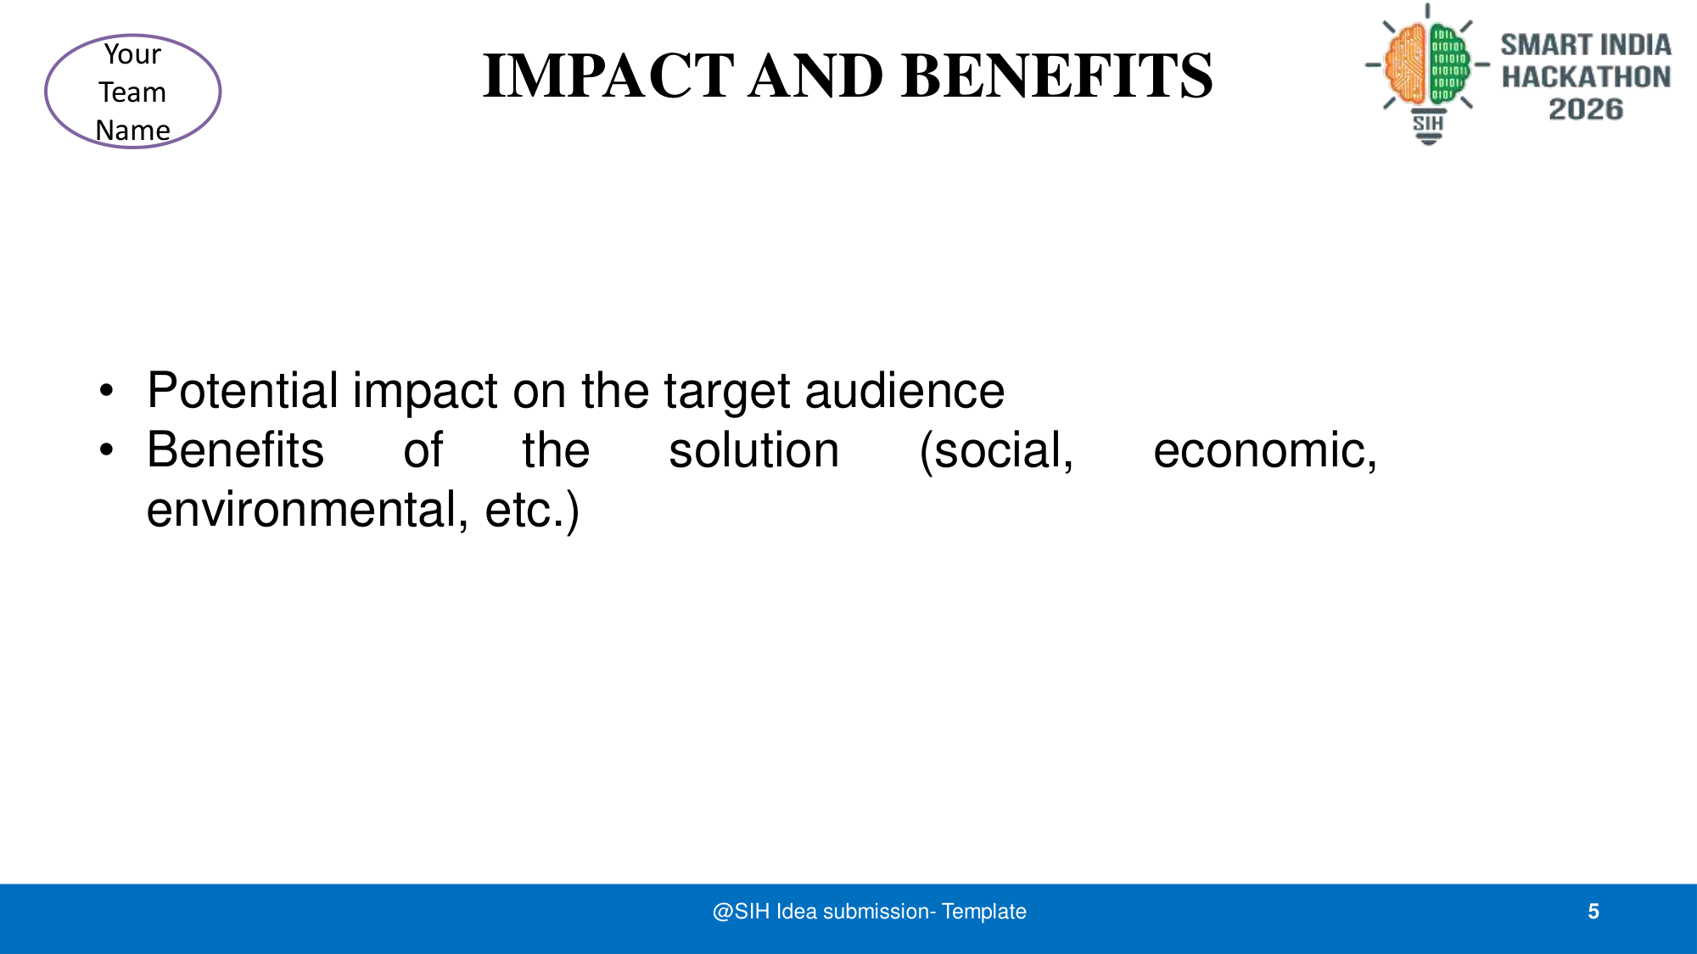
• Target Audience Impact: Empowers NDRF commanders and District Magistrates with zero-latency actionable intelligence, reducing evacuation response times by 80%.
• Social Benefits: Saves lives in highly vulnerable Himalayan/coastal basins.
• Economic Benefits: Prevents massive infrastructural damage via early warning.
• Technical Benefits: Standardized protocol for disaster communication.

Slide 6
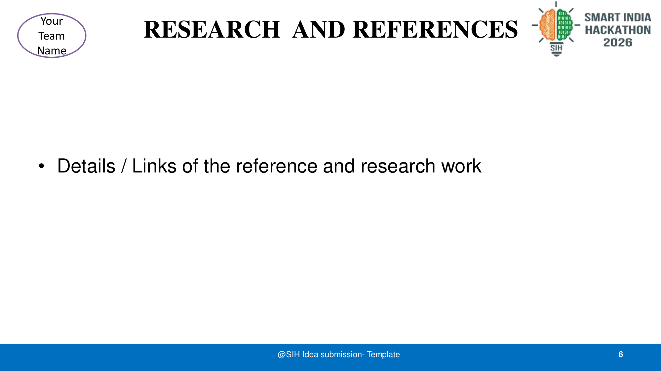
• Ministry of Jal Shakti Guidelines on Flood Forecasting.
• Telegram Bot API Documentation for High-Throughput Messaging.
• Advanced LSTM models for Hydrological time-series prediction.
• UI/UX principles from Defense and Aviation Command Interfaces.

