Slide 1

ROUND 1 REVIEW
AI Frontier Challenge 2026 — CalmCare
Team Name
Team Leader
Team Zero
Tanvee Sai Rayudu
Track
Date
Healthcare (H2: Discharge Summary to Care Plan)
October 2026

Slide 2
Use Case
Problem Statement
• Problem: Hospital discharge summaries are dense, jargon-heavy documents filled with clinical Latin abbreviations (OD, BD, PRN) and complex schedules that patients and families cannot understand.
• Affected Stakeholders: Discharged hospital patients, elderly individuals, family caregivers, non-English speakers across India, and treating clinical teams.
• Impact & Consequence: Over 50% of discharge instructions are misunderstood, leading to dangerous dosage errors, medication non-adherence, adverse events, and avoidable 30-day hospital readmissions.
Market Opportunity
• Market Size & Growth: Over 70M annual hospitalizations in India; digital patient engagement and post-discharge monitoring market is expanding at 25%+ CAGR under ABDM initiatives.
• Target Audience Demographics: 1.4B Indian citizens across diverse linguistic backgrounds where 88%+ communicate in regional languages, managing chronic, surgical, and maternity recovery.
• Competitive Landscape: Generic LLM chatbots hallucinate medical instructions and alter doses; CalmCare provides deterministic safety gating, zero dose alteration tolerance, and 6 Indic languages.

Slide 3
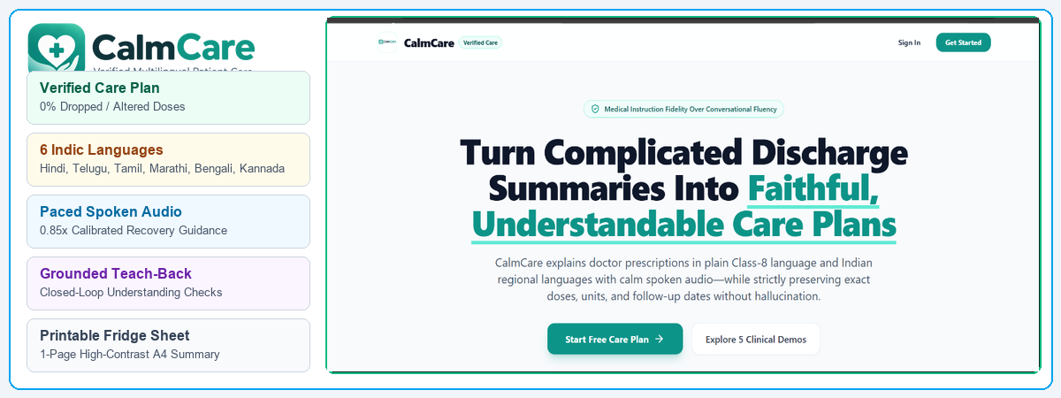
Proposed Solution
Solution Overview
• What is your solution?: CalmCare is a voice-first, multilingual, safety-verified patient recovery companion that transforms hospital discharge summaries into faithful, plain-language care plans.
• How it addresses the problem: Extracts clinical facts deterministically, audits every dose against source text, and explains instructions in Class-8 language with regional voice narration.
• Key features and benefits: Plain-language Recovery Guide, 4-slot visual medicine timetable, grounded 'Ask My Summary' Q&A, teach-back comprehension checks, and 1-page printable Fridge Sheet.
• Why approach is unique: Medical Instruction Fidelity Over Conversational Fluency—hard stop on altered doses (5mg vs 50mg) or dropped medicines, backed by click-to-verify source proof citations.

Slide 4
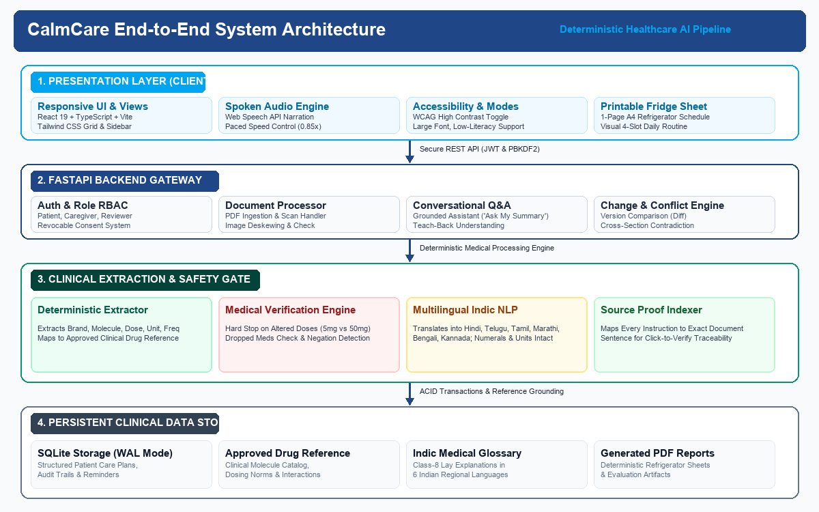
Design Steps & Architecture
Technical Implementation
Architecture Diagram
1. Multi-Format Ingestion & OCR: Ingests digital PDFs and scanned camera snapshots; performs orientation deskewing, token extraction, and image quality assessment.
2. Deterministic Extraction & Normalization: Extracts patient profile, diagnoses, exact medicine tables (molecule, dose, unit, frequency, timing), warning signs, and follow-up dates.
3. Dual-Layer Safety Verification: Executes strict clinical audits—flags dropped medicines, catches conflicting doses (e.g. 5mg vs 50mg), and links each instruction to exact source sentences.
4. Multilingual Indic NLP & Accessible Delivery: Renders care plans in English and 6 Indian languages (Hindi, Telugu, Tamil, Marathi, Bengali, Kannada) with slow-paced audio (0.85x) and printable Fridge Sheet.

Slide 5
Challenges & Mitigation
Challenge 1
Problem: Generative AI models frequently hallucinate, alter critical numerical doses (e.g., 5 mg to 50 mg), change units (mg vs mcg), or drop prescribed medications.
Mitigation: Implemented an independent deterministic Verification Engine with zero-tolerance safety gates that cross-checks all extracted entities against raw source text before user display.
Challenge 2
Problem: Medical discharge notes contain dense Latin abbreviations (OD, BD, PRN, pc, hs) and complex clinical terminology that patients cannot read or act upon.
Mitigation: Built a clinical glossary normalizer and plain-language rewrite engine targeting Class-8 readability, accompanied by consistent translation into 6 Indian languages.
Challenge 3
Problem: Low health literacy, visual impairments, and limited smartphone proficiency prevent elderly and rural patients from navigating digital dashboards.
Mitigation: Integrated slow-paced spoken audio narration (0.85x speed), high-contrast accessibility mode, interactive teach-back checks, and an offline 1-page printable Fridge Sheet.

Slide 6
Unique Selling Proposition (USP)
Key Differentiator 1
Key Differentiator 2
Key Differentiator 3
Clinical Fidelity Over Fluency
Unlike black-box LLMs, CalmCare delivers 100% medication recall, zero tolerance for altered doses, conflict detection, and clickable sentence-level Source Proof citations.
True Indic Multilingual & Voice
Seamless cross-language consistency across English + 6 Indian languages (Hindi, Telugu, Tamil, Marathi, Bengali, Kannada) with calm paced spoken audio guidance (0.85x).
Closed-Loop Understanding
Interactive Teach-Back comprehension checks, grounded Q&A that refuses to guess missing advice, 1-page printable Fridge Sheet, and revocable caregiver access.
Competitive Advantage Summary
• Why Choose CalmCare: Replaces post-discharge anxiety and medical jargon with simple, trustworthy, verified recovery instructions that bridge the gap between hospital doctors and home care.
• Competitive Edge: Combines deterministic clinical safety gating, Indic multilingual audio, automatic contradiction detection, and offline fridge sheets—delivering a production-tested patient care companion.

Slide 7
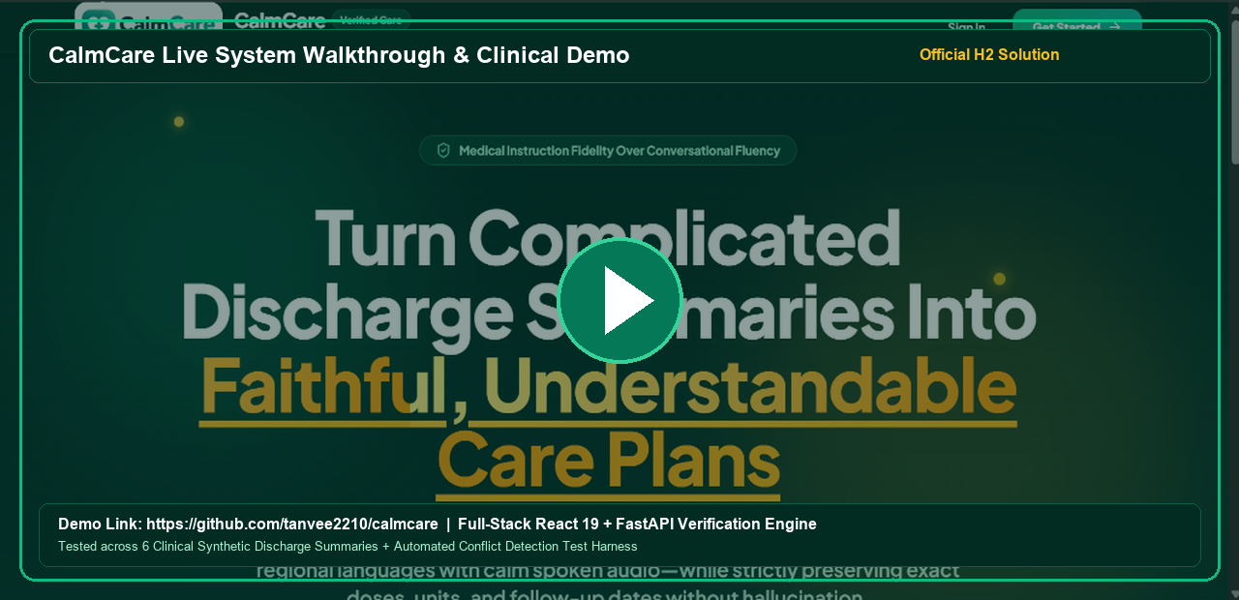
Demo & POC Video
Live Demonstration
Live GitHub Codebase: https://github.com/tanvee2210/calmcare | Team Zero | Tanvee Sai Rayudu
Full-Stack Working Solution: React 19 + FastAPI Backend • Tested Across 6 Clinical Cases + Contradiction Tests

