Slide 1

Tic Tech Toe’26
Team Name : NexaMind
Problem Statement Number : 6
Domain : Agentic AI and Intelligent Workflow Automation using Model Context Protocol (MCP)
Team Lead : Tanveer Rajput

Slide 2
Description of Idea
Proposed Solution : FlowMind AI a self-evolving Agentic MCP Gateway that leverages LLM-driven planning, contextual memory, and adaptive learning to autonomously orchestrate and optimize cross-platform workflows.
---->Core Idea
FlowMind AI is an intelligent orchestration layer that:
Interprets natural language → workflows (DAG)
Executes tasks across tools via MCP
Continuously improves using feedback-driven learning
----> How It Solves the Problem
🔹 Intelligent Workflow Automation
Converts user instructions into executable steps using LLMs
Automates end-to-end workflows, Example: Bug→Notify team→Update tracker
🔹 Cross-Platform Integration
Integrates GitHub, Slack, Google Sheets
Enables seamless multi-tool automation, Eliminates manual coordination
🔹 Self-Learning Optimization (USP)
Stores execution history & feedback
Learns from failures + user input, Optimizes workflow structure & execution
🔹 Context-Aware Intelligence
Adapts based on user role, priority, workflow state
Ensures relevant & efficient execution
🔹 Explainable & Controlled AI
Provides reasoning for decisions & failures
Smart human-in-the-loop approvals for critical actions
End-to-End Workflow
User Input (Natural Language) ⬇ AI understands intent (LLM) ⬇ Workflow generated as DAG ⬇ Execution across tools via MCP ⬇ Results stored + feedback collected ⬇ System learns and improves

Slide 3
Objective & Prototype
🔹 1. Autonomous Cross-Platform Orchestration
Enable seamless execution of complex workflows across distributed systems using natural language interfaces
Eliminate manual coordination through unified MCP-based integration
----- Impact: Reduces operational latency and eliminates tool fragmentation
🔹 2. Agentic AI-Based Workflow Planning
Utilize LLM-driven reasoning to dynamically decompose user intent into structured DAG workflows
Support real-time workflow generation without predefined rules or templates
----- Impact: Enables scalable, flexible, and intelligent automation
🔹 3. Feedback-Driven Self-Learning System (Core Innovation)
Implement a closed-loop learning architecture using execution traces
Continuously refine: Workflow structure, Task sequencing, Tool selection strategies
Learn from failures, retries, and user feedback signals
----- Impact: System evolves from static automation → adaptive intelligent agent
🔹 4. Context-Aware Decision Intelligence
Leverage contextual memory (user role, task priority, historical workflows)
Dynamically optimize execution paths based on situational context
----- Impact: Ensures personalized, efficient, and relevant workflow execution
🔹 5. Explainability, Control & Trust Layer
Integrate decision traceability and reasoning outputs
Implement risk-aware human-in-the-loop gating for sensitive actions
----- Impact: Enhances transparency, debuggability, and safe enterprise adoption
Prototype Design
----- Core Architecture
Input Layer: Natural language → intent extraction (LLM)
Planner: Generates workflow DAG (task dependencies)
MCP Layer: Integrates GitHub, Slack, Sheets APIs
Execution Engine: Orchestrates tasks with retry & parallelism
Learning Engine: Optimizes workflows using execution history
Control Layer: Explainability + approval system

Slide 4
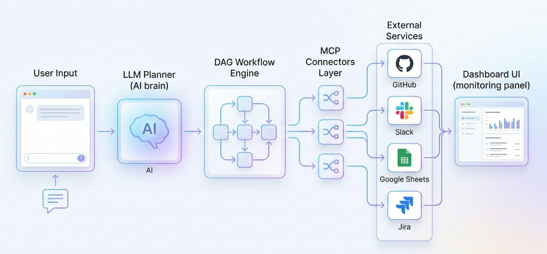
Objective & Prototype

Slide 5
Feasibility
⚙️ Feasibility
Technically Viable: Built using LLM APIs, MCP protocol, and REST-based integrations; lightweight backend (FastAPI + async execution) with no heavy data dependency
Modular Implementation: Phase-wise development — Input Parsing → DAG Workflow Generation → MCP Execution → Learning Layer, enabling fast prototyping and incremental enhancement
Seamless Integration: Easily connects with platforms like GitHub, Slack, Google Sheets via APIs; MCP ensures standardized and scalable extensibility
Scalable Architecture: Supports parallel execution, microservices-based scaling, and addition of new tools/services without redesign
Secure & Controlled: Implements API authentication, role-based access, and AI-driven human-in-the-loop approvals for critical operations
Cost-Efficient: Uses open-source tools + pay-as-you-go LLM APIs, requiring minimal infrastructure for deployment
Real-World Ready: Applicable across DevOps, business workflows, and incident management, delivering reduced manual effort and faster operations

Slide 6
Uniqueness
🔥 Self-Evolving Workflow Intelligence
-Implements a feedback-driven learning loop over execution traces
-Continuously refines workflow DAG structure, sequencing & tool selection
-Transitions from static automation → adaptive autonomous orchestration
🧠 LLM-Driven Agentic Planning
-Uses LLM-based reasoning to convert natural language → executable DAG
-Enables dynamic workflow decomposition without predefined rules
⚙️ Context-Aware Decision Engine
-Leverages contextual memory (user role, priority, history)
-Dynamically adapts execution paths for optimal efficiency, relevance & situational automation
🔍 Explainable AI Layer
-Integrates reasoning traces & decision attribution
-Provides actionable insights for failures, step selection & optimization
-Enhances trust, debuggability, and system transparency
👨‍💻 Intelligent Human-in-the-Loop Control
-AI-driven risk-aware approval gating for critical actions
-Minimizes interruptions while ensuring secure and controlled execution
🔗 Unified MCP-Oriented Orchestration
-Standardized integration via Model Context Protocol (MCP)
-Enables seamless interoperability across heterogeneous services
-Eliminates fragmentation in enterprise workflows
“Our key innovation is not automation—but evolution. Our system gets smarter with every execution.”

Slide 7
Team Member Details
Member Name | Role | Degree | Semester
Tanveer Rajput | Backend Developer | B. Tech | 4
Chaitanya Sarvaiya | Frontend developer | B. Tech | 4
Rajvi Shah | UI/UX designer | B. Tech | 4
Taksh Sanghavi | Database handler | B. Tech | 4
Aayush Pandya | AI Analyst | B. Tech | 4

