Slide 1
Real-Time Voice Translator: Minor Project Presentation
Welcome to the presentation on the Real-Time Voice Translator minor project. This innovative tool aims to break language barriers and facilitate seamless communication across different languages. In the following slides, we'll explore the project's objectives, scope, theoretical background, and implementation details, providing a comprehensive overview of this exciting venture in language technology.
Tanveer Ahmed
03990302022
BCA(M1)

Slide 2
Project Overview
Title
Subtitle
Presented by
Real-Time Voice Translator
Minor Project Presentation
Tanveer Ahmed
Course
BCA(M1)

Slide 3
Project Objective
1
Goal
2
Key Objectives
To develop a real-time voice translation tool that allows users to understand and communicate in different languages.
Break language barriers effectively. Ensure ease of use for anyone, regardless of technical skill.
3
Importance
Enhances global connectivity and understanding. Useful in sectors like tourism, healthcare, education, customer service, and international business.

Slide 4
Scope of the Project
Language Compatibility
Real-Time Focus
User Scenarios
Currently supports languages like English, Spanish, French, and German. (Update based on the languages your project supports.)
Designed for quick, on-the-fly translation with minimal delay.
Tourists needing help navigating in a foreign country. Professionals in international conferences. Healthcare providers assisting non-native speakers.

Slide 5
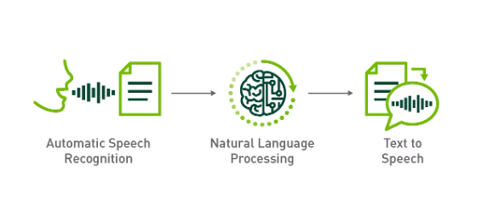
Theoretical Background
1
Speech Recognition
Uses machine learning to interpret audio and convert it into text. Common libraries include SpeechRecognition, Google's Web Speech API.
2
Translation Algorithms
Translation involves understanding context, grammar, and syntax. Utilizes Neural Machine Translation (NMT) for improved accuracy.
3
Speech Synthesis
Converts translated text to audio output using Text-to-Speech (TTS) libraries like pyttsx3 or Google Text-to-Speech API.

Slide 6
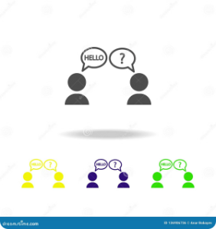




Problem Definition
Real-Time Processing
Accuracy
Multilingual Support
Usability
Processing each step (recognition, translation, synthesis) quickly enough to feel immediate to the user.
The system must interpret regional accents and idioms correctly to avoid misunderstandings.
The need for a broad range of languages and adaptability to different dialects.
Ensuring the tool is accessible and user-friendly, even for those not tech-savvy.

Slide 7

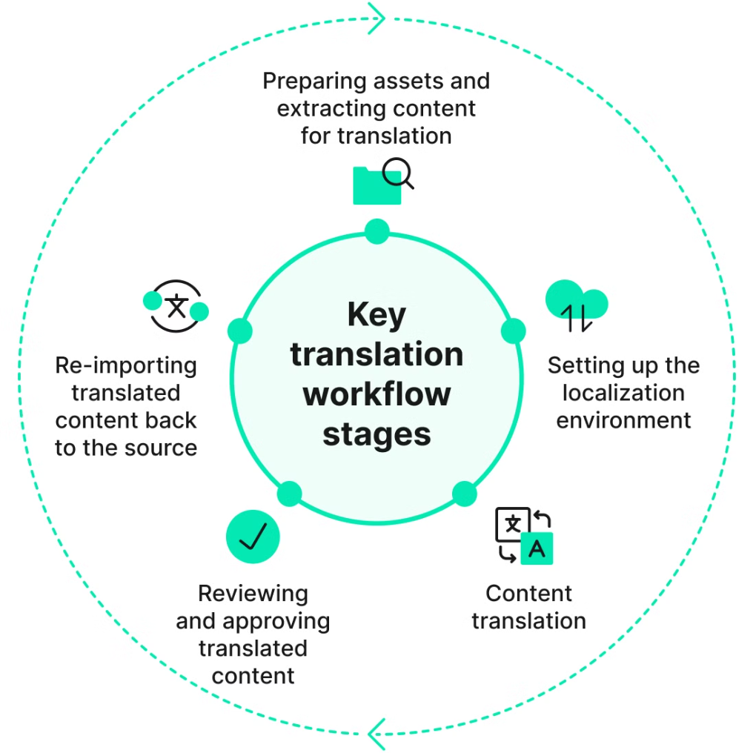



Methodology
Step 1: Voice Input
The user speaks into the device microphone.
Step 2: Speech Recognition
Audio is processed and converted to text.
Step 3: Translation
Text is translated into the target language via APIs (e.g., Google Translate).
Step 4: Text-to-Speech
Translated text is converted into voice output for the listener.

Slide 8

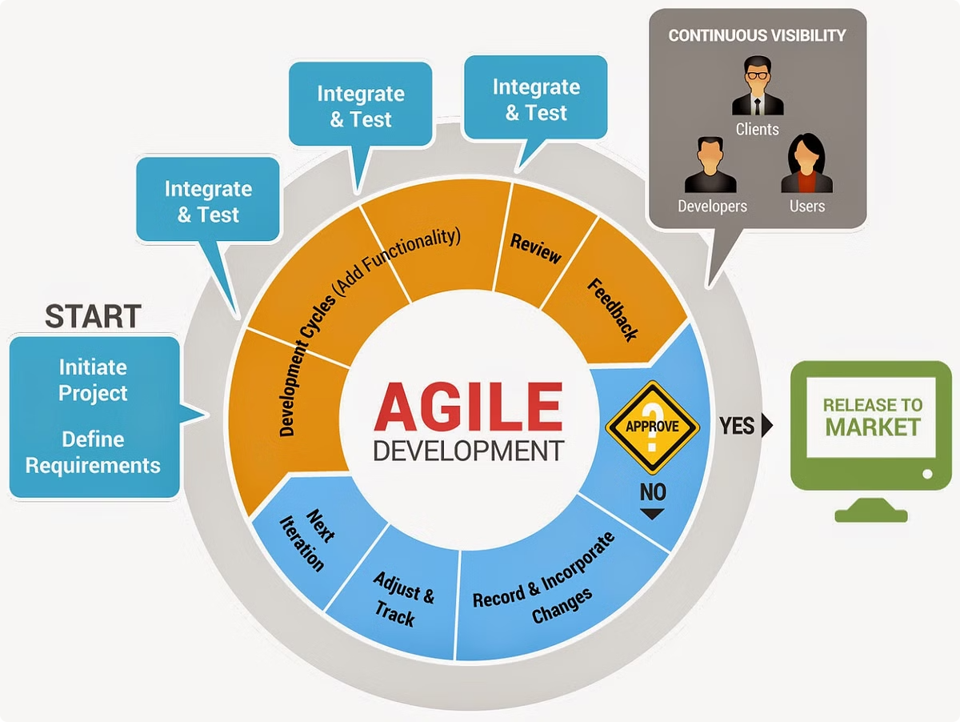
System Implementation
1
Phase 1
Research and gather requirements for supported languages, accuracy, and processing time.
2
Phase 2
Set up and configure SpeechRecognition for audio processing.
3
Phase 3
Integrate translation API for language conversion.
4
Phase 4
Implement Text-to-Speech for outputting translated voice.

Slide 9
Future Enhancements and Limitations
Future Enhancements
Limitations
Additional Language Support: Add more languages to increase usability globally.
Internet Dependency: Most real-time translation tools rely on internet-based APIs.
Accent Adaptation: Enhance system to understand various regional accents more effectively.
Accuracy Issues: Some translations may lose contextual meaning.
Offline Functionality: Develop an offline mode to enable translation without internet.
Voice Clarity: Background noise and unclear speech can impact recognition accuracy.
Reduced Latency: Optimize processing for near-instantaneous translation.

Slide 10
Conclusion
1
Project Summary
2
Key Achievements
The Real-Time Voice Translator project aims to break language barriers and facilitate seamless communication across different languages.
Developed a functional system that integrates speech recognition, translation, and text-to-speech technologies.
3
Future Outlook
With continued development and enhancements, this tool has the potential to significantly impact global communication in various sectors.

Slide 11
THANK YOU

