Slide 1

SPCL INFOTECH SERVICES PVT LTD
SNEHA PLAZA, OFFICE NO-7,2ND FLOOR, MUMBAI BANGLORE HIGHWAY NEAR CHURCH, WARJE , PUNE-411058, MAHARASHTRA.
+91-9823713441
+91-8483090269
www.spclinfotech.com

Slide 2
INDEX
1.Full-Stack Overview
2.Roadmap
3.SDLC (software development life cycle)
4.How to work on Live project?

Slide 3
Full-Stack Development
A full-stack developer is person who understand the client requirements and able to make flow chart of a project to contribute his/her skills considering time factor to terminate the project without anyone’s help.
A full-stack developer is a developer or engineer who can build both the front end and the back end of a website.

Slide 4
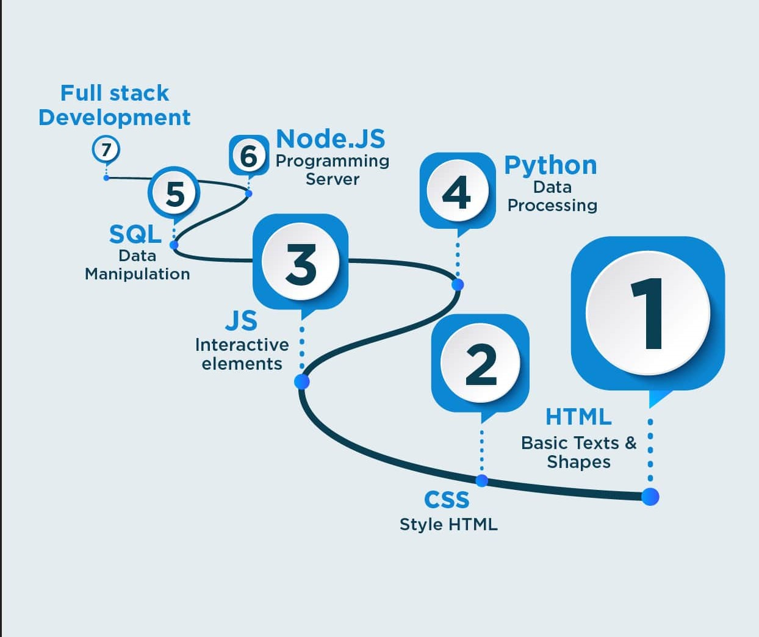
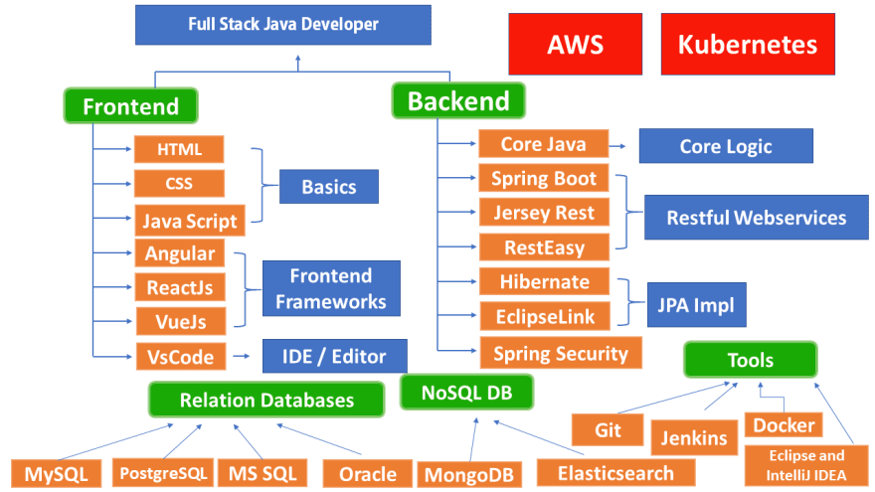
Full-Stack Development
Basics of full-stack
Roadmap to full-stack

Slide 5
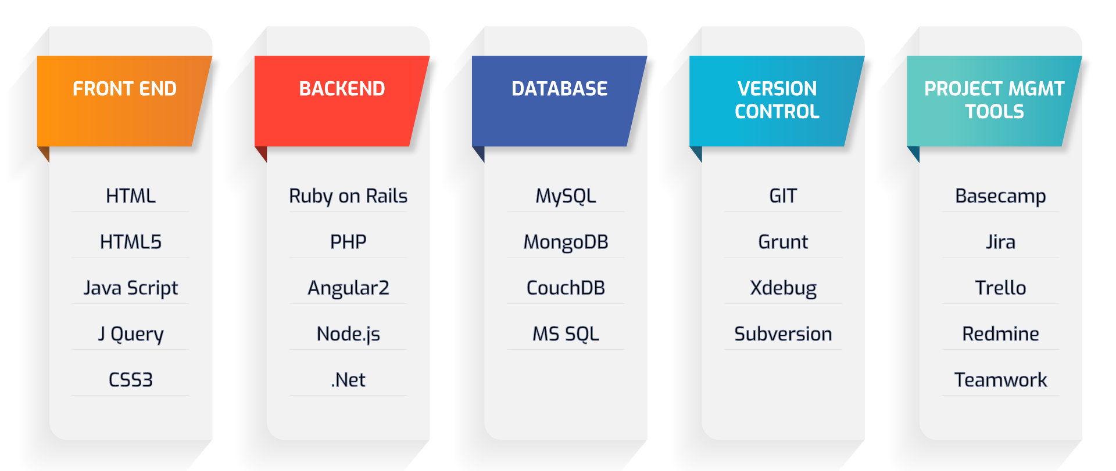
What is Full-stack Development ?

Slide 6
What is front-end developer?
Whenever we see an application like Google, Facebook, Twitter, Amazon, etc., so what we can see is the front end.
The front end refers to the interface we see on the website.
The developers who convert that UI into code are front-end developers.

Slide 7
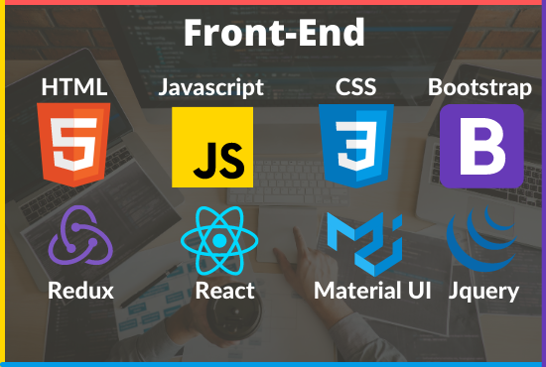
Front-end languages
HTML
CSS
JAVASCRIPT
ANGULAR
JQUERY

Slide 8
What is back-end developer?
A Back-End Developer is a specialized programmer who work on business applications, software, and websites along with software engineers and web developers. A BackEnd developer can work in following two domains.
Software/Backend development: As a software developer or backend developer, the Java developer has to perform requirement gathering, designing, database connectivity etc.
Mobile App development: A Java developer working in mobile app development domain operate on technologies such as Android development with Kotlin/Java.

Slide 9
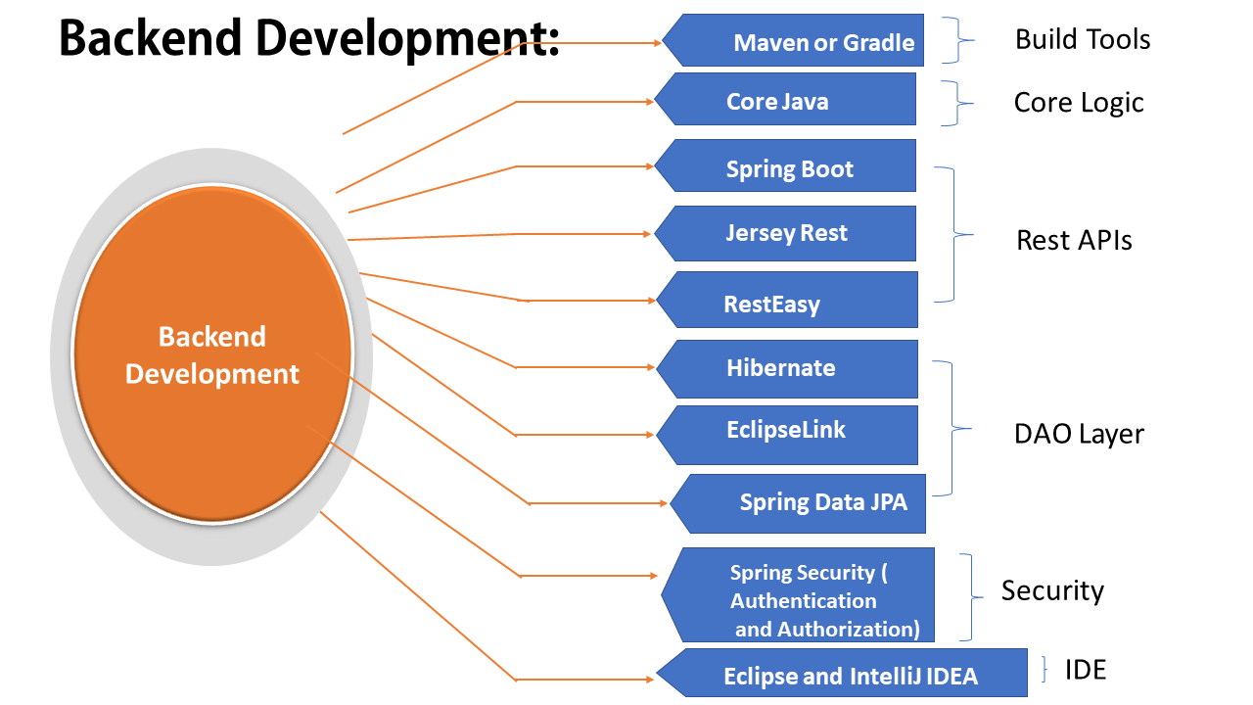
Backend languages
C
C++
JAVA
PHP
ASP.NET
PYTHON
NODEJS
C#

Slide 10
What is Database?
A database is an organized collection of structured information, or data, typically stored electronically in a computer system.
Data within the most common types of databases in operation today is typically modeled in rows and columns in a series of tables to make processing and data querying efficient.
The data can then be easily accessed, managed, modified, updated, controlled, and organized.

Slide 11
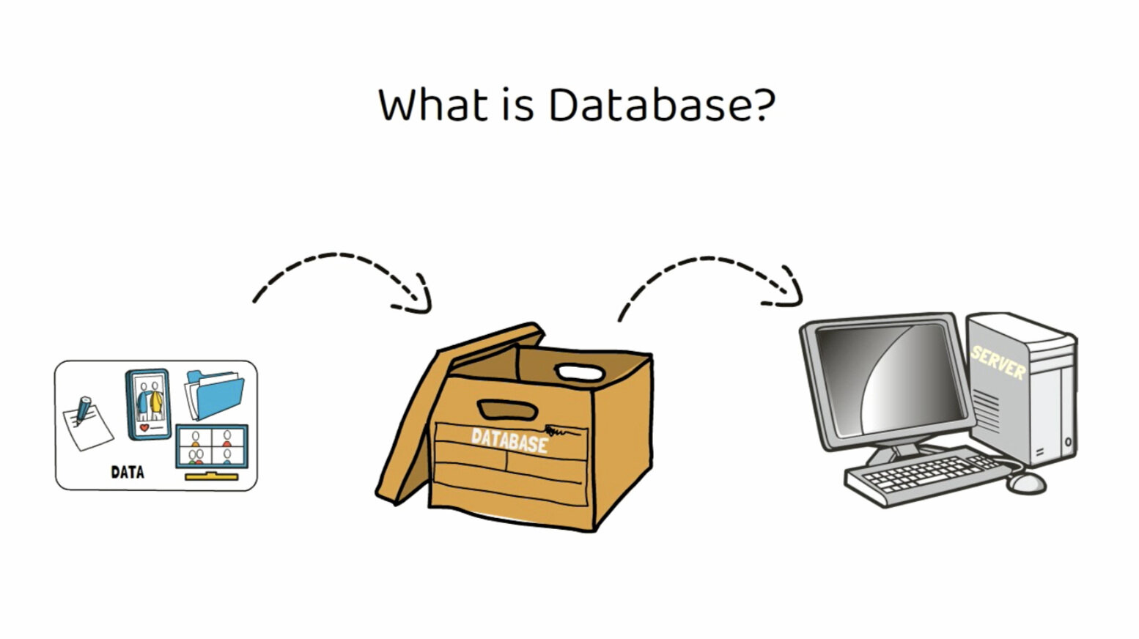
Database?

Slide 12
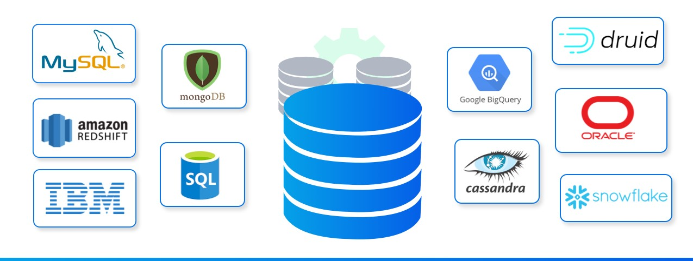
Types of Databases
MYSQL
MONGODB
MARIADB
REDIS
SNOWFLAKE

Slide 13
What is SDLC?
Software development life cycle (SDLC) is a term used in the software industry to describe a series of steps a software developer goes through when creating a new software product.
The software development life cycle (SDLC) is the process of planning, writing, and modifying software.
Understand your requirements and how you want your software to work
Identify risks at an early stage
Plan how you will deliver your solution in stages, such as building prototypes or writing functional specifications
Be sure that each stage of development fits with what has gone before and what comes next.

Slide 14
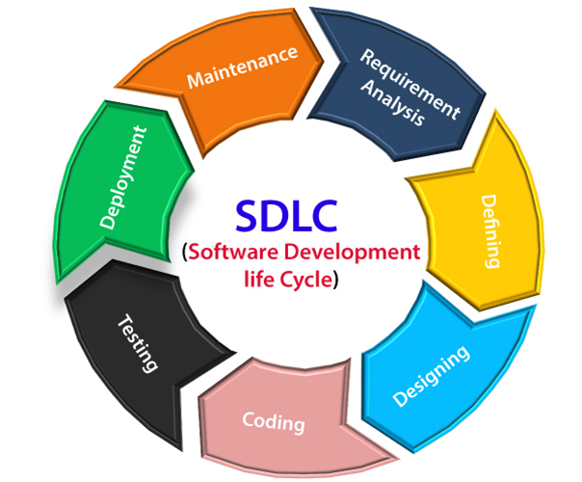
SDLC(software development life cycle)

Slide 15



Server
FE
request
Client
Data layer
response
BE
Database
Third Party

Slide 16
Thank you Feel free to contact us SPCL Infotech Services PVT Ltd +91-9552903206 spclinfotechservices@gmail.com www.spclinfotech.com

