Slide 2
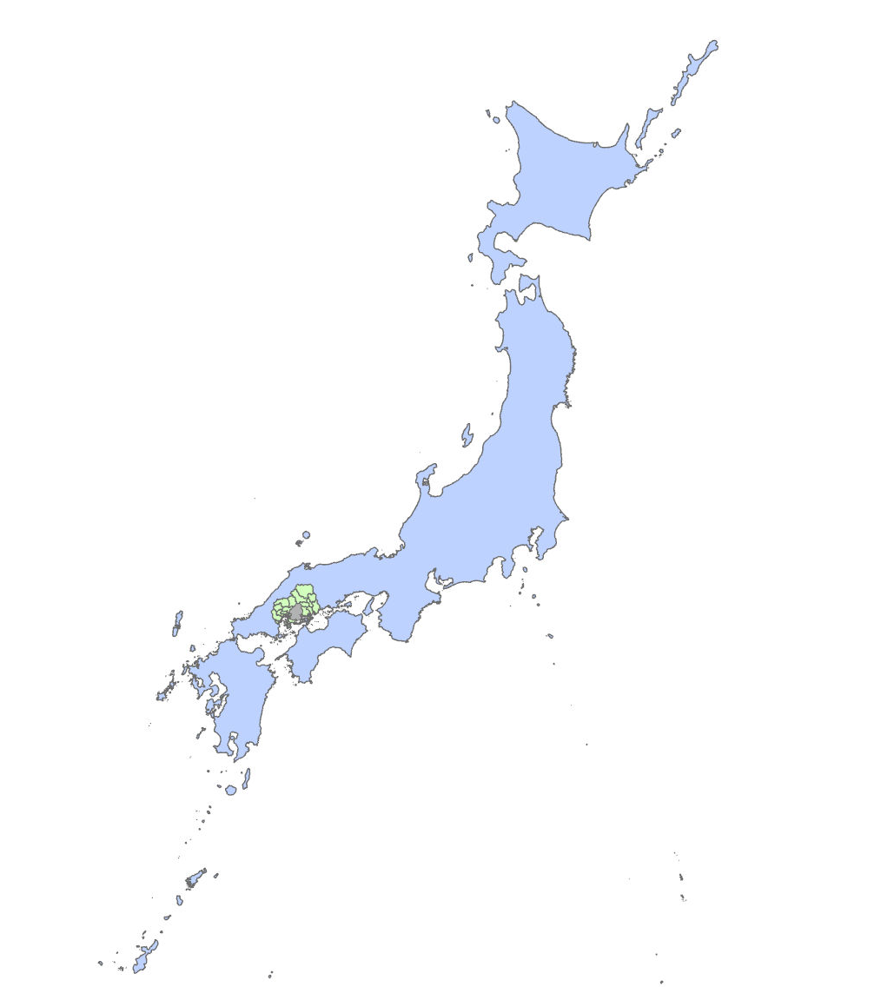
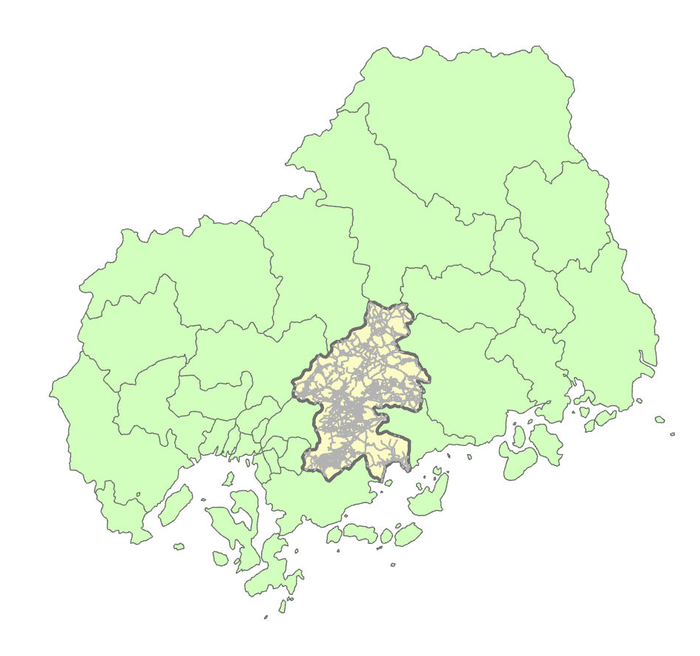

Slide 3
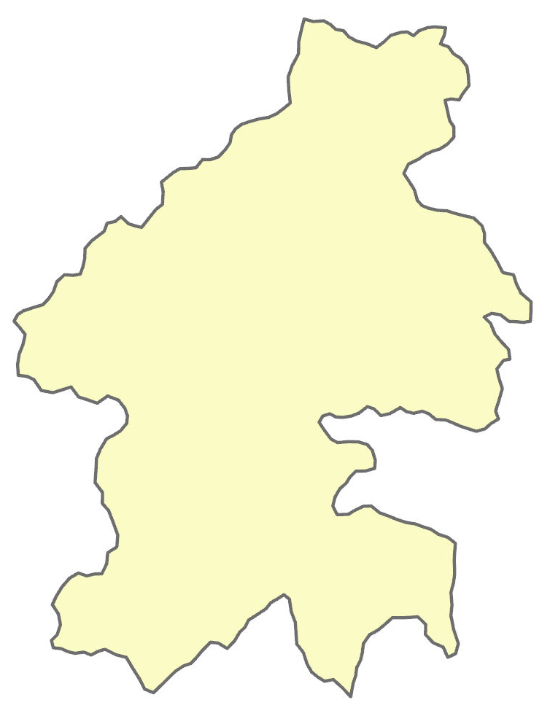

Slide 4
Extent of
Higashihiroshima City

Slide 5
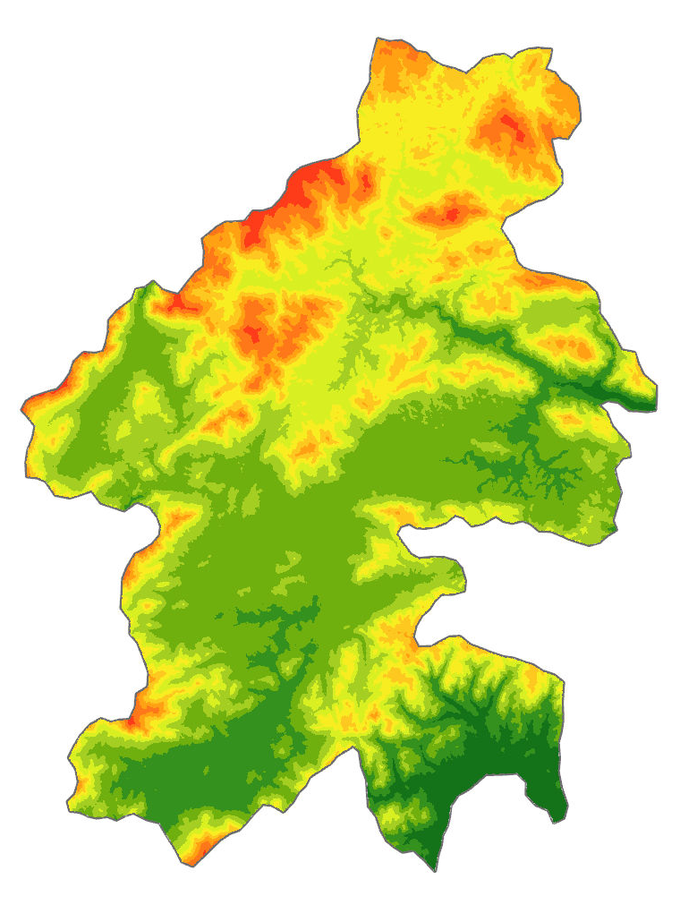
Digital Elevation Map
Data Source: USGS

Slide 6
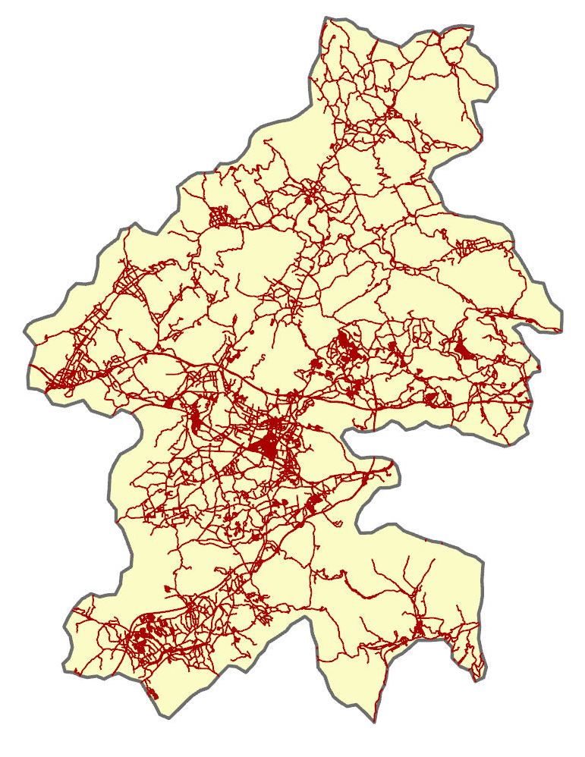
Road Network

Slide 7
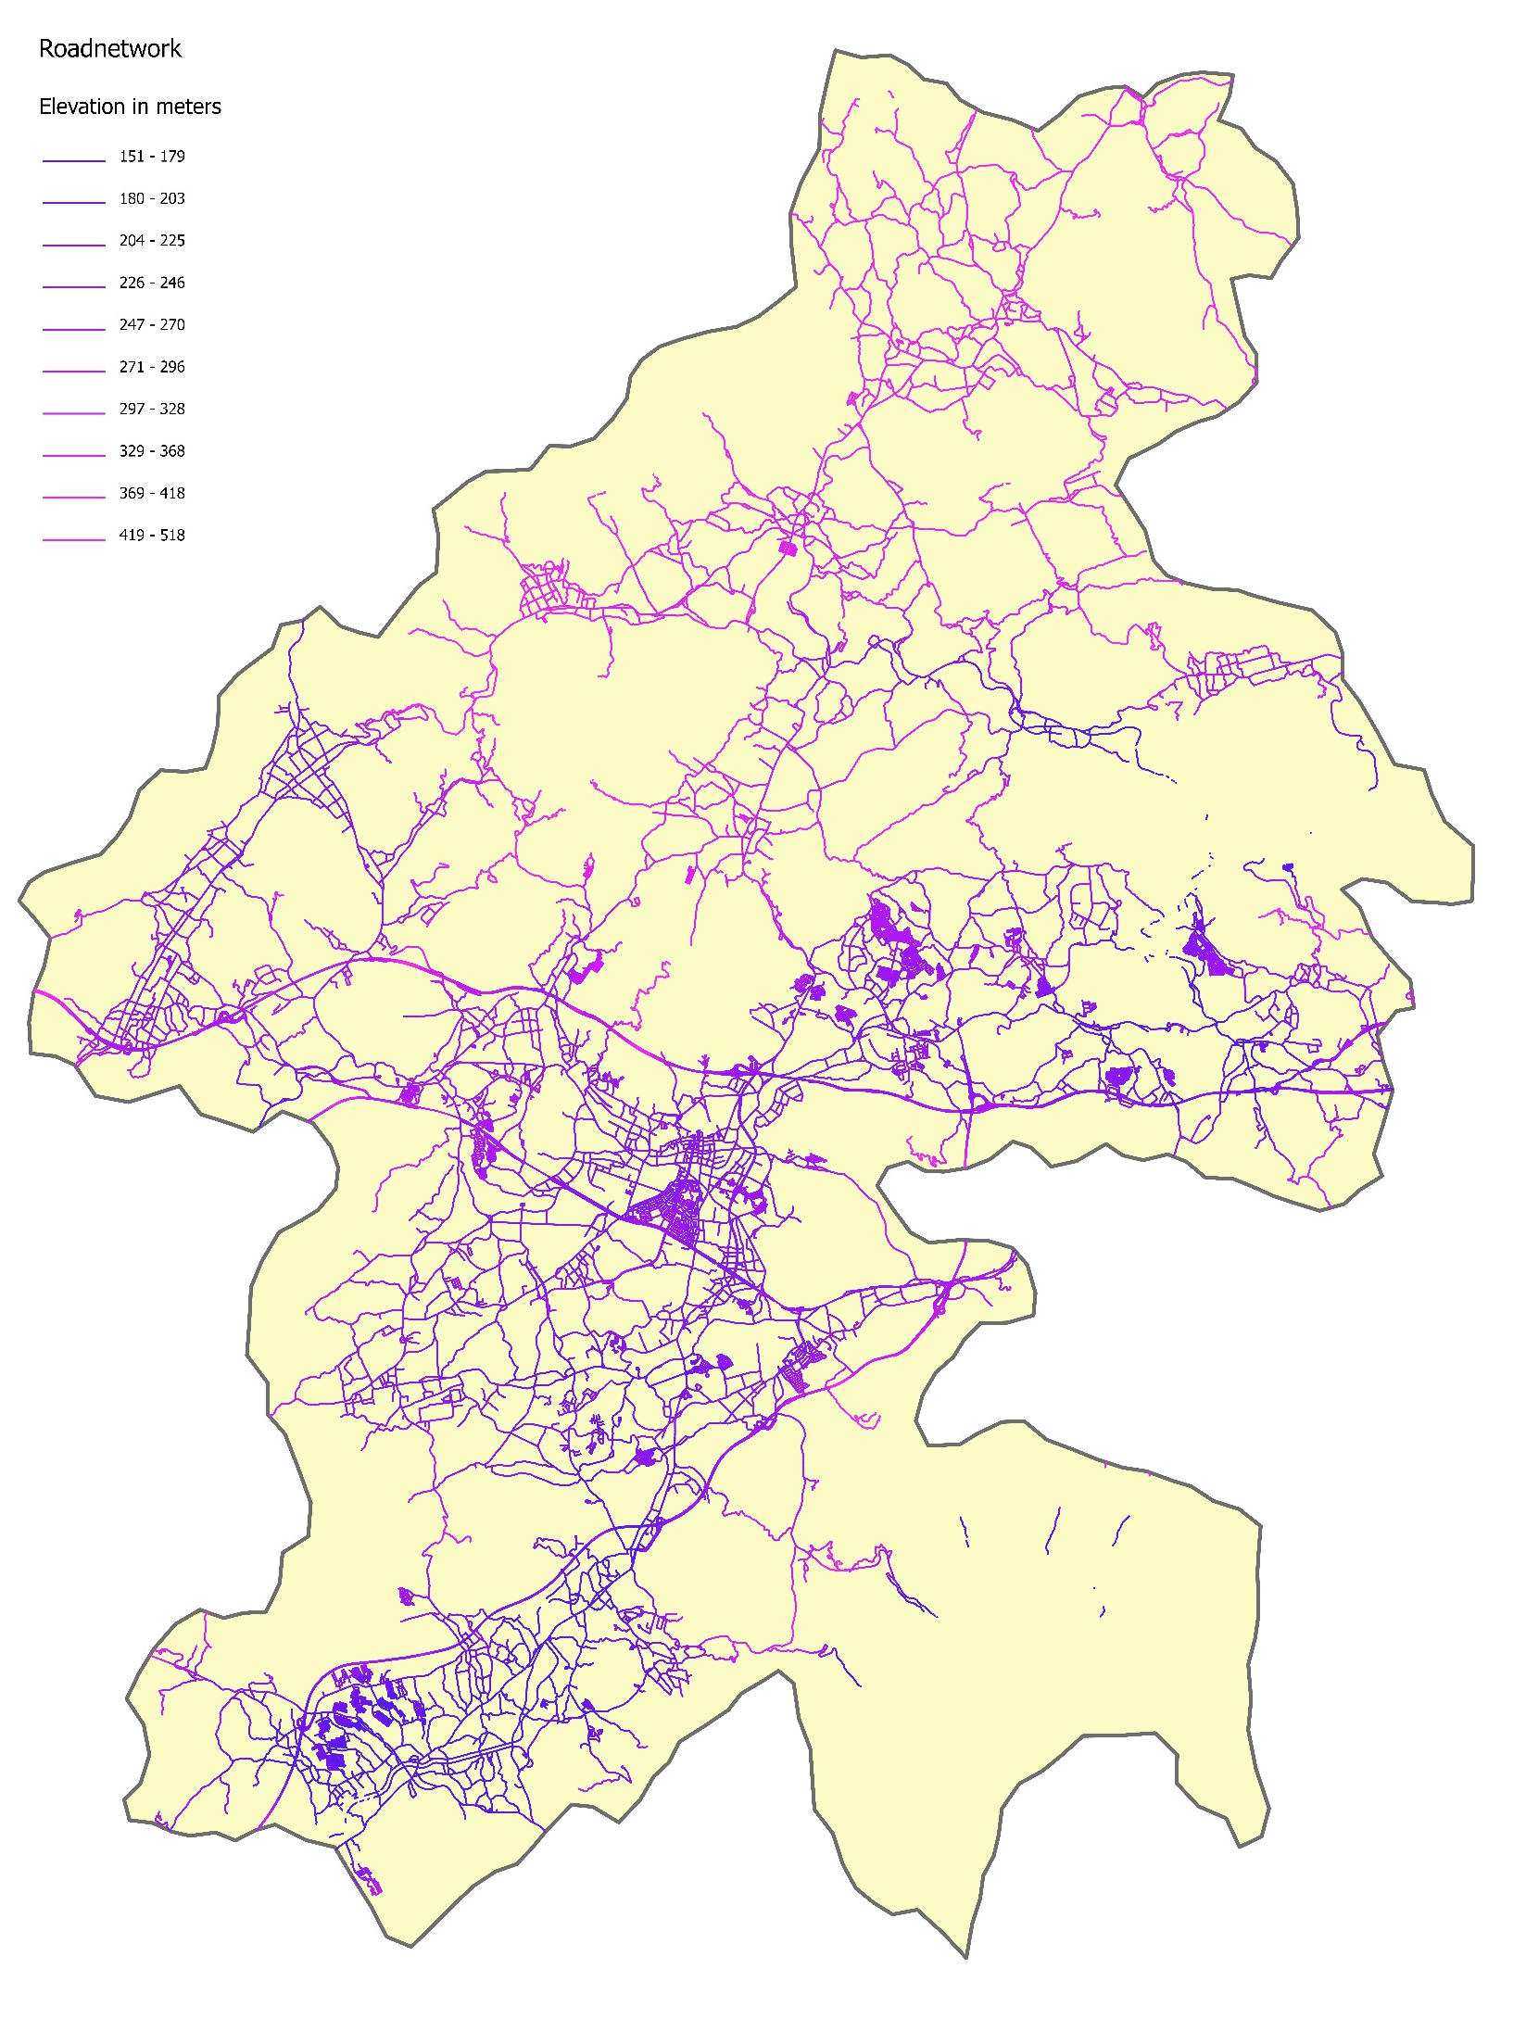
Road Network
with Elevation

Slide 8
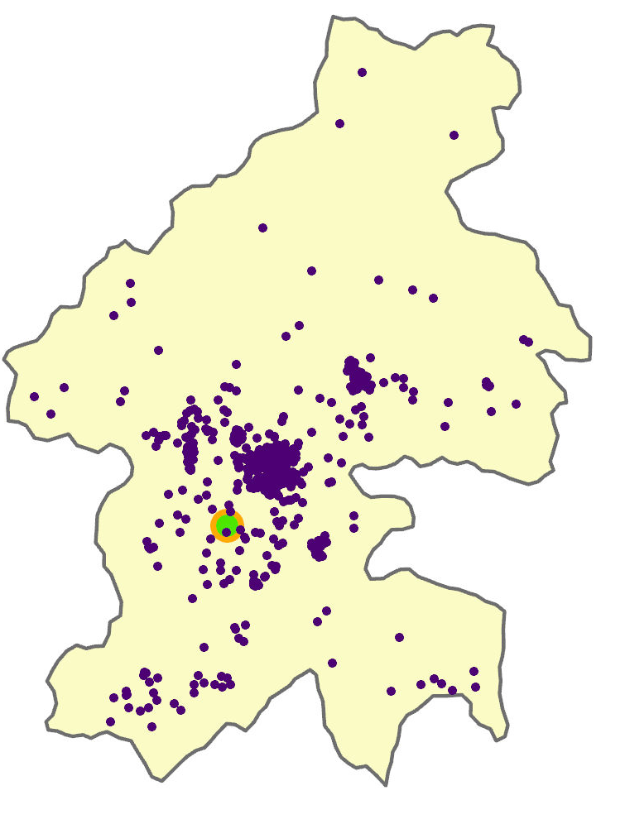
Origin and Destination
2023

Slide 9
Network Analysis in ArcGIS pro
Closest Facilities Analysis:
Facilities Destination (IDEC, HU)
Incedents Origins(2023,2024, 2025)
After the analysis we get shortest routes as Line Features
Stack Profile tool:
Input: Route layer as line features, DEM as Raster
Output: Elevation data along the routes are generated
Summary Statistic tool:
To find out the Maximum and Minimum elevation along a route

Slide 10
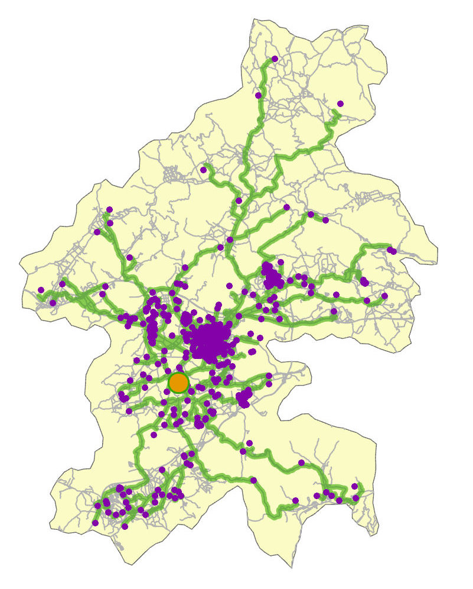
Route Analysis
2023

Slide 11
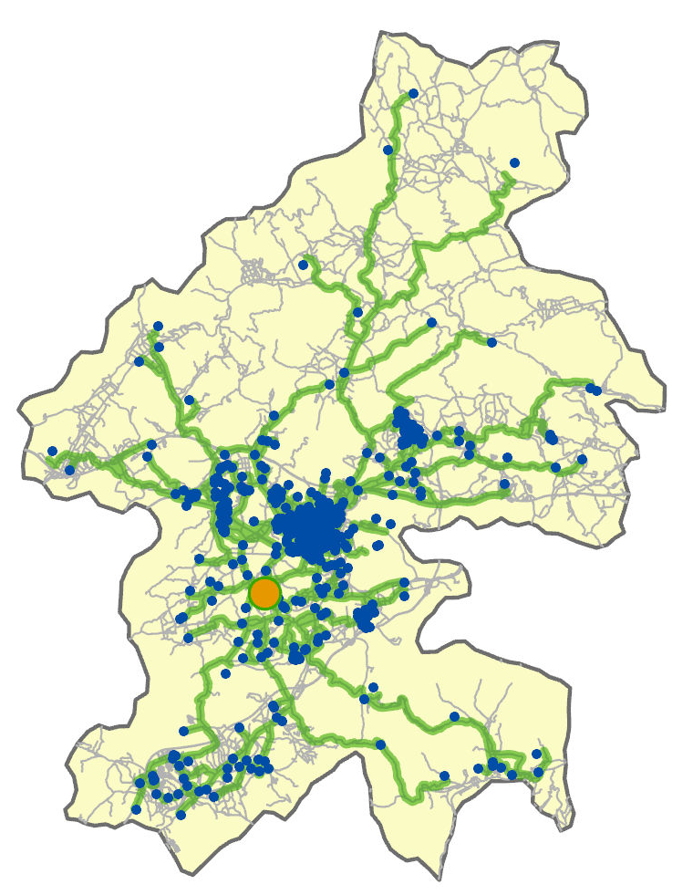
Route Analysis
2024

Slide 12
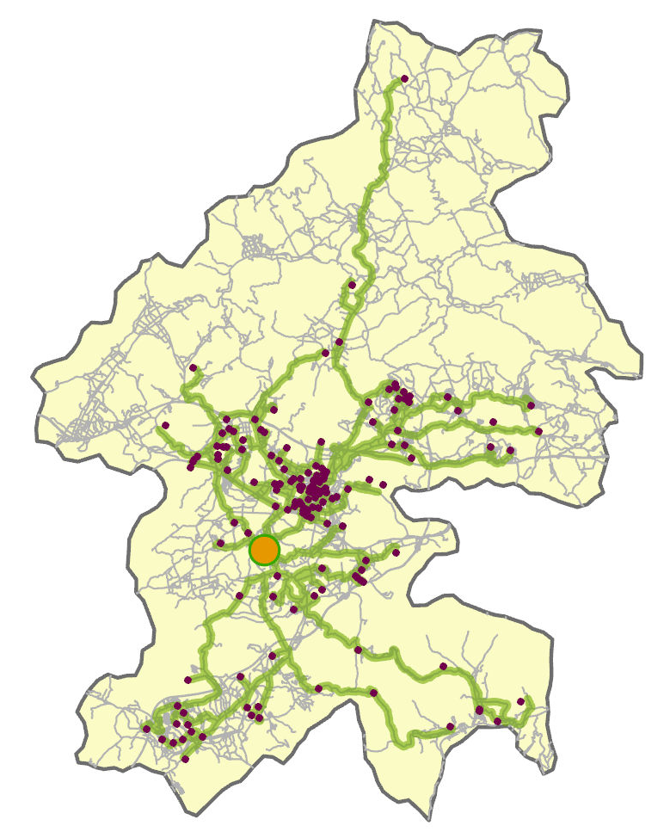
Route Analysis
2025

