Slide 1
Cyclistic Bike-Share
Rider Behavior Analysis
Marketing Analytics Team · Cyclistic Executive Stakeholders

Slide 2
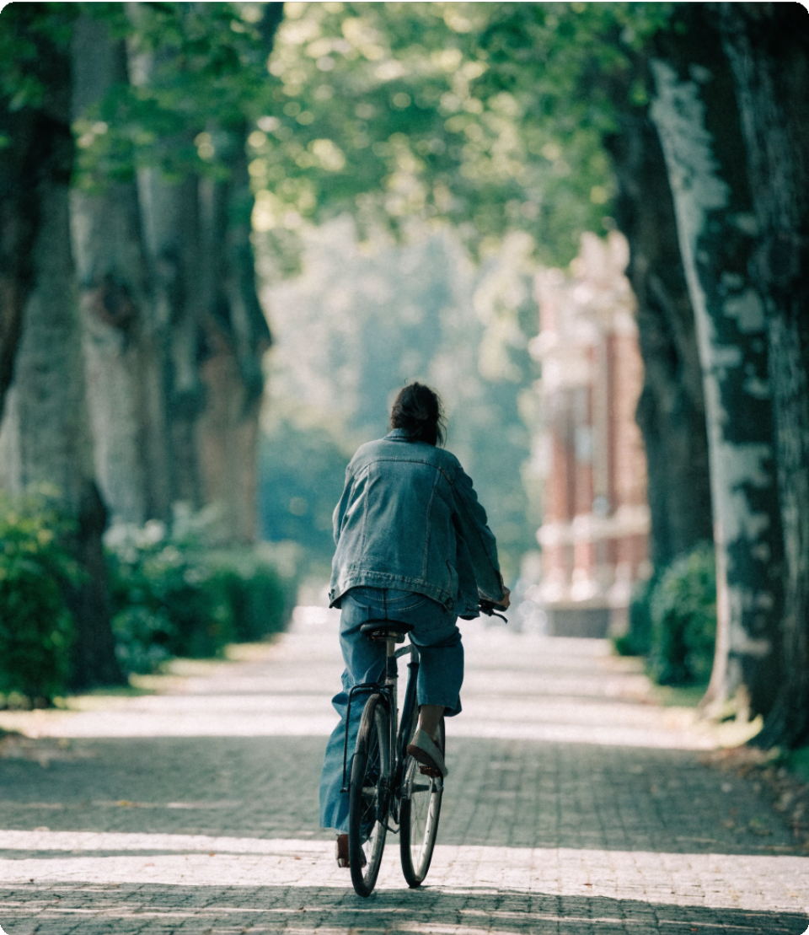
How do riders use Cyclistic differently?
Annual members are more profitable than casual riders.
The goal is to identify behavioral differences and design a marketing strategy that converts casual riders into members.

Slide 3

Analysis Observations
Members drive volume, casuals drive duration
Members consistently take more rides across all months, but casual riders tend to take longer trips.
Bike preference differs by usage pattern
Electric bikes are used more frequently overall, but longer rides are typically done on classic bikes—especially by casual users.
Weekends shift behavior toward casual riders
Ride counts between members and casuals become nearly equal on weekends, with casual riders taking longer trips.
Strong seasonality, especially for casual riders
Ride activity peaks in summer (June–August), with casual riders showing a sharper increase in both ride count and duration.
Time-of-day usage varies by user type
Members ride consistently throughout the day, while casual riders prefer longer rides in the afternoon.

Slide 4
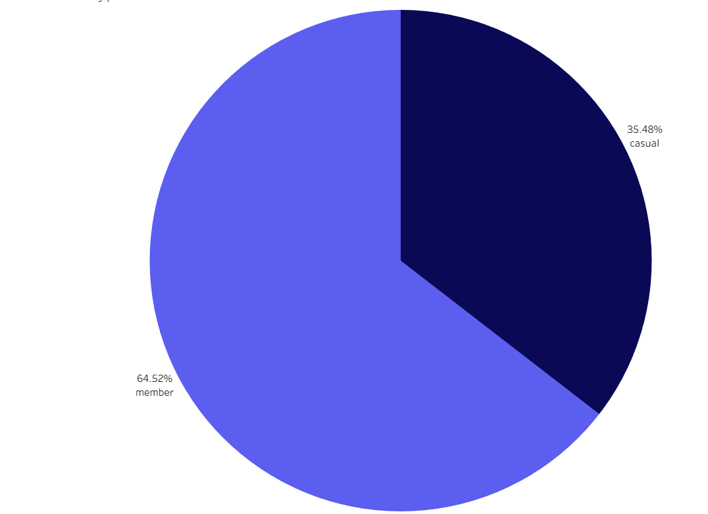
Distribution of Members and Casuals
Rider distribution
Who rides Cyclistic
Members
Casual rid…
35.5
Casual riders constitute a 3rd of the total riders, hence have a great conversion potential
64.5

Slide 5
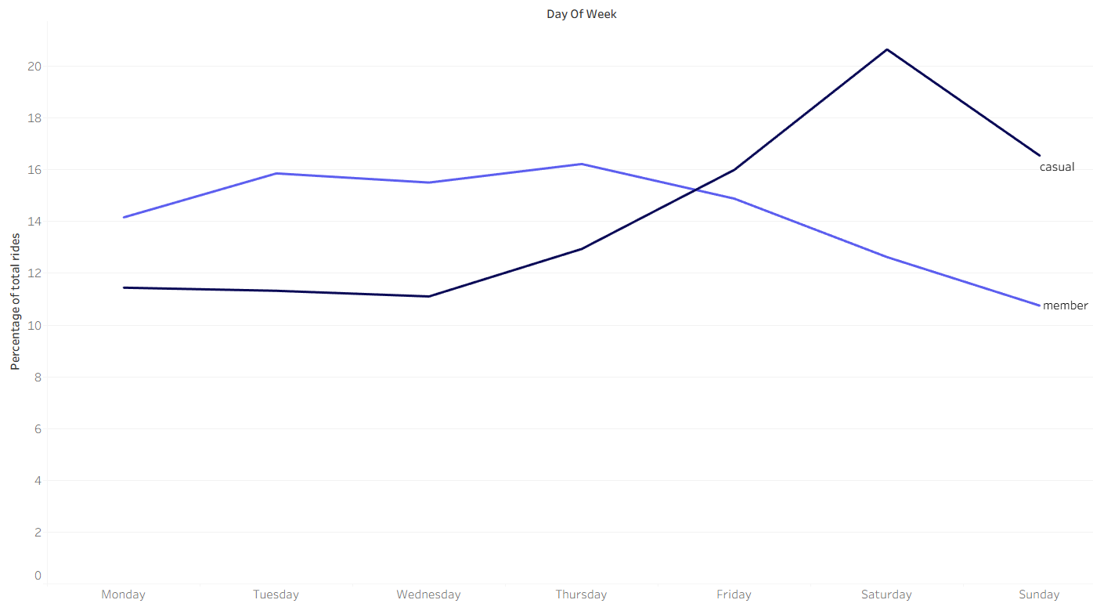
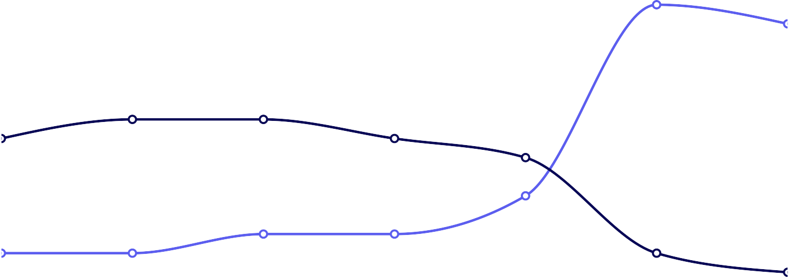


% of total rides by day — Casual vs. Member
Weekly patterns
Casuals ride on weekends, members ride all week
Casual
Member
25
20
15
10
Members commute steadily Mon–Fri. Casual riders peak on weekends. Weekend
campaigns can convert these casuals into members.
5
0
Mon
Tue
Wed
Thu
Fri
Sat
Sun
Day

Slide 6
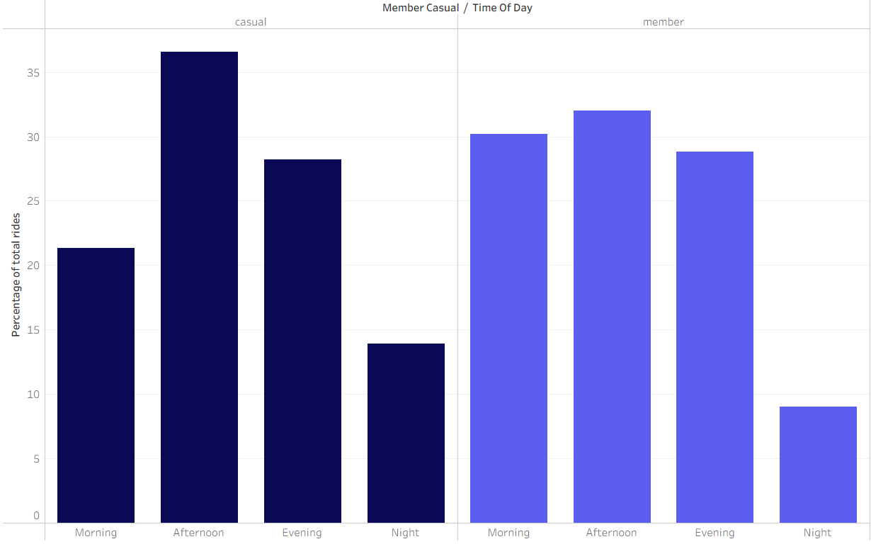
Ride share by time of day — Casual vs. Member
Time of day
Casuals prefer to ride in the afternoon
Casual
Member
50
40
30
20
Afternoon peaks signal leisure usage. Target casuals with digital ads and push notifications during midday hours near high-traffic stations.
10
0
Morning
Afternoon
Evening
Night
Time of Day

Slide 7
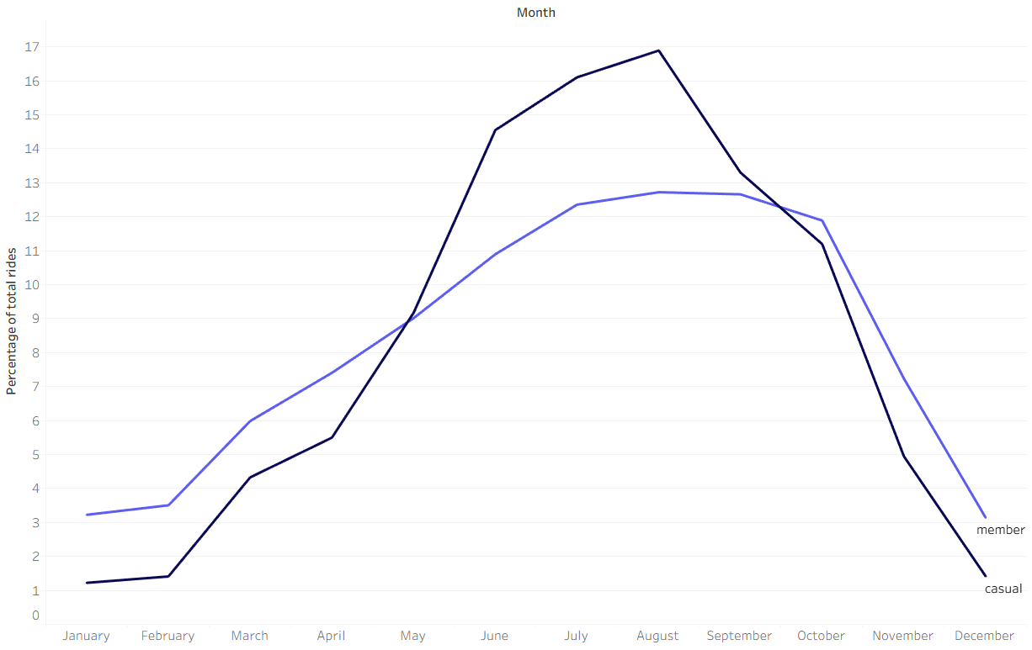
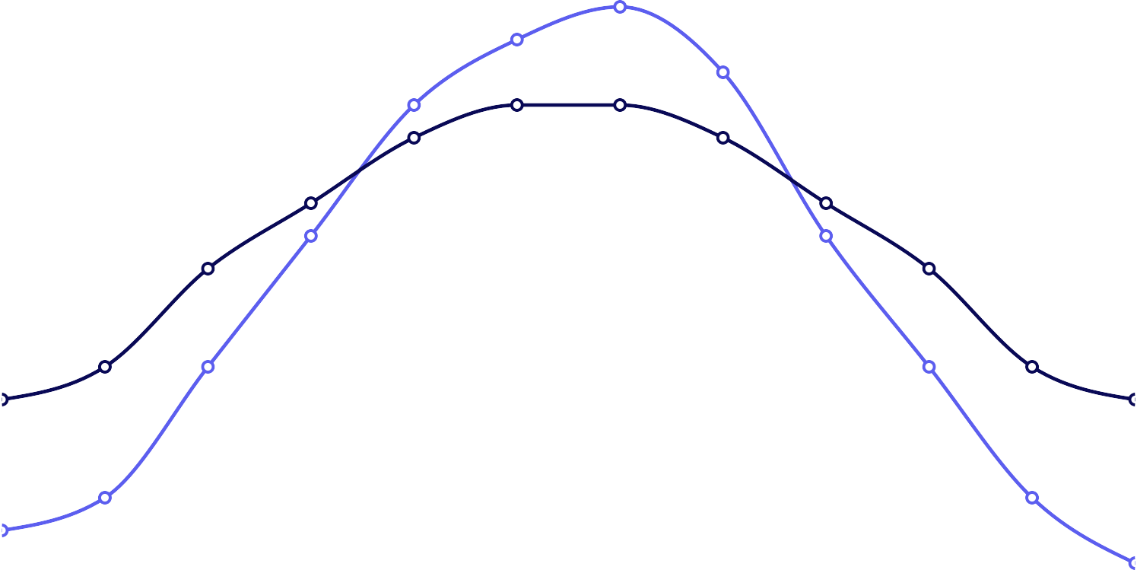


Ride share throughout the Year
Seasonal patterns
Summer drives the most rides for both groups
Casual
Member
20
15
10
Summer is the highest-impact window to run conversion campaigns. Casual riders are most active — and most likely to see membership value — between May and August.
5
0
Jan
Feb
Mar
Apr
May
Jun
Jul
Aug
Sep
Oct
Nov
Dec
Month

Slide 8
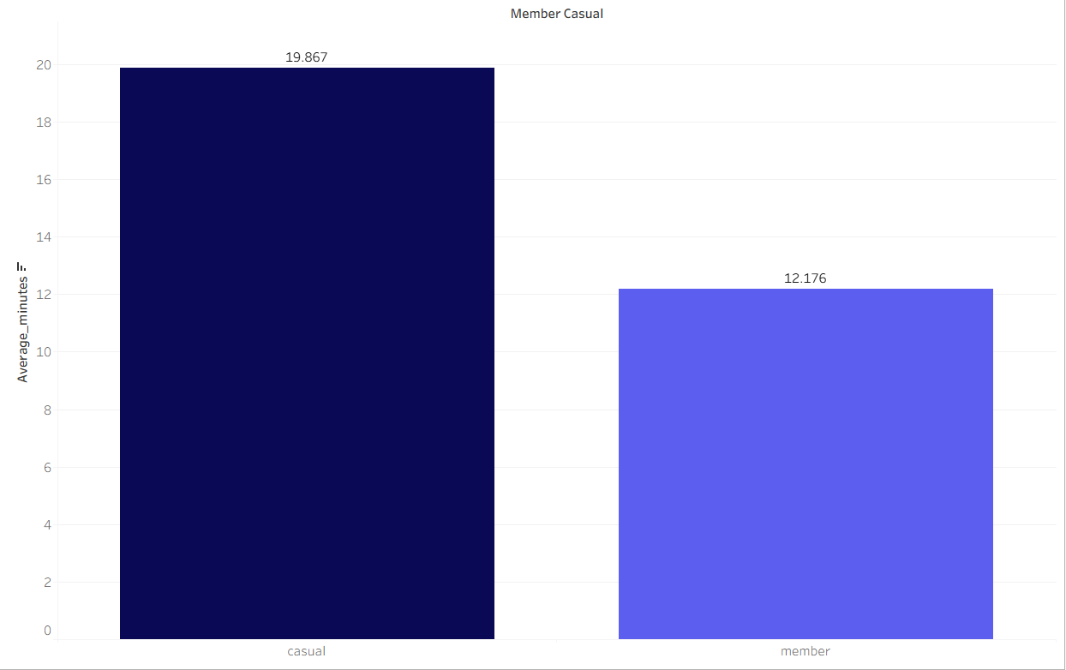
Average Ride duration for riders
Ride duration
Casuals ride 62% longer per trip than members
Casual
Member
20
15
10
Casual riders average 19.87 min per trip vs. 12.18 min for members — a pattern consistent with leisure use. Highlighting ride duration dependency.
5
0
Jan
Feb
Mar
Apr
May
Jun
Jul
Aug
Sep
Oct
Nov
Dec
Month

Slide 9
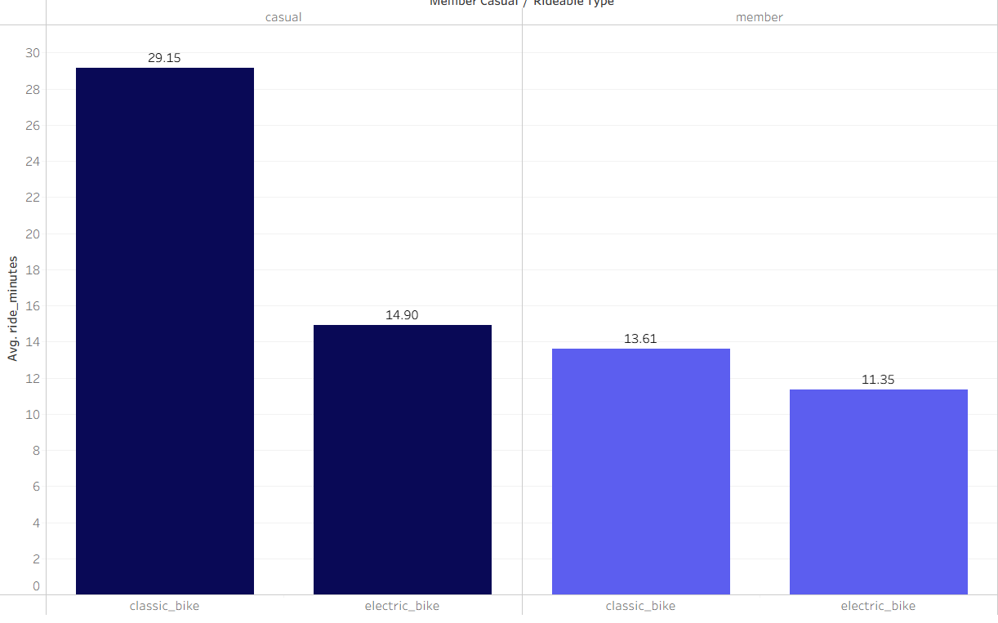
Ride duration dependency on bike type
Bike Dependency
Casuals log the longest rides on classic bikes
Casual
Member
20
15
10
Classic bikes drive the longest rides, especially for casuals. Target membership promotions at high classic-bike docking stations to reach this high-engagement segment.
5
0
Jan
Feb
Mar
Apr
May
Jun
Jul
Aug
Sep
Oct
Nov
Dec
Month

Slide 10
Targeted seasonal and location-based marketing
Launch marketing campaigns at high-traffic weekend and summer locations — parks, tourist spots, lakefronts. The message should directly show casual riders how an annual membership pays for itself across their existing summer and weekend riding habits. This is supported by the seasonal dependency chart and the weekend riding pattern chart.
Three
recommendations
Time-targeted digital advertising
Since casual riders are most active in the afternoon, Cyclistic should run targeted digital ads — social media, push notifications, in-app messages — specifically during afternoon hours. Strike when the casual rider is already thinking about riding. The message should promote annual membership sign-up with a limited-time incentive during peak casual riding hours.
Cost comparison marketing
Casuals ride nearly 8 minutes longer per ride than members and pay per ride every single time. A simple cost comparison campaign showing "you've already spent enough for an annual membership" would be highly effective. Show casual riders exactly how much they're spending on single rides versus what an annual membership costs. Let the math make the argument. This is supported directly by your ride duration chart

Slide 11
Thank you
Get in touch analytics@cyclistic.com
Cyclistic Marketing Analytics Team

