Slide 1

Project Title -Seasonal Agriculture Performance Analysis
Student Name-Tanvi Shashikant Magdum
College Name- Sharad institute of technology college of engineering yadrav
AICTE STU ID : STU689366b8157891754490552

Slide 2

PROBLEM STATEMENT
Agricultural activities are influenced by seasonal variations in environmental conditions,farming practices, resource availability and market conditions. As a result, agricultural performance may differ from one season to another.
However, raw agricultural data does not clearly explain how agricultural performance changes across seasons or what patterns can be observed in different seasonal conditions.
The problem is to analyze the given agricultural dataset and investigate seasonal differences in agricultural performance by identifying meaningful patterns, trends, relationships and variations within the available data.

Slide 3
Project Description This project analyzes seasonal agricultural performance using a dataset covering farming practices, environmental conditions, crop production, resource usage, and economic outcomes across different seasons and regions. The goal is to move beyond raw data and uncover meaningful seasonal patterns, trends, and relationships that explain how agricultural performance shifts from one season to another. The analysis involves cleaning and preparing the dataset, exploring seasonal variations through statistical and visualization techniques, comparing performance across seasons and regions, and identifying significant differences or unusual patterns. The complete workflow — from data exploration to final insights — is documented in a Jupyter Notebook, concluding with evidence-based recommendations to support better seasonal agricultural planning.

Slide 4

WHO ARE THE END USERS?
Farmers and agricultural producers — for planning crops by season
Agricultural policymakers and government bodies — for evidence-based planning
Agribusinesses and supply chain planners — for resource and demand forecasting
Agricultural researchers and data analysts — for further study
Financial/insurance institutions — for risk assessment tied to seasonal performance

Slide 5

Technology Used
Python (Pandas, NumPy) — data cleaning and analysis
Matplotlib / Seaborn — data visualization
Google colab — documentation and analysis environment
Statistical techniques — correlation, comparison across groups, trend analysis

Slide 6
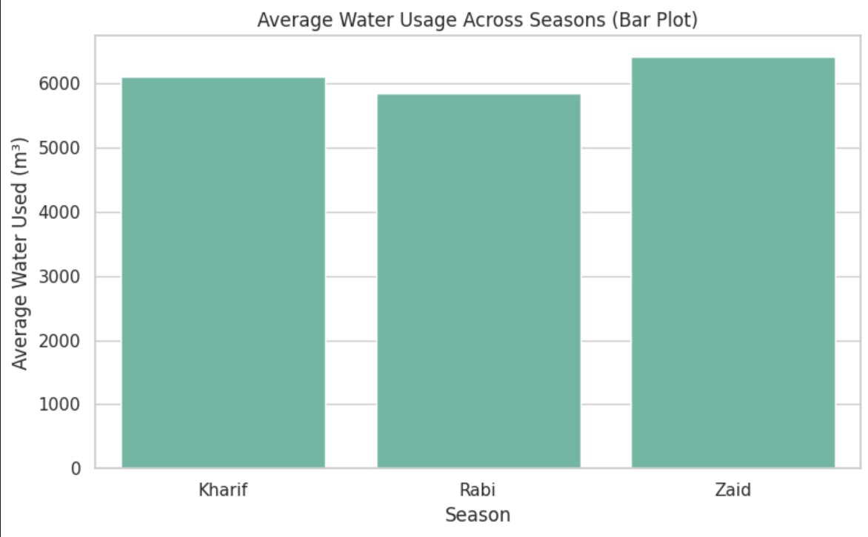
RESULTS
The bar plot shows that Zaid season has the highest average water usage, while Rabi season has the lowest. Overall, water consumption varies across seasons, indicating seasonal differences in water requirements

Slide 7
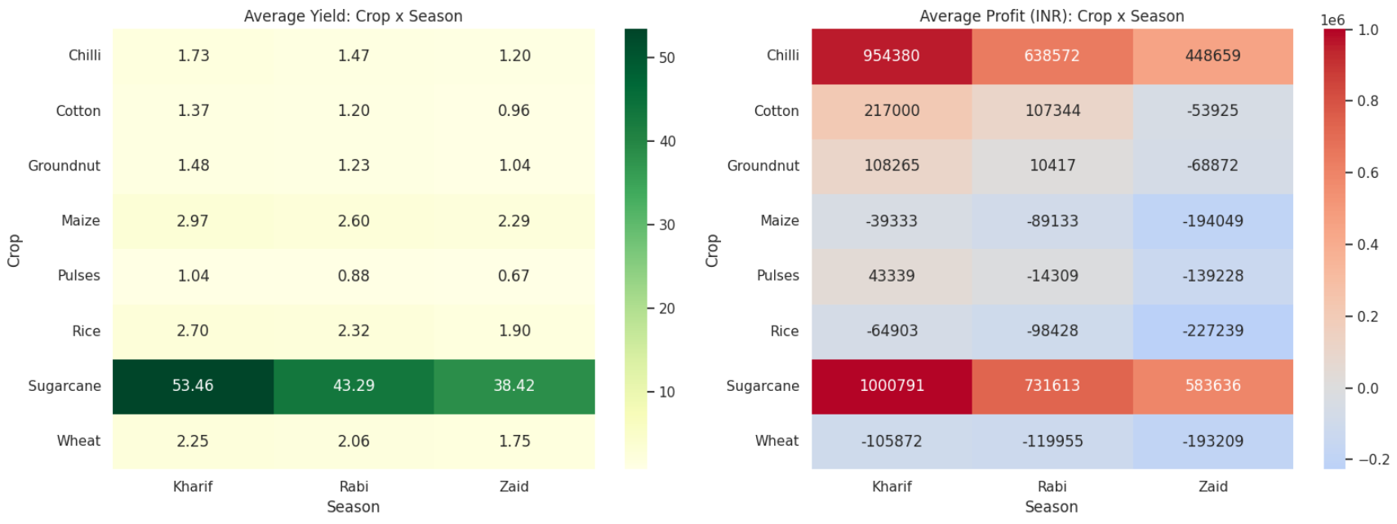
RESULTS
[Add screen shots of your code ]
The heatmaps show that Sugarcane has the highest average yield and profit across all seasons, while crops like Maize and Wheat show comparatively lower profits.

Slide 8
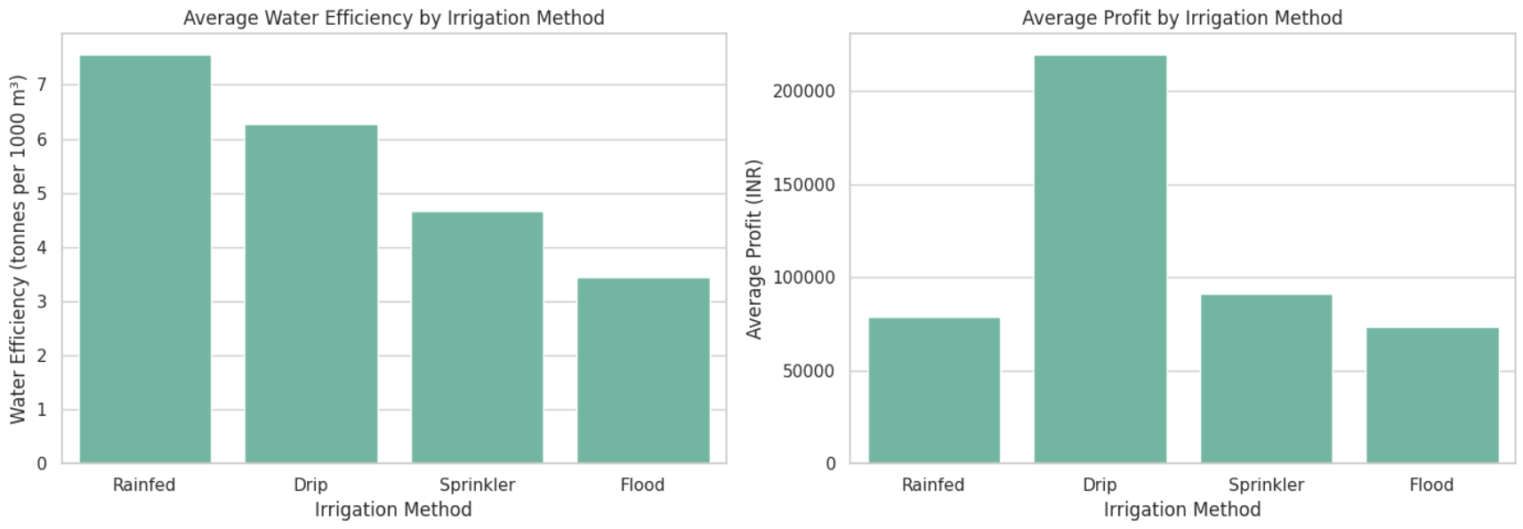
RESULTS
[Add screen shots of your code ]
The results show that Rainfed irrigation has the highest water efficiency, while Drip irrigation provides the highest average profit. Overall, Drip irrigation offers the best profitability, whereas Rainfed irrigation is more water-efficient.

Slide 9
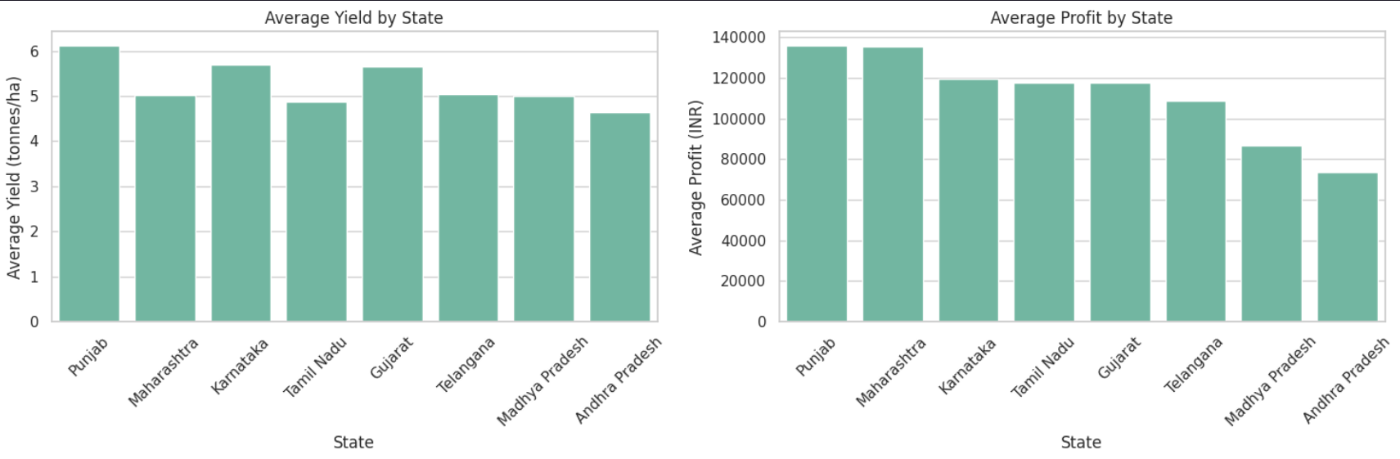
RESULTS
The results show that Punjab has the highest average yield and profit, while Andhra Pradesh has the lowest among the states shown. Overall, Punjab performs best in both crop productivity and profitability, indicating strong agricultural performance

Slide 10
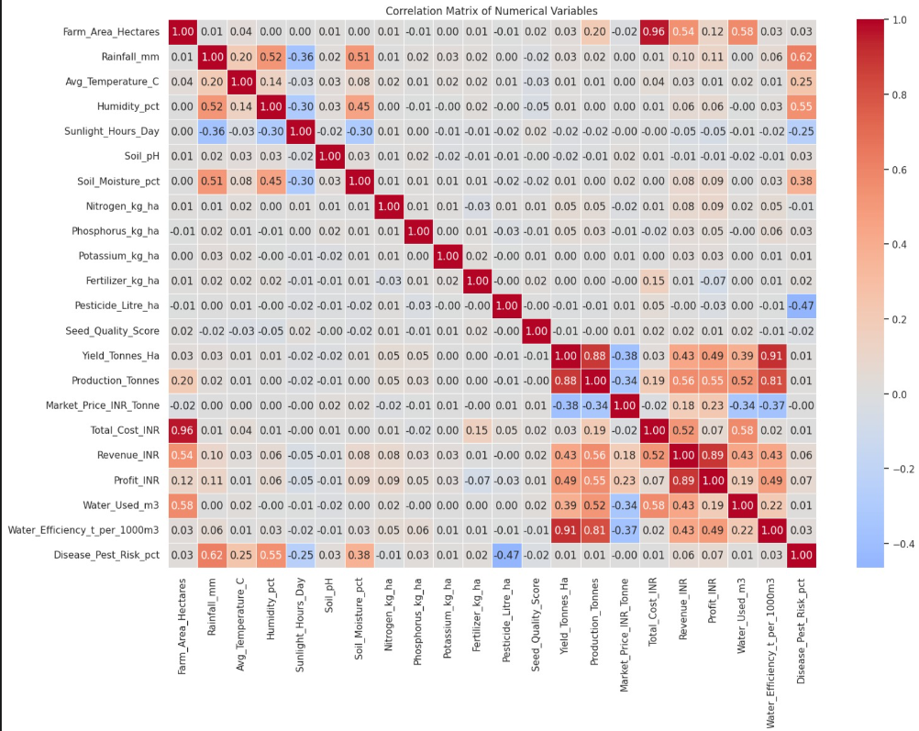
RESULTS
The correlation heatmap shows that yield, production, revenue, and profit have strong positive relationships, indicating that higher crop yield generally leads to higher production and profitability. It also highlights negative correlations between some cost-related and productivity variables, helping identify factors that influence overall agricultural performance.

Slide 11
Future scope Incorporate multi-year data to verify whether the Kharif yield advantage and irrigation-method effects hold consistently across years, rather than in a single dataset snapshot. Conduct a deeper cost-and-pricing analysis for currently loss-making crops (Wheat, Rice, Maize, Pulses) to identify specific cost drivers behind negative profit margins. Study non-linear relationships between soil pH, seed quality, and yield, since simple correlation showed no strong linear link — threshold or interaction effects may still exist. Extend the analysis to district-level granularity to uncover more localized patterns currently masked by state-level aggregation. Integrate real-time weather and market-price data to move from historical/observational analysis toward predictive planning tools. Build a dashboard for farmers and policymakers to interactively explore seasonal recommendations by crop, region, and irrigation method.

Slide 12
GitHub Link
https://github.com/tanvi-23-magdum/Seasonal-Agriculture-Performance-Analysis.git

Slide 13
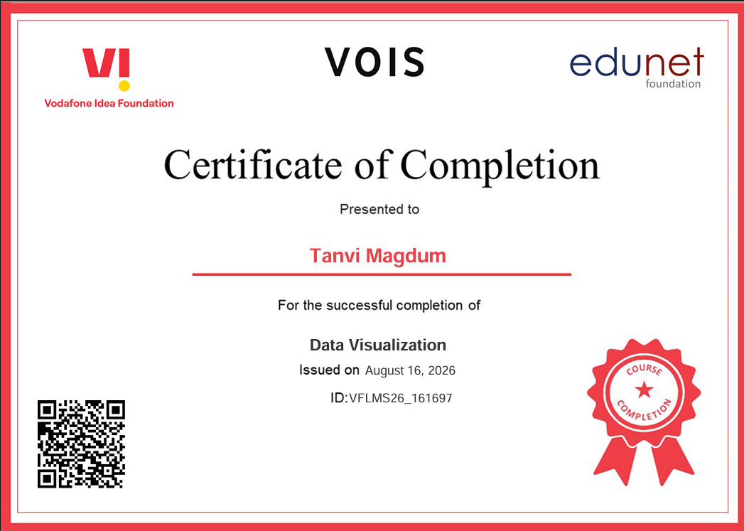
VOIS Course completion certificate - Course name- Data Visualization

Slide 14
Thank you
.
.

