Slide 1

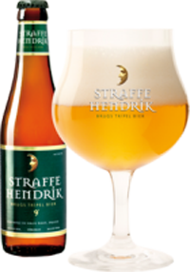
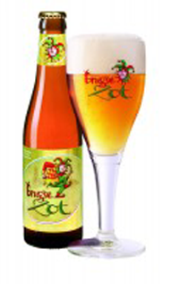

U.S. BREWERY ANALYSIS
PHASE 1
REVIEW MEETING
aartAnalytics Authors :
Anne Francomano Anjli Solsi Rebecca Holsapple Tanvi Arora
Source of Images: https://www.halvemaan.be/nl/home
Notes:
Images used in this presentation courtesy of: https://www.halvemaan.be/nl/home
https://github.com/tanvi-arora/Beerplant

Slide 2
Phase 1 Review Meeting - Agenda
Introduction
Two Key Characteristics
Alcohol Content by Volume
Bitterness Rating
Data Source Details
Phase 1 Analysis Findings
Statistics by U.S. State
Recommendations for Phase 2
Questions/Discussion
Source of Images: https://www.halvemaan.be/nl/home
Notes:
Images used in this presentation courtesy of: https://www.halvemaan.be/nl/home

Slide 3
Introduction
Client Goals
Long term Establish foothold in U.S. alcoholic beverage market
Short term Determine best U.S. market entry point, e.g. state-level
Phased Analysis Approach
Phase 1
Statistics for two key beer characteristics per U.S. state
Present findings and next step recommendations
Phase 2 focus to be determined by client and aartAnalytics
Source of Images: https://www.halvemaan.be/nl/home
Notes:
Images used in this presentation courtesy of: https://www.halvemaan.be/nl/home

Slide 4
Two Key Characteristics
Alcohol Content by Volume (ABV)
Number of ounces of alcohol with respect to the volume
International Bittering Units scale (IBU)
Parts per million of acid in beer giving the beer its bite
European Measurement of Bitterness (EBU) essentially equivalent to IBU
Use to…
Understand U.S. consumer taste preferences
Evaluate De Halve Maan’s product line
Realistic fit within the U.S. market?
Too different ?
Where are potential clientele?
Source of Images: https://www.halvemaan.be/nl/home
Notes:
Images used in this presentation courtesy of: https://www.halvemaan.be/nl/home

Slide 5
Data Source
558 Breweries
2410 Beers
Beer Name
Style
ABV
IBU
Ounces of Beer
Brewery Name
U.S. City
U.S. State
iBeverage Inc. (NY)
Compiled data encompasses wide breadth of craft breweries across the United States
Reflect range of tastes and styles
Source of Images: https://www.halvemaan.be/nl/home
Notes:
Images used in this presentation courtesy of: https://www.halvemaan.be/nl/home

Slide 6
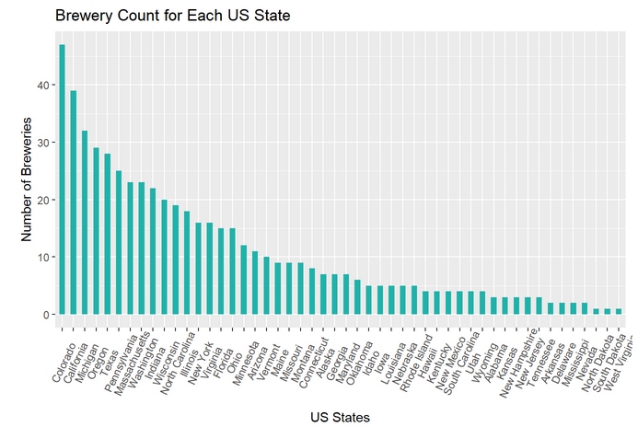
U.S. Brewery Presence By State
Largest concentration of breweries
Colorado (47)
California (39)
Michigan (32)
Oregon (29)
One brewery apiece
District of Columbia
North Dakota
South Dakota
West Virginia
Number of breweries alone should not drive strategy… Consider the product characteristics!
Source of Images: https://www.halvemaan.be/nl/home
Notes:
Images used in this presentation courtesy of: https://www.halvemaan.be/nl/home

Slide 7

Summary Statistics For ABV
De Halve Maan 33% greater median alcohol content
Verification of Maximum legal alcohol content limit for import and resale
US Breweries
Range 0.1% – 12.8%
Median 5.6%
Colorado Maximum
De Halve Maan
Range 0.4% – 11%
Median 8%
Quadrupel beer Maximum
Source of Images: https://www.halvemaan.be/nl/home
Notes:
Images used in this presentation courtesy of: https://www.halvemaan.be/nl/home

Slide 8
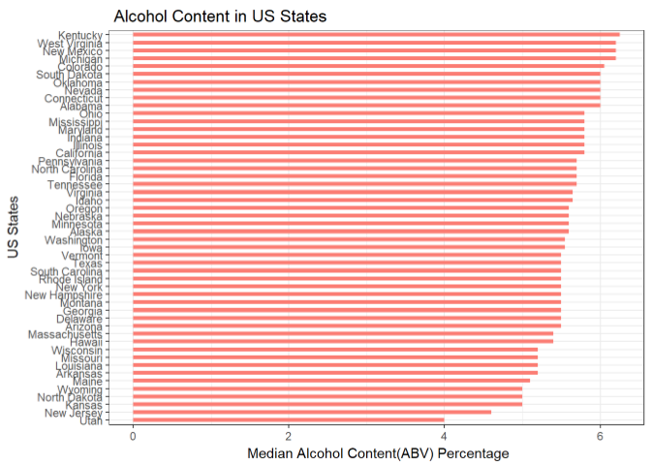
ABV vs State
Colorado maximum ABV of 12.8%
May be due to local, within-state micro-brewing allowances for higher ABV
De Halve Maan’s product line exceeds the US breweries’ maximum median by state of approximately 6.3%.
Source of Images: https://www.halvemaan.be/nl/home
Notes:
Images used in this presentation courtesy of: https://www.halvemaan.be/nl/home

Slide 9
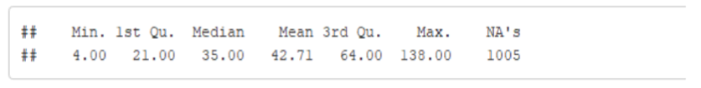
Summary Statistics For IBU
De Halve Maan’s median IBU of 32.5 falls approximately in the middle of the US breweries.
The imported Belgian beer would be well within normal standards when compared to US beers available.
US Breweries
Range 4 - 138
Median 35
Oregon Maximum
De Halve Maan
Range 23 - 35
Median 32.5
Tripel beer Maximum
Source of Images: https://www.halvemaan.be/nl/home
Notes:
Images used in this presentation courtesy of: https://www.halvemaan.be/nl/home

Slide 10
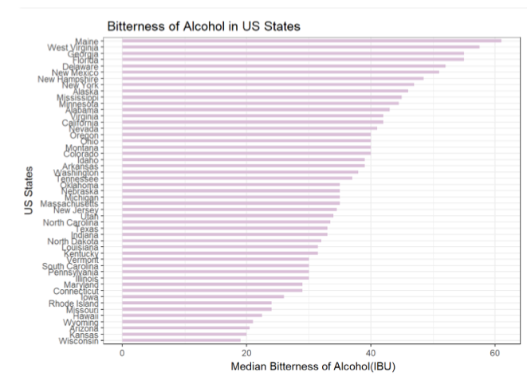
IBU vs State
Oregon maximum 138 IBU
De Halve Maan’s products range from 23 – 37 which is consistent with the majority of US Breweries
Source of Images: https://www.halvemaan.be/nl/home
Notes:
Images used in this presentation courtesy of: https://www.halvemaan.be/nl/home

Slide 11
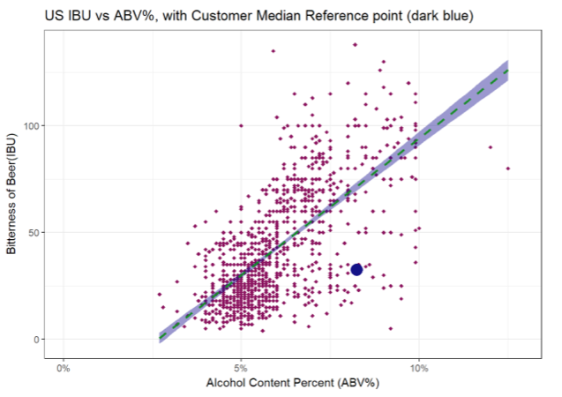
ABV and IBU
General positive relationship between the ABV and IBU
Where the company falls in comparisons to US beers in terms of alcohol content percentage and bitterness of beer
42% IBU Absent from collected observations
Source of Images: https://www.halvemaan.be/nl/home
Notes:
Images used in this presentation courtesy of: https://www.halvemaan.be/nl/home

Slide 12
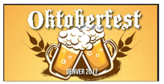

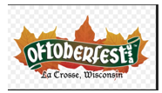
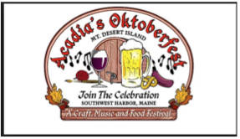
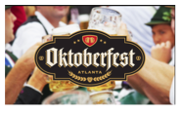

Conclusion and Recommendations
Beer Characteristics ABV and IBU are consistent with options currently available
Valid customer base in the US
PHASE 2
Determine if there is a regional or seasonal factor
Take advantage of special events occurring during the same time frame in multiple locations such as the US Oktoberfests held from late August through October.
Source of Images: https://www.halvemaan.be/nl/home; https://www.oktoberfestusa.com ; https://oktoberfestatl.com ; https://dasbestoktoberfest.com ; http://www.acadiaoktoberfest.com/ ; https://bigbearevents.com/oktoberfest/
Notes:
Images used in this presentation courtesy of: https://www.halvemaan.be/nl/home

Slide 13
Discussion and Questions
Source of Images: https://www.halvemaan.be/nl/home
Notes:
Images used in this presentation courtesy of: https://www.halvemaan.be/nl/home

Slide 14
THANK YOU!
“Gezondheid!”
Follow-up Contacts:
Anne Francomano afrancomano@aartAnalytics.com
Anjli Solsi asolsi@aartAnalytics.com
Rebecca Holsapple rholsapple@aartAnalytics.com
Tanvi Arora tarora@aartAnalytics.com
Source of Images: https://www.halvemaan.be/nl/home
Notes:
Images used in this presentation courtesy of: https://www.halvemaan.be/nl/home

