Slide 1

Gold Prices Predictions
- TANVI ARORA
- SMU MSDS 6373 TimeSeries
This Photo by Unknown author is licensed under CC BY-SA.

Slide 2
Subject of Discussion
Price discovery is crucial for any market.
India – Amongst Top 5 Consumers of Gold
A day every year dedicated to gold buying
Gold Investment is like a birth right for common-man's investment
The LBMA(London Bullion Market Association) Gold Price is used as an important benchmark throughout the gold market, while the other regional gold prices are important to local markets.
https://www.gold.org/goldhub/data/gold-prices
This Photo by Unknown author is licensed under CC BY-SA.

Slide 3
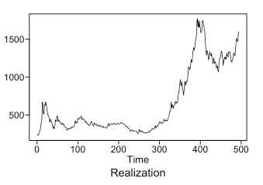
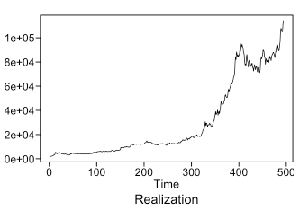
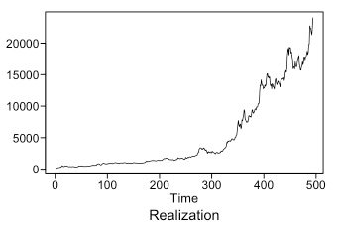
Gold Prices in International Market
US. Dollar . ( KEY Currencies ) | Indian.rupee ( TOP Consumer ) | SouthAfrican.rand ( TOP Producer )
Monthly Average price from Jan-1979 to Feb 2020

Slide 4
Gold Prices in Local market
Consumers in the largest markets of China and India base their buying decisions on the local price of gold. These regional prices often deviate from the international price of gold, reflecting local dynamics in those markets
This Photo by Unknown author is licensed under CC BY-SA.

Slide 5
INDIAN Local Market
for Gold
This Photo by Unknown author is licensed under CC BY-SA.

Slide 6
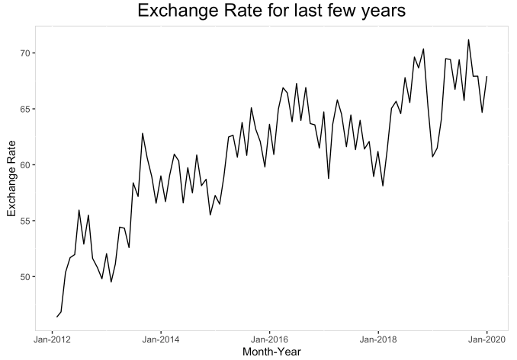
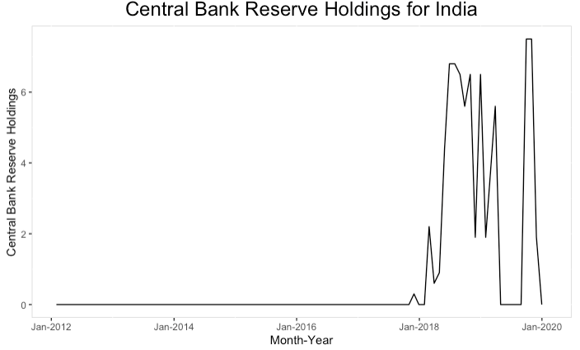
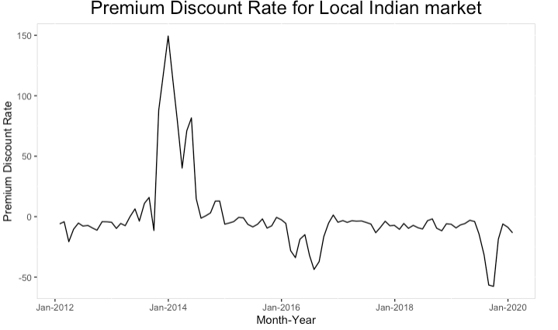
Data transformation considering additional variables
DATA | DATE AVAILABILITY | USABLE ?
Gold Price in INR | Jan-1979 onwards | Yes
Exchange Rate | April-1973 onwards | Yes
Central Bank Reserve Holdings | April-2002 onwards | No
Premium Discount Rate | Jan-2012 onwards | Yes

Slide 7
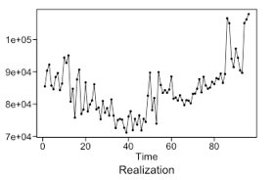

Is local gold price data also stationary ?
Mean
Variance
This Photo by Unknown author is licensed under CC BY-SA.

Slide 8
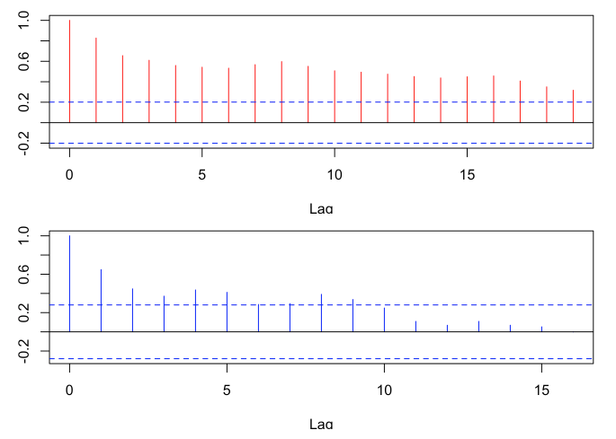
Is local gold price data also stationary ?
Mean
Variance
ACFs
This Photo by Unknown author is licensed under CC BY-SA.

Slide 9
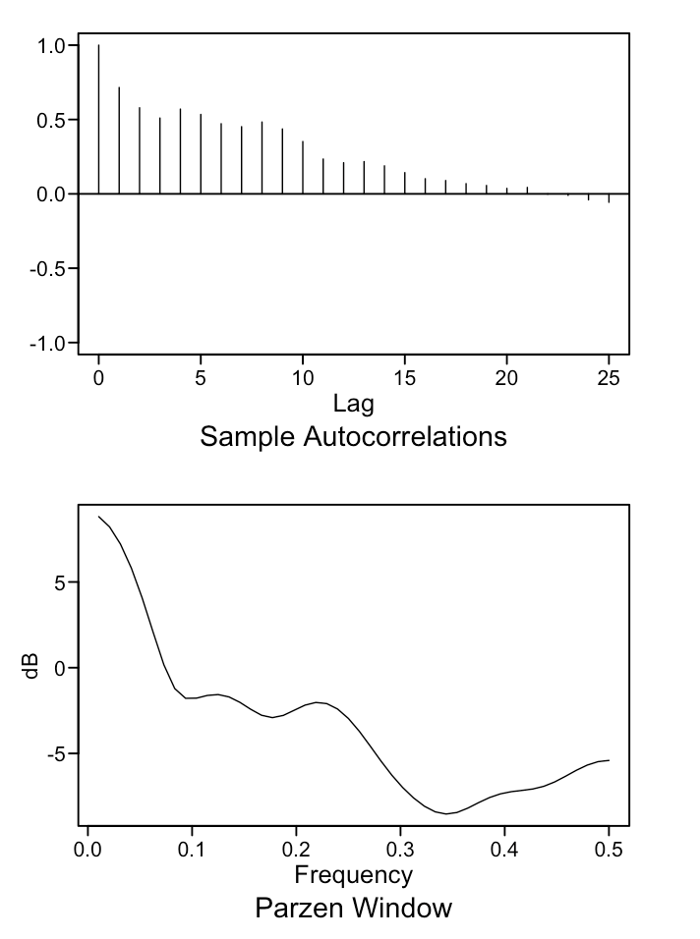
Univariate models
Seasonal Model | Peak at freq = 0 and ~ 0.22
Model with a trend | (1-B) factor
Stationary Model | How would it perform on Non-stationary data?

Slide 10
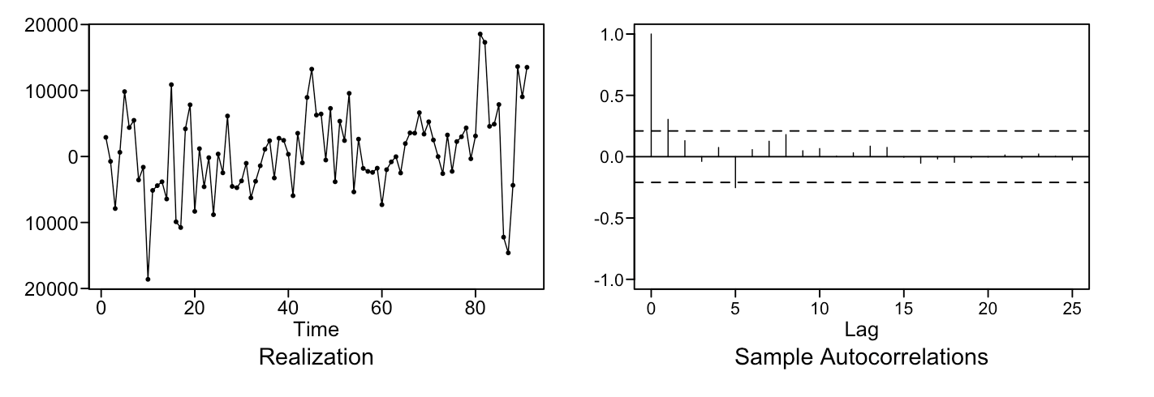
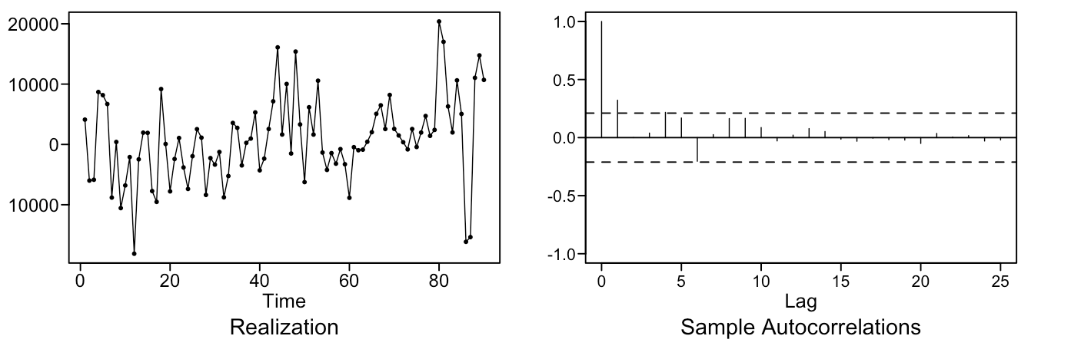
Seasonal Model
S = 5
S = 6
ARIMA(11,0,2) with S=6 Model , ASE of last 6 predictions = 63,526,675
This Photo by Unknown author is licensed under CC BY-SA.

Slide 11
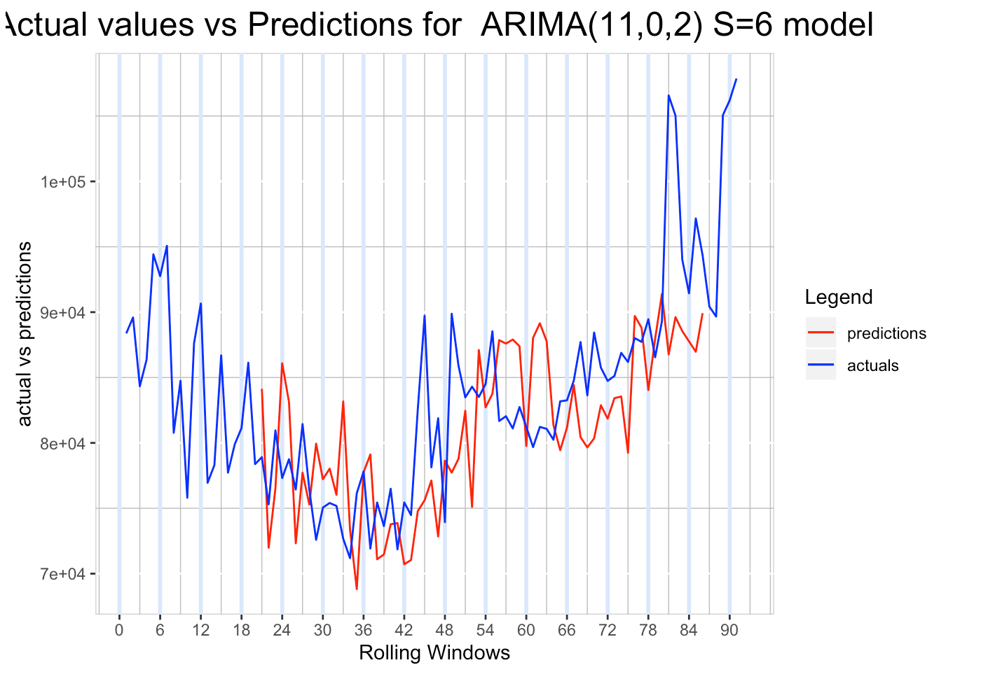
Seasonal Model – ARIMA(11,0,2) WITH S = 6
Rolling ASE = 41,950,665
This Photo by Unknown author is licensed under CC BY-SA.

Slide 12
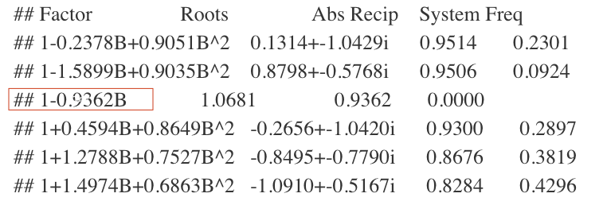
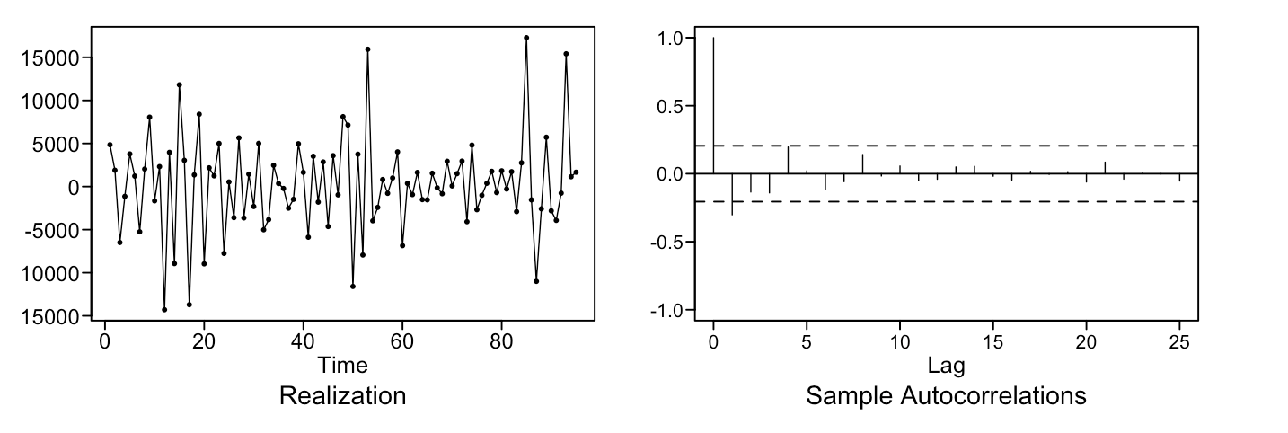
Univariate models - ??
d=1 transformed data
ARIMA(3,1,0) model with ASE on last 6 predictions = 62,612,580

Slide 13
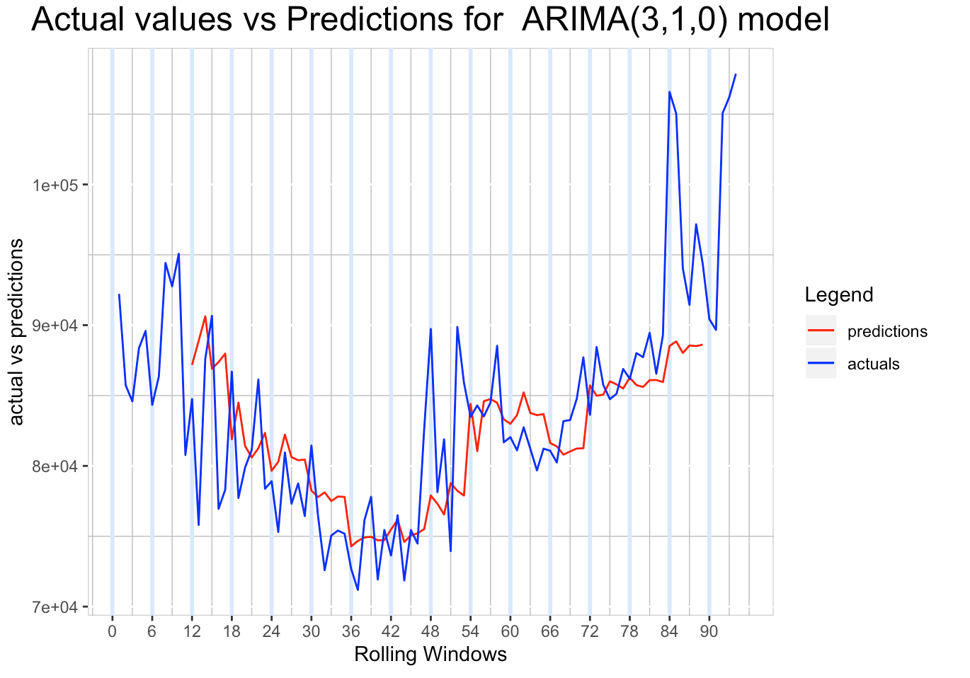
Seasonal Model – ARIMA(3,1,0)
Rolling ASE = 32,548,667
This Photo by Unknown author is licensed under CC BY-SA.

Slide 14
Curious about Stationary Univariate Model?
ARMA(2,1) model with ASE on last 6 predictions = 450,302,547

Slide 15
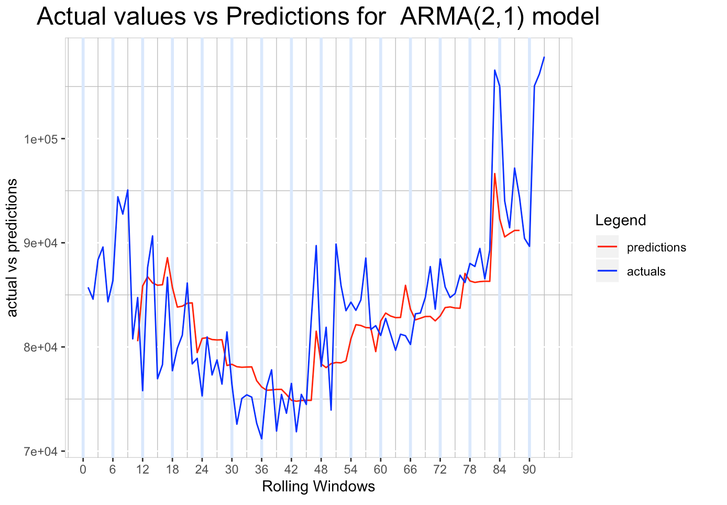

Curious about Stationary Univariate Model?
ARMA(2,1) model with ASE on last 6 predictions = 450,302,547
Rolling ASE = 25,758,608
Minimum ASE

Slide 16
VAR model :- no trend V/S with trend
ASE on last 6 predictions : 124,283,409
ASE on last 6 predictions : 108,256,317

Slide 17
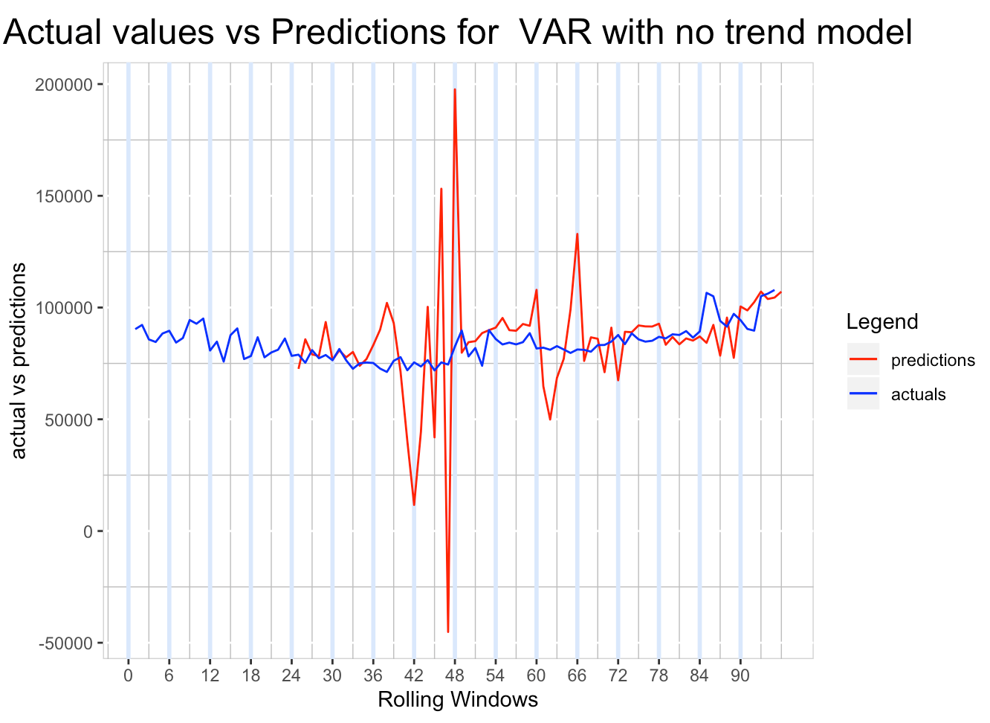
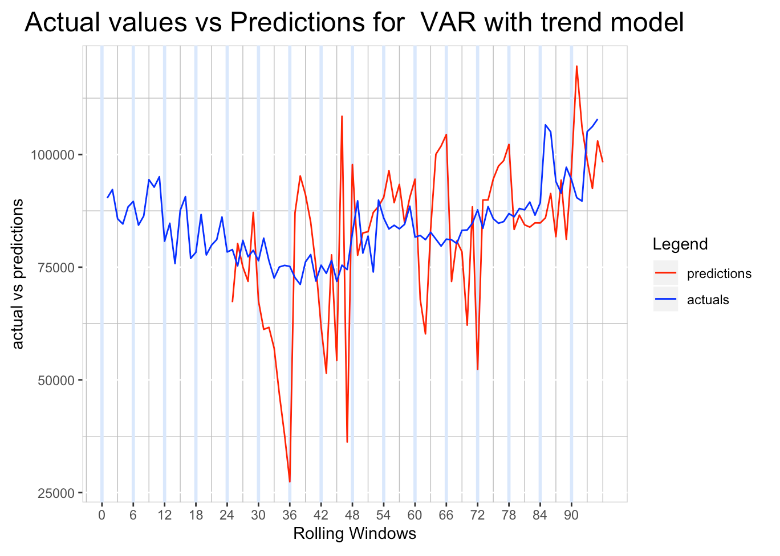
VAR model :- no trend V/S with trend
ASE on last 6 predictions : 124,283,409
ASE on last 6 predictions : 108,256,317
Rolling ASE : 715,115,551
Rolling ASE : 258,450,781

Slide 18
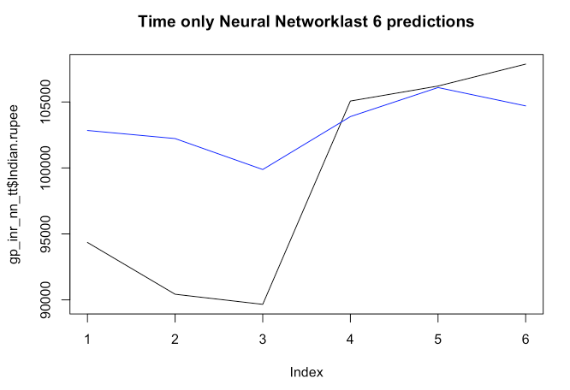
Neural Network model – univariate form
ASE on last 6 predictions = 188,605,183

Slide 19
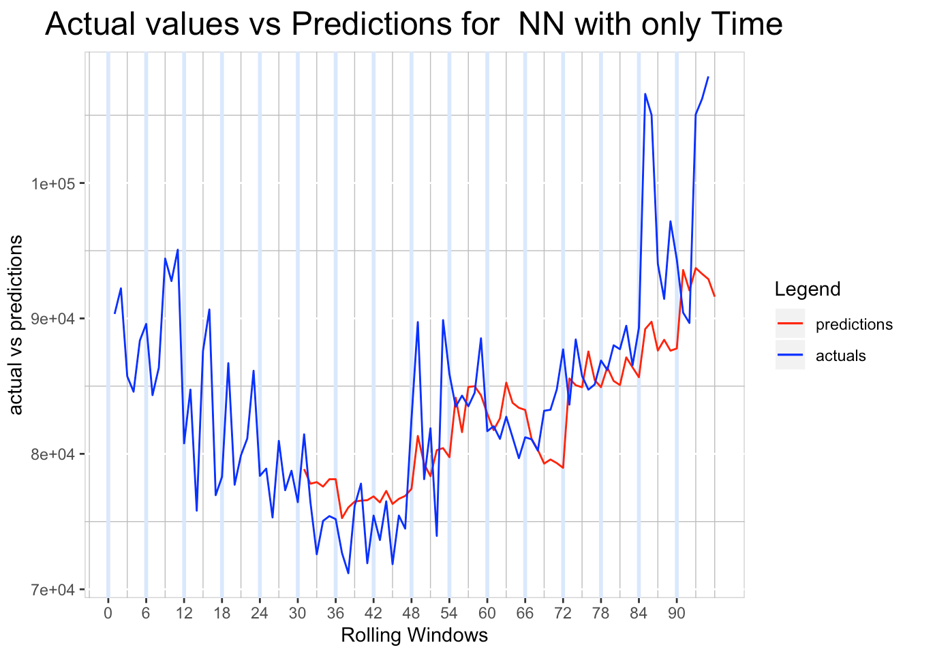
Neural Network model – univariate form
Rolling ASE = 36,506,859
COMPETITOR

Slide 20
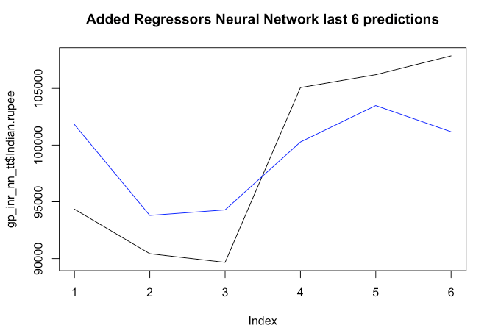
Neural Network model – VAR style
ASE on last 6 predictions = 99,617,135

Slide 21
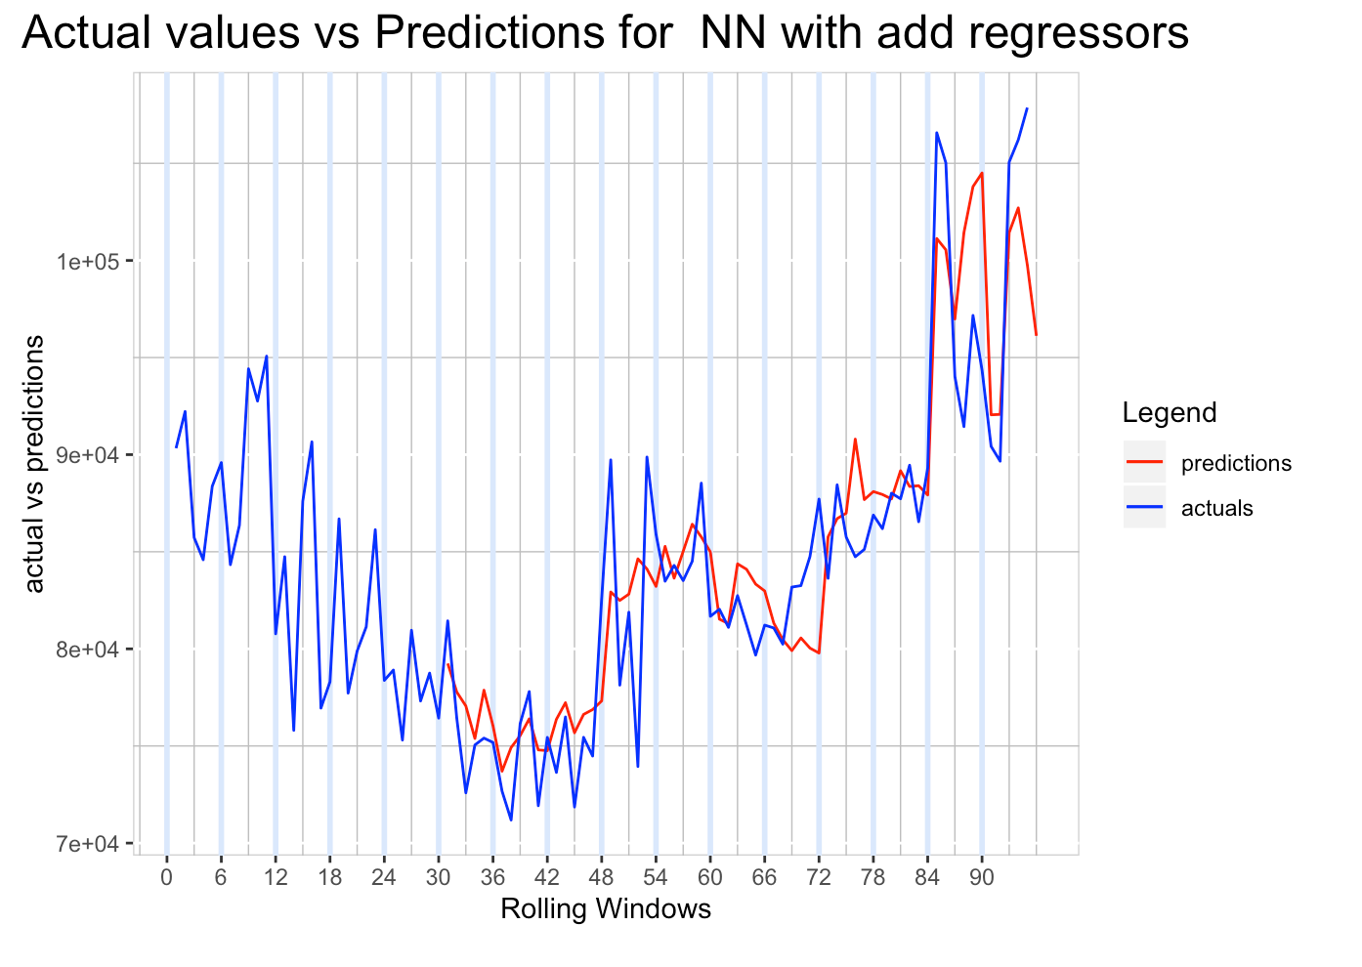
Neural Network model – VAR style
Rolling ASE = 22,981,667
BEST
?

Slide 22
Summary of Models

Slide 23
Model | ASE from last 6 predictions | Ljung test p-val(K=24,48) | Rolling Window ASE | Std Deviation for Rolling Window ASE
ARIMA(11,0,2) with s=6 | 69,610,384 | (0.95,0.6) | 41,950,665 | 35,398,412
ARIMA(3,1,0) | 123,827,211 | (0.99,0.9) | 32,548,667 | 43,207,241
ARMA(2,1) | 450,302,547 | (0.99,0.9) | 25,758,608 | 28,317,108

Slide 24
Model | ASE from last 6 predictions | Ljung test p-val(K=24,48) | Rolling Window ASE | Std Deviation for Rolling Window ASE
ARIMA(11,0,2) with s=6 | 69,610,384 | (0.95,0.6) | 41,950,665 | 35,398,412
ARIMA(3,1,0) | 123,827,211 | (0.99,0.9) | 32,548,667 | 43,207,241
ARMA(2,1) | 450,302,547 | (0.99,0.9) | 25,758,608 | 28,317,108
VAR_notrend | 124,283,409 |  | 715,115,551 | 1,694,417,203
VAR_withtrend | 108,256,317 |  | 258,450,781 | 257,488,754

Slide 25
Model | ASE from last 6 predictions | Ljung test p-val(K=24,48) | Rolling Window ASE | Std Deviation for Rolling Window ASE
ARIMA(11,0,2) with s=6 | 69,610,384 | (0.95,0.6) | 41,950,665 | 35,398,412
ARIMA(3,1,0) | 123,827,211 | (0.99,0.9) | 32,548,667 | 43,207,241
ARMA(2,1) | 450,302,547 | (0.99,0.9) | 25,758,608 | 28,317,108
VAR_notrend | 124,283,409 |  | 715,115,551 | 1,694,417,203
VAR_withtrend | 108,256,317 |  | 258,450,781 | 257,488,754
NeuralNetwork_with timeonly | 188,605,183 |  | 36,506,859 | 58,733,356
NeuralNetwork_withadded_regressors | 99,617,135 |  | 22,981,667 | 31,720,246

Slide 26
Ensemble Model
ARIMA(11,0,2) . S=6
Neural-Network with regressors
ASE : 40,893,249

Slide 27
Ensemble Model
ARIMA(11,0,2) . S=6
Neural-Network with regressors
ARMA(2,1)
ASE : 115,296,289

Slide 28
Model | ASE from last 6 predictions | Ljung test p-val(K=24,48) | Rolling Window ASE | Std Deviation for Rolling Window ASE
ARIMA(11,0,2) with s=6 | 69,610,384 | (0.95,0.6) | 41,950,665 | 35,398,412
ARIMA(3,1,0) | 123,827,211 | (0.99,0.9) | 32,548,667 | 43,207,241
ARMA(2,1) | 450,302,547 | (0.99,0.9) | 25,758,608 | 28,317,108
VAR_notrend | 124,283,409 |  | 715,115,551 | 1,694,417,203
VAR_withtrend | 108,256,317 |  | 258,450,781 | 257,488,754
NeuralNetwork_with timeonly | 188,605,183 |  | 36,506,859 | 58,733,356
NeuralNetwork_withadded_regressors | 99,617,135 |  | 22,981,667 | 31,720,246
Ensemble1(ARIMA(11,0,2)S=6 + NeuralN/W with added regressors | 40,893,249
Ensemble2(ARMA(2,1) + NeuralN/W with added regressors) | 115,296,289

Slide 29
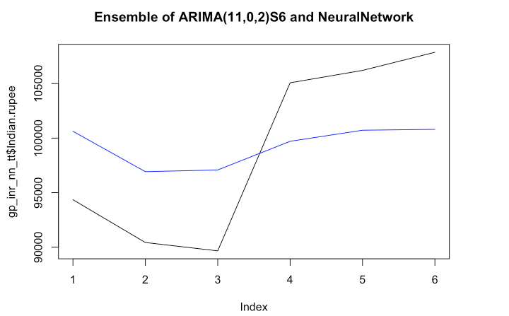
Predictions of last 6 values using preferred model

Slide 30
THANK YOU

