Slide 1
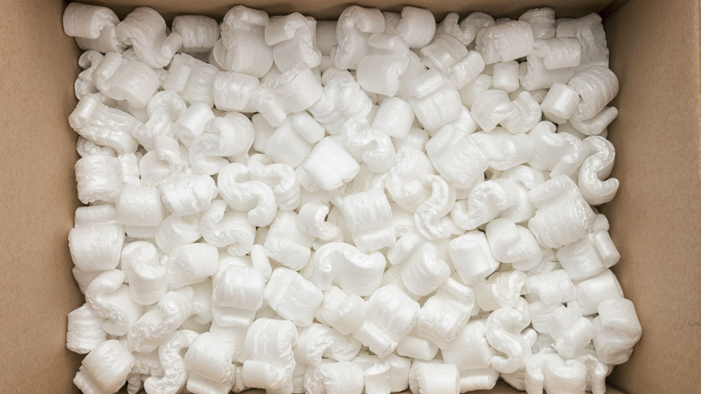
Order Fulfillment for Fudgemart Inc.
Group 5F
Anushi Doshi (Data Engineer and ETL Architect)
Avin Deshmukh (BI Architect)
Parth Lodaria (Data Architect and ETL Architect)
Pranjal Sondkar (BI Analyst)
Rajvee Shah (BI Analyst and ETL Architect)
Tanvi Borkar (Project Manager and ETL Architect)

Slide 2
Project Overview
Data from Fudgemart and Fudgeflix database is integrated into the data warehouse
Fudgemart is an online retail business where customers can Buy or Sell products.
Fudgeflix is a at home movie service where customers can order DVD's to watch movies and TV shows
The aim of the project is Improvement of the order fulfillment process

Slide 3

Business Case
Identify
Identify the Functional and Business Requirements for improving order fulfillment
Create
Create Data warehouse by integrating data from two sources Fudgeflix and Fudgemart
Analyze
Analyze the order fulfillment of Fudge Corporation using the Business Intelligence Tool
Make
Make recommendations for improving the order fulfillment to the business team

Slide 4
Business Questions?
Which category of products are in high and low demand?
Measure the efficiency of Order Fulfillment - Yearly, Quarterly, Monthly according to days elapsed!
Measure the company performance - Yearly, Quarterly, Monthly according to Order placed
Which state has the highest shipping lag?

Slide 5
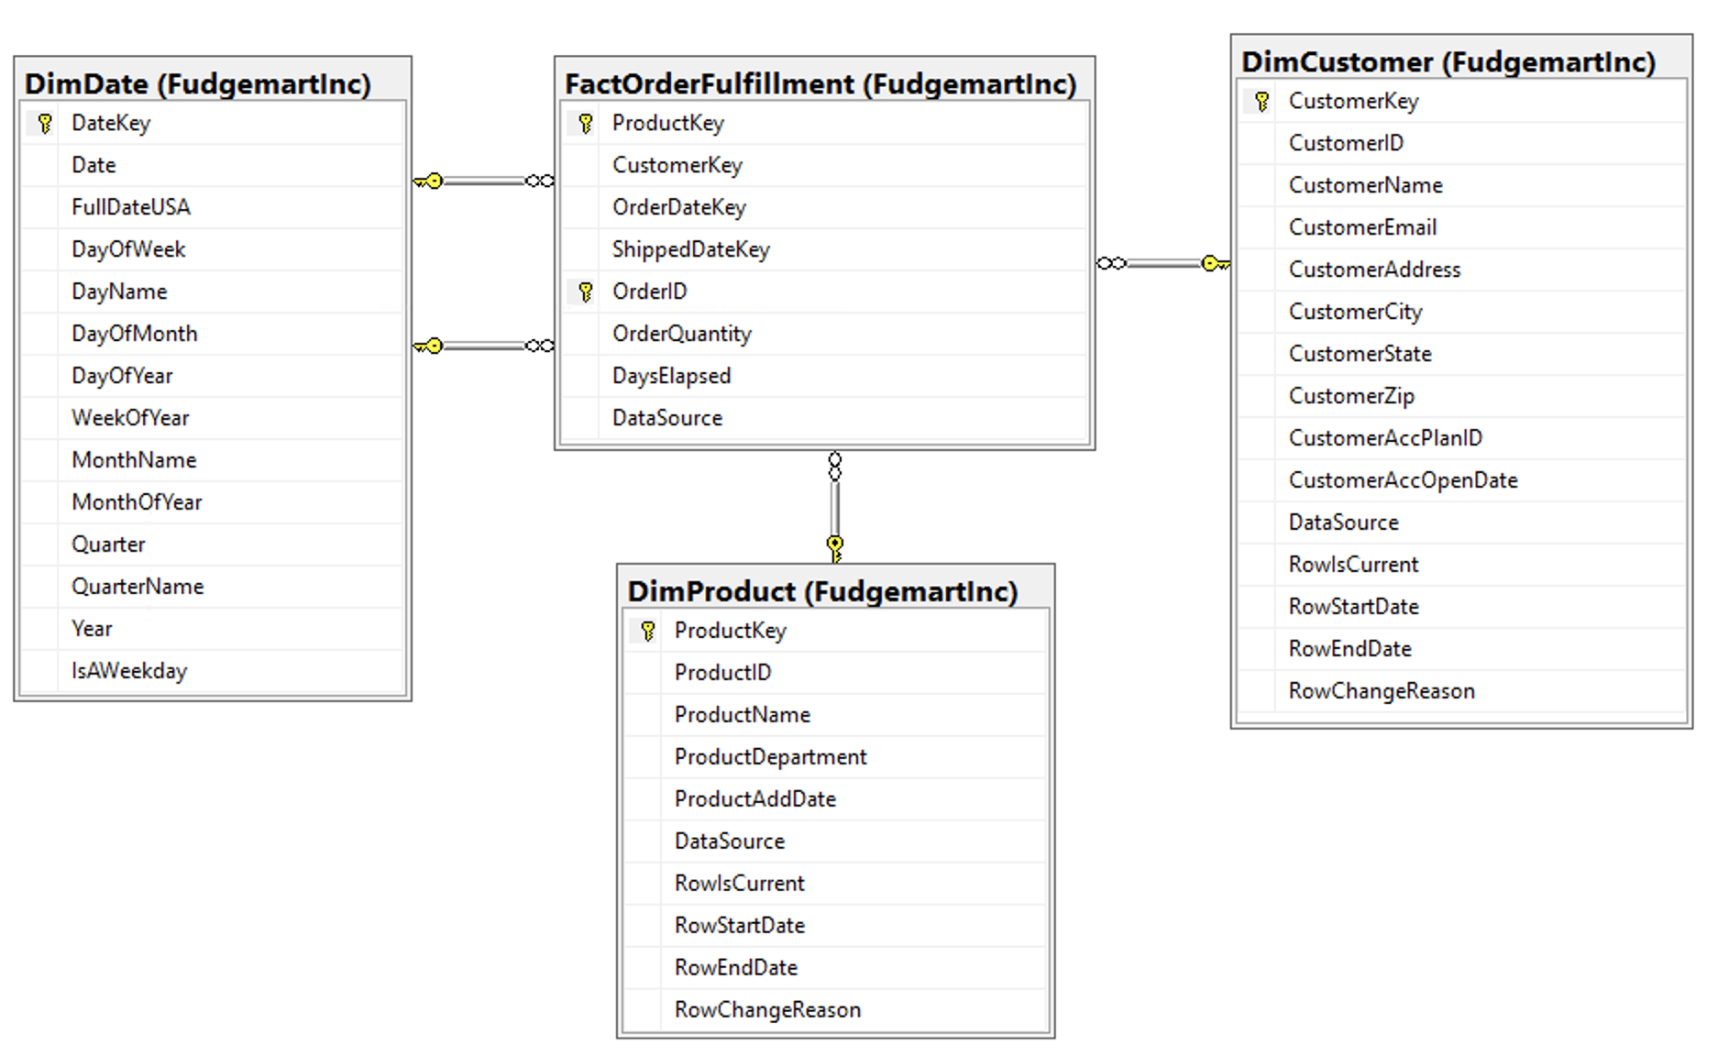
ROLAP Star Schema

Slide 6
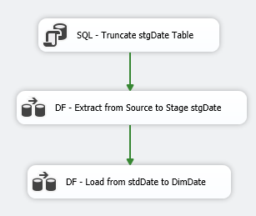
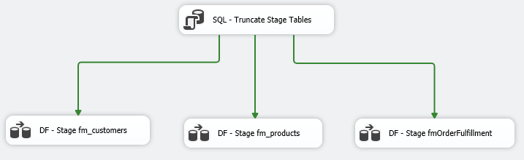
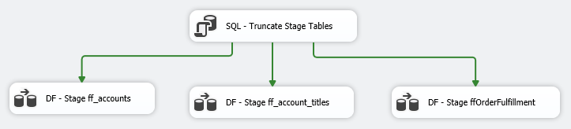
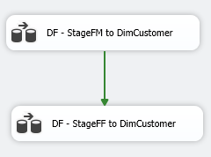
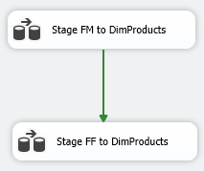
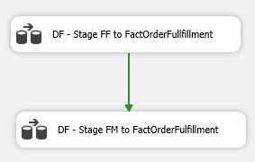
ETL: Staging & Loading

Slide 7
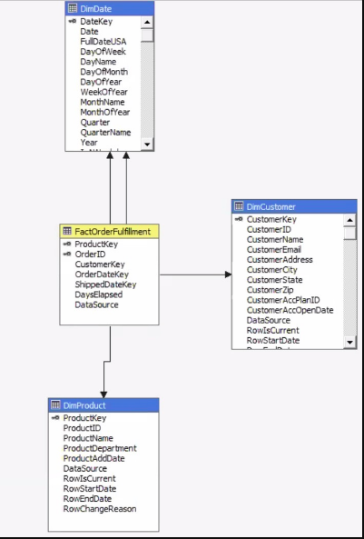
MOLAP Cube

Slide 8
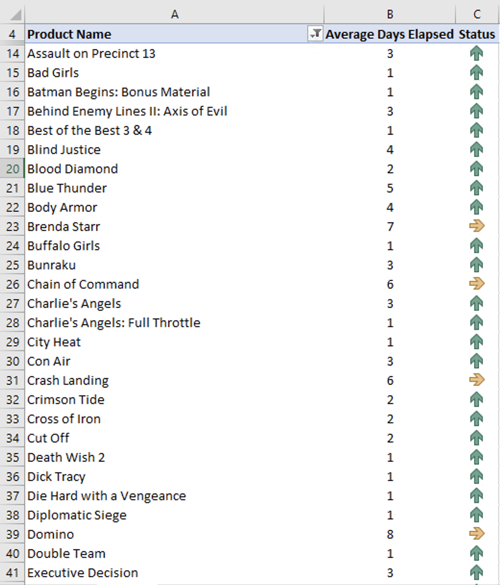
Track Order Fulfillments KPI

Slide 9
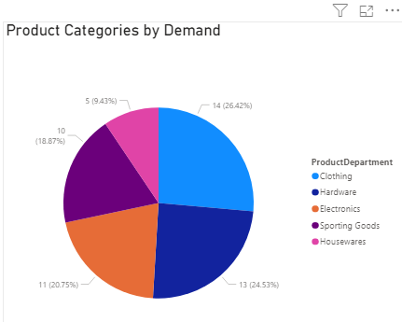
Product Categories in Demand

Slide 10
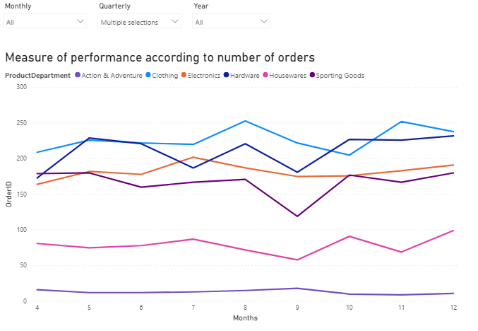
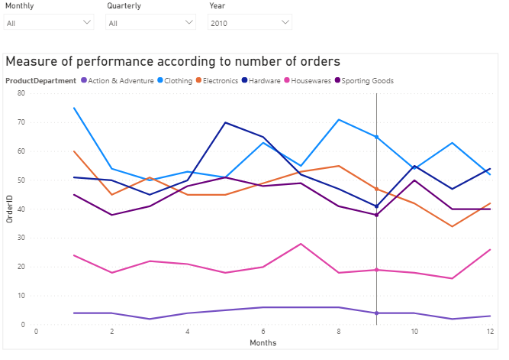
Measure of Performance by Orders

Slide 11
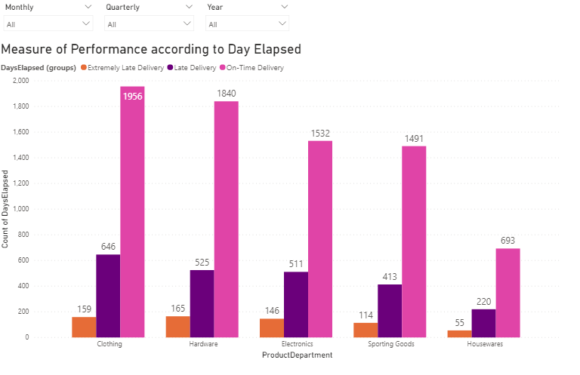
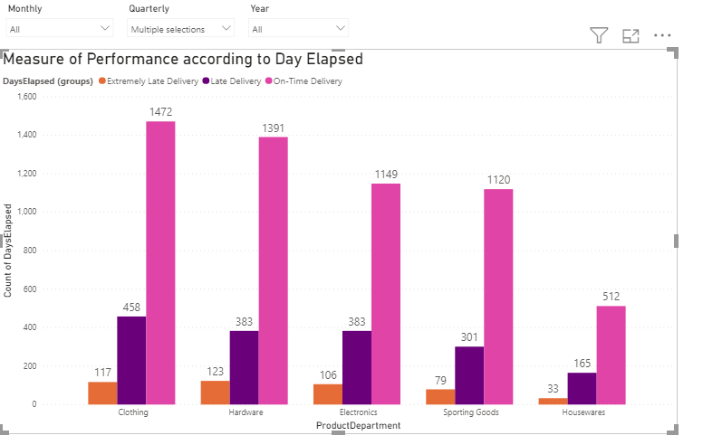
Measure of Performance by Days Elapsed

Slide 12
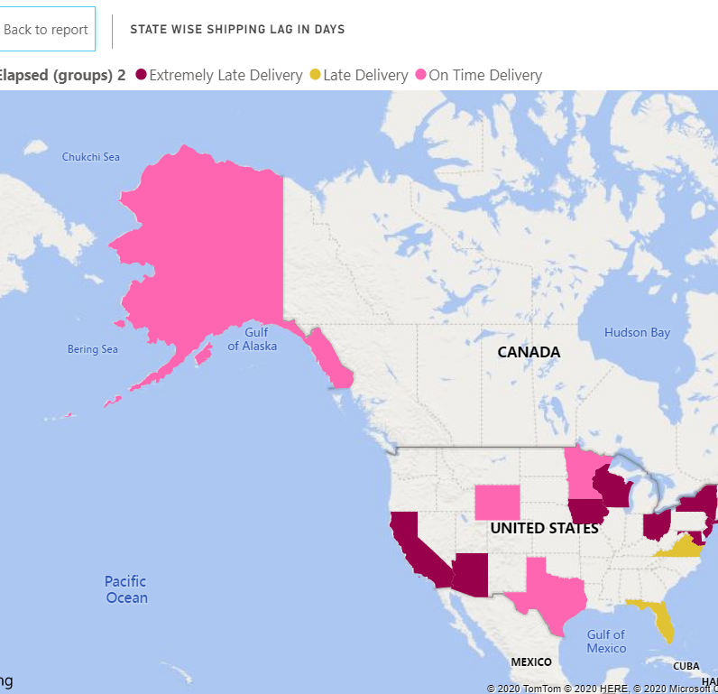
State wise Shipping lag in days

Slide 13
Recommendations
There are no records for shipper and what state shipper ships to. This would help streamline the process to improvise the shipping efficiency.
Along with order date and shipping date, keep a record of delivery date to ensure complete tracking of an order.
Establishing a process for handling those returns is critical. This should include a designated area and quality control team to receive, unpack and inspect the items, then assign each a disposition classification.
Keep a track of product inventory to increase efficiency of delivery.
Power BI Dashboad

Slide 14

Thank You!
Any question?

