Slide 1
Investment Portfolio for Patrick Iyengar & peter Iyengar
- Tanvi joshi

Slide 2
Agenda
Objective
Background
Key findings
Recommendations
Appendix:
Data sources
Data methodology
Data model assumptions

Slide 3
objective
Understand the investor persona and investment goals of investors
Determine key risk and return metrics for all 24 stocks
Shortlist the names of stocks to be invested in.
Allocate the funds and create portfolio

Slide 4
Investor personas
Patrick Iyengar
Initial Investment Amount : $ 500,000
Final Amount : > $ 1,000,000
Condition : least risk
Investment period : 5 years
Distribution of amount must be equal among all shares
Peter Iyengar
Initial Investment Amount : $ 1,000,000
Final Amount : very high
Condition : Highest returns
Investment period : 5 years
Distribution of amount must be equal among all shares

Slide 5
Primary analysis
Imported libraries : pandas , NumPy, matplotlib, seaborn plotly, functools, datetime, math
Data contains stocks of 24 companies, 1259 rows each and S&P 500 index
Database contains 6 stocks from Aviation, Finance, technology and healthcare industry each
Data contains 10 years duration which has been cut to 5 years for the purpose of analysis

Slide 6
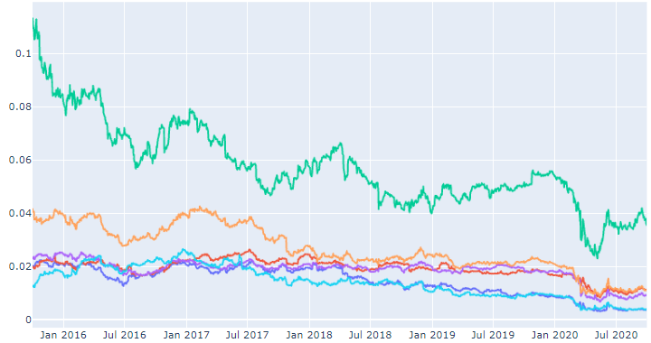

Relative strength of Aviation sector with S&P500
All stocks have a downward trend
Hence the aviation sector has incurred losses

Slide 7
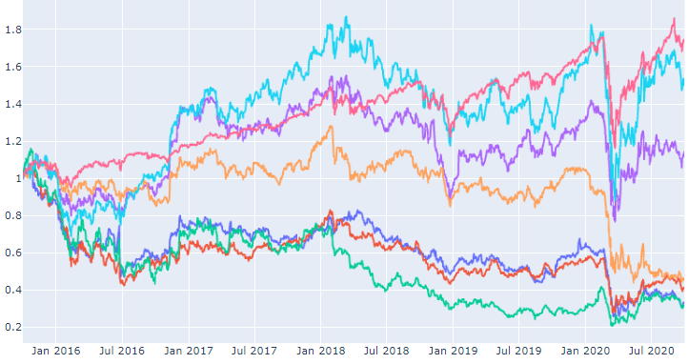
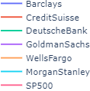
Normalized stocks of the finance sector
All stocks have faced a dip during march 2020 due to pandemic
Morgan Stanley and goldman sachs have shown an increase in closing prices.

Slide 8
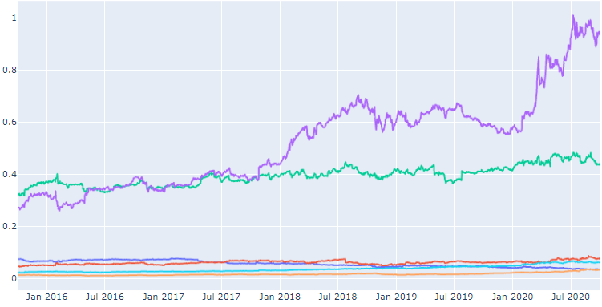

Relative strength of Technology sector with S&P500
Google and amazon’s performance is better than s&P500 index
Rest all companies have performed similar to S&P500 except IBM

Slide 9
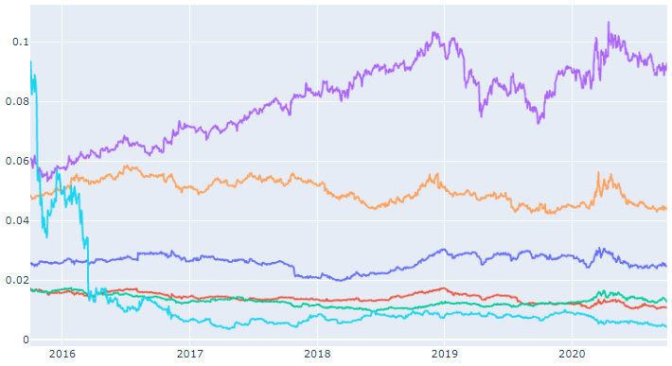

Relative strength of health sector with S&P500
United health group has performed better than s&p500
Merckco has performed similar to s&p500.
Rest of the companies have performed worse than s&p500 index

Slide 10
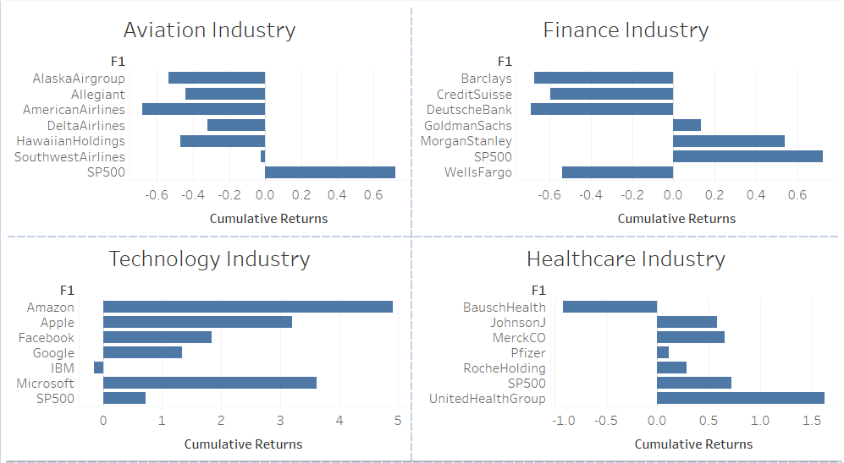

Cumulative Returns in each sector
Aviation - No companies will be chosen
Finance – Goldman Sachs, Morgan Stanley can be further analysed
Tech – All can be checked except IBM
Healthcare – All except Bausch Health will be further analysed

Slide 11
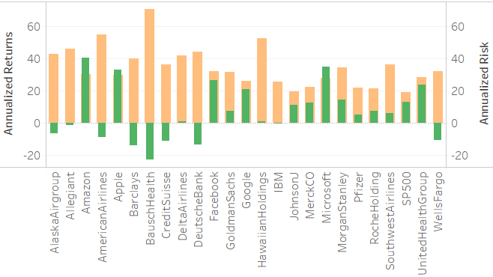

Key findings 1
Aviation – All companies have negative cumulative returns.
Finance – Goldman Sachs and Morgan Stanley have positive annualized returns.
Tech – Except IBM , all other stocks have positive returns, with amazon and Microsoft being highest.
Healthcare – Except Bausch health , other stocks have positive Cumulative Returns.

Slide 12
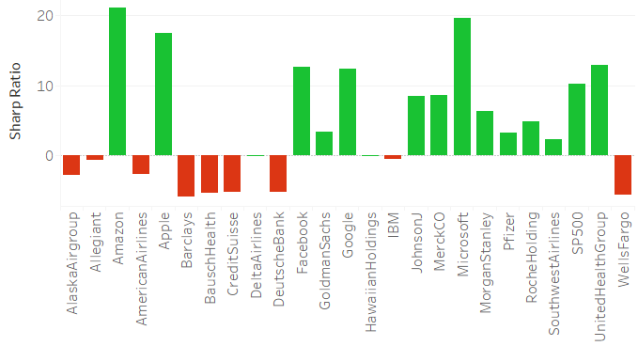
Key findings 2
Shows the return of investment compared to risk.
The red color indicates negative sharp ratio
From each sector, only those stocks with high sharp ratio shall be chosen
According to investor person, a trade off between sharp ratio and risk is done.

Slide 13
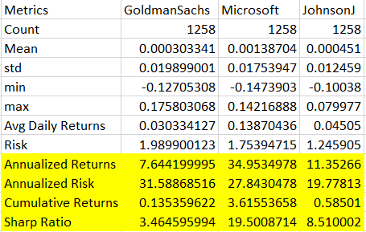
portfolio metrics for patrick

Slide 14
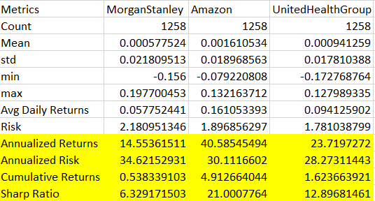
portfolio metrics for peter

Slide 15
Portfolio for Patrick
Johnson & Johnson , Microsoft and goldman sachs
Initial investment amount : $ 500,000
Cumulative returns after 5 years : $ 1,215,425
Portfolio risk 21.6%
Portfolio sharp ratio : 12.5

Slide 16
Portfolio for Peter
Morgan Stanley , amazon and united health group
Initial investment amount : $ 1,000,000
Cumulative returns after 5 years : $ 3,334,640
Portfolio risk 24.31%
Portfolio sharp ratio : 16.4

Slide 17
appendix-data sources
closing prices of stocks from aviation , finance, technology and healthcare industry
data sources:
Stocks dataset provided by upgrad

Slide 18
Appendix - Data methodology
conducted a thorough analysis of the stocks dataset. The process included:
Data importing and setting date correctly, deleting null values.
appending all stocks closing prices and creating a separate excel sheet.
Heatmap for correlation between stocks
Comparing all stocks with S&P500 index
Plotting the normalized closing prices
Plotting histogram to check volatility of stocks
Creating a descriptive statistics table to check all metrics

Slide 19
Appendix – data assumptions
It is assumed that the trend of the stock will continue to be the same for the next five years as the previous five years
Hence all metrics have been calculated based on this assumption.
Fundamental analysis has not been done, hence , it is not assured whether the stock is over valued or under valued.

