Slide 1
Credit eda case study
By -
Tanvi Joshi

Slide 2


Primary Analysis
Here we look for basic pattern in data and have done analysis by segmentation based on gender and based on the ‘TARGET’ variable in the dataset.
Here we take a broader look of the dataset

Slide 3
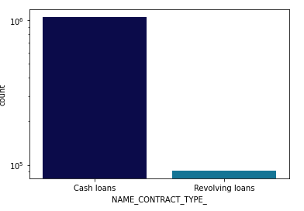
Distribution of loans
As we can see from the graph, Cash Loans are the favored mode of lending by the banks as compared to Revolving Loans.
There is a sizeable difference between the two types of Loans handed out to the applicants by the bank.

Slide 4
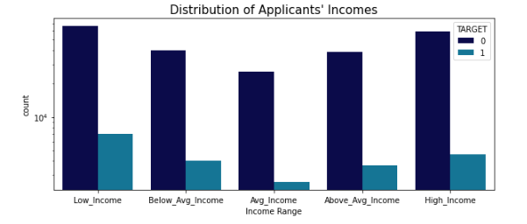
Distribution of applicants AS PER THEIR INCOME
Applicants belonging to the Low-Income category, i.e. people in the income range of 25650 -112500 have defaulted the most.
The least defaulters are people having an Average Income range, i.e. people within the income of 147150 - 168797

Slide 5
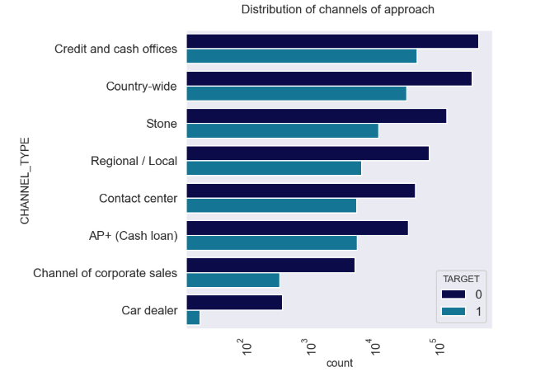
Approach to the banks
As from the visual, we can see that there is no certain pattern for the applicants to approach the banks for Loans.
There are various modes through which an applicant can approach the bank for Loans.

Slide 6
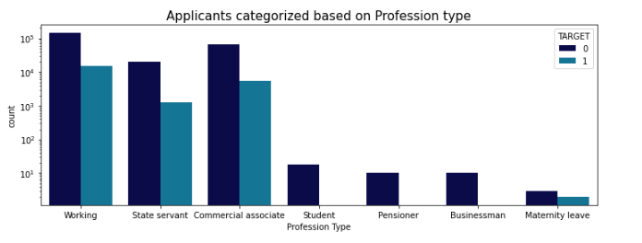
Categorization by profession
Most of the applicants belong to the Working category.
While most of the defaulters are concentrated in the three professions of a Working-class professional as well as State servants and Commercial associates, there are almost none to negligible defaulters if the applicant is either a businessman, a student or a pensioner

Slide 7

Univariate analysis
Here we try and analyze the data keeping only one variable

Slide 8
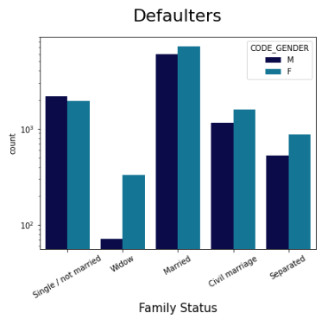
Defaulters by gender and family status
When it comes to defaulting on Loans, Applicants who are married, tend to default the most.
Females who are widowers tend to default on loans more than their male counterparts.
Apart from the single/unmarried category, men default on loans on fewer instances than females.

Slide 9
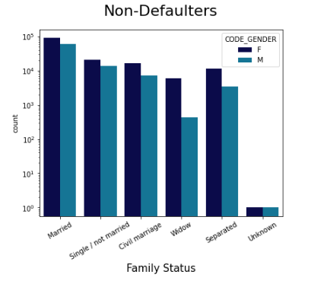
Non-defaulters by gender and family status
When it comes to the non-defaulters, married men and women have defaulted the least.

Slide 10
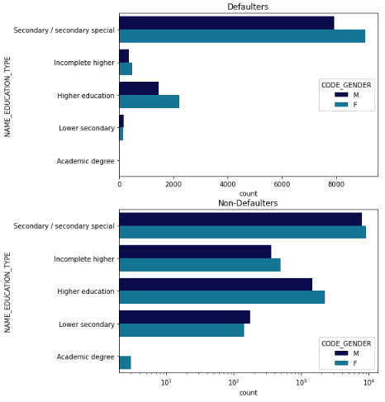
Applications by education
Most of the applications which have defaulted are the applicants who have completed only their Secondary Education.
People having academic degrees and who possess lower secondary degrees have the least probability of defaulting

Slide 11
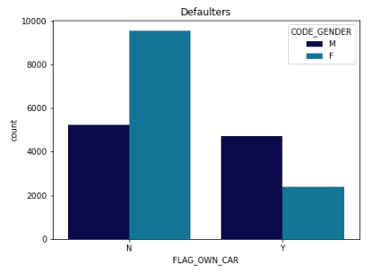
Result of owning a car for defaulters
We observe that among the defaulters, very few women have a car but almost half the men have a car.

Slide 12
Bivariate analysis
Here we will analyze the effect of one variable over the other.

Slide 13
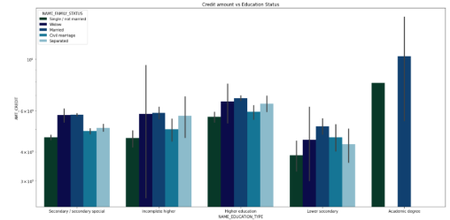
Relationship of education with credit amount
Among all categories, Married persons with an Academic Degree are the highest number of defaulters.

Slide 14
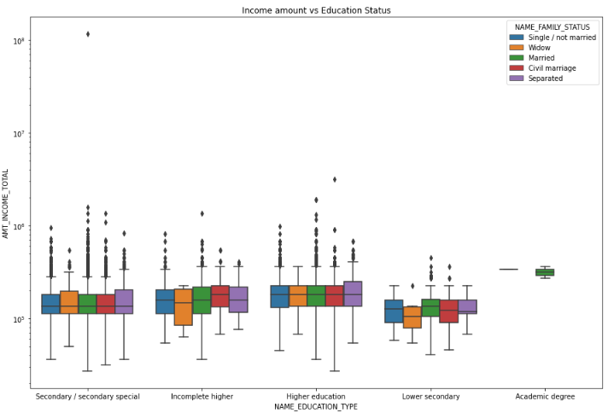
Relationship of education with income amount
Income varies significantly in the married population of the ‘Higher education’ and ‘Secondary Education’ segment .

Slide 15

observations
People with higher education have a higher repayment rate.
Customers who are repeaters are finding it difficult to repay the loans
People with greater annuity have not defaulted as much as others.
People with low income category have defaulted on loans and hence the bank can take precautions while handing out loans

Slide 16
Observations - cont.
The banks can trust people who are students, businessmen and pensioners to repay their loans on time.
Owning a car is not a vindictive metric in defining a person will default or not.
People in the married segment with an academic degree must be a cautious segment for the bank while handing out loans.

Slide 17

Thank you!
This case study has tested our knowledge of Python and its libraries for Data Analysis.
We have gained a tonne of knowledge and have experimented with the data to draw insights.

