Slide 1

Presentation -1
NOTES SHARING SYSTEM
Synopsis
ER Diagram
Use Case Diagram
Tanvi Kolte
16

Slide 2
Synopsis
Title of the Project: Notes Sharing System
Company/Client Name & Contact Details (if any):
Details :
Name | Tanvi Kolte
Roll Number | 16
Contact Number | 9156991484
Email ID | koltetanvi07@gmail.com

Slide 3
About the Existing System:
The existing system was developed in response to a common challenge faced during the pandemic when individuals encountered difficulties in sharing educational notes due to the collapse of traditional offline methods. The pandemic created a situation where physical gatherings and offline note-sharing became impractical or even impossible. As a result, there was a need for an online platform that could facilitate the sharing of educational materials efficiently.
Beyond the pandemic, the online platform remains a convenient and accessible way for students and teachers to share educational materials. Users can access notes from anywhere, eliminating the constraints of physical location.
Key Challenges Addressed:
Pandemic-Related Restrictions
The pandemic imposed restrictions on physical interactions, making it challenging for students and teachers to share educational notes in traditional offline settings.
2. Time Constraints:
The offline sharing process was time-consuming, leading to delays in accessing and distributing important educational materials.
3. Limited Accessibility:
Offline methods restricted the accessibility of notes, especially for individuals who were geographically distant from each other.

Slide 4
Need of Proposed System:
The proposed Online Notes Sharing System aims to provide an advanced and user-friendly platform for seamless collaboration among students, teachers, and administrators. The system addresses the challenges posed by the pandemic and enhances the overall educational experience through efficient digital note-sharing.
Sharing class notes as a group can help create community in your class while supporting students at the same time! Students can fill in the blanks and share what they heard differently. You may even be able to see where they aren't quite understanding certain points.
In summary, the proposed system's purpose is to create a dynamic and adaptive online learning environment that addresses the challenges of the present while preparing for the future. It seeks to enhance collaboration, streamline processes, and provide an enriching educational experience for students, teachers, and administrators alike.
Scope:
The system will encompass user-friendly interfaces for students, teachers, and administrators, allowing for secure note-sharing, user profile management, and administrative oversight. The proposed system builds upon the existing features while introducing enhancements for a more robust and comprehensive online learning experience.
The system focuses on facilitating the sharing of educational materials by students and teachers. It ensures that notes uploaded by users go through an approval process managed by the admin.

Slide 5
Objectives of the Proposed System:
The objectives for the proposed Online Notes Sharing System can be derived from the outlined purpose and the potential benefits mentioned. Here are some specific objectives for the system:
Facilitate Seamless Collaboration:
To provide a platform that enables seamless collaboration among students, teachers, and administrators for efficient note-sharing and knowledge exchange.
2. Enhance User Experience:
To improve the overall educational experience by offering a user-friendly interface and advanced features that support collaborative learning.
3. Address Pandemic Challenges:
To specifically address challenges posed by the pandemic, ensuring continuity in education through effective digital note-sharing and online collaboration.
4. Promote Community Building:
To foster a sense of community within classes by encouraging students to share class notes, collaborate, and support each other in their learning journey.
5. Support Different Learning Styles:
To accommodate various learning styles by allowing students to contribute to shared notes, fill in missing information, and provide alternative perspectives.
6. Improve Understanding:
To facilitate improved understanding of course materials by identifying areas where students may struggle or have different interpretations.

Slide 6
7. Create Dynamic Learning Environment:
To establish a dynamic and adaptive online learning environment that can evolve based on user feedback, emerging trends, and changing educational needs.
These objectives collectively aim to create a comprehensive and effective Online Notes Sharing System that meets the diverse needs of students, teachers, and administrators while adapting to the challenges and opportunities presented by the current educational landscape.
Problem Statement:
The traditional methods of sharing educational notes face significant disruptions due to the pandemic, leading to inefficiencies in communication and collaboration among students and educators. Current online platforms lack a centralized system for collaborative note-sharing, quality control measures, and efficient administrative oversight, resulting in a disjointed and less secure educational environment. There is an immediate need for a robust Online Notes Sharing System that addresses these challenges, providing a seamless and secure platform for students and teachers to collaborate, share educational materials, and enhance the overall online learning experience.

Slide 7
Goals of the Proposed System:
Adaptability to Future Educational Trends:
Goal: Design the system with adaptability in mind, ensuring it remains responsive to emerging trends in online education and technology.
Encourage Active Learning and Participation:
Goal: Promote active learning by incorporating features that encourage user participation, such as discussion forums, live Q&A sessions, and collaborative editing.
Ensure Data Security and User Privacy:
Goal: Implement robust security measures to protect user data, maintain privacy, and establish trust in the platform's integrity.
4. Reduce Delays in Accessing Educational Materials:
Goal: Minimize delays in accessing educational materials by providing a platform that allows quick sharing and approval of notes.
5. Facilitate Efficient Communication Channels:
Goal: Enhance communication among users through features like notifications, discussion forums, and real-time interaction tools.
6. Create a Dynamic and Adaptive Learning Environment:
Goal: Establish a dynamic online learning environment that adapts to user feedback, evolving educational needs, and technological advancements.

Slide 8





Technology Description:
Front End Language | HTML,CSS,JS
Back End Language | Python
Library
Tools | PyCharm
API
Framework | Django
Database | MySQL

Slide 9
Hardware-Software Requirements:
Hardware:
RAM : 4GB And Onwards
Storage: 150GB Minimum
Processor: 2.0 GHz or Faster.
Software:
Platforms: Window 7 and Onwards
Browser: Google Chrome, Internet Explorer
Database: MYSQL
Expected GUI Screens:
Home Page
User Signup Page
User Login Page
User Home Page
Admin Login Page
Admin Home Page
About Us Page
Contact Us Page

Slide 10
2. Entity Relationship Diagram

Slide 11
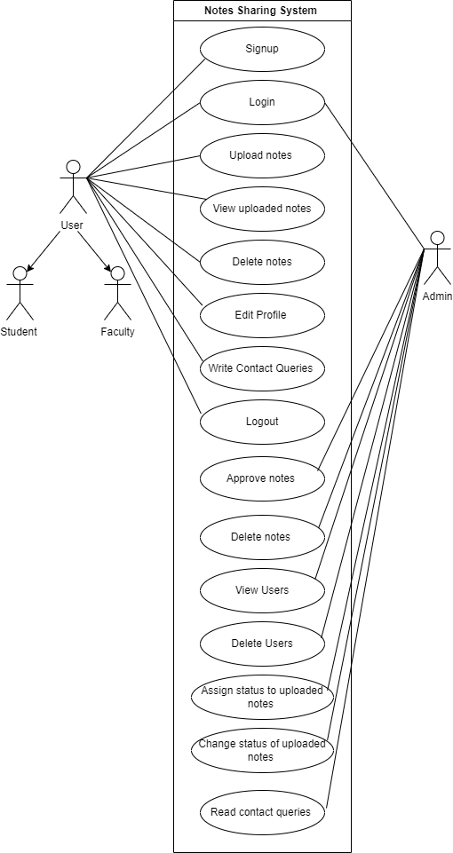
3. Use Case Diagram

Slide 12

Thank you!

