Slide 1


VIDARBHA YOUTH WELFARE SOCIETY’S
Prof Ram Meghe College of Engineering & Management, Badnera-Amravati
Department of Computer Science & Engineering
2025-2026
A Presentation on
“Coronary Artery Disease integrated with X-AI using technique SHAP”
Presented by
Riya M. Bhattad
Shraddha S. Gobare
Tanvi R. Gawande
Rajnandini V. Kasar
Guided by
Prof. Ashish D. Sawant

Slide 2
Introduction
This project integrates Coronary Artery Disease prediction with Explainable AI, which will show why the model predicts that a patient may or may not have CAD, which make the results explainable through X-AI techniques like SHAP.
This means:
The model will predict the risk of CAD based on patient health data (age, blood pressure, cholesterol, etc.)
With SHAP, we can visualize and interpret which features (like high cholesterol, smoking, blood pressure) contributed most to each prediction.
Doctors and medical professionals can therefore trust and understand the model’s decision, instead of it being a “black box.”

Slide 3
Problem Statement
Now, let’s first understand the problem.
CAD happens when the arteries that supply blood to the heart become narrow due to cholesterol deposits. This reduces blood flow and increases the risk of heart attack.
Doctors usually look at various factors — age, blood pressure, cholesterol, diabetes, smoking — before making a decision. But manually analyzing all these together can be time-consuming and sometimes difficult.
So, we thought: Can a computer help doctors by predicting CAD faster and more accurately?
The answer is yes — through Artificial Intelligence (AI).

Slide 4
Objective
To integrate Explainable AI (X-AI) methods so that predictions are transparent and understandable.
To help doctors and researches trust the model by providing clear reasoning behind predictions.
To build a user-friendly interface where patients or doctors can input data and instantly get predictions with explanations.
To contribute to the use of AI in healthcare decision-making by combining prediction and explanation in one system.

Slide 5
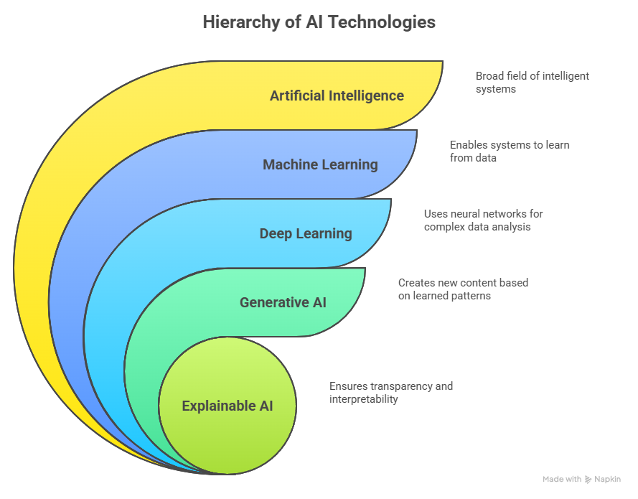
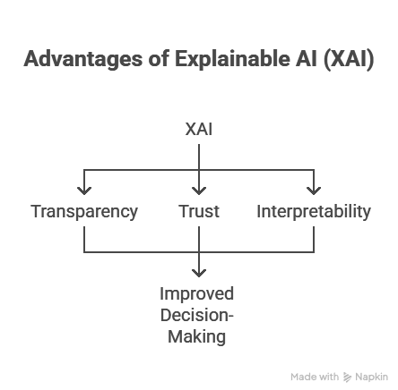

Slide 6
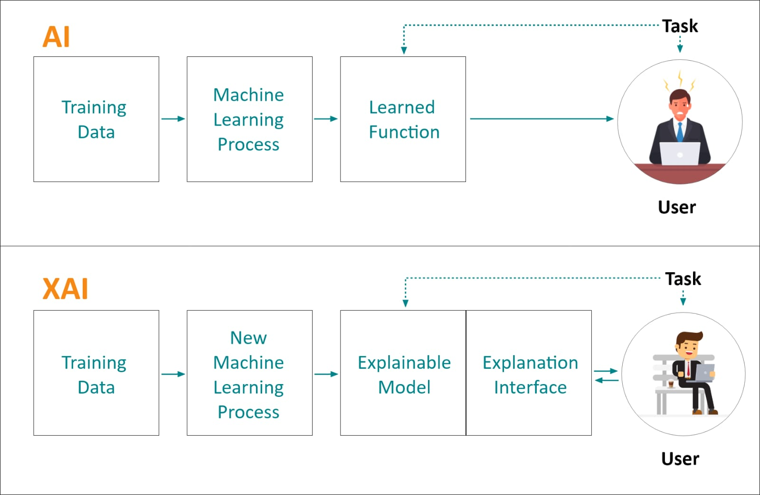
X-AI
Black - Box Model
?
Normally, AI models just say “Yes/No” or give a number.
White - Box Model
With X-AI, we can explain why the AI is giving that result. For example, if AI says “High Risk,” SHAP can show that “High Cholesterol + Smoking + Age” are the main reasons.

Slide 7
Proposed Method
Dataset Collection → Heart disease datasets from Kaggle/UCI.
Data Preprocessing → Cleaning, handling missing values, normalization, encoding.
Feature Selection → Correlation / PCA to select important health features.
Model Development → Train ML models (Naïve Bayes, Random Forest, XGBoost).
Explainable AI (X-AI) → Apply SHAP to interpret predictions.
System Implementation → Built a user-friendly interface where patients enter details, model predicts risk, SHAP shows reasons.
Result & Future Scope → Achieved accurate and transparent predictions; future integration with hospitals and wearable devices.

Slide 8
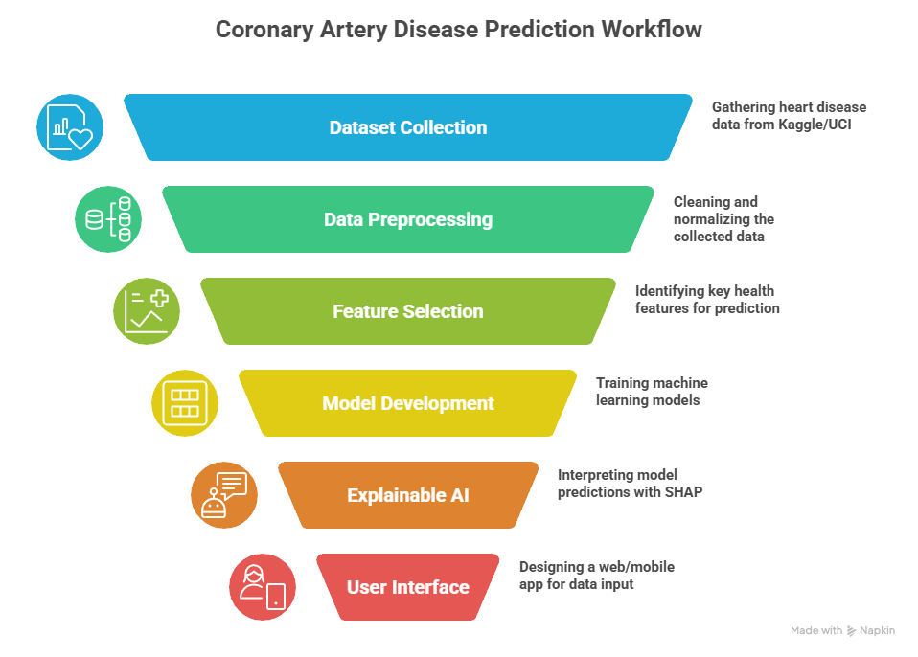

Slide 9
Uses Cases
Early Diagnosis for Patients -> Helps detect risk of Coronary Artery Disease before severe symptoms appear.
Decision Support for Doctors & Researchers -> Doctors & Researchers can see which medical doctors and give explaination - making it easier to trust AI decisions.
Preventive Healthcare -> Patients with high risk can get lifestyle advice (diet, exercise, quitting smoking) early to prevent disease.
Hospital Integration -> Can be used in hospital systems (EHR/EMR) to automatically screen patients during check-ups.

Slide 10
Conclusion
In conclusion, our project is not just about predicting heart disease. It’s about predicting with trust, explaining with clarity, and supporting healthcare in a transparent way.
Using X-AI and SHAP, we make sure that every prediction comes with a reason. This makes our system reliable, ethical, and truly useful for doctors and patients.

Slide 11
Reference
Ensemble Learning With X-AI for CAD Prediction Based on Multiple Datasets (2025) Used stacking & voting ensembles + SHAP to predict heart disease across multiple datasets.
Explainable Artificial Intelligence for Healthcare Holzinger et al. (2019): Highlighted the importance of transparency in AI-based medical systems. Stressed on trust and accountability but did not focus specifically on CAD.
SHAP for Medical Predictions Lundberg & Lee (2017): Introduced SHAP as a unified approach to explain ML models. Demonstrated on healthcare datasets but not specialized for CAD.

Slide 12
Thank you so much for your attention.
We are now open for your questions.

