Slide 1
N-Queens State Space Tree
Project 10 · Unit IV – Backtracking · N = 4
Design and Analysis of Algorithms – Macro Project

Slide 2
Problem / Objective
• Place 4 queens on a 4×4 board so that no two queens share a row, column or diagonal.
• Solve it with recursive backtracking: one queen per row, try each column.
• Visualize the state space tree for N=4, marking invalid branches in red.
• Expected outcome (from the project list): a tree showing recursive exploration.

Slide 3
Backtracking Idea
• Level k of the tree = placing the queen of row k (one recursive call).
• Each node = one attempt: queen in column c of that row.
• Unsafe square (same column or diagonal) → branch pruned, shown in red.
• Safe square → place queen, recurse into next row.
• All columns tried → return, remove the queen (backtrack), try the next column.
• Row 5 reached → all 4 queens placed → solution.

Slide 4
Pseudocode
procedure Solve(row): // N = 4
if row > N: record solution; return
for col ← 1 to N:
if IsSafe(row, col):
place queen at (row, col)
Solve(row + 1) // recurse
remove queen from (row, col) // BACKTRACK
else: prune branch (invalid, red)
function IsSafe(row, col):
for r ← 1 to row − 1:
c ← column of the queen in row r
if c = col or |c − col| = row − r: return false
return true
Solve(1)

Slide 5
Prompt Used
“Visualize the state space tree for N=4 queens, marking invalid branches in red.”
• Refined with: Start root, one level per row, one node per column attempt, red invalid branches labelled col/diag, green solution paths.
• Generated with an AI assistant (Claude Code) from the real backtracking algorithm; saved as Visualization.png.

Slide 6
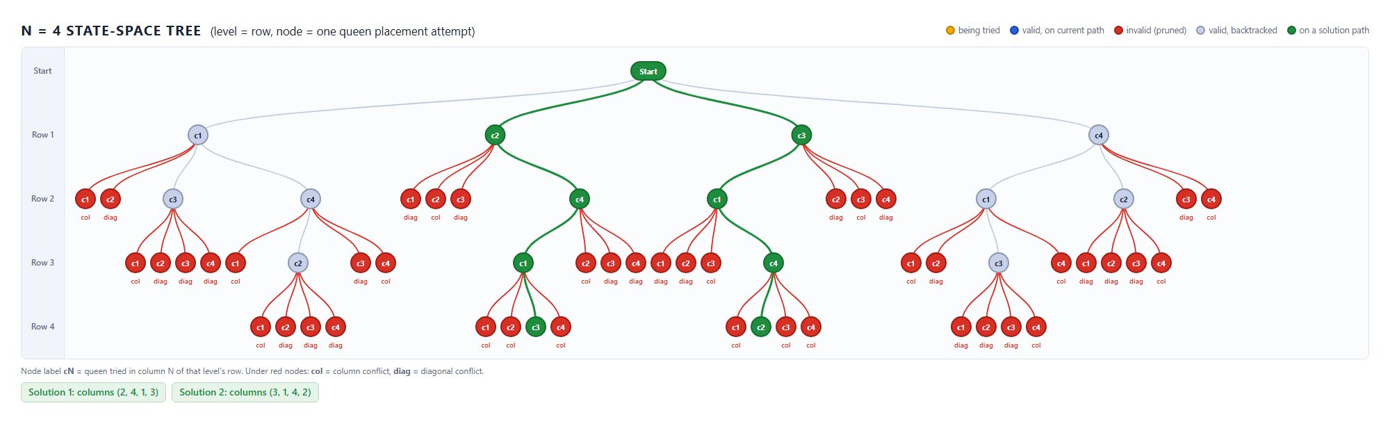
State Space Tree Visualization (N = 4)
Red = invalid (pruned) placements, labelled col / diag. Green = paths to the two solutions.
60 nodes explored: 44 invalid, 16 valid, 2 solutions.

Slide 7
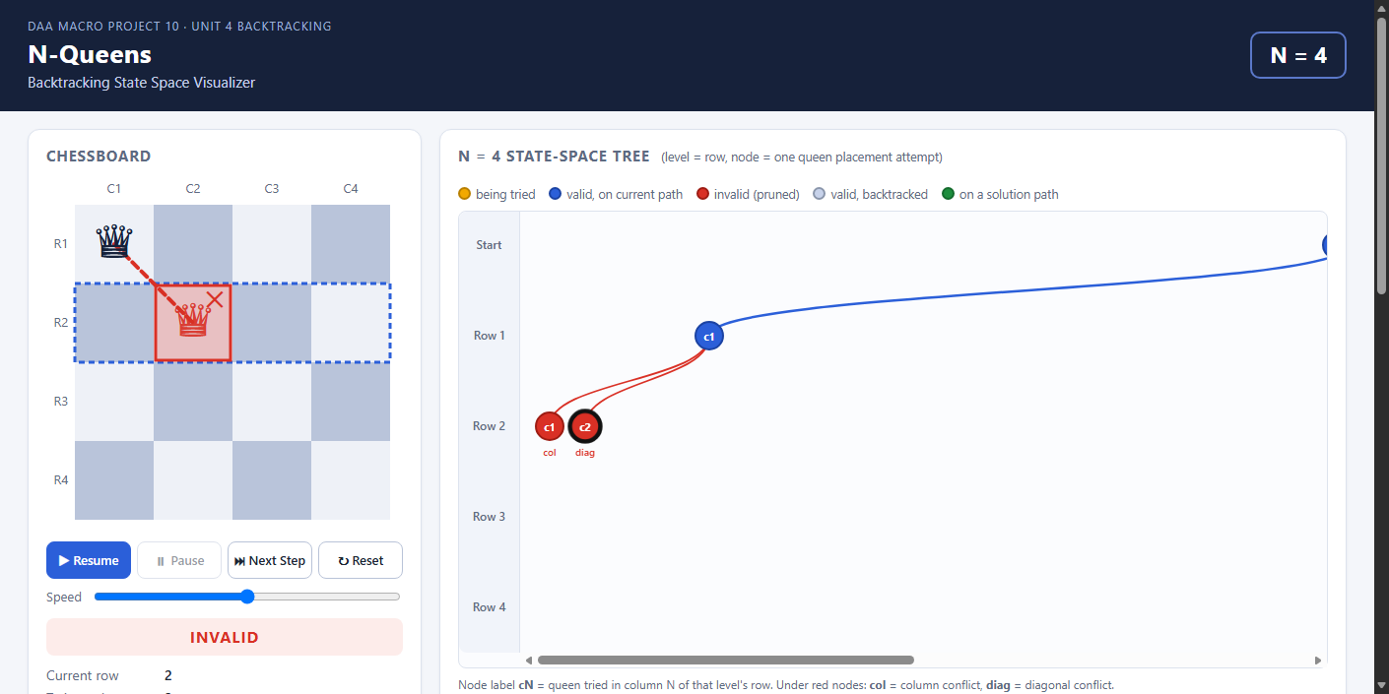
How Backtracking Is Shown
• Invalid square: red ✕ on the board, dashed line to the attacking queen, red node in the tree.
• Red nodes are leaves – nothing below them is explored.
• After all columns of a row fail, the queen is removed and the search returns to the parent node.
• Next sibling column is then tried.

Slide 8
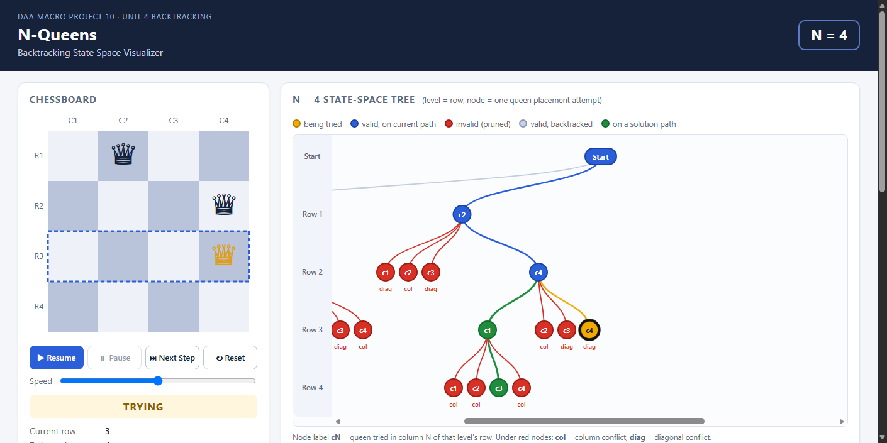
Animated Website
• Open Visualizer/index.html – no server, no install.
• Start, Pause, Next Step, Reset and a speed slider.
• Board and tree update with every real backtracking step.
• Status panel shows row, column, action and reason; pseudocode line is highlighted.

Slide 9
Results
• Solutions for N = 4: (2, 4, 1, 3) and (3, 1, 4, 2) (column of rows 1–4)
• Tree nodes explored (excluding Start): 60
• Invalid (red) nodes: 44 Valid nodes: 16
• Java program and JavaScript animation give identical results.

Slide 10
Learning Outcome
• Understood recursive backtracking.
• Learned prompt-based visualization.
• Practiced GitHub documentation.

