Slide 1
Recursion Tree for Merge Sort
DAA Macro Project • Group 11 • Unit I, Topic 2

Slide 2
Problem and Algorithm
Input: [38, 27, 43, 3, 9, 82, 10, 1]
Divide the array into left and right halves recursively.
Stop when each subarray has one element.
Merge adjacent sorted subarrays until the full array is sorted.

Slide 3
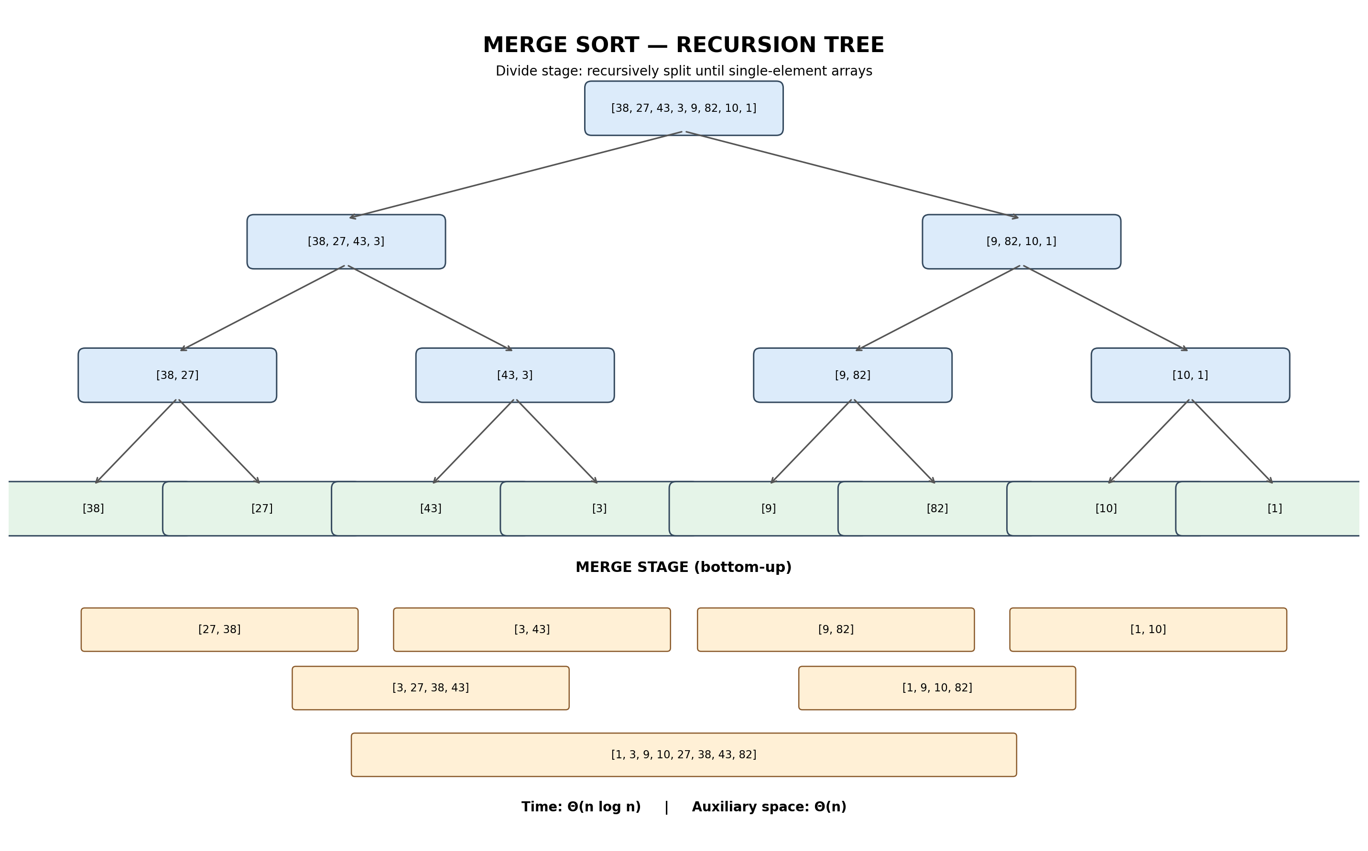
Recursion Tree Visualization

Slide 4
Complexity and Output
Sorted output: [1, 3, 9, 10, 27, 38, 43, 82]
Recurrence: T(n) = 2T(n/2) + Θ(n)
Time complexity: Θ(n log n) in best, average, and worst cases
Auxiliary space: Θ(n); recursion depth: Θ(log n)
Key idea: divide-and-conquer reduces the problem size at each recursive level.

