Slide 1

ANALYSIS AND RESEARCH ON THE DAILY ACTIVITIES AND SLEEP SCHEDULE FOR WOMEN (HUMAN MOVEMENT TRACKING)
By:
Anusha Ananth Kirigere
Kruthi Kishore
Tanvi Patil
MIS 695 Business System Analysis and Design
Dr. Vivian L. Huangfu
Fall 2022

Slide 2
Table of contents
Introduction
What is the problem?
What is the solution?
What are the most challenging parts?
What are the most interesting parts?
Conclusion

Slide 3
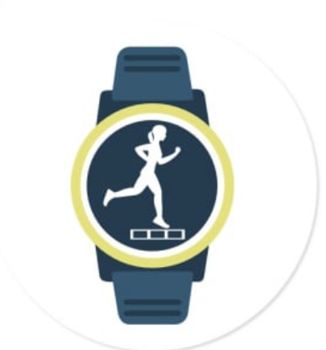
Introduction
Fitness trackers
Psychosocial influences on women’s participation in physical activity
The main task is to analyze smart device data to gain insight into how consumers are using their smart devices by tracking their movements.

Slide 4

What is the problem?
Scarcity of time
Less sleep
Perceptions of safety
Household care
Parenting demands

Slide 5
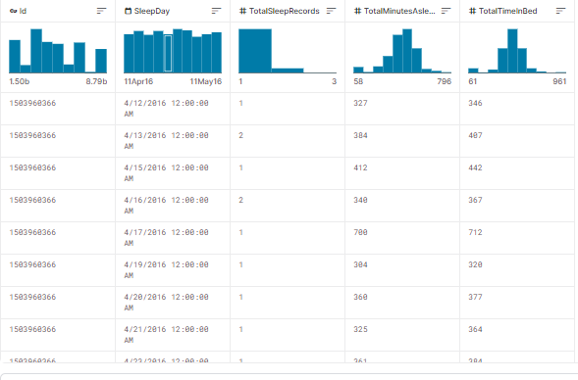
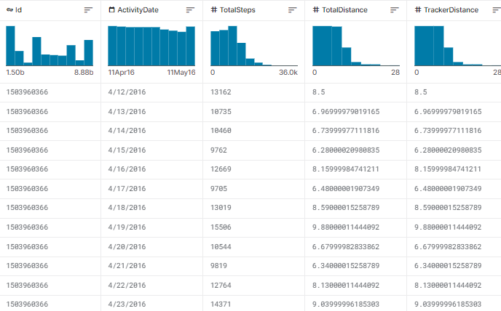
DATASET

Slide 6
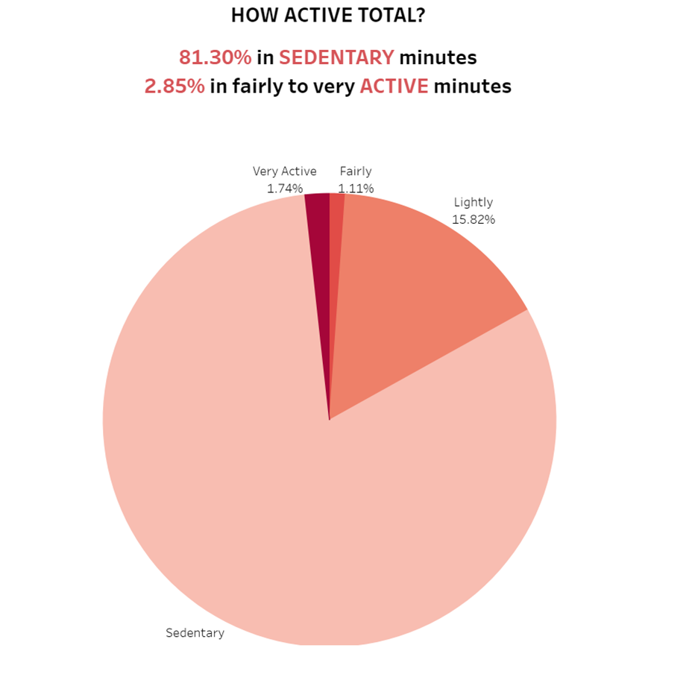
Analysis of the tracked data
A person who has a higher average non-active minutes tends to have a higher average BMI.
More time a person spent non-active, the lower the time they are asleep in bed. It is a negative relation which implies non-activity negatively impact sleep quality.
A person who has higher active minutes tends to burn more calories in a day, the more time they spend inactive, the lower calories they tend to burn in a day.

Slide 7

Data Visualization

Slide 8

What is the solution?
This study combines a tracker and holistic health coach specifically for women.
Exploring their activity tracking in the app
Altering High number to sedentary minutes
Comparing the relation between high sedentary minutes and BMI to promote an active lifestyle
Sleep tracking function

Slide 9
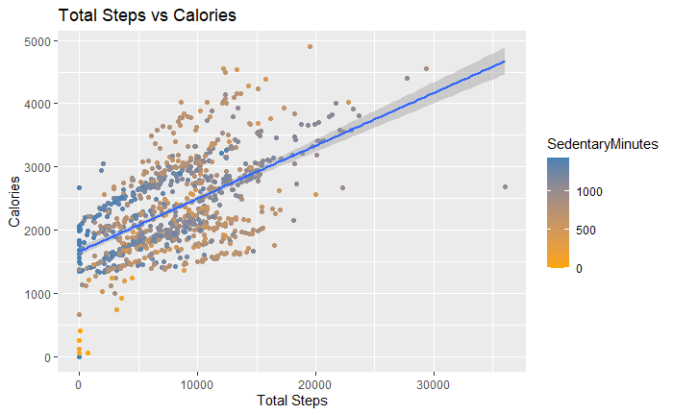
What are the most novel/interesting parts?
More steps per day does not always lead to more sleep or more calories burned. One does not always need to hit “10,000” steps to achieve their fitness goals.

Slide 10

What are the most challenging parts?
Limitations for this data exist due to the sample size and absence of key characteristics of the participants, such as age, location, lifestyle.
The running distance is not accurately recorded as the app measures distance using stride length and does not feature a GPS tracker.
The data is not all-inclusive.

Slide 11
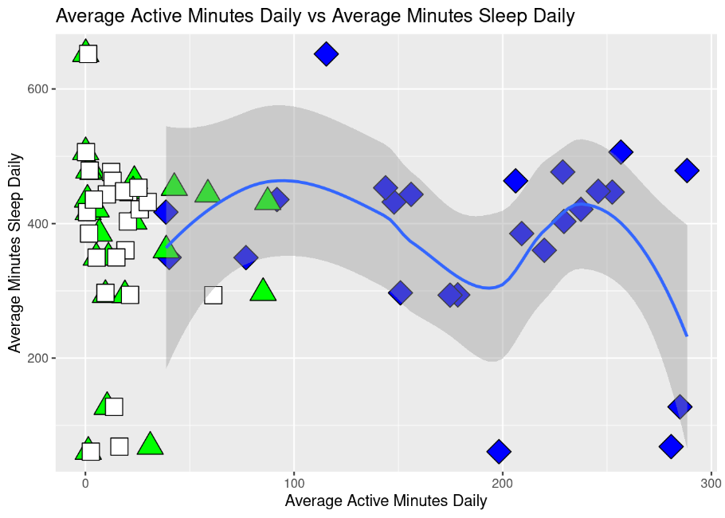
Conclusion
From the analysis result, there is a clear trend in non-active people having a negative lifestyle. The three relations we found during the analysis includes:
Very-active minutes has a positive relation to calories burnt
Active person has a positive relation to sleep quality
Non-active person is more likely to have a high BMI

