Slide 1
IBM HR Analytics Employee Attrition & Performance

Slide 2
Introduction
Employee attrition refers to the gradual reduction of the workforce due to resignations, retirements, or other reasons.
Analyzing attrition data helps organizations understand why employees leave, which can support strategies to retain top talent and improve organizational performance.

Slide 3
Problem Statement
High employee attrition can significantly impact an organization's productivity, morale, and financial performance.
Understanding the factors contributing to employee attrition is crucial to developing effective retention strategies and improving employee satisfaction.
Organizations today face challenges due to increasing employee turnover, which results in:
• Loss of skilled employees leading to decreased organizational knowledge.
• Increased hiring and training costs.
• Reduced employee morale and productivity.
Despite efforts to engage employees, understanding the underlying causes of attrition remains complex due to the interplay of multiple factors like work environment, job satisfaction, compensation, career development opportunities, and management effectiveness.
Thus, a detailed analysis is required to uncover the critical drivers of attrition

Slide 4
Objective
• Analyze employee data to identify key factors influencing attrition.
• Measure the overall attrition rate within the organization.
• Develop insights and visualizations to support data-driven decision-making.
• Assist HR teams in formulating strategies to retain employees.

Slide 5
Hypothesis
H1: Employees with lower job satisfaction are more likely to leave the organization.
H2: Longer working hours (over time) are positively correlated with higher attrition rates.
H3: Lower monthly income increases the likelihood of employee attrition.
H4: Lack of career advancement opportunities leads to higher attrition.
H5: Employees with fewer years at the company are more likely to resign compared to those with longer tenure.

Slide 6
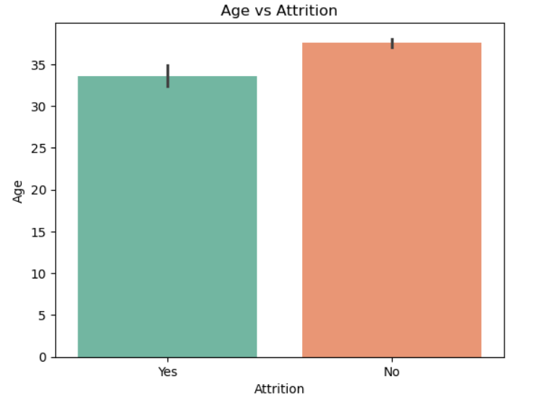
EXPLORATRY DATA ANALYSIS
Employees who left (‘Yes’): Average age is around 33–34 years.
Employees who stayed (‘No’): Average age is closer to 38 years.
Younger employees are more likely to leave the company.
Most of the company's employees are in the 30-35 age group. This indicates that the company has many employees who are at a productive and experienced age

Slide 7
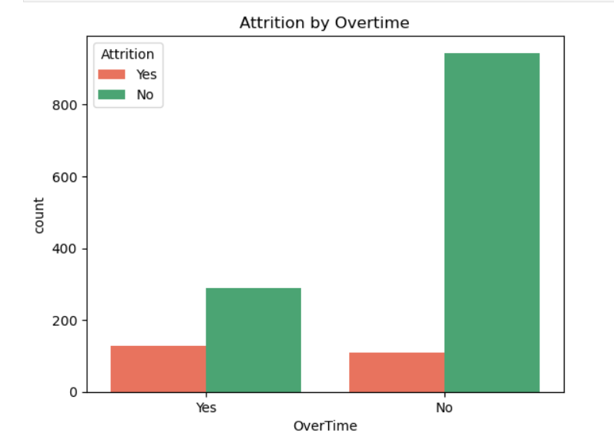
Attrition vs overtime
Employees who work overtime have a higher attrition rate compared to those who don't.
The number of employees leaving is significantly higher among those who are required to work overtime.
Employees not working overtime show much lower attrition relative to their overall group size.
Majority of employees without overtime responsibilities stay with the organization.

Slide 8
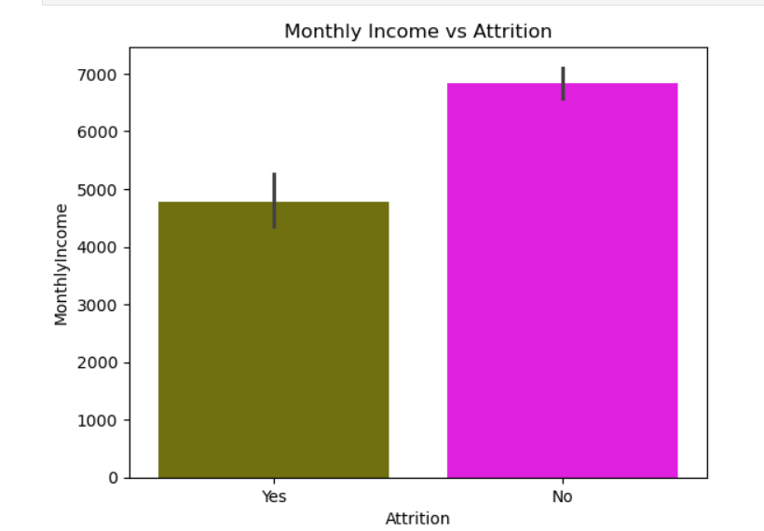
Attrition vs Monthly income
Employees who left ("Yes") have a lower average monthly income (~4800).
Employees who stayed ("No") have a higher average monthly income (~6800).
The income gap is significant — almost 2000 units difference.
Lower income is strongly associated with higher attrition.
Employees who are paid less are more likely to leave the company.
Salary dissatisfaction could be a major push factor for attrition.

Slide 9
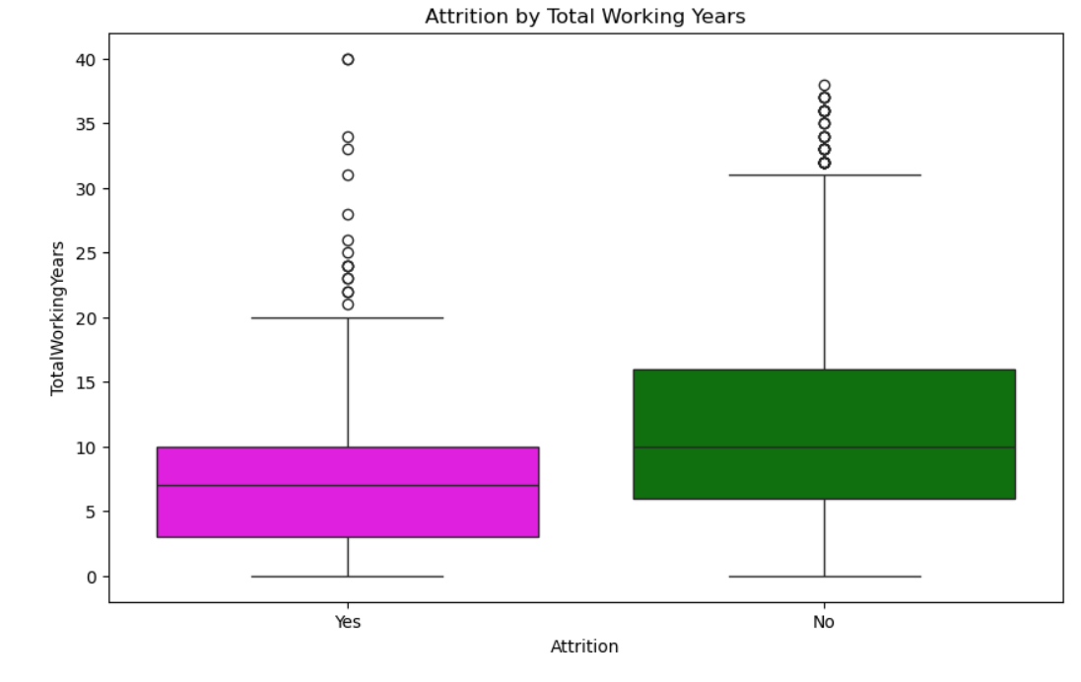
Attrition by Total working years
.
Employees who left ("Yes") have a lower median number of working years compared to those who stayed ("No").
This suggests employees with fewer total working years are more likely to leave.
The IQR for employees who left is narrower, indicating their total working years are more tightly clustered around the median.
Those who stayed have a wider spread, showing more variability in their total working years.
Employees with fewer total working years are more likely to experience attrition.
Those with longer careers tend to stay with the company.
There are a few exceptions where employees with long experience still leave, but they are outliers

Slide 10
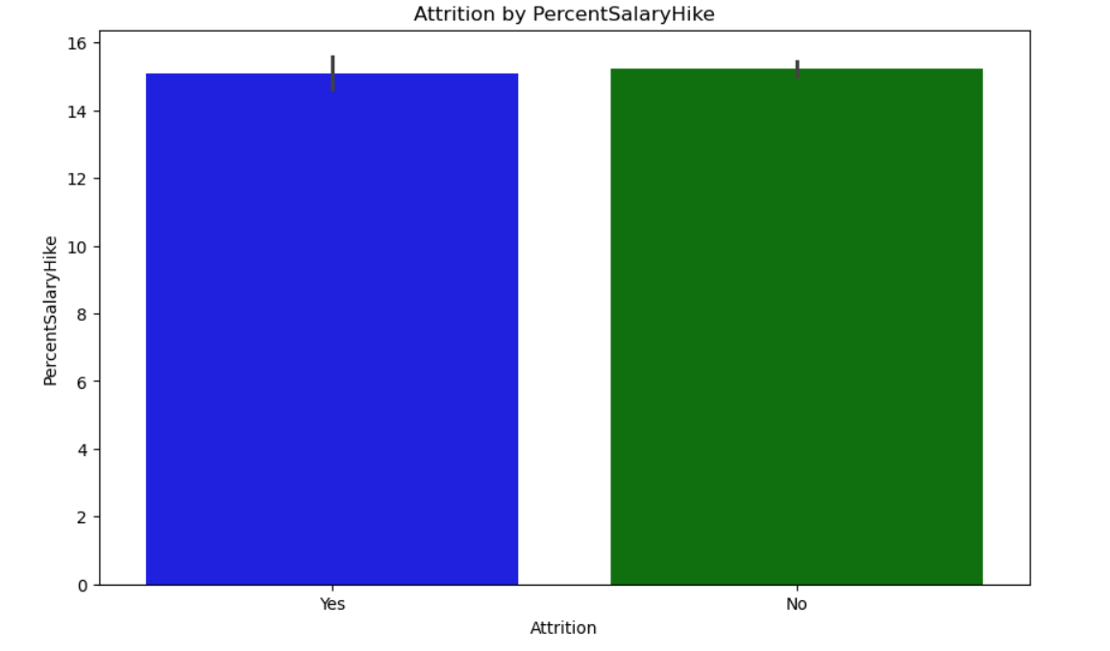
Attrition vs Percent salary hike
The analysis shows that employees who left (Attrition = Yes) and employees who stayed Attrition = No) both received a similar percent salary hike (approximately (15%).
This suggests that the percent salary hike is not a significant differentiating factor influencing attrition in this dataset.
Other variables such as job satisfaction, work environment, or overtime might have a stronger relationship with attrition and should be further explored.

