Slide 1
Project Presentation of CO-OP Project at Industry (Module-2) (22CS421)
On
Enhancing Debugging and Maintainability of ASP.NET
Core Backend APIs
Tanvi Gupta, 2210990905
Vanshita Thakral, 2210992510
Supervised By
Dr Rajat Takkar
Department of Computer Science and Engineering,
Chitkara University, Punjab

Slide 2
Introduction
Backend APIs are responsible for handling all the core operations of an application. As systems grow, debugging becomes more difficult because logs are not properly structured and exception handling is scattered. This leads to increased debugging time and makes the system harder to maintain. So, there is a need for a better approach to handle logging and errors.
2

Slide 3
Problem in Backend Systems
Debugging backend APIs is difficult in large applications
Logs are often unstructured and unclear
Exception handling is scattered using multiple try-catch blocks
Leads to increased debugging time, code duplication, and inconsistent responses

Slide 4
Proposed Approach
Structured Logging: logs stored in key-value format
Centralized Exception Handling using middleware
Cleaner code, better debugging, consistent responses

Slide 5
Methodology
Developed two systems: Traditional and Proposed
Traditional: simple logging + multiple try-catch
Proposed: structured logging + centralized handling
Tested using invalid inputs, DB failures, API exceptions
Metrics: debugging time, log clarity, response consistency, maintainability

Slide 6
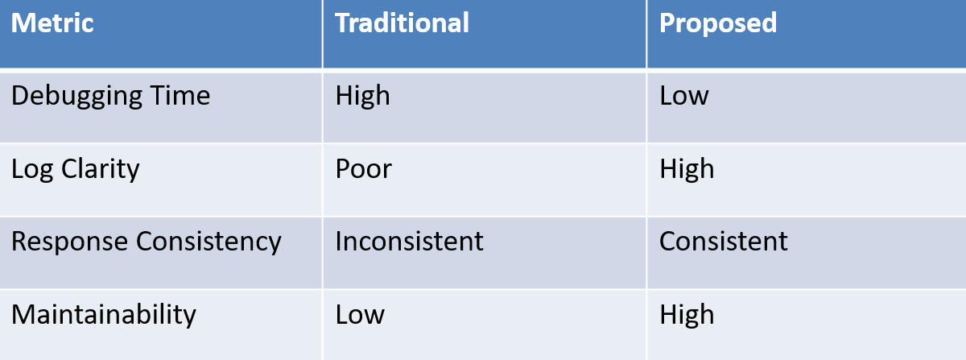
Results Comparison

Slide 7
Conclusion & Future Work
Structured logging improves traceability
Centralized exception handling reduces duplication
System becomes more maintainable and scalable
Future: microservices, distributed tracing, AI-based log analysis

Slide 8
Thank You
8

