Slide 1

Global Sales Performance & Profitability Dashboard
Sales Analytics, Profitability Monitoring & Business Intelligence Reporting
TABLEAU
EXCEL
BUSINESS ANALYTICS

Slide 2

Project Overview
This interactive Tableau dashboard was built to give management teams a real-time, visual window into global business performance — transforming raw data into actionable intelligence.
🌍 Global Sales
Track revenue across all regions and countries
💰 Profitability
Monitor margins by category, segment, and region
👥 Customer Behavior
Analyze buying patterns and segment performance
📈 Monthly Trends
Identify growth patterns and seasonal fluctuations

Slide 3
Business Problem & Objectives
The Challenge
Project Objectives
Global companies struggle to maintain visibility across distributed operations. Without unified analytics, leadership faces blind spots in sales tracking, margin monitoring, and product performance.
Analyze global sales trends over time
Monitor and improve profit margins
Sales scattered across regions with no consolidated view
Profitability difficult to track at the category level
Operational inefficiencies hidden in siloed data
Identify the most profitable regions and products
Track customer segment performance
Support strategic, data-driven decisions

Slide 4
Dataset & Tools Used
Dataset Fields
Tools & Technologies
The dataset captures the full order lifecycle, enabling deep-dive analysis across every dimension of the business.
Tool
Purpose
Tableau
Dashboard development & visualization
Order ID, Region & Country
Product Category & Customer Segment
Sales Amount, Cost & Profit
Quantity Sold & Discount %
Shipping Cost
Excel
Dataset preparation & cleaning
GitHub
Portfolio hosting & version control

Slide 5

Key KPIs & Calculated Fields
The dashboard tracks six core KPIs that give leadership an at-a-glance view of business health.
Total Sales
Total Profit
Profit Margin %
Quantity Sold
Avg Order Value
Delivery %
Profit = Sales Amount − Cost
Avg Order Value = Total Sales ÷ Total Orders
Profit Margin % = (Profit ÷ Sales) × 100

Slide 6
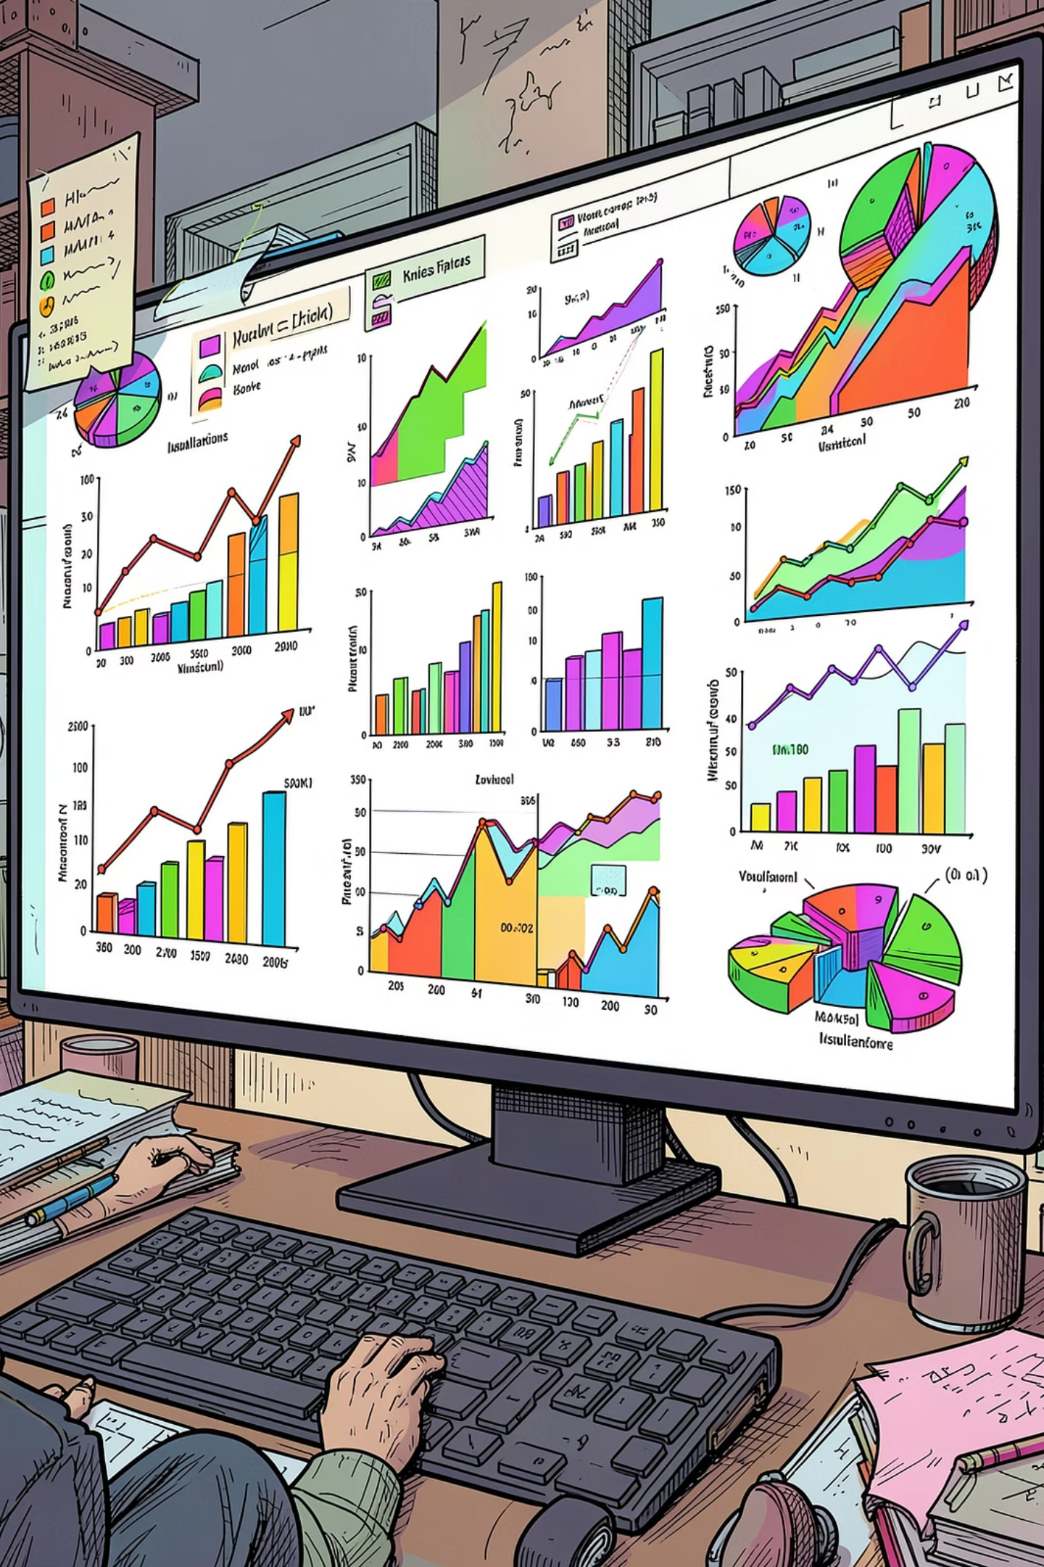
Dashboard Visualizations
Eight visualization types work together to tell a complete story — from high-level KPIs to granular transactional detail.
Sales by Region
Column chart comparing revenue across global markets
Monthly Sales Trend
Line chart revealing growth patterns and seasonality
Geographic Sales Map
Visual map of sales distribution by country
Sales vs. Profit Scatter
Identifies high-value, high-margin product combinations

Slide 7
Dashboard Layout & Design
Layout Structure
Design Theme
A clean, recruiter-friendly layout uses color strategically to signal performance at a glance.
Top Section
Middle Section
KPI cards for instant performance snapshot
Charts & trend analysis for deeper exploration
Bottom Section
Right Side Panel
Detailed sales table & business insights
Interactive filters: Region, Country, Category, Segment
🔵 Corporate Blue
🟢 Green
🔴 Red / Orange
Primary brand color
Profit indicators
Loss warnings

Slide 8



Key Business Insights
The dashboard surfaces clear, actionable findings across three critical dimensions of the business.
Regional Insights
Product Insights
Customer Insights
North America generated the highest total sales volume
Asia-Pacific demonstrated the strongest growth trajectory
Technology category delivered the highest profit margins
Furniture category showed consistently lower margins
Corporate customers placed higher-value orders on average
Heavy discounting eroded overall profitability

Slide 9
Skills Gained & Career Relevance
Technical Skills Developed
Career Relevance
01
This project directly supports candidacy for analytics and business intelligence roles across industries.
Tableau Dashboard Development
02
KPI Design & Monitoring
03
Advanced Data Visualization
04
Business Analytics & Reporting
Business Analyst
Data Analyst
Sales Analyst
BI Developer
Revenue Analyst

Slide 10


Conclusion
The Global Sales Performance & Profitability Dashboard demonstrates end-to-end analytical capability — from data preparation to interactive visualization and strategic insight delivery.
📊 Interactive BI Reporting
Real-time, filterable dashboards for decision-makers
💡 Sales & Profitability Analysis
Deep-dive into margins, trends, and segments
🎯 Strategic KPI Monitoring
Executive-ready metrics at a glance
🏆 Professional Tableau Design
Polished, recruiter-friendly portfolio piece
This project reflects strong analytical thinking and the ability to translate data into business value.

