Slide 1
Backtracking to solve a rat in a maze

Slide 2
A 2D matrix with some cells blocked.
One source cell, another one is destination.
We have to find a path from the source to the destination without moving into any of the blocked cells.
Notes:
A maze is a 2D matrix in which some cells are blocked. One of the cells is the source cell, from where we have to start. And another one of them is the destination, where we have to reach. We have to find a path from the source to the destination without moving into any of the blocked cells.

Slide 3
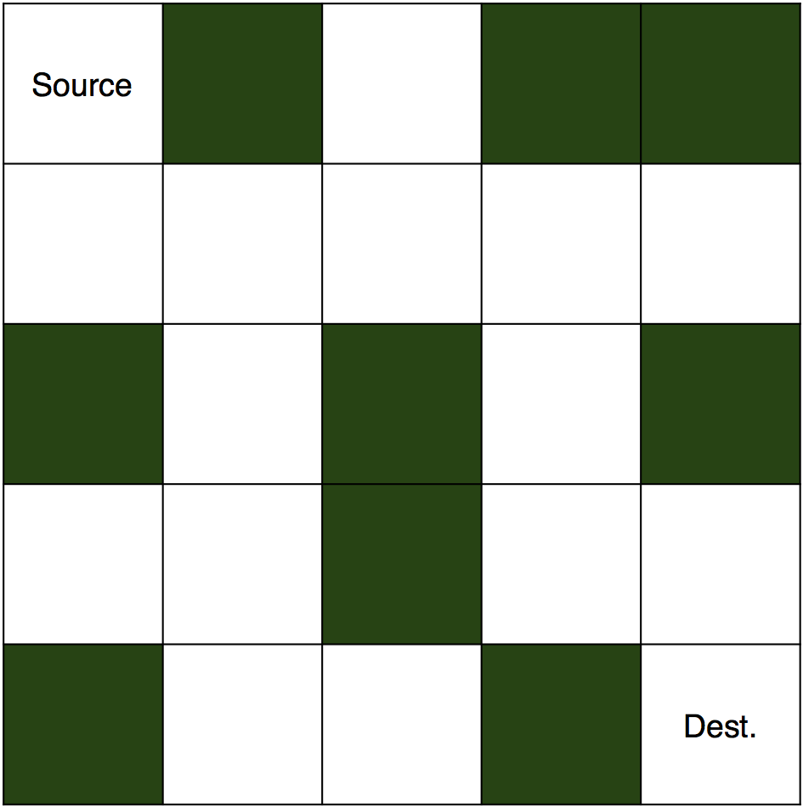

Slide 4
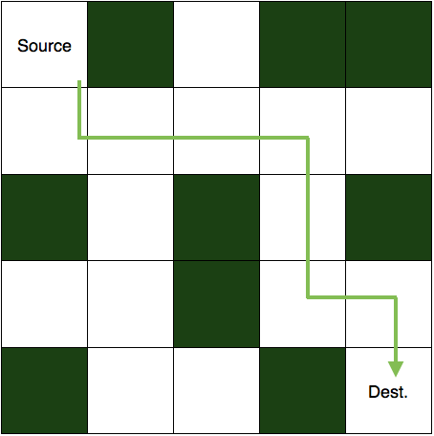

Slide 5
0 1 0 1 1
0 0 0 0 0
1 0 1 0 1
0 0 1 0 0
1 0 0 1 0
1 0 0 0 0
1 1 1 1 0
0 0 0 1 0
0 0 0 1 1
0 0 0 0 1
Notes:
You know about the problem, so let's see how we are going to solve it. Firstly, we will make a matrix to represent the maze, and the elements of the matrix will be either 0 or 1. 1 will represent the blocked cell and 0 will represent the cells in which we can move. The matrix for the maze shown above is:
0 1 0 1 1
0 0 0 0 0
1 0 1 0 1
0 0 1 0 0
1 0 0 1 0
Now, we will make one more matrix of the same dimension to store the solution. Its elements will also be either 0 or 1. 1 will represent the cells in our path and rest of the cells will be 0. The matrix representing the solution is:
1 0 0 0 0
1 1 1 1 0
0 0 0 1 0
0 0 0 1 1
0 0 0 0 1

Slide 6
1) Check for the current cell, if it is the destination cell, then the puzzle is solved.
2) If not, then we will try to move downward and see if we can move in the downward cell or not (to move in a cell it must be vacant and not already present in the path).
3) If we can move there, then we will continue with the path taken to the next downward cell.
4) If not, we will try to move to the rightward cell. And if it is blocked or taken, we will move upward.
5) Similarly, if we can't move up as well, we will simply move to the left cell.
6) If none of the four moves (down, right, up, or left) are possible, we will simply move back and change our current path (backtracking).
7) Thus, the summary is that we try to move to the other cell (down, right, up, and left) from the current cell and if no movement is possible, then just come back and change the direction of the path to another cell.

Slide 7
Code time
SIZE = 5
#maze problem
maze = [
[0,1,0,1,1],
[0,0,0,0,0],
[1,0,1,0,1],
[0,0,1,0,0],
[1,0,0,1,0]
]
#list to store the solution matrix
solution = [[0]*SIZE for _ in range(SIZE)]
#function to solve the maze
#using backtracking
def solvemaze(r, c):
#if destination is reached, maze is solved
#destination is the last cell(maze[SIZE-1][SIZE-1])
if (r==SIZE-1) and (c==SIZE-1):
solution[r][c] = 1;
return True;
#checking if we can visit in this cell or not
#the indices of the cell must be in (0,SIZE-1)
#and solution[r][c] == 0 is making sure that the cell is not already visited
#maze[r][c] == 0 is making sure that the cell is not blocked
if r>=0 and c>=0 and r<SIZE and c<SIZE and solution[r][c] == 0 and maze[r][c] == 0:
#if safe to visit then visit the cell
solution[r][c] = 1
#going down
if solvemaze(r+1, c):
return True
#going right
if solvemaze(r, c+1):
return True
#going up
if solvemaze(r-1, c):
return True
#going left
if solvemaze(r, c-1):
return True
#backtracking
solution[r][c] = 0;
return False;
return 0;
if(solvemaze(0,0)):
for i in solution:
print (i)
else:
print ("No solution")

