Slide 1
Dualcore’s Supplier Engagement – Customer Q&A’s
Presented By: Tanvi Kini, Rashi Sharma, Sidhartha Bora, and Rohit Verma

Slide 2
Business Question
What improvements can Dualcore make to their website, to quicken a customer’s decision making process?

Slide 3
Proposed Business Impact
We will calculate the supplier engagement for each category to tell Dualcore where they can improve
We’ll recommend ways to improve the product description section of the Dualcore website
Effectively reducing the decision time required by a customer when shopping on Dualcore’s website

Slide 4
Supplier Engagement Analysis
Identify Answers Given By Suppliers
Calculate Supplier Engagement
Analyze common Customer Concerns
Identify Common NGRAMS Questions

Slide 5



Tools & Technologies
Data Cleaning
Data
Ingestion
Data
Querying
Data Framework
Utilized Python script to clean data and only keep relevant columns and rows
3M rows and 7 Columns to 63K rows and 3 Columns (Question, Answer, and Category)
Utilized Spark virtual cluster and Hue UI to import data and create a table called Q&A
Utilized YARN as a resource manager while running queries
Utilized Hive Command Line interface and Hue editor to write / run queries

Slide 6
Data Integration Process
Schema Alignment
Record Linkage
Data
Fusion

Slide 7
Data Integration – Schema Alignment
Identify the Grain; based on the business question at hand
Determine Attributes
Select data sources
Problem we were trying to solve involved finding the supplier engagement in the Q&A section of Dualcore’s website for each product category, so the grain of our schema becomes a category which encompasses several products

Slide 8
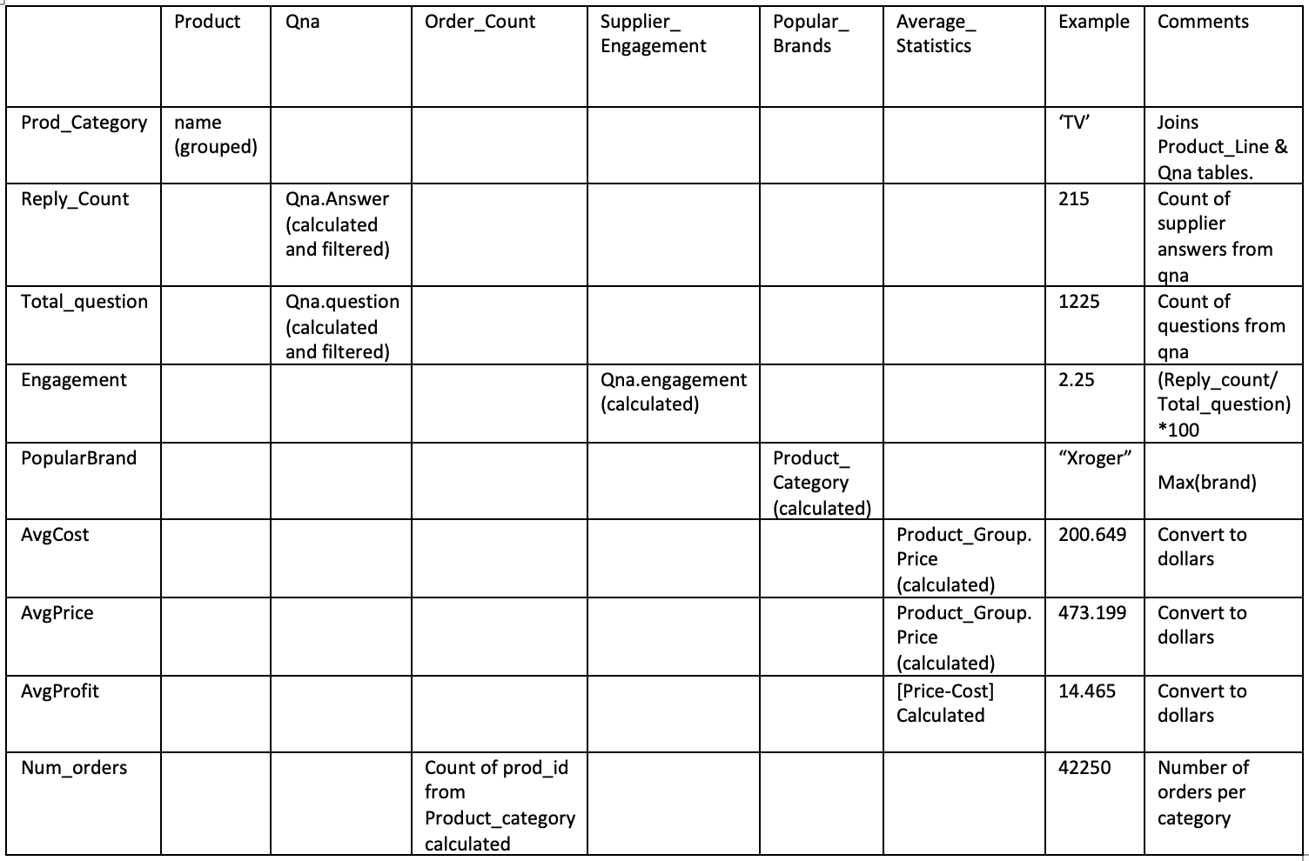
Mediated Schema

Slide 9
Data Integration – Record Linkage
Necessary when joining data sets based on entities that may or may not share a common identifier
Since most of our data was free form text, it was unlikely that we would have the exact same data in separate rows

Slide 10
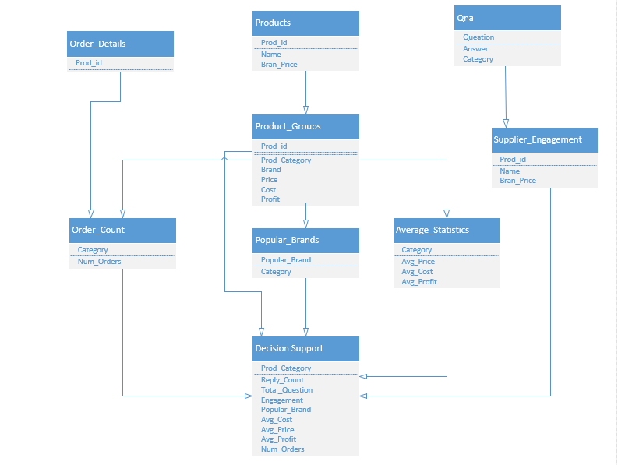

Slide 11
Data Integration – Data Fusion
Last step of data integration
Involved formatting the source attributes to match fields in the mediated schema
Challenge: Could not match the product IDs from the Dualcore dataset to the external Amazon Q&A dataset
Strategy: Aggregated data based on category to create a new table called Product_Groups, with the column ‘category’ – this new table was then joined with the external qna table on ‘category’
For Example, a product with the name “Cannon Scanner” would be categorized as a ‘scanner’

Slide 12
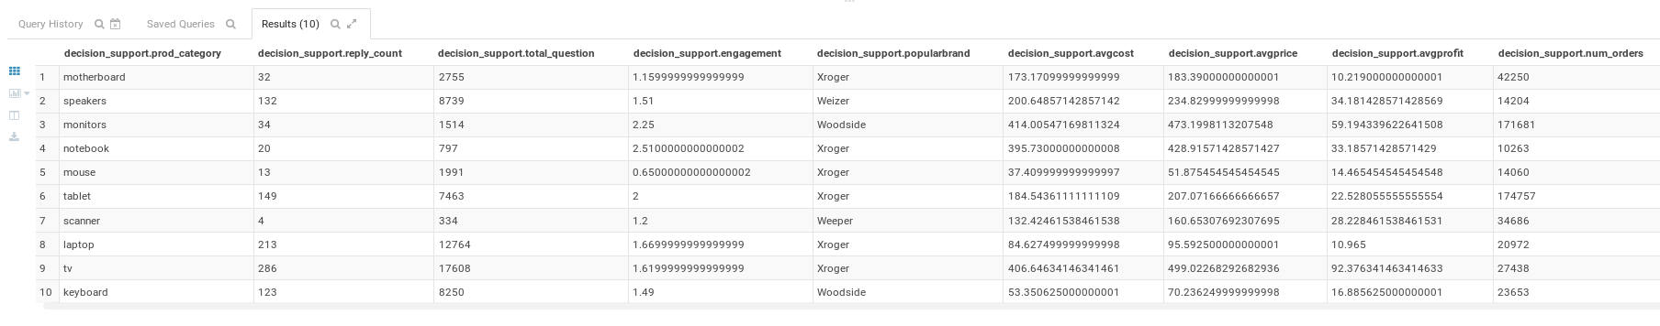
Calculating Supplier Engagement
Supplier Engagement = (No. of Answers given by suppliers/ Total question count) * 100.

Slide 13
Analyzing Customer Concerns
Finding the most common questions asked by customers using NGRAMS.

Slide 14
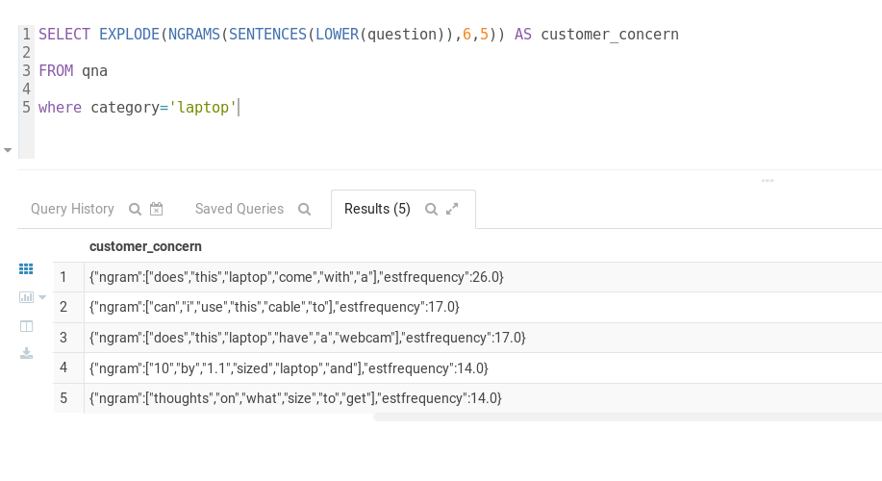
Product Group: Laptops
FAQs:
Included accessories?
Equipped with Webcam?
Screen size?
Suggestions:
List of included accessories
Webcam (Y/N)
Screen size comparison chart / or video

Slide 15
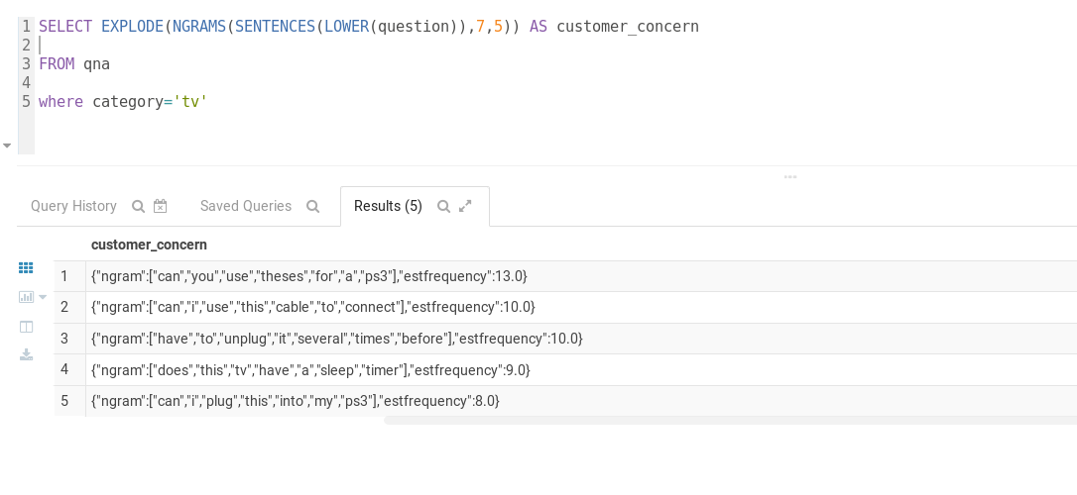
Product Group: TV
FAQs:
PS3 compatible?
Sleep timer feature?
Suggestions:
Provide details of supported gaming consoles
List of features and functionalities (example: 30 minute sleep timer)

Slide 16
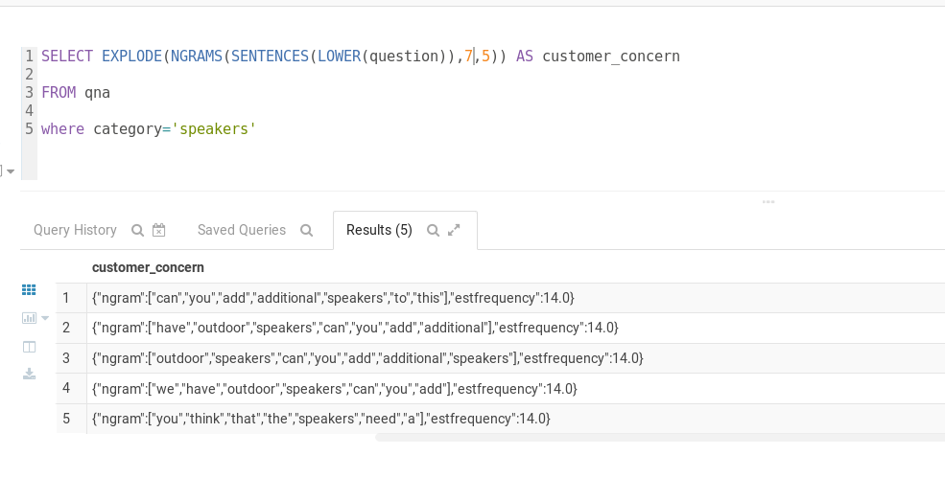
Product Group: Speakers
FAQs:
Supports additional speakers?
Outdoor usability?
Suggestions:
Provide details of supported additional speakers (brand and model)
List the speak models that support outdoor use and which models work best outdoors

Slide 17
Future Steps
ML Algorithms that can measure customer and supplier tone in response
Chat Bot integrated into website to answer questions immediately

Slide 18
THANKS!
Any questions?

