Slide 1
Predicting UFO Sightings based on US Air Quality Group 4

Slide 2



Project analysis slide 3
TEAM
Karishma Bhatnagar
Tanvi Kini
Ankeeta Majumder

Slide 3
Project analysis slide 2
Data Analysis
Data Collection
Model Use
PROJECT
Model Specification
Model Validation
Parameter Estimation
Model Adequacy Checking

Slide 4
Project analysis slide 2
DATA COLLECTION
Selecting our Data:
We used a dataset from Kaggle (https://www.kaggle.com) which was a fusion of 2 interesting datasets:
US Pollution Data
UFO Sightings
Goal:
The goal is to analyze the effect of Air pollution on the number of UFO Sightings and whether or not we can predict if a sighting will occur given a set of conditions like dates, locations and concentration of 4 main gases – NO2, O3, SO2 and CO in the air.
Our response variable is a binary variable called ET; this variable is equal to 1 if a sighting has occurred and 0 otherwise. 0 values were added to introduce noise into the dataset by including observations with no UFO sightings.
This dataset contained 24 columns and approximately 63 thousand records.

Slide 5
Project analysis slide 2
DATA COLLECTION
Data Cleansing:
We wanted to clean the data and eliminate unnecessary information from the dataset.
We reduced the rows by removing the null values first which eventually reduced the number of rows from ~63000 to 15822.
We reduced the number of covariates from 23 to 12 keeping only those which were relevant to our analysis.
State was a categorical variable with 18 levels and we decided to split it up into separate numeric covariates for each level.

Slide 6
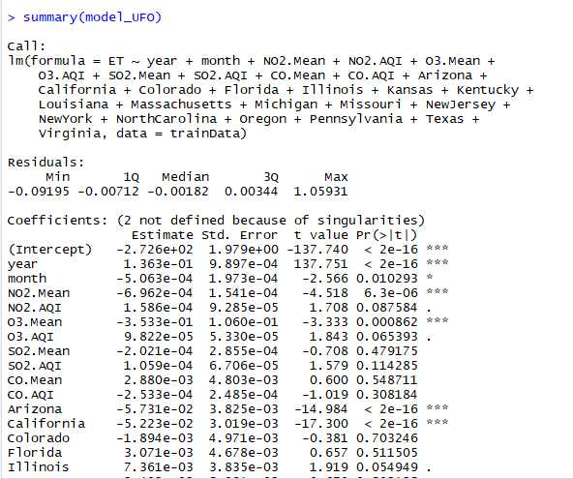
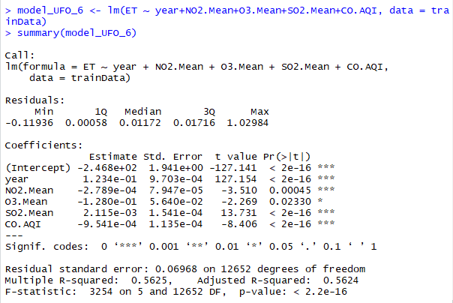
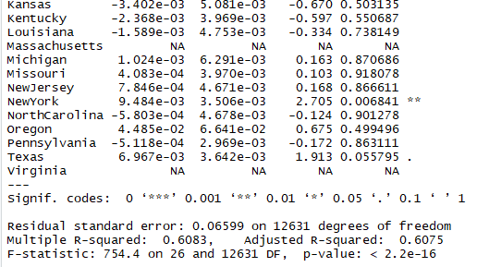
Project analysis slide 2
MODEL SPECIFICATION
Multiple Linear Regression:
We initially started by fitting our dataset into a multiple linear regression model. We came up with 2 different versions of linear models, keeping our response variable same for both:
With all the different regions as covariates
Without any region as covariates

Slide 7
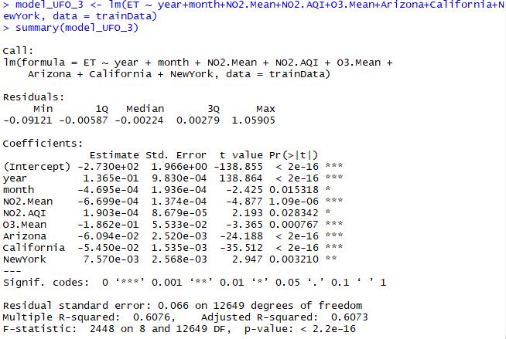
Project analysis slide 2
Parameter Estimation
Model 1:
When we performed a summary of model 1 i.e. fitting multiple linear regression model with all the covariates including regions, we found that the p-values for most of the regions were insignificant since they were much higher than 0.05.
We decided to eliminate these regions from our model and ended up with only 3 regions as covariates – Arizona, California and New York.
We also eliminated the other covariates with p-value greater than 0.05 and ultimately landed with the below model with 8 covariates.

Slide 8
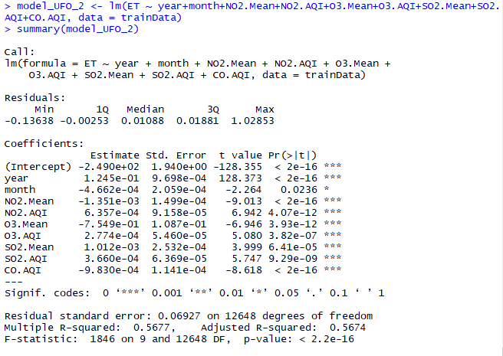
Project analysis slide 2
Parameter Estimation
Model 2:
When we performed a summary of model 2 i.e. fitting multiple linear regression model with all the covariates excluding all regions with insignificant p-values, we came up with a better model with all significant p-values less than 0.05 and year, month, NO2.Mean, NO2.AQI, SO2.Mean, SO2.AQI, CO.AQI, 03.Mean, O3.AQI, Arizona, California and New York as our covariates until now.
But, we realized that if we keep regions Arizona, California and New York as our covariates then our model decision will be biased since these regions have a larger percentage of observations than the other regions.
We went ahead and removed these 3 regions from our covariate list. The model looked even better with good p-values.
The resultant Model 2 had one response variable ET and 8 covariates - year, month, NO2.Mean, NO2.AQI, SO2.Mean, SO2.AQI, CO.AQI, 03.Mean, O3.AQI.

Slide 9
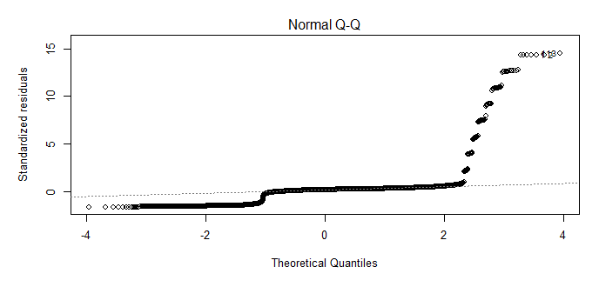
Project analysis slide 2
MODEL ADEQUACY CHECKING
We wanted to be sure that our resultant Model i.e. Model 2 with covariates - year, NO2.Mean, NO2.AQI, SO2.Mean, SO2.AQI, CO.AQI, 03.Mean, O3.AQI does not violate the 4 LINE assumptions.
We plotted a QQPlot as below for our residual analysis:
From the QQPlot above, we can see that it is a heavy- tailed positively skewed distribution and we must perform transformations.
We wanted to perform a transformation on Y by using a BOX-COX plot. We were unable to plot it as our intercept value was negative.
We further did multicollinearity analysis and ended up with a refined model that had VIF values close to 1.

Slide 10
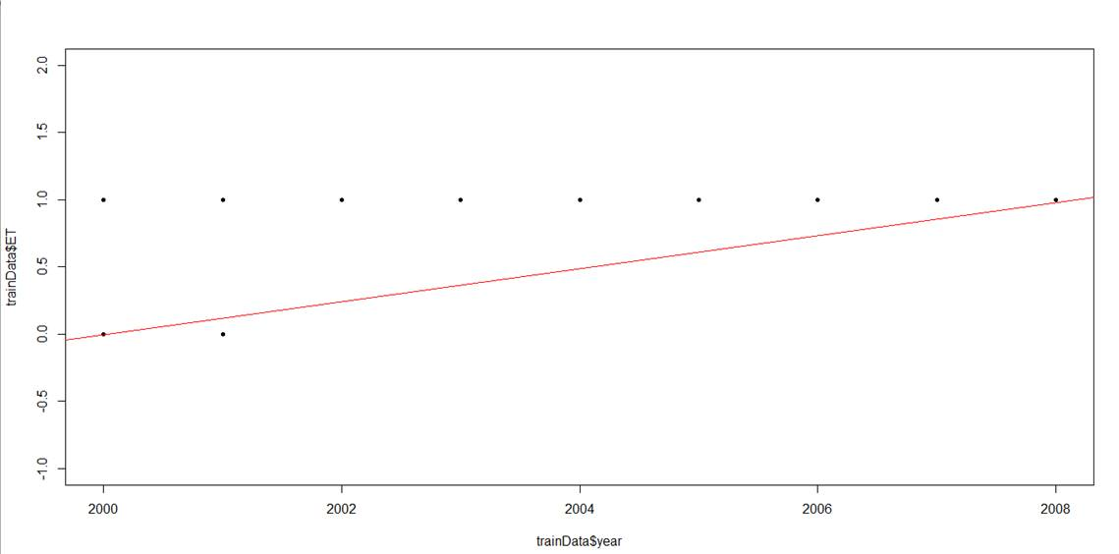
Project analysis slide 2
MODEL VALIDITY
We then plotted our multiple linear regression model against our training data and got the following graph:
Obviously, linear regression does not make sense in this situation because some predictions are below 0 or above 1.
Hence, this multiple linear regression does not make sense for our data set.

Slide 11
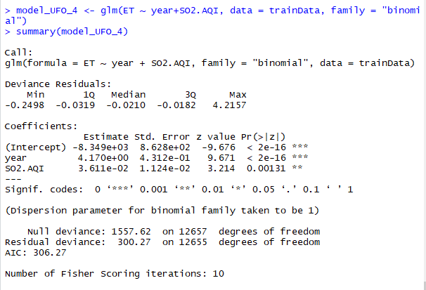
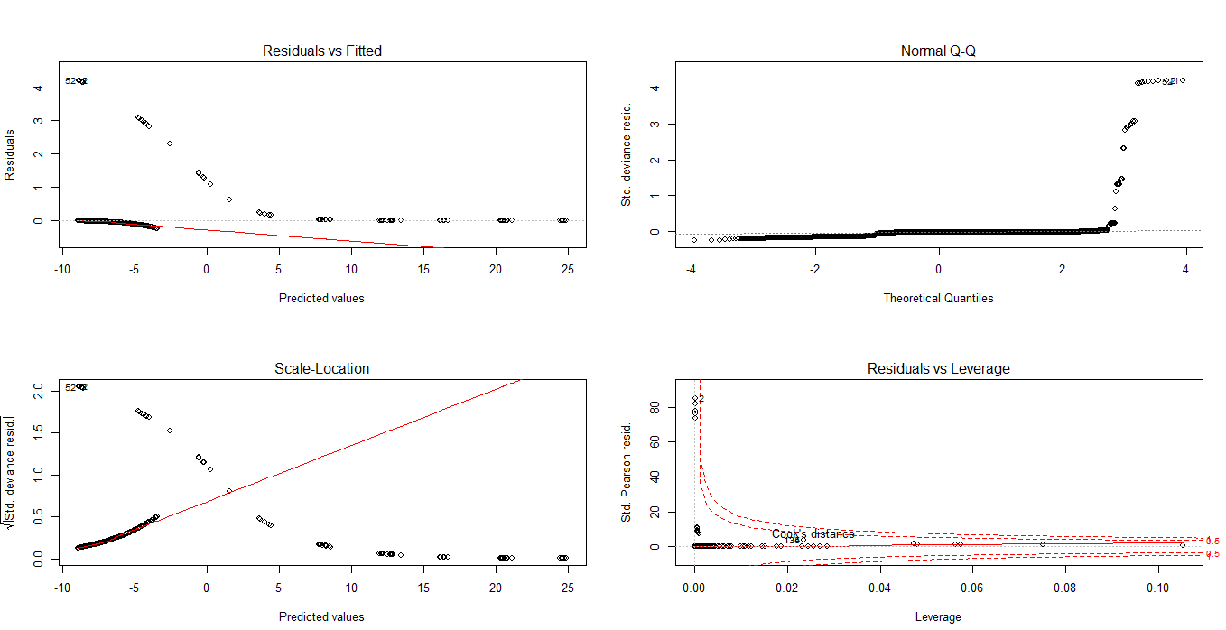
Project analysis slide 2
MOVING TOWARDS LOGISTIC REGRESSION
The best model for a binary response variable is by fitting a Logistic Regression Model to the dataset.
We restarted the whole process and repeated the steps from Model Specification, Parameter Estimation and Model Validation.
We came up with a model which had the best p-values smaller than 0.05 and with only 2 covariates year and SO2.Mean against our one binary response variable ET.

Slide 12
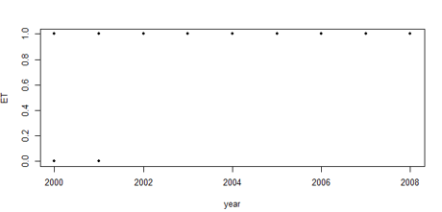
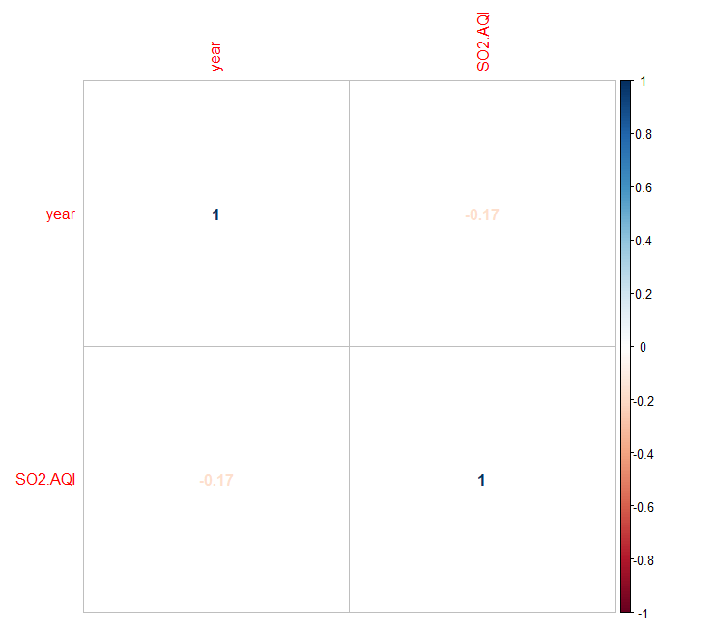
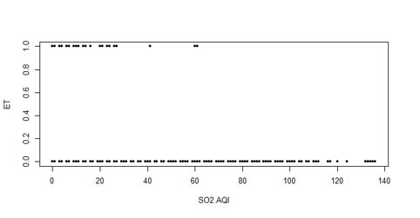
Project analysis slide 2
MODEL ADEQUACY CHECKING
Multicollinearity check:
VIF:
Correlation Plot:

Slide 13
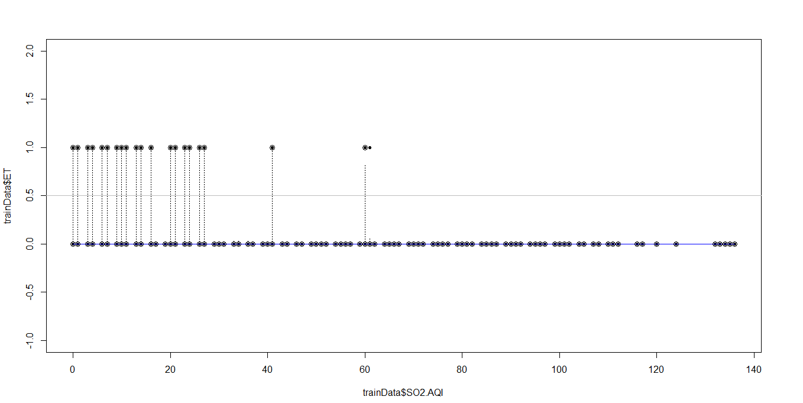
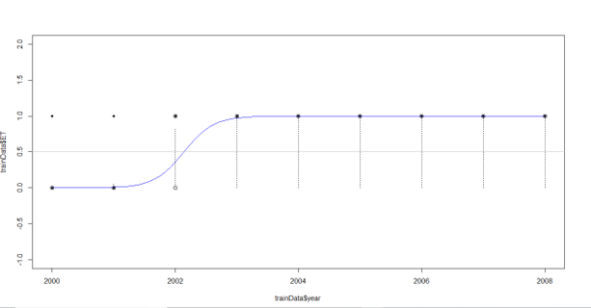
Project analysis slide 2
LOGISTIC REGRESSION MODEL
Plotting Logistic regression for each covariate:
Covariate 2: SO2.AQI
Covariate 1: Year
With an increase in concentration of SO2.AQI the no. of UFO Sightings are decreasing.
There were more UFO Sightings between 2003 and 2008 and none in 2001 and 2002.
We found the maximum SO2.AQI value in our dataset for when a sighting occurred. The result concurred with the graph above.

Slide 14
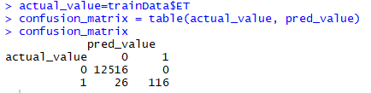

Project analysis slide 2
MODEL VALIDATION
Using a confusion matrix to evaluate the prediction performance:
Using misclassification error rate to find the minimum error rate of our model:
This is a great error rate value!

Slide 15
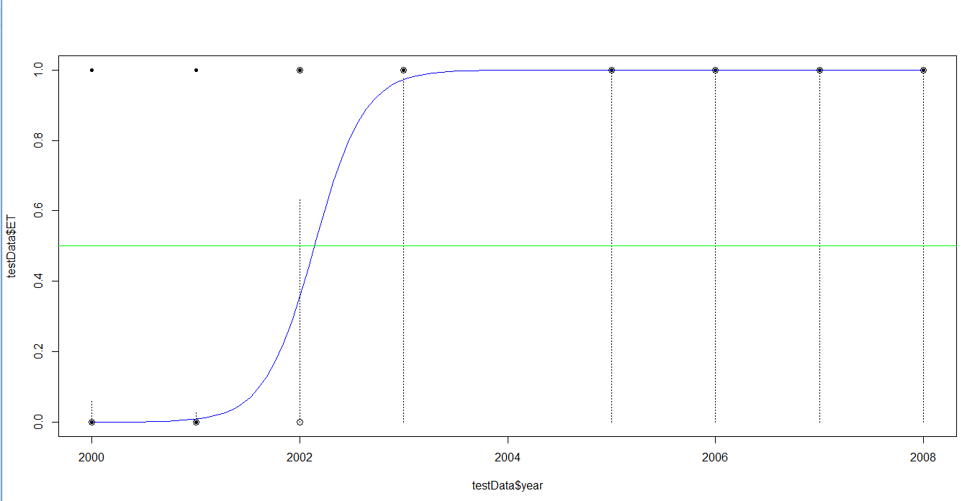
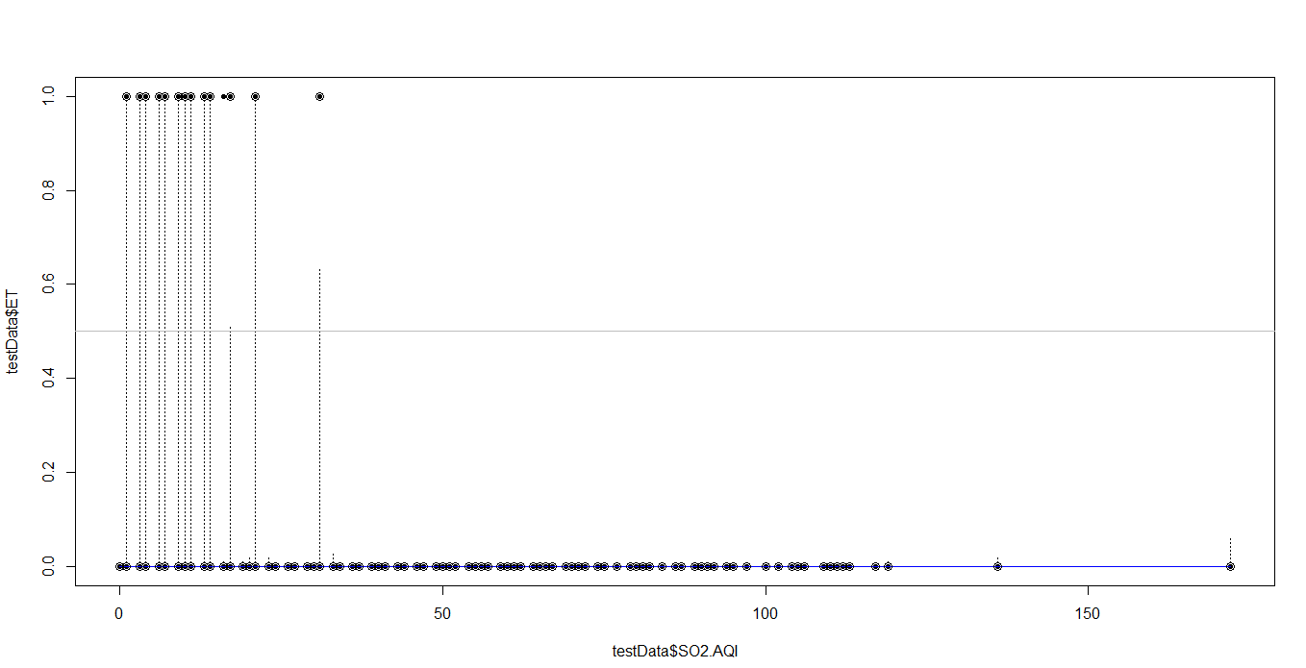
Project analysis slide 2
MODEL USE
Using our model on Test data:
We had earlier split our dataset into ‘TrainData’ and ‘TestData’ in a 80:20 ratio. We will now use the model obtained from analyzing train data to test it on ‘TestData’.
Covariate 1: Year
Covariate 2: SO2 AQI

Slide 16
Project analysis slide 2
CONCLUSION
Our findings with a never-before analyzed data-set taught us that a Logistic Regression is the best option when your response variable is binary.
From among the 24 covariates that we began our analysis with, only the SO2 Air Quality Index and Year were found to have an effect on the number of UFO Sightings.

Slide 17
Thank You

