Slide 1








EchoVerse: AI-Powered Audiobook Creation Tool
Introduction
Generative AI for Audio
Accessibility
Customization
Transforms user-provided text into
Empowers visually impaired users,
Supports selectable tones like
expressive, natural-sounding
students, and professionals with
Neutral, Suspenseful, or Inspiring
narrations.
audio access to written content.
to adapt narration style.

Slide 2








System Architecture of EchoVerse
Workflow Overview
Input Processing
Tone Adaptation
Accepts pasted text or uploaded .txt files and displays
Uses IBM Watsonx Granite LLM with prompt chaining
original content.
to rewrite text in Neutral, Suspenseful, or Inspiring
styles.
Audio Generation
User Interaction
Transforms rewritten text into expressive audio
Provides downloadable audio files with customizable
output using AI-driven TTS models.
narration settings.

Slide 3



EchoVerse Solution
Addressing Accessibility & Convenience
• Accessibility: Offers visually impaired users
seamless conversion of written content into
audio.
• Learning & Productivity: Helps students and
professionals transform study materials,
articles, and reports into portable audio.
• Customization: Supports adjustable tones to
suit narrative needs, from suspenseful
storytelling to inspiring speeches.
• Content Reusability: Repurposes written
Photo by Ye Lin Aung on Unsplash
content into engaging audio formats for wider
reach and flexible use.

Slide 4




Future Scope of EchoVerse
Expanding Capabilities
Multilingual Support
Emotional Range
Extend narration capabilities across multiple global
Introduce advanced emotional voice synthesis for
languages to reach diverse audiences.
empathy-driven and immersive experiences.
Cross-Platform Integration
Personalization
Embed EchoVerse into e-learning platforms, e-
Allow dynamic adaptation to individual user
readers, and productivity tools.
preferences in pacing, tone, and delivery style.

Slide 5


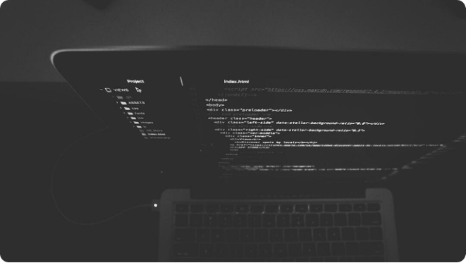
Code Example: EchoVerse Integration
Watsonx + Text-to-Speech Pipeline
• Text Input: User pastes or uploads .txt file for
processing.
• Tone Adaptation: LLM rewrite with chosen style
(Neutral, Suspenseful, Inspiring).
• Audio Synthesis: Generate natural-sounding
voice output with TTS engine.
Photo by Nate Grant on Unsplash

Slide 6

EchoVerse in Action
Visual Showcase
• From Text to Audio: Seamless transformation
of written material into expressive narration.
• AI + Accessibility: Blending generative AI with
inclusive design for all users.
• Immersive Experience: Customizable tones
and natural voices create engaging audiobooks.
Photo by Luana Azevedo on Unsplash

Slide 7


Conclusion
EchoVerse – Redefining Audiobook Creation
Innovation
Accessibility
Future Growth
Transforms written text into
Empowers visually impaired users,
Poised for multilingual expansion,
expressive, natural audio using AI.
learners, and professionals with
personalization, and deeper
inclusive design.
integrations.

