Slide 1
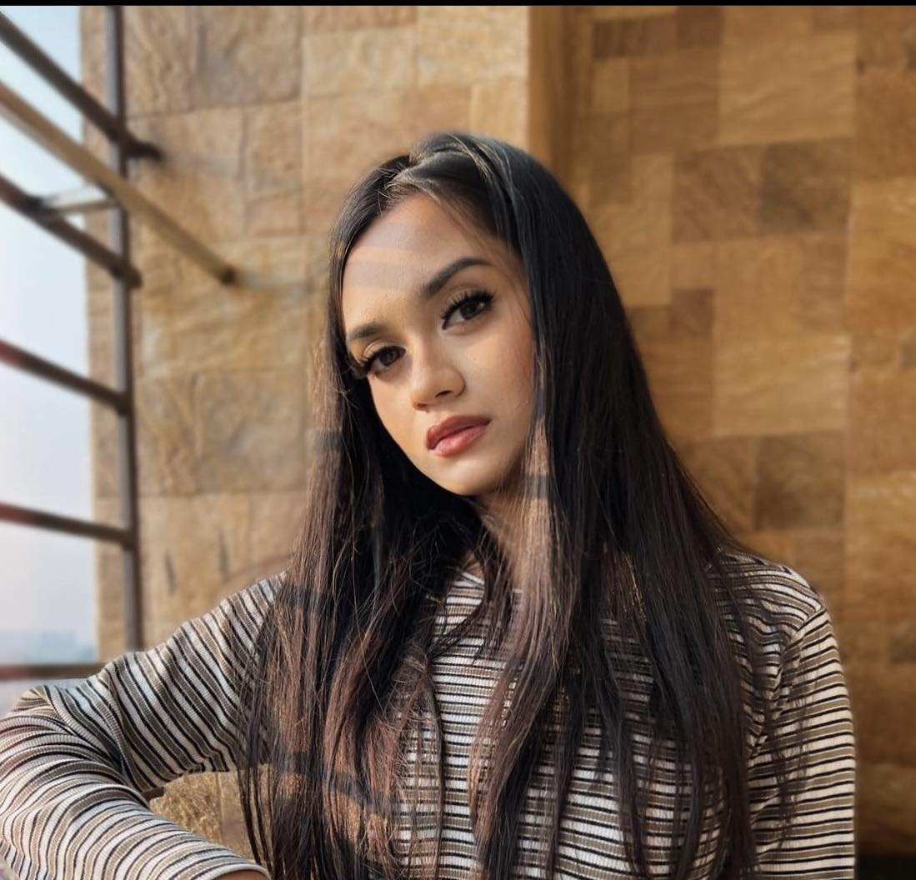
Tanvina amin
A fresher who shows enough enthusiasm and dedication to learn something new everyday and work hard to master it while also being regarded for having a peaceful nature with people.

Slide 2
Contact details
EMAIL ADDRESS
tanvina.amin00@gmail.com
MOBILE NUMBER
01715614927
ADDRESS
Bashundhara R/A, Dhaka, Bangladesh

Slide 3
Relevant skills
Customer Service
Communication
Social Media Management
Leadership
Time Management
Team Player
Project Scheduling
Mar. 2021
Thought leadership
Mentorship
and guidance
Feb. 2020
Jan. 2022

Slide 4
Work experience
1
IMA ( IUB MARKETING ASSOCIATION), January, 2022, General Member, Independent University, Bangladesh
IUB Social Welfare Society, June 2022, General Member, Independent University, Bangladesh
2
IUB Art club March, 2022 General Manager, Independent University, Bangladesh
3

Slide 5
education
Bachelors of Business Administration (BBA) Independent University, Bangladesh
Adamjee Cantonment College, Dhaka (2018- 2020
Shaheed Anwar GIrls school, Dhaka ( 2006- 2018)
Long-term influence
Enduring relevance
Inspire future gens
Continuing projects
Enduring values
Effective principles

Slide 6
CERTIFICATIONS
Higher Secondary School Certificate ( HSC) GPA - 5.00 ( Science)
Secondary School Certificate ( SSC) GPA – 5.00 ( Science)

Slide 7
PERSONALITY HIGHLIGHTS AND STRENGTHS
Cheerful disposition
Motivated by problem solving
Independent worker

