Slide 1
Paper review
VCTP: A Verifiable Credential-based Trust Propagation Protocol for Personal Issuers in Self-Sovereign Identity Platforms

Slide 2
Conference: 2023 IEEE International Conference on Decentralized Applications and Infrastructures (DAPPS)
Authors:
Rahma Mukta
Rue C. Teh
Hye-young Paik
Date: July 2023 Paper link: https://ieeexplore.ieee.org/document/10237034

Slide 3
Introduction

Slide 4
Problem statement
This paper proposes a verifiable credential-based trust propagation protocol for personal issuers in self-sovereign identity platforms.
SSI platform:
An emerging identity platform that facilitates secure credential issuance and verification without placing trust in any centralised authority
Employs blockchain to leverage decentralisation for identity credential issuance and verification.
These credentials are provided by trusted issuers within the blockchain for example: government agencies or healthcare institutions in different contexts.
SSI platform faces trust issues as all credential issuers in SSI are not supported with adequate trust
Lack of trust in personal issuers can limit the scope of SSI applications.

Slide 5
Personal Issuers and Trust
Personal issuers, often overlooked, are referred to as non-officiated issuers.
Risk-averse verifiers may be reluctant to accept credentials from personal issuers.
Personal issuers may issue credentials like a "letter of authority" or a “ownership change”
Example of a treating doctor’s role in attesting to the patient’s identity and legitimacy
Importance of updating credentials without invalidating existing sections.
Challenges in personal issuer onboarding, trust propagation, and avoiding collusion.

Slide 6
Policy-based Sanitizable Signature Scheme
Updating credentials while ensuring integrity and authenticity is a challenge.
Conventional digital signatures (e.g., RSA or DSA) provide integrity and authentication but may not support controlled updates.
Policy-based Sanitizable Signature Scheme introduced to address controlled updates.
This scheme allows authorized updaters to modify a credential in a controlled and verifiable manner.
An ideal basis for building a protocol that adds trust to signers of a credential.

Slide 7
Background

Slide 8
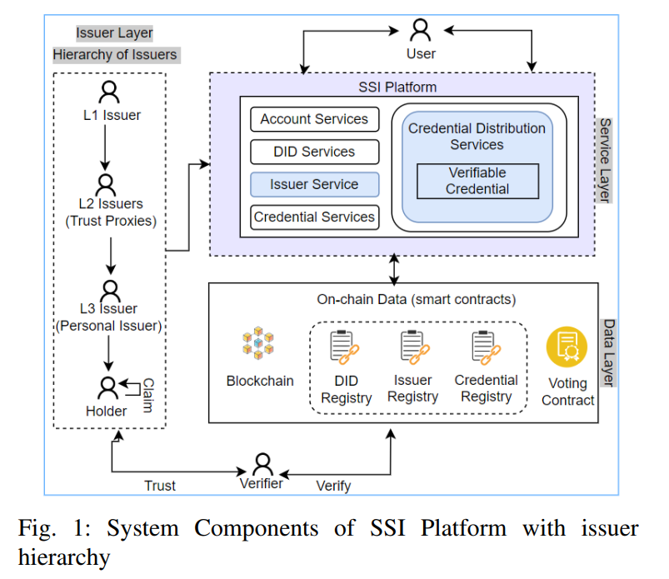
SSI Platform
dfddferewtgergergredgergreuuuuuuuuuuuuuuuuuuuuuuuuuuuuuuuuuuuuuuuuuuuuuuuuuuuuuuuuuuuuuuuuuuuuuuuuuuuu
The SSI platform, illustrated in Fig. 1, features multiple levels of issuers.
Three levels, L1, L2, and L3, are shown. L1 issuers have the highest level of trust and are endorsed by a governing authority.
L1 issuers can endorse the next-level issuers using verifiable credentials.
The VCTP protocol relies on blockchain to manage core SSI components such as DIDs and credential records.

Slide 9
Role Credential (RC)
Role Credential (RC) is a regular, verifiable credential.
It contains sets of attributes to identify an individual based on their position.
These attributes, individually or in combination, establish the individual's membership in a group or a unique identity.
Role attributes are captured in a role credential issued by authorized entities, such as hospitals or educational institutions, for authentication in subsequent interactions.

Slide 10
Sanitizable signatures
Sanitizable signatures enable partial delegation of signing rights to a semi-trusted party, known as an updater.
These signatures are based on the Chameleon Hash (CH) technique
The root signer, such as a Level 1 issuer, initially signs a hashed message, like a credential.
The CH technique allows the root signer to select a specific updater who can update predetermined sections of the credential while maintaining the original hash
Chameleon Hash Functions incorporate a trapdoor mechanism, allowing the updater to make updates without changing the original hash.

Slide 11
Policy-based Sanitizable Signatures
Policy-based Sanitizable Signatures utilizes Chameleon Hash.
The trapdoor keys in this scheme are managed with an access policy.
When computing a credential hash, public keys of required access attributes are included.
This ensures that only entities possessing private keys to the corresponding attributes can obtain the trapdoor key.

Slide 12
Policy-based Sanitizable Signatures
Policy-based Sanitizable Signatures combine the concepts of CH and Attribute-Based Encryption (ABE).
This scheme allows an L1 issuer to specify updatable sections of the credential and determine which entities, in terms of attributes, can access the trapdoor key.
Each updatable section is hashed individually using access policy-based chameleon hash functions.
This ensures that only entities possessing private keys to the corresponding attributes can obtain the trapdoor key.
All sections are then combined and signed as σ = SIGN(PCH_{(s1)}||...||PCH_{(sn)}), where PCH_{(si)} represents the chameleon hash of each section.
In the implementation, each trapdoor key tdi is encrypted using ABE.
Updaters can only update the credential if they hold a valid tdi and the private keys to access the required attributes.

Slide 13
Voting Process
Voting process is very important to mitigate challenges arising from human users colluding to onboard illegitimate users.
In this process the voters are asked to review someone’s action and vote to confirm if the action is legitimate
The voting action practically indicates if the voter is satisfied that the credential update is legitimate

Slide 14
AN OVERVIEW OF VCTP PROTOCOL

Slide 15
Trust Propagation Templates
Trust propagation template is a type of credential for encoding trust propagation policies
This policy propagates trust from higher-level issuers to personal issuers.
Components:
Update Policy Section (L1)
Trust Proxy Section (L2)
Credential Section (L3)

Slide 16
Trust Propagation using Policy-based Sanitizable Signatures
Access Attribute Key Generation:
L1 issuers create public/private hashing keys and master keys for each required access attribute.
Template Hashing and Signing:
L1 issuers hash each updatable section using chameleon hash functions.
They encrypt trapdoor keys with attribute-based encryption.
Concatenate all hashes with remaining sections.
Sign the template hash with their key.
Store hashed template and signature in the blockchain's credential registry.

Slide 17
Trust Propagation using Policy-based Sanitizable Signatures
Template In-Use:
L1 issuers create public/private hashing keys and master keys for each required access attribute.
Sign their updated sections.
Send updated template hash and signatures to the credential registry.
Voting process may be required before committing updates.
Template Verification:
Verifiers can check the template hash and signatures in the credential registry
They use public hashing keys for verification.
Access DID information from the DID registry and issuer registry.

Slide 18
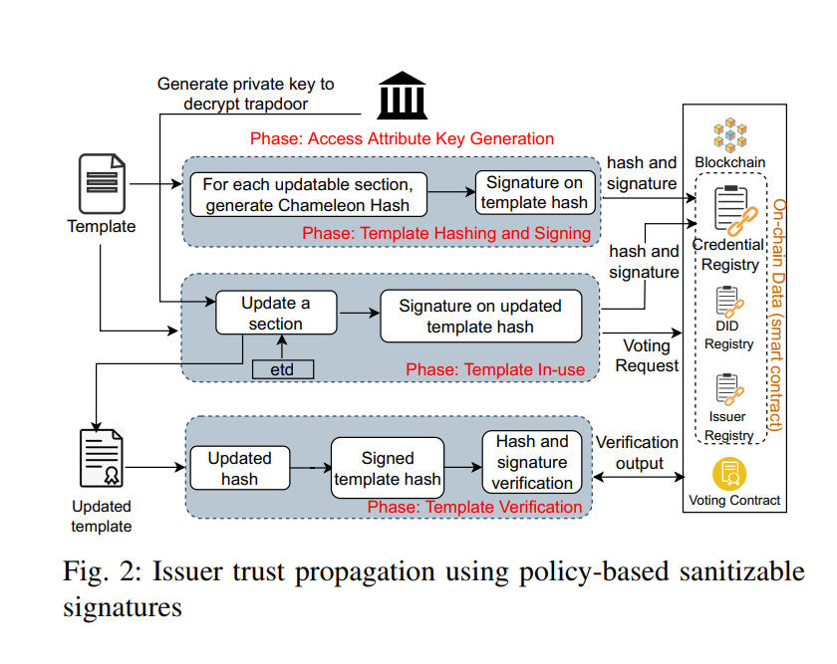

Slide 19
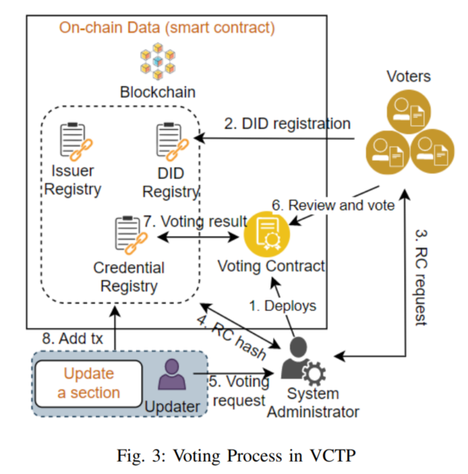
Voting Process
System Initialization:
A system administrator generates a key pair for deploying the voting contract.
Role credentials are issued to voters.
Voters must have a DID and a role credential within the organization.
Voting Update:
An updater sends a voting request to the voting contract when updating a template.
Each voter reviews the update and votes by encrypting their signature with their vote choice.
The voting contract verifies the voter's signature, role, and checks for duplicate votes.
It computes the voting result.

Slide 20
Voting Process
Voting Management:
Updates are verified against the voting result before being added on-chain.
If the result satisfies the required number of votes, the update is added to the credential registry and issuer registry.
If not, the transaction is rejected, and the issuer is not verified on-chain.

Slide 21
SYSTEM EVALUATION

Slide 22
Implementation
Implemented in Python.
Utilizes a Linux virtual machine for analysis.
SSI platform services and registry smart contracts deployed on Ethereum blockchain using Solidity and brownie framework.
Extensive unit tests and end-to-end tests performed to ensure system functionality and integration.

Slide 23
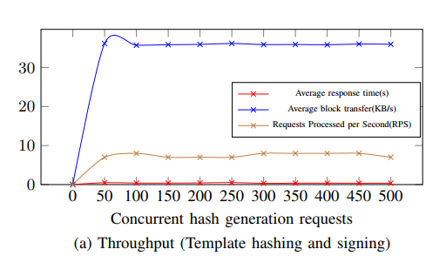
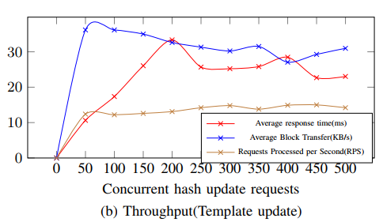
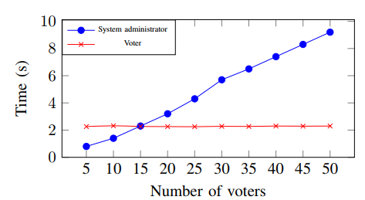
Performance Analysis
Measures execution time of template hashing algorithms.
Evaluates average response time and block transfer time for various processes:
Template hashing and signing.
Template updates.
Voting process under varying system loads.
Results demonstrate practicality and good performance in different scenarios.

Slide 24
Security Analysis:
Assesses potential attack scenarios, including secret information intercepts, impersonation, and collusion.
Safeguards against these attacks using:
Encryption.
Access policies.
Verifiable credentials.
Voting process.

Slide 25
Conclusion

Slide 26
Main limitations
The protocol assumes that L1 issuers are trustworthy and follow the governance policies. However, there may be cases where L1 issuers are compromised or malicious.
The protocol relies on human review and voting to ensure the legitimacy of credential updates. However, this may introduce human errors or biases in the process.
The protocol does not consider other factors that may affect the trust of issuers, such as reputation, feedback, or context.

Slide 27
Thank you

