Slide 1


Team JayHackers
Tanvir Hossain
Mahmudul Hasan
Anupam Golder
Zachary J Ellis
Arijit Raychowdhury
Tamzidul Hoque

Slide 2
HOST IP Security Competition
ASCON’s Authenticated Encryption with Associated Data (ASCON_AEAD) [ASCON21]
4 phases of AEAD:
  Keyed INITIALIZATION
  Associated Data ABSORPTION
  Plaintext ENCRYPTION
  Keyed FINALIZATION

Slide 3
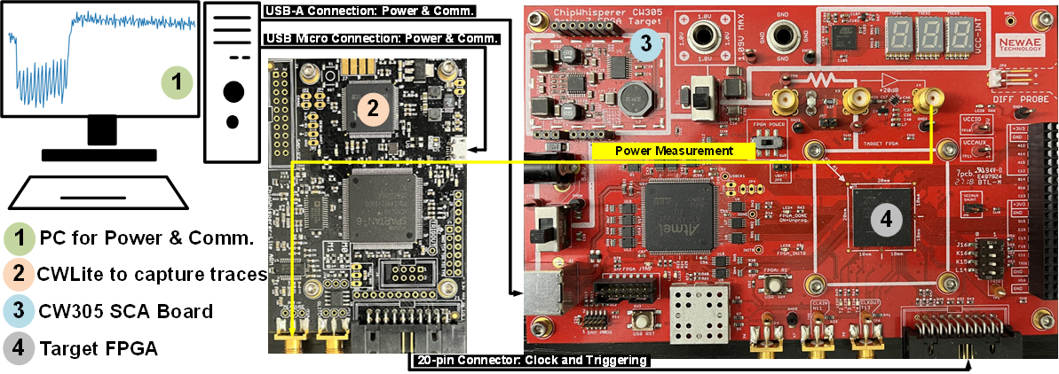
Power Analysis
Simple Power Analysis (SPA) of INITIALIZATION Phase of ASCON_AEAD
Measurement setup: ChipWhisperer toolchain, AMD/Xilinx Artix-7 FPGA-based SCA evaluation board, 10MHz CryptoCore frequency, 40MHz sampling frequency
Visible peaks during register updates → Cycle count
Parallel execution on 320-bit state + Constant-time implementation → Visually indistinguishable data-dependent leakage from single measurement

Slide 4
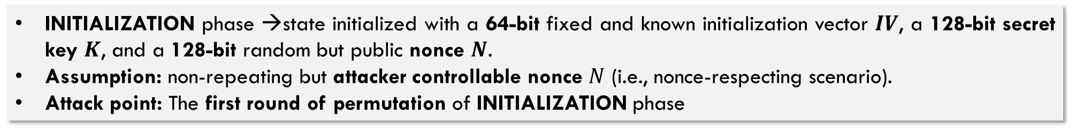
Power Analysis
Differential Power Analysis (DPA) Attack on INITIALIZATION Phase of ASCON_AEAD [S16]: Threat Model
INITIALIZATION phase →state initialized with a 64-bit fixed and known initialization vector $IV$, a 128-bit secret key $K$, and a 128-bit random but public nonce $N$.
Assumption: non-repeating but attacker controllable nonce $N$ (i.e., nonce-respecting scenario).
Attack point: The first round of permutation of INITIALIZATION phase

Slide 5
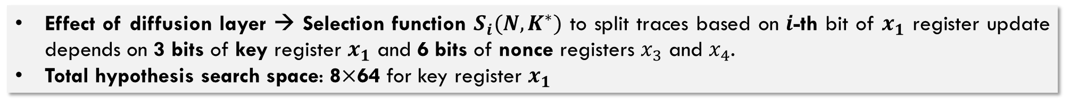
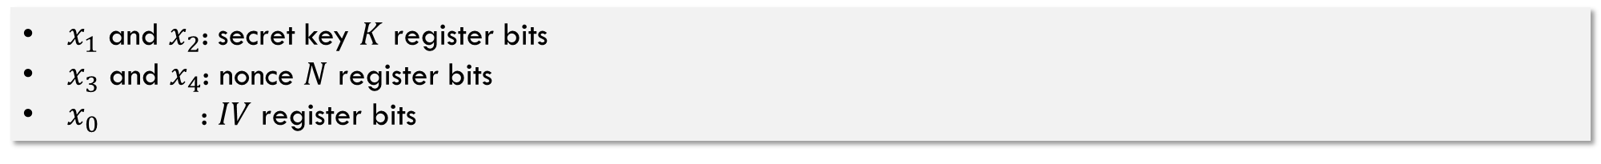
Power Analysis
DPA Attack on INITIALIZATION Phase of ASCON_AEAD [S16]: Selection Functions
$x_{1}$ and $x_{2}$: secret key $K$ register bits
$x_{3}$ and $x_{4}$: nonce $N$ register bits
$x_{0}$ : $IV$ register bits
$$(y_{0},y_{1},y_{2},y_{3},y_{4})=Sbox\left(x_{0},x_{1},x_{2},x_{3},x_{4}\right)$$
$$y_{0}=x_{0}⊕x_{2}⊕x_{1}x_{2}⊕x_{3}⊕x_{1}⊕x_{0}x_{1}⊕x_{1}x_{4}$$
Highlighted in blue → Constant register activity
$$y_{0}=x_{3}⊕x_{1}x_{4}$$
Intermediate value → 2 bits from two nonce registers, 1 bit from key register $x_{1}$
$$\sum_{l_{0},r_{0}}{(x_{0}) }=x_{0}⊕\left(x_{0}⋙19\right)⊕\left(x_{0}⋙28\right)$$
$$S_{i}\left(N,K^{∗}\right)=k_{i}^{∗}\left(n_{64+i}\right)⊕n_{i}⊕k_{i−19+64}^{∗}\left(n_{64+i−19+64}\right)⊕n_{i−19+64 }⊕k_{i−28+64}^{∗}\left(n_{64+i−28+64}\right)⊕n_{i−28+64}$$
Effect of diffusion layer → Selection function $S_{i}(N,K^{∗})$ to split traces based on $i$-th bit of $x_{1}$ register update depends on 3 bits of key register $x_{1}$ and 6 bits of nonce registers $x_{3}$ and $x_{4}$.
Total hypothesis search space: 8$×$64 for key register $x_{1}$

Slide 6
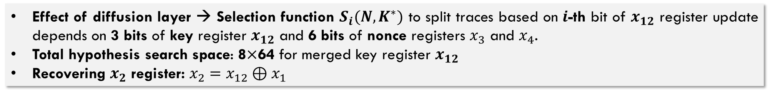
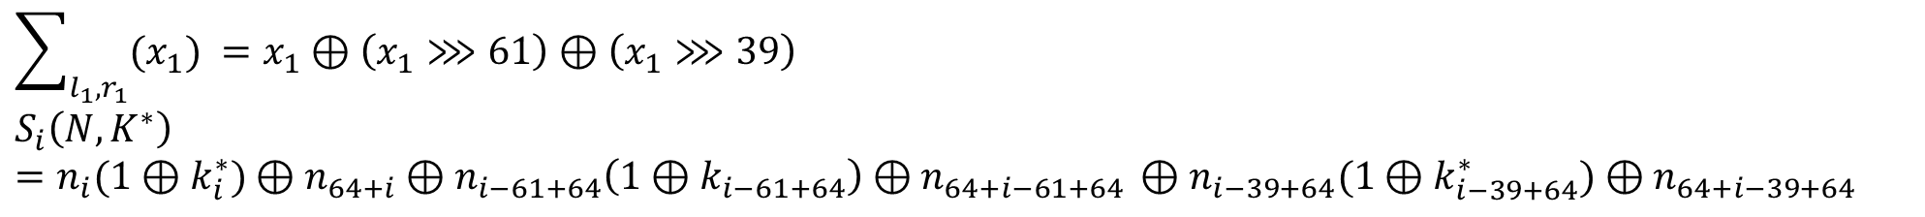
Power Analysis
DPA Attack on INITIALIZATION Phase of ASCON_AEAD [S16]: Selection Functions
Remaining hypothesis search space: $2^{64}$ for key register $x_{2}$
S-box output with non-linear term → only $y_{1}$ has a result with a quadratic term containing $x_{2}$.
$$y_{1}=x_{1}⊕x_{3}⊕x_{1}x_{3}⊕x_{2}x_{3}⊕x_{0}⊕x_{4}⊕x_{2}⊕x_{1}x_{2}$$
Highlighted in blue → Constant register activity
$$y_{1}=x_{3}⊕x_{1}x_{3}⊕x_{2}x_{3}⊕x_{4}=x_{3}\left(1⊕x_{1}⊕x_{2}\right)⊕x_{4}=x_{3}\left(1⊕x_{12}\right)⊕x_{4}$$
$x_{1}$ and $x_{2}$ → indistinguishable due to XOR operation → Merged bit $x_{12}=x_{1}⊕x_{2}$
$$\sum_{l_{1},r_{1}}{(x_{1}) }=x_{1}⊕\left(x_{1}⋙61\right)⊕\left(x_{1}⋙39\right)$$
$$S_{i}\left(N,K^{∗}\right)=n_{i}(1⊕k_{i}^{∗})⊕n_{64+i}⊕n_{i−61+64}\left(1⊕k_{i−61+64}\right)⊕n_{64+i−61+64 }⊕n_{i−39+64}(1⊕k_{i−39+64}^{∗})⊕n_{64+i−39+64}$$
Effect of diffusion layer → Selection function $S_{i}(N,K^{∗})$ to split traces based on $i$-th bit of $x_{12}$ register update depends on 3 bits of key register $x_{12}$ and 6 bits of nonce registers $x_{3}$ and $x_{4}$.
Total hypothesis search space: 8$×$64 for merged key register $x_{12}$
Recovering $x_{2}$ register: $x_{2}=x_{12}⊕x_{1}$

Slide 7
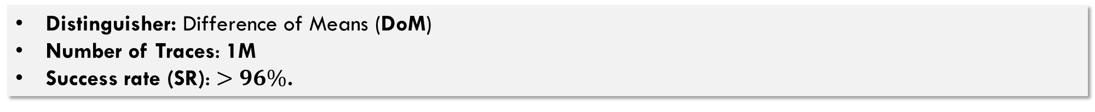
Power Analysis
DPA Attack on INITIALIZATION Phase of ASCON_AEAD [S16]: Results
Distinguisher: Difference of Means (DoM)
Number of Traces: 1M
Success rate (SR): $>96\%$.

Slide 8
Power Analysis
DPA Protection: Round unrolled Implementation [BSL+10,M21]
Key idea:
  Perform multiple rounds in each cycle
  Increase hypothesis search space due to deeper diffusion of the key
Hardware overhead: Doubling of Combinational datapath
Performance: Increase in latency (due to longer critical path), Increase in throughput (due to removal of MUXing logic)

Slide 9
Power Analysis
DPA Protection: Trickled Nonce Absorption [TS14]
Key idea:
  Limit data complexity accessible to attackers
  Absorb one or few bits of nonce at a time
Proposed for Keccak (SHA-3 candidate), XOODYAK and ISAP (LWC candidates)
Hardware overhead: Lowest
Performance overhead: One-time (during INITIALIZATION)

Slide 10
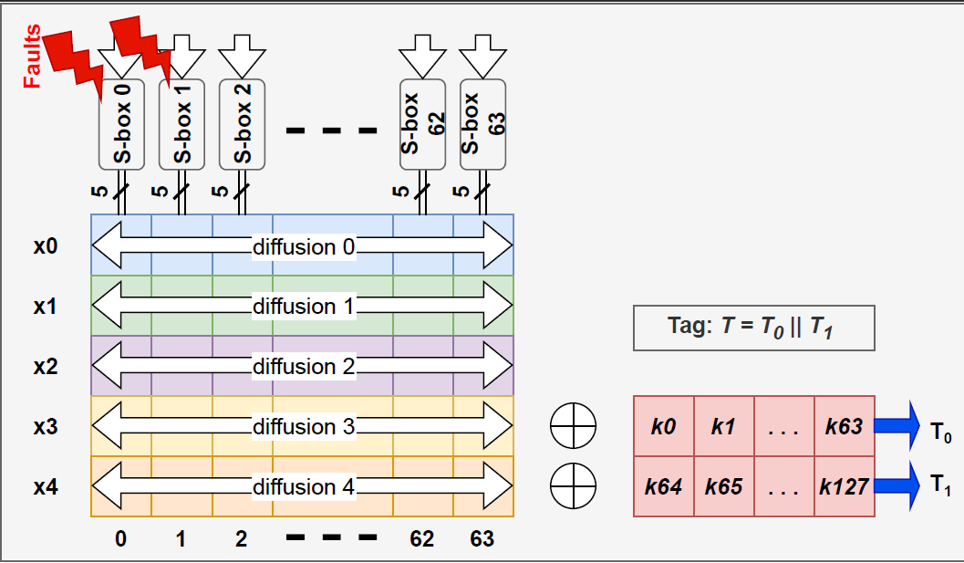
Simple and Differential Fault Attack
Simple Fault Attack
A random fault injection is induced subsequent to the S-box operation in the last round of the FINALIZATION phase.
A random value was XOR’ed with the last two S-box outputs.
Due to the fault injection, the tag results changed for the golden key and nonce value.
In the next phase, we will implement Differential Fault Attack proposed in [KPW’19]

Slide 11
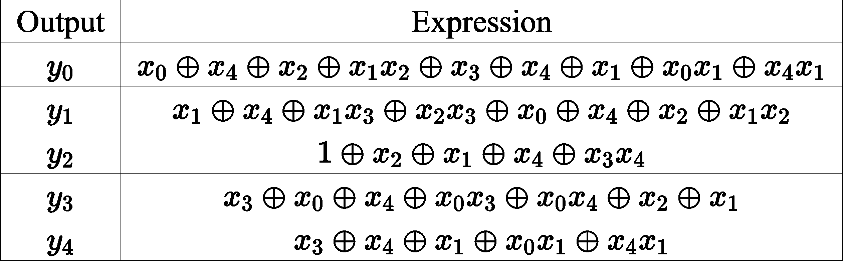
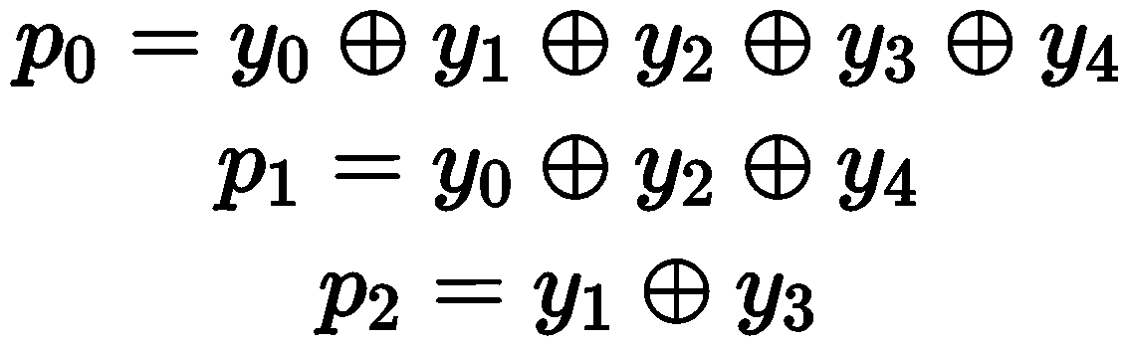
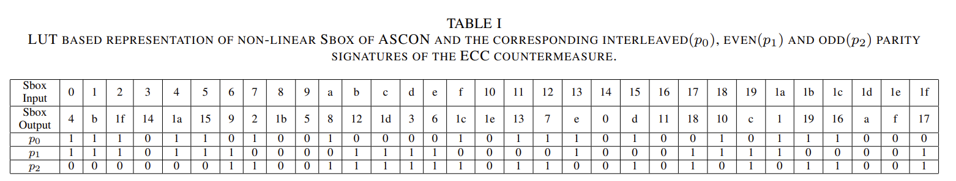
Countermeasure for Fault Attack
Error Correction Coding based Parity Signature Generation [JMR22]
Key idea:
  Generate Interleaved, Even, and Odd Parity Signatures
  Match the parity signatures with the corresponding S-box input.
Hardware overhead: Lowest
Performance overhead: Highly Accurate in terms of error detection.
Logic Implementation of ASCON Sbox
Logic Implementation of Parity Signatures

Slide 12
References
[W23] | Witteman M., “Security Highlight: Ascon”, 2023, URL: https://www.riscure.com/security-highlight-ascon/
[NIST23] | NIST LWC selection announcement, 2023, URL: https://csrc.nist.gov/News/2023/lightweight-cryptography-nist-selects-ascon, https://www.nist.gov/news-events/news/2023/02/nist-selects-lightweight-cryptography-algorithms-protect-small-devices
[NIST18] | NIST Call for LWC, 2018, URL: https://www.nist.gov/news-events/news/2018/04/nist-issues-first-call-lightweight-cryptography-protect-small-electronics
[Rambus23] | ASCON IP from Rambus, 2023, URL: https://www.rambus.com/blogs/rambus-ip-solution-supports-new-nist-lightweight-cryptography-algorithm/
[HN23] | HackerNews, 2023, URL: https://thehackernews.com/2023/02/nist-standardizes-ascon-cryptographic.html
[ASCON21] | ASCON final specification, URL: https://ascon.iaik.tugraz.at/specification.html , https://csrc.nist.gov/CSRC/media/Projects/lightweight-cryptography/documents/finalist-round/updated-spec-doc/ascon-spec-final.pdf
[B19] | Buchanan B., “One of the greatest advancements in Cybersecurity: The Sponge Function (Keccak, SHAKE and ASCON)”, 2019, URL: https://medium.com/asecuritysite-when-bob-met-alice/one-of-the-greatest-advancements-in-cybersecurity-the-sponge-function-keccak-and-shake-6e6c8e298682
[Keccak] | URL: https://keccak.team/
[T22] | Tezcan C., “ASCON Authenticated Encryption Scheme”, 2022, URL: https://www.youtube.com/watch?v=YIjiTB9ZxYw

Slide 13
References
[SP21] | Steinegger, S., & Primas, R. (2021, January). A fast and compact RISC-V accelerator for ascon and friends. In Smart Card Research and Advanced Applications: 19th International Conference, CARDIS 2020, Virtual Event, November 18–19, 2020, Revised Selected Papers (pp. 53-67). Cham: Springer International Publishing. URL: https://www.youtube.com/watch?v=rC4Ib6T-qm4 , https://github.com/Steinegger/riscv_asconp_accelerator
[P22] | Primas, R., 2022, URL: https://github.com/ascon/ascon-hardware
[RD22] | Rezvani, B., Diehl W., 2022, URL: https://github.com/vtsal/ascon_lwc_aead_hash
[NGK22] | Nagpal, R., Gaj, K., Kaps, J.P., 2022, URL: https://github.com/GMUCERG/Ascon
[MGK22] | Mohajerani, K., Gaj, K., Kaps, J.P., 2022, URL: https://github.com/kammoh/bluelight/tree/api3/Ascon
[GWD+15] | Gross, H., Wenger, E., Dobraunig, C., & Ehrenhöfer, C. (2015, August). Suit up!--Made-to-Measure Hardware Implementations of ASCON. In 2015 Euromicro Conference on Digital System Design (pp. 645-652). IEEE. URL: https://github.com/IAIK/ascon_hardware/tree/master/caesar_hardware_api_v_1_0_3/ASCON_ASCON
[KKA21] | Kaur, J., Kermani, M. M., & Azarderakhsh, R. (2021). Hardware constructions for error detection in lightweight authenticated cipher ASCON benchmarked on FPGA. IEEE Transactions on Circuits and Systems II: Express Briefs, 69(4), 2276-2280.
[KHK+17] | Kumar, S., Haj-Yahya, J., Khairallah, M., Elmohr, M. A., & Chattopadhyay, A. (2017). A comprehensive performance analysis of hardware implementations of CAESAR candidates. Cryptology ePrint Archive.

Slide 14
References
[GIB18] | Groß, H., Iusupov, R., & Bloem, R. (2018). Generic low-latency masking in hardware. IACR transactions on cryptographic hardware and embedded systems, 1-21.
[GM18] | Groß, H., & Mangard, S. (2018). A unified masking approach. Journal of cryptographic engineering, 8, 109-124.
[S16] | Samwel, N. (2016). Side-Channel Analysis of Keccak and Ascon.
[TS14] | Taha, M., & Schaumont, P. (2014, May). Side-channel countermeasure for SHA-3 at almost-zero area overhead. In 2014 IEEE International Symposium on Hardware-Oriented Security and Trust (HOST) (pp. 93-96). IEEE.
[M20] | Moos, T. (2020). Unrolled cryptography on silicon: a physical security analysis. IACR Transactions on Cryptographic Hardware and Embedded Systems, 416-442.
[BSL+10] | Bhasin, Shivam, Sylvain Guilley, Laurent Sauvage, and Jean-Luc Danger. "Unrolling cryptographic circuits: A simple countermeasure against side-channel attacks." In Topics in Cryptology-CT-RSA 2010: The Cryptographers’ Track at the RSA Conference 2010, San Francisco, CA, USA, March 1-5, 2010. Proceedings, pp. 195-207. Springer Berlin Heidelberg, 2010.
[JMR22] | J. Kaur, M. Mozaffari Kermani and R. Azarderakhsh, "Hardware Constructions for Error Detection in Lightweight Authenticated Cipher ASCON Benchmarked on FPGA," in IEEE Transactions on Circuits and Systems II: Express Briefs, vol. 69, no. 4, pp. 2276-2280, April 2022, doi: 10.1109/TCSII.2021.3136463.
[KPQ19] | K. Ramezanpour, P. Ampadu and W. Diehl, "A Statistical Fault Analysis Methodology for the Ascon Authenticated Cipher," 2019 IEEE International Symposium on Hardware Oriented Security and Trust (HOST), McLean, VA, USA, 2019, pp. 41-50, doi: 10.1109/HST.2019.8741029.

