Slide 1
C# Basics
Course Code: CSC 3115
Course Title: Object Oriented Programming 2
Dept. of Computer Science
Faculty of Science and Technology
Lecture No: | 02 | Week No: | 02 | Semester: | Fall 2020-2021
Lecturer: | Victor Stany Rozario, stany@aiub.edu

Slide 2
Topics
C# Data Types
Type Casting
The keywords readonly and const
Structures
Enumeration
String
Use of params, ref, out
Understand the concept of Class and Object
Learn about constructors
Variable Types

Slide 3
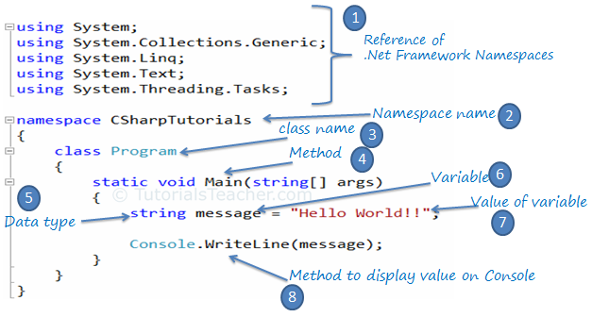
Simple Console Project with C#

Slide 4
THE C# BASICS

Slide 5


Slide 12
Data Type
Integral
Floating-Point
Other
byte
float
bool
short
double
char
int
decimal
long

Slide 16
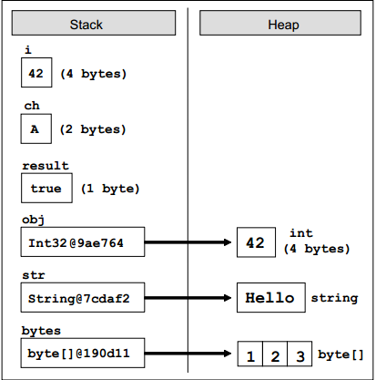
Value and Reference Types and the Memory In this example we will illustrate how value and reference types are represented in memory. Consider the execution of the following programming code:
At this point the variables are located in the memory as follows:
int i = 42; char ch = 'A'; bool result = true; object obj = 42; string str = "Hello"; byte[] bytes ={1,2,3};

Slide 17
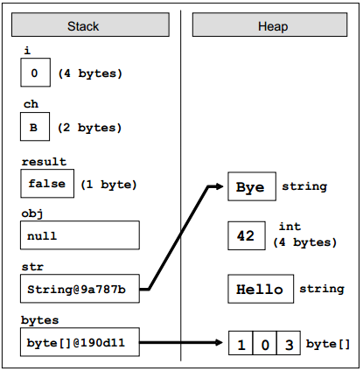
Value and Reference Types and the Memory If we now execute the following code, which changes the values of the variables, we will see what happens to the memory when changing the value and reference types:
After these changes the variables and their values are located in the memory as follows:
i = 0; ch = 'B'; result = false; obj = null; str = "Bye"; bytes[1] = 0;

Slide 46
Class & Object

Slide 76

Thank You

Slide 77
Books
C# 4.0 The Complete Reference; Herbert Schildt; McGraw-Hill Osborne Media; 2010
Head First C# by Andrew Stellman
Fundamentals of Computer Programming with CSharp – Nakov v2013

Slide 78
References
MSDN Library; URL: http://msdn.microsoft.com/library
C# Language Specification; URL: http://download.microsoft.com/download/0/B/D/0BDA894F-
2CCD-4C2C-B5A7-4EB1171962E5/CSharp%20Language%20Specixfication.doc
C# 4.0 The Complete Reference; Herbert Schildt; McGraw-Hill Osborne Media; 2010

