Slide 1
Database Concept
Course Code: CSC 2210
Course Title: Object Oriented Programming 2
Dept. of Computer Science
Faculty of Science and Technology
Lecturer No: | 11 | Week No: | 12 | Semester: | Summer 2019-2020
Lecturer: | Md. Hasibul Hasan, hasib.hasan@aiub.edu

Slide 2
Lecture Outline
Introduction to ADO.NET.
Introduction to MS SQL Server.
Database CRUD operation.
Familiarize with Desktop based Management System.

Slide 3
ADO.NET

Slide 4
Introduction to ADO.NET
ADO.NET is a set of classes (a framework) to interact with data sources such as databases and XML files.
ADO is the acronym for ActiveX Data Objects.
It has classes and methods to retrieve and manipulate data.
ADO.NET provides a bridge between the front end controls and the back end database.
ADO.NET provides a rich set of components for creating distributed, data-sharing applications.
The following are a few of the .NET applications that use ADO.NET to connect to a database, execute commands and retrieve data from the database.
ASP.NET Web Applications
Console Applications
Windows Applications.

Slide 5
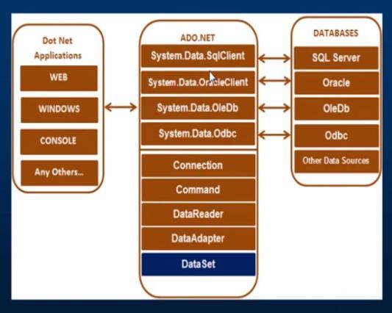
ADO.NET Basic Architecture
There are the following two types of connection architectures:
Connected architecture: the application remains connected with the database throughout the processing.
Disconnected architecture: the application automatically connects/disconnects during the processing. The application uses temporary data on the application side called a DataSet.

Slide 6
DataSet Class
The dataset represents a subset of the database. It does not have a continuous connection to the database. To update the database a reconnection is required. The DataSet contains DataTable objects and DataRelation objects. The DataRelation objects represent the relationship between two tables.
Some important properties of the DataSet class: Namepace, prefix, Relations, Tables etc.
Some important methods of the DataSet class: GetDataSetSchema, GetType, Copy, Clone, Equals(Object) etc.
For More details please follow the link:
https://www.tutorialspoint.com/asp.net/asp.net_ado_net.htm

Slide 7
Important Classes
We can also observe various classes our work. They are:
Connection Class
Command Class
DataReader Class
DataAdaptor Class
DataSet Class
We can also observe that there are various types of applications that use ADO.NET to connect to several databases such as: SQL Server, Oracle, OleDb, ODBC, XML files and so on.
We will discuss our situation based on SQL Sever.

Slide 8
Connection Class
In ADO.NET, we use these connection classes to connect to the database. These connection classes also manage transactions and connection pooling.

Slide 9
Command Class
The Command class provides methods for storing and executing SQL statements and Stored Procedures. The following are the various commands that are executed by the Command Class.
ExecuteReader: Returns data to the client as rows.
ExecuteNonQuery: Executes a command that changes the data in the database, such as an update, delete, or insert statement, or a Stored Procedure that contains one or more of these statements.
ExecuteScalar: This method only returns a single value. This kind of query returns a count of rows or a calculated value.
ExecuteXMLReader: (SqlClient classes only) Obtains data from an SQL Server 2000 database using an XML stream. Returns an XML Reader object.

Slide 10
DataReader Class
The DataReader is used to retrieve data. It is used in conjunction with the Command class to execute an SQL Select statement and then access the returned rows.

Slide 11
DataAdapter & DataSet Class
The DataAdapter is used to connect DataSets to databases. The DataAdapter is most useful when using data-bound controls in Windows Forms, but it can also be used to provide an easy way to manage the connection between your application and the underlying database tables, views and Stored Procedures.
The DataSet is the heart of ADO.NET. The DataSet is essentially a collection of DataTable objects. In turn each object contains a collection of DataColumn and DataRow objects. The DataSet also contains a Relations collection that can be used to define relations among Data Table Objects.

Slide 12
Example
string sql = @"select * from person;";
SqlConnection sqlcon = new SqlConnection(@"");//Connection String
sqlcon.Open();
SqlCommand sqlcom = new SqlCommand(sql, sqlcon);
SqlDataAdapter sda = new SqlDataAdapter(sqlcom);
DataSet ds = new DataSet();
sda.Fill(ds);
sqlcon.Close();

Slide 13
Search & CRUD

Slide 14
Example (Biniding GridView)
private void PopulateGridView(string sql = "select * from table;")
{
var dt = this.Da.ExecuteQuery(sql);
this.dgvMain.AutoGenerateColumns = false;
this.dgvMain.DataSource = dt;
}

Slide 15
Example (Insert & Update)
//Insert
string query = @"insert into table
values('" + this.txtId.Text + "','" + this.txtTitle.Text + "'," + this.txtVal1.Text + "," + this.txtVal2.Text + ",'" + this.dtpVal3.Text + "','" + this.cmbVal4.Text + "');";
int count = this.Da.ExecuteUpdateQuery(query);
//Update
string query = @"update table
set title = '" + this.txtTitle.Text + @"',
val1 = " + this.txtVal1.Text + @",
val2 = " + this.txtVal2.Text + @",
val3 = '" + this.dtpVal3.Text + @"',
val4 = '" + this.cmbVal4.Text + @"'
where id = '" + this.txtId.Text + "';";
int count = this.Da.ExecuteUpdateQuery(query);

Slide 16
Example (Delete)
string query = "delete from table where id = '" + id + "';";
int count = this.Da.ExecuteUpdateQuery(query);

Slide 17

Thank You

Slide 18
Books
C# 4.0 The Complete Reference; Herbert Schildt; McGraw-Hill Osborne Media; 2010
Head First C# by Andrew Stellman
Fundamentals of Computer Programming with CSharp – Nakov v2013

Slide 19
References
https://www.codeproject.com/Articles/823854/How-to-Connect-SQL-Database-to-your-Csharp-Program
https://www.guru99.com/c-sharp-access-database.html
https://www.udemy.com/course/csharp-database-programming/
https://codesamplez.com/database/desktop-form
https://docs.microsoft.com/en-us/visualstudio/data-tools/create-a-simple-data-application-by-using-adonet?view=vs-2019
https://docs.microsoft.com/en-us/visualstudio/data-tools/create-a-sql-database-by-using-a-designer?view=vs-2019
https://www.c-sharpcorner.com/UploadFile/18fc30/understanding-the-basics-of-ado-net/
https://www.tutorialspoint.com/asp.net/asp.net_ado_net.htm
https://docs.microsoft.com/en-us/dotnet/framework/data/adonet/
https://docs.microsoft.com/en-us/dotnet/framework/data/adonet/ado-net-code-examples

