Slide 1
Course Orientation & General Discussion
Course Code: CSC 3115
Course Title: Object Oriented Programming 2
Dept. of Computer Science
Faculty of Science and Technology
Lecture No: | 01 | Week No: | 01 | Semester: | Fall 21-22
Lecturer: | Ismail.hossen@aiub.edu

Slide 2
Lecture Outline
Vision, Mission & Goals of AIUB
Vision, Mission & Goals of CS
The Instructor
The Course
Books & References
Evaluation Criteria's
Class Policies
Grading Policies & General Info.
Consultation

Slide 3

Vision & Mission of AIUB
VISION
AMERICAN INTERNATIONAL UNIVERSITY-BANGLADESH (AIUB) envisions promoting professionals and excellent leadership catering to the technological progress and development needs of the country.
MISSION
AMERICAN INTERNATIONAL UNIVERSITY-BANGLADESH (AIUB) is committed to provide quality and excellent computer-based academic programs responsive to the emerging challenges of the time. It is dedicated to nurture and produce competent world class professional imbued with strong sense of ethical values ready to face the competitive world of arts, business, science, social science and technology.

Slide 4
Goals of AIUB
Sustain
Sustain development and progress of the university
Continue
Continue to upgrade educational services and facilities responsive of the demands for change and needs of the society
Inculcate
Inculcate professional culture among management, faculty and personnel in the attainment of the institution's vision, mission and goals
Enhance
Enhance research consciousness in discovering new dimensions for curriculum development and enrichment
Implement
Implement meaningful and relevant community outreach programs reflective of the available resources and expertise of the university
Establish
Establish strong networking of programs, sharing of resources and expertise with local and international educational institutions and organizations
Accelerate
Accelerate the participation of alumni, students and professionals in the implementation of educational programs and development of projects designed to expand and improve global academic standards

Slide 5

Vision & Mission of Computer Science Department
VISION
Provides leadership in the pursuit of quality and excellent computer education and produce highly skilled and globally competitive IT professionals.
MISSION
Committed to educate students to think analytically and communicate effectively; train them to acquire technological, industry and research-oriented accepted skills; keep them abreast of the new trends and progress in the world of information communication technology; and inculcate in them the value of professional ethics.

Slide 6
Goals of Computer Science Department
Enrich
Enrich the computer education curriculum to suit the needs of the industry- wide standards for both domestic and international markets
Equip
Equip the faculty and staff with professional, modern technological and research skills
Upgrade
Upgrade continuously computer hardware's, facilities and instructional materials to cope with the challenges of the information technology age
Initiate and conduct
Initiate and conduct relevant research, software development and outreach services.
Establish
Establish linkage with industry and other IT-based organizations/institutions for sharing of resources and expertise, and better job opportunities for students

Slide 7
About Me
MSC (Information and Database Management)
American International University-Bangladesh
BSC (Computer Science and Engineering)
American International University-Bangladesh

Slide 8
Contact Details
Lecturer
Department of Computer Science
FST, AIUB
Email – ismail.hossen@aiub.edu
Office – D0318

Slide 9
Possible List of Advantages of Online Instruction During Shutdown:
1. Continued schooling ensures graduation/ completion on a stipulated time.
2. Maximizes time, making it productive and beneficial to future career.
3. Learning on student’s pace, as they can review the lectures after the online class.
4. Ensures safe, convenient and a secured environment at home.
5. Avoid risk of contamination of the deadly corona virus due to group and face to face contacts with other students/individuals.
6. Lessen parent’s anxiety on security and health
7. Develops self confidence and independence as students can express their ideas without hesitation being away from the direct face-to-face presence of classmates avoiding embarrassment when the answer/response is not correct, or a mistake is committed.

Slide 10
Possible List of Advantages of Online Instruction During Shutdown:
8. Develops the creative ability of the students in the learning process with the use of technology.
9. Enhances teachers’ creativity in motivating students to learn using different platforms and presentations to suit students’ interest and ability.
10. Work assignment, practical exercises, problem solving are easily accomplished with the aid of technology.
11. Performance assessment/evaluation is made easy, practical and immediate so that remedial measures can be provided easily and directly through one-on-one approach.
12. Less expense in personal, social and miscellaneous expenses.
13. Online learning skills enhance cognitive knowledge and ability to cope with industry/employer’s emerging requirements and new approach in hiring of graduates.
14. Teachers availability by email and Teams

Slide 11
The Course
Course Title: OBJECT ORIENTED PROGRAMMING 2
Course Code: CSC 3115
Credit Hour: 3/1
Prerequisite: (CSC 2209: Object Oriented Programming 1)

Slide 12
Objectives
At the end of the course, the following objectives should be achieved:
Develop classes and describe how to declare a class
Create .Net Technology applications that leverage the object-oriented features of the C# language, such as encapsulation, inheritance, polymorphism and abstraction.
Use .Net technology data types and expressions
Use arrays and other data collections
Use the concept of Assembly
Implement error-handling techniques using exception handling
Perform multiple operations on database tables, including creating, reading, updating and deleting using MSSQL.
Create an event-driven graphical user interface using Windows Form: panels, buttons, labels, text fields, and text areas.
Learn .Net Framework 4.5.

Slide 13
Importance of the course
This will allow you to understand and take full advantage of the upcoming courses like Advanced Programming with .NET etc

Slide 14
Topics to be covered
IDE OVERVIEW
.NET OVERVIEW
OOP OVERVIEW IN .NET
C# BASICS
SOFTWARE DESIGN PATTERN
LAYERED ARCHITECTURE DESIGN
SOFTWARE DEVELOPMENT

Slide 15
Books/References
1.C# 4.0 The Complete Reference; Herbert Schildt; McGraw-Hill Osborne Media; 2010
2. The C# Programming Language (Covering C# 4.0); Anders Hejlsberg, Mads Torgersen, Scott Wiltamuth, Peter Golde; Addison-WesleY; 2010
3. Headfirst C# by Andrew Stellman
4. Fundamentals of Computer Programming with CSharp – Nakov v2013
5. MSDN Library; URL: http://msdn.microsoft.com/library
6. C# Language Specification; URL: http://download.microsoft.com/download/0/B/D/0BDA894F-
2CCD-4C2C-B5A7-4EB1171962E5/CSharp%20Language%20Specixfication.doc

Slide 16
Course Requirements
These are the things need to be accomplished properly by the students during the term such as:
Attending at least 80% of the classes
Attending quizzes, presentation sessions and term exams
Submission of the assignments, lab tasks in due time, etc.

Slide 17
Quiz & Assignments
N number of quizzes and assignments in a term
N-1 will be counted for the final grading of each term
Assignment
You should not miss any deadline.
50% marks will be deducted for each day in case of late submission
Quiz
No request will be entertained if you miss any quiz.

Slide 18
Final Project
You will be assigned a group project at the end of the course which will contribute 50-100% of the final grade
Group Members: Min :3 , Max : 4
*** Proposal Submission: Within 5th week of midterm
*** Prototype Submission: Within 9th week
*** Submission Deadline: week after the final term
(Exact dates will be announced later)

Slide 19
Classroom Policies
Must be present inside the class in due time
Late in Class: max 10 minutes, after that you will not be able to enter into the classroom.
Class Break: I would prefer giving a break in the middle of the class.
Every class will start with a question-answer session about the last lecture. So students must be prepared with the contents and exercises from the last lecture.
Students are suggested to ask questions during or after the lecture.
Do not hesitate to ask any question any number of time about the lecture
*** Additional/bonus marks may be given to any good performances during the class.

Slide 20
Classroom Policies: Attendance
At least 80% presence is required by the student. Absent classes must be defended by the student through application and proper documentation to the course teacher.
Single absences or absences within 20% range will be judged by the course teacher.
Long absences/irregular presence/absences out of 20% range must go through application procedures via department Head (+ probation office, if student is in probation) to attend the following classes.
Acceptance of an application for absence only gives permission to attend the following classes. This might still result in deduction of marks (for attendance) which will be judged by the course teacher.
Informing regarding Absence: Must be informed through email.

Slide 21
Classroom Policies: Inside the Classroom
You do not need to ask permission to go out or come inside the class. Just try to keep it quiet
You need not stand to talk with me
Your cellphone should be in silent mode during the class hours
No call receiving or calling inside the class room.
No use of laptops or tabs or cell phones inside class rooms unless it is instructed or required for class related specific tasks.
No side talk or discussion unless it is instructed.
Never take food or drink coffees, soft drinks except water during the ongoing class time.
Finally be gentle and keep calm and approach modestly and nicely

Slide 22
Classroom Policies: Laboratory
Laboratory Classes
First 0.5 – 1 hour will be spent explaining the problems/task/experiment to be performed.
Next 1 – 1.5 hour(s) will be spent by the students to complete the experiment.
Next 0.5 – 1 hour will be spent in checking, marking, and discussing the solution.
Students are not allowed to discuss with each other in solving problems.
The checking (executing/viva) & marking will be with individual students only.
Laboratory Exam
Laboratory exams are scheduled in the week before the major exams during the normal laboratory hours.
Generally students are given one/more problems to be solved of which at least one part is solved using computers.
One hour is given to the students to solve the problem. And half hour to submit and viva. Generally 20 students in the first 1.5 hours and the other 20 students in the rest 1.5 hours.
Students may be given choices to select the problem. At most 3 selection can be given to a student with 0, 2, and 4 marks deduction as a penalty for each selection respectively.
Only in case of unavoidable circumstances, the laboratory exams may be taken in the off days or week after the major exams.

Slide 23
Classroom Policies: Makeup Evaluation
There will be no makeup quiz as long as a student have appeared in (n-1) quizzes.
Makeup for missing evaluations like quizzes/assignment submission date/presentation date/viva date/etc., must go through valid application procedure with supporting document within the deadline of the actual evaluation date.
Makeup for missing Midterm/Final term must go through Set B form along with the supporting document within the 1st working day after exam week. The set B exam is generally scheduled from the 2nd working day after the exam week. Must get signature and exam date from the course teacher and get it approved by the department Head (monetary penalty might be imposed).
Students unable to attend the set B exam may apply for set C exam within the same time limit as set B. Such applications must be supported by very strong reason and documentation, as they are generally rejected.
The course teacher will be the judge of accepting/rejecting the request for makeup.
*** Students absent for more than two weeks before midterm or after midterm and missing more than one evaluation categories are suggested to drop the course.

Slide 24
Grading Policies
All the evaluation categories & marks will be uploaded to the VUES within one week of the evaluation process except the attendance & performance, which will be uploaded along with the major (mid/final term) written exam marks.
Letter grades ‘A+’ through ‘F’ is counted as grades. Other grades ‘I’ and ‘UW’ are considered as temporary grades which are counted/calculated as ‘F’ grade in the CGPA. These grades must/will be converted to the actual grades, i.e. ‘A+’ through ‘F’.
‘I: INCOMPLETE’ is given to students who have missed at most 30% of evaluation categories (quiz/assignment/etc.). Students must contact the course teacher for makeup, through valid application procedures immediately after grade release.
‘UW: UNOFFICIAL WITHDRAW’ is given when the missing evaluation categories are too high (more than 30%) to makeup. A student getting ‘UW’ has no option but to drop the course immediately after grade release

Slide 25
Grading Policies contd..
Once a student’s gets ‘I’ or ‘UW’ and unable to fulfill the requirements with the course teacher for makeup, must drop the course within officially mentioned time period from the registration department.
Students in probation or falls into the probation due to ‘I’/’UW’ grade are not allowed to drop the course.
Unable to do so will result in the automatic conversion of the grades ‘I’/’UW’ to ‘F’ grade after the 4th week of the following semester.
Any problem with the mark/grade must be consulted with the course teacher within one week of the release of grades.

Slide 26
IMPORTANT!!
Never Come to my office with the request for an extra grade.
Never miss any deadline.
Marks will be deducted, even worse can happen if you copy assignment

Slide 27

WELCOME TO
OBJECT ORIENTED PROGRAMMING 2

Slide 28
Lecture Outline
Introduction and Overview of .NET Architecture and .Net Framework
Introduction to C#
Introduction to Visual Studio

Slide 29
Overview of .NET
.NET Architecture
What is .NET Framework
The .Net framework is a software development platform developed by Microsoft.
The framework was meant to create applications, which would run primarily on the Windows Platform.
The first version of the .Net framework was released in the year 2002.
The .Net framework can be used to create any kind of applications - Form based, Web based, Mobile applications

Slide 30
Overview of .NET
.NET Architecture
VB
C++
C#
JScript
…
Common Language Specification
Enormous platform
Over 10000++ types
Well-defined sub-systems and partitioning of responsibility
ASP.NET: Web Services
and Web Forms
Windows Forms
Visual Studio.NET
ADO.NET: Data and XML
Base Classes
Common Language Runtime

Slide 31
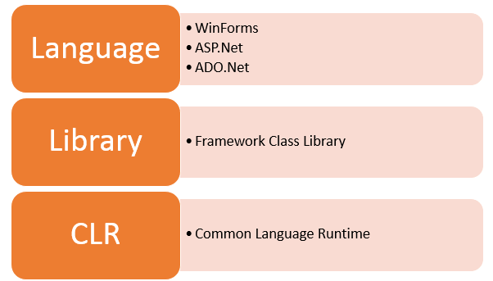
Overview of .NET
.NET Architecture
.Net Framework Architecture

Slide 32
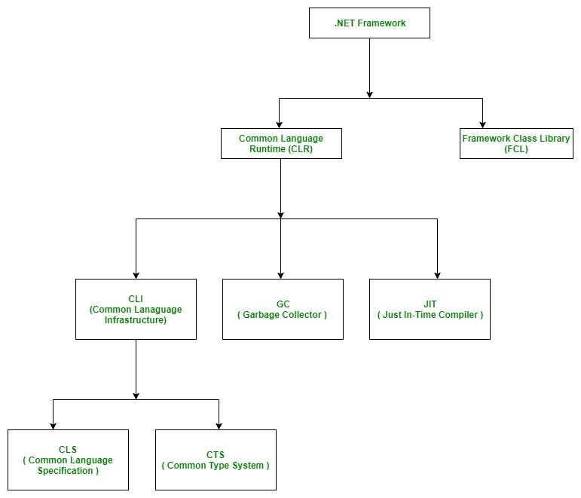
Overview of .NET
.NET Architecture

Slide 33
What is .NET platform?
C# is the language for .NET platform
Microsoft .NET is a platform for developing “managed” software
Traditional practice of compiling to an executable file that contains machine code and how that file is loaded and executed by the operating system.
This “unmanaged” compilation-to-execution process.
In the traditional compilation process, the executable file is binary and can be executed by the operating system immediately.

Slide 34
.NET platform
In the managed environment of .NET, the file produced by the compiler (the C# compiler in our case) is not an executable binary. Instead, it is an assembly, which contains metadata and intermediate language (IL) code.
An assembly contains intermediate language and metadata rather than binary code. This intermediate language is called Microsoft Intermediate Language (MSIL), which is commonly referred to as IL. IL is a high-level, component-based assembly language. IL supports a common type system and multiple languages in the same platform.

Slide 35
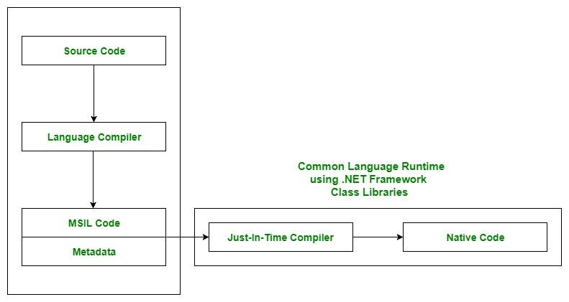

Slide 36
.NET Execution Model
Source code
Visual Basic
C#
C++
Unmanaged
Component
Compiler
Compiler
Compiler
Managed
code
Assembly
IL Code
Assembly
IL Code
Assembly
IL Code
Common Language Runtime
JIT Compiler
Native Code
Operating System Services

Slide 37
MSIL, IL & JIT
Microsoft Intermediate Language (MSIL), the intermediate code produced by the compiler after compiling the source code. This intermediate code is known as MSIL.
Intermediate Language (IL) is also known as MSIL (Microsoft Intermediate Language) or CIL (Common Intermediate Language).
Just In-Time Compiler (JIT), responsible for converting the CIL(Common Intermediate Language ) into machine code using the Common Language Runtime environment.
Common Language Runtime (CLR) provides an environment to execute .NET applications on target machines. The responsibilities of CLR are listed as follows:
Automatic memory management
Garbage Collection
Code Access Security
Code verification
JIT compilation of .NET code

Slide 38
Common Language Runtime (CLR)
Where is CLR on my machine?
C:\WINDOWS\Microsoft.NET\Framework\v2.0.50727\mscorlib.dll
(the path may vary for different framework versions)
The mscorlib.dll file is described as the Microsoft Common Language Runtime Class Library file integrated into the Microsoft Windows Operating System platform. The Common Language Runtime or CLR which is linked to the file mscorlib.resources.dll is the virtual machine constituent attributed to Microsoft's .NET enterprise.
The CLR where the mscorlib.resources.dll file is associated with is the Common Language Infrastructure or CLI standard implementation of Microsoft that identifies the program code's execution environment.

Slide 39
.NET Framework Class Library (FCL)
.NET has an extensive library, offering literally thousands of reusable types. Organized into namespaces, the FCL contains code supporting all the .NET technologies, such as
Windows Forms
Windows Presentation Foundation
ASP.NET
ADO.NET
Windows Workflow
Windows Communication Foundation.
In addition, the FCL has numerous cross-language technologies, including file I/O, networking, text management, and diagnostics. As mentioned earlier, the FCL has CLR support in the areas of built-in types, exception handling, security, and threading. Table below shows some common FCL libraries

Slide 40
.NET Framework Class Library (FCL)
Some Common .NET Framework Class Library Namespaces
System | System.Runtime
System.Collections | System.Security
System.Configuration | System.ServiceModel
System.Data | System.Text
System.Diagnostics | System.Threading
System.Drawing | System.Web
System.IO | System.Windows
System.Linq | System.Workflow.*
System.Net | System.Xml

Slide 41
According to Wiki…
In computer programming, a software framework is an abstraction in which software providing generic functionality can be selectively changed by additional user-written code, thus providing application-specific software. It provides a standard way to build and deploy applications and is a universal, reusable software environment that provides particular functionality as part of a larger software platform to facilitate development of software applications, products and solutions.

Slide 42
Introduction to .Net Framework
What is .NET Framework?
.NET is a platform for the developers made up of tools, programming languages and libraries. The framework is a complete environment that allows developers to develop, run and deploy applications such as:
Console applications.
Windows Forms applications.
Windows Presentation Foundation (WPF) applications.
Web applications (ASP.NET applications).
Web services.
Windows services and some more.

Slide 43
The main components of .NET Framework
.NET Framework Class Library
Common Language Runtime
Dynamic Language Runtimes (DLR)
Application Domains
Runtime Host
Common Type System
Metadata and Self-Describing Components
Cross-Language Interoperability
.NET Framework Security
Profiling
Side-by-Side Execution

Slide 44
A Tiny Bit of History
The C# language was originally developed by a small team led by two distinguished Microsoft engineers, Anders Hejlsberg and Scott Wiltamuth in 2001.
Anders Hejlsberg is also known for creating Turbo Pascal, a popular language for PC programming, and for leading the team that designed Borland Delphi, one of the first successful integrated development environments (IDEs) for client/server programming.

Slide 45

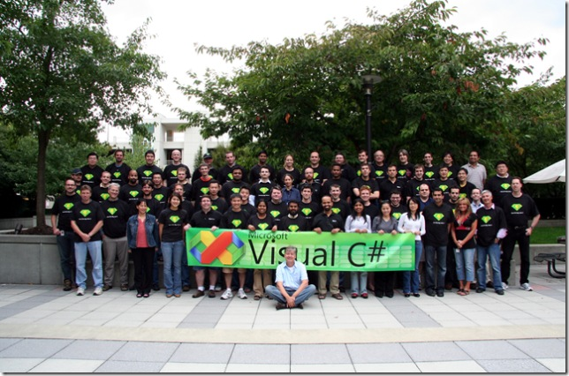
Anders Hejlsberg
Anders Hejlsberg
Since 2000, he has been the lead architect of the team developing the language C# and currently is a Microsoft Chief Architect

Slide 46
C# Genealogy
Object Oriented
Advanced Object Oriented
Elementary Procedural
Advanced Procedural
Special Procedural
Eiffel
Fortran
Algol 68
C
C++
C#
Cobol
PL/I
Pascal
Java
Ada 83
Ada 95

Slide 47
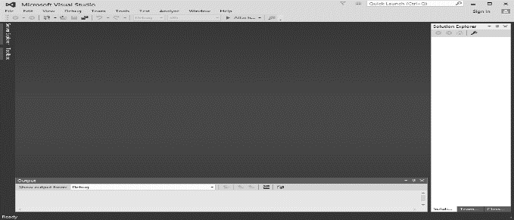
Introduction to Visual Studio
Visual Studio is an IDE (integrated development environment) for building apps. Similar to using Microsoft Word to write documents, you’ll use Visual Studio to create web apps.

Slide 48
Visual Studio
VS supports multiple languages (C#, C++, Visual Basic, J#) in one IDE.
VS manages features and content in a convenient way.
All Visual Studio .NET languages are object-oriented.
All programs have a similar structure.
All programs compiled into Common Intermediate Language (CIL)
For this course at least Visual Studio 2012

Slide 49
IDE’s and CLI Implementations
Visual C# http://www.microsoft.com/express/2012/
in MSDNAA
must be version 2012: we need C# 4.5
Mono: http://www.go-mono.com
Open Source for Linux
Rotor: http://msdn.microsoft.com/net/sscli
Shared Source for Windows
Use to work on BSD / OS X, too
Portable.NET: http://www.dotgnu.org
yet another open source implementation

Slide 50
First C# Program
using System;
namespace Test
{
class ExampleClass
{
static void Main()
{
System.Console.WriteLine("Hello, world!");
}
}
}

Slide 51
Books
Visual Studio from the Microsoft Developer Network (MSDN) https://msdn.microsoft.com/enus/library/dd831853(v=vs.120).aspx (particularly note the Visual Studio IDE User Guide and the Application Development in Visual Studio links).
C# 4.0 The Complete Reference; Herbert Schildt; McGraw-Hill Osborne Media; 2010

Slide 52
References
MSDN Library; URL: http://msdn.microsoft.com/library
C# Language Specification; URL: http://download.microsoft.com/download/0/B/D/0BDA894F-2CCD-4C2C-B5A7-4EB1171962E5/CSharp%20Language%20Specixfication.doc

Slide 53
Thank you!

