Slide 1
Layered Architecture & Project
Course Code: CSC 2210
Course Title: Object Oriented Programming 2
Dept. of Computer Science
Faculty of Science and Technology
Lecturer No: | 12 | Week No: | 13 | Semester: | Summer 2019-2020
Lecturer: | Md. Hasibul Hasan, hasib.hasan@aiub.edu

Slide 2
Lecture Outline
Discuss the basics of layered architecture in desktop app.
Discuss the advantages and disadvantages.
Working policies.
Discuss about the project proposal.
Discuss about the project demonstration.

Slide 3
Layered Architecture

Slide 4
Layered Architecture
Layered architecture is an approach to breaking down large applications into manageable areas.
This improves maintainability of the software by isolating functionality, improving testability, allowing code to be reused, and changes to be made to a layer without impacting another in a significant way.
When the various components in a system are organized systematically we call it a system architecture.
Each layer having responsibility for a major part of the system and with as little direct influence on other layers.
Tiers and Layers are used interchangeably.
Layers can be applied to the logical structure of the application and Tiers can be applied to the physical structure of the system architecture or infrastructure.

Slide 5
Layered Architecture
Tiers
The terms tier and layer are often used interchangeably. This isn’t wrong when the context is correct, but it is important to make and understand the distinction that they are not the same in software architecture. A tier refers to the physical location that your code base runs. A common case would be a client-server application that has two tiers, the physical client, and physical server. Tiers are distinguished by they fact that they are separated by physical boundaries.

Slide 6
Layered Architecture
Layers
Layers on the other hand, are logical separations of concerns in your application architecture. You might design your architecture to run a layer of the software on a specific tier, or share a layer across tiers. These decisions usually account for requirements such as security, performance, or management of the infrastructure. The most common and accepted layers of software are listed below:
Data Layer (also combination of Entity Layer)
Business Layer
Service Layer
Application Layer

Slide 7
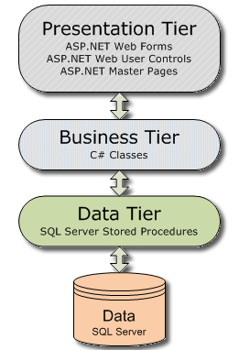
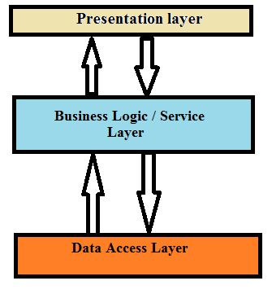
Layered Diagram

Slide 8
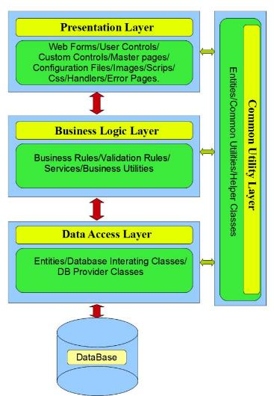
Layered Diagram

Slide 9
Layered Architecture
Data Layer
The data layer is also referred to as the DAL, or data abstraction layer.
This particular area of the software is responsible for encapsulating all access to application data.
Application data will be stored in a database like SQL Server or MySQL, but the DAL can also encapsulate data stored in other formats, such as xml.
Sometimes this layer also incorporates ‘Entity layer’ which often considered as separate layer.
Entity layer includes the classes which maps the DB table with the system.

Slide 10
Layered Architecture
Business Layer
The business layer is also referred to as business abstraction layer.
Sometimes it is also referred to as the domain layer.
The business layer is responsible for encapsulating all business logic for a given problem domain.

Slide 11
Layered Architecture
Service Layer
An application architecture might contain one or more service layers.
Typically, a service layer is used to abstract communication between a set of services.
Services could be web services, third party API, or other subsystems of a product.
It’s primary goal is to provide a consistent mechanism for sending data, receiving data, and handling errors.
This layer is also known as framework layer.

Slide 12
Layered Architecture
Application Layer
The application layer is also called the presentation layer
It is the layer of the software responsible for the user interface, and ultimately the specific environment hosting the software.
In a web application, your app layer will be the web application and the web server, while in a desktop application, it would be the desktop client and the OS.

Slide 13
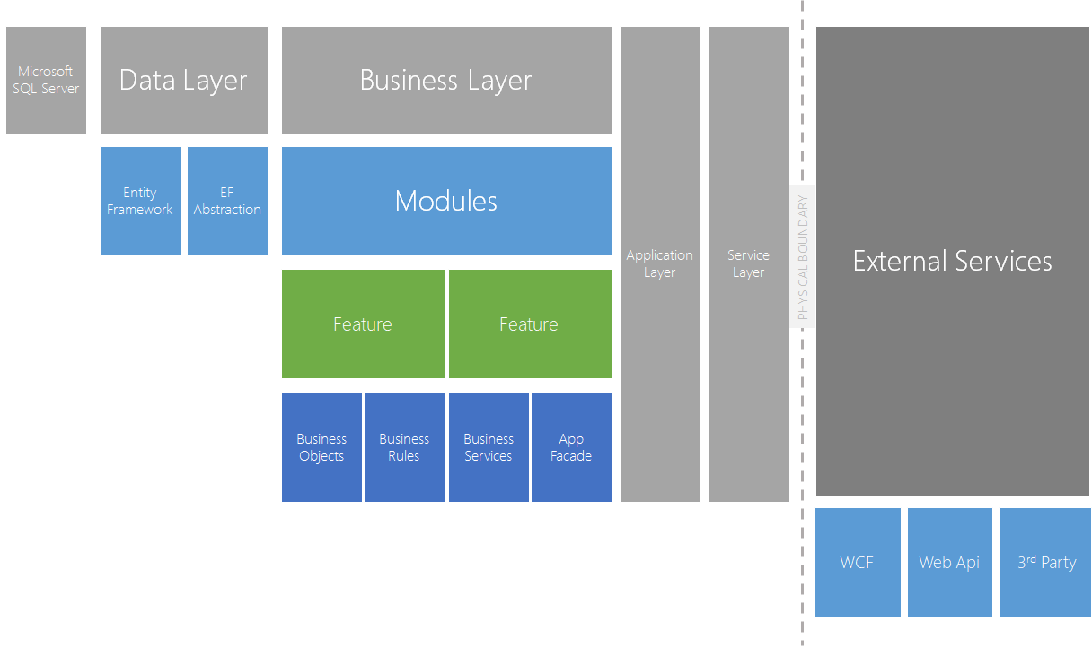
Layered Diagram

Slide 14
Layered Architecture
Which Architecture to use
The right architecture largely depends on the application you will build. Designer have to ask some question which are:
How many tiers will your architecture have?
Is your application heavily data driven?
Do you have complex domain requirements or business rules?
Small applications might not require a layered architecture at all.
The important part is you architect a solution that fits your needs.

Slide 15
Layered Architecture
Advantages
Improve productivity via Reuse (The entire Data Access Layer module is reusable).
Improve Productivity via Team Segment.
Improve Maintainability.
If a change is made with Database it will only effect only DAL. If change is BL it will only effect BL.
Looser coupling.
More physical deployment. Adding this feature can affect the performance.

Slide 16
Layered Architecture
Disadvantages
Adding additional servers to our application to increase its performance and scalability. But in reality is that the fastest an application can perform is when all its processes is in-process in a single machine.
More complex designs.
Complex and good amount of skills and experience required for the team.
More complex deployment.
Loose coupling allow connected modules to change independently of one another.

Slide 17
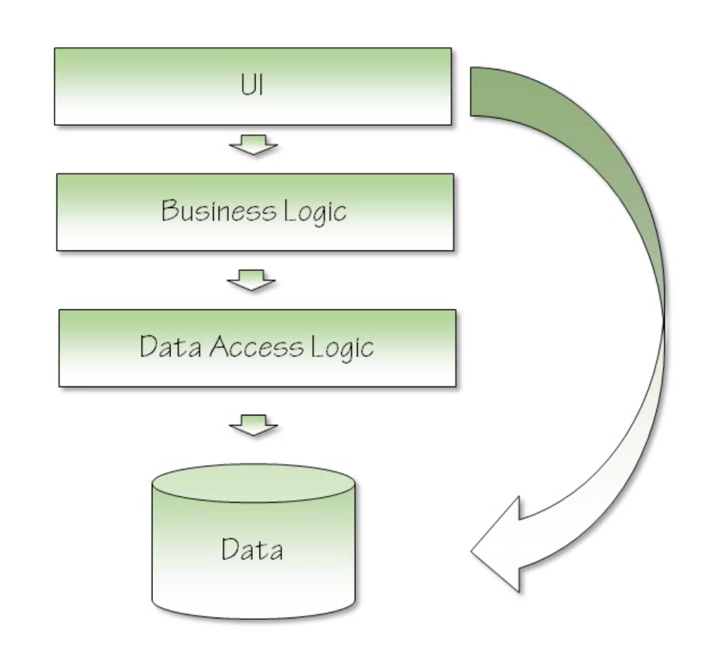
Layered Architecture
Monolithic Application
N-tier application where N= 1, Single unit of deployment.
No logical or physical separation of concerns.
All parts of the application are included in one assembly. For example: Microsoft Access Database

Slide 18
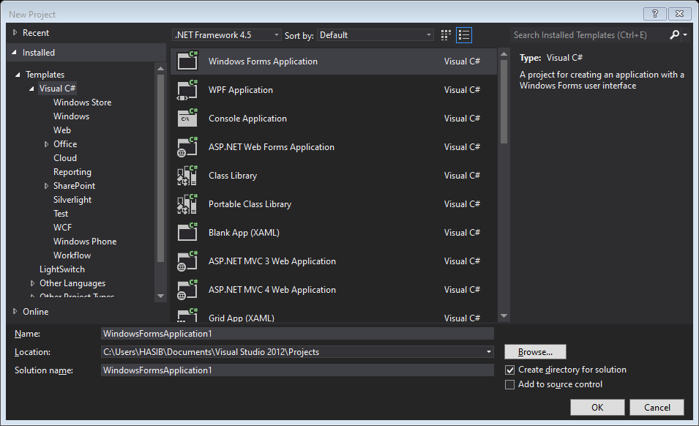
Add a Windows Form Application Project (Presentation Layer)

Slide 19
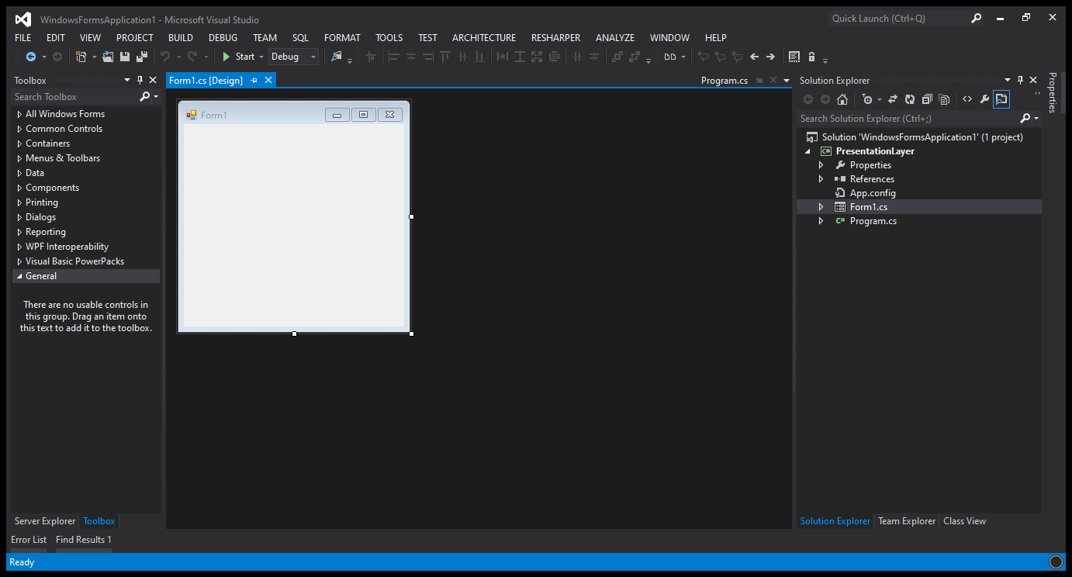
Let's set up our next projects and define them in separate layers.Add 3 projects to your solution named BusinessLogicLayer, DataAccessLayer and ServiceLayer.

Slide 20
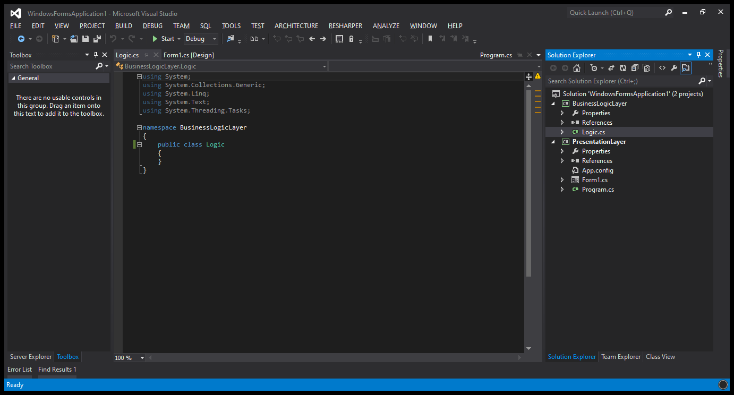
Creating Business Logic Layer

Slide 21
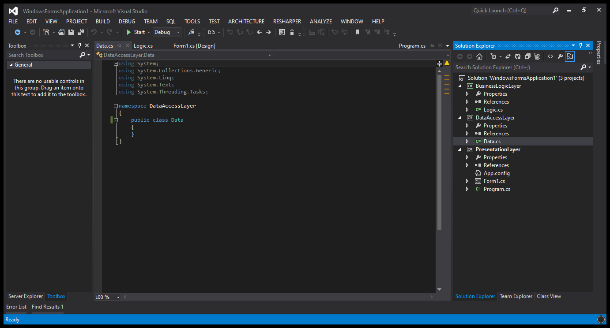
Creating Data Access Layer

Slide 22
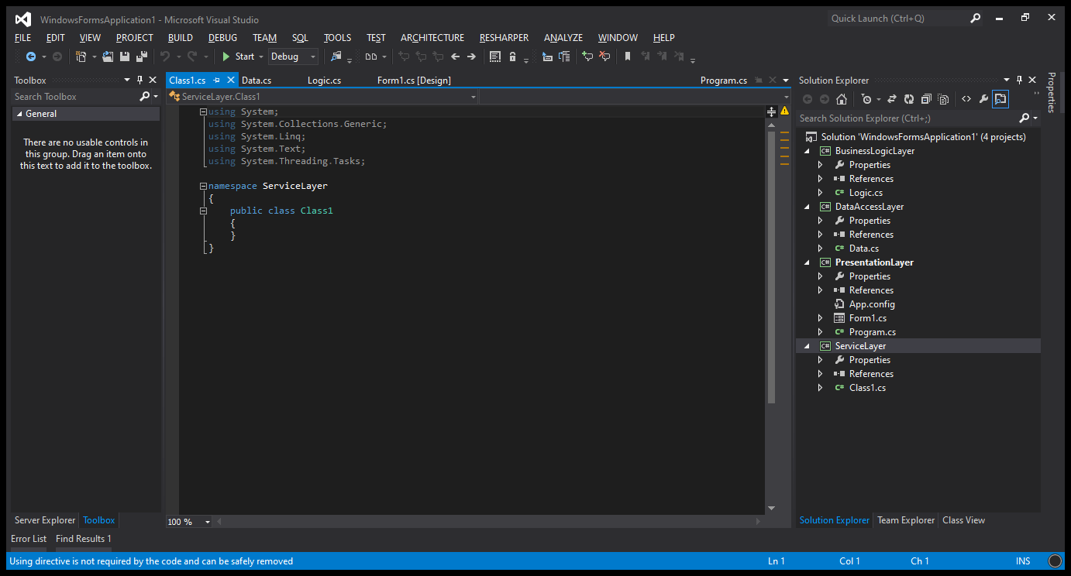
Creating Service Layer

Slide 23
Layered Architecture
Common Rules to practice
The Data Access Layer Project Contains the entities classes and objects to communicate with the database.
Service layer contains properties and helper classes to communicate with all.
It also acts as a mode of communication among the layers.
Presentation Layer needs no direct interact with the database.
Add a reference of the Business Logic Layer to Presentation Layer and Data Access Layer to the Business Logic Layer and Service Layer to all other layers.

Slide 24
Project Discussion

Slide 25
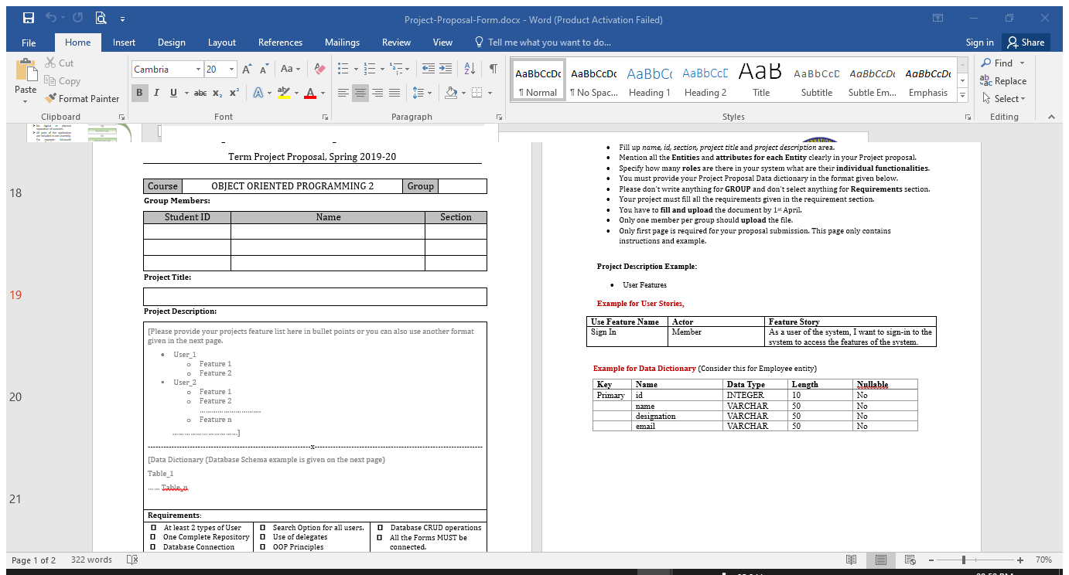
Project Proposal Form

Slide 26

Thank You

Slide 27
Books
C# 4.0 The Complete Reference; Herbert Schildt; McGraw-Hill Osborne Media; 2010
Head First C# by Andrew Stellman
Fundamentals of Computer Programming with CSharp – Nakov v2013

Slide 28
References
https://www.c-sharpcorner.com/UploadFile/1492b1/understanding-multilayered-architecture-in-net/
https://medium.com/@hidayatarg/n-tier-layer-architecture-in-c-15b8fe97283c
http://danderson.io/layered-architecture/
https://github.com/topics/layered-architecture?l=c%23

