Slide 1

Operating Systems
Course Code: CSE 323
Course Teacher: Rabeya Khatun
Initial: RAK

Slide 2
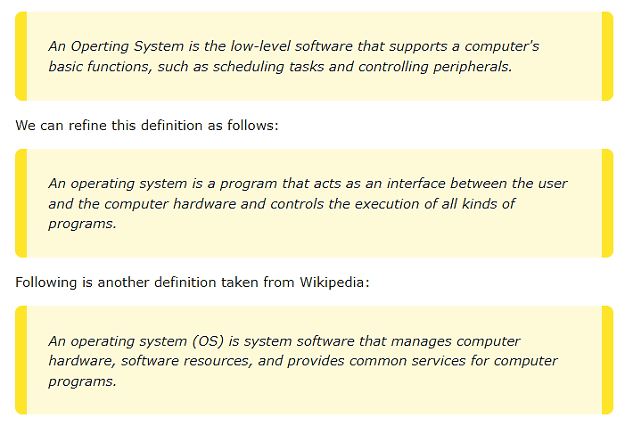

Slide 3
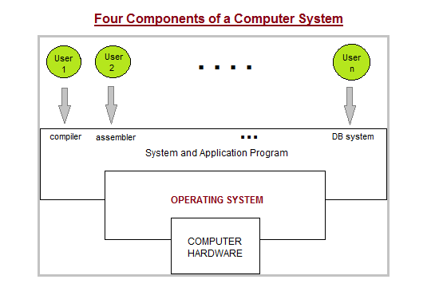

Slide 4
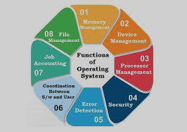
Functions of Operating Systems
Process Management
I/O Device Management
File Management
Network Management
Main Memory Management
Secondary Storage Management
Security Management
Command Interpreter System
Control over system performance
Job Accounting
Error Detection and Correction
Coordination between other software and users

Slide 5
Process Management
A program in running state is called a process.
The operating system is responsible for the following activities in connection with process management:
Create, load, execute, suspend, resume, and terminate processes.
Switch system among multiple processes in main memory.
Provides communication mechanisms so that processes can communicate with each others
Provides synchronization mechanisms to control concurrent access to shared data to keep shared data consistent.
Allocate/de-allocate resources properly to prevent or avoid deadlock situation.

Slide 6
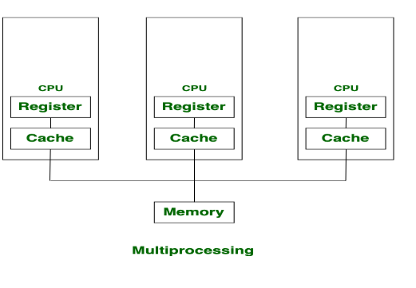
Multiprocessing Operating System
Advantages of Multi-Processing Operating System
It increases the throughput of the system.
As it has several processors, so, if one processor fails, we can proceed with another processor.
Disadvantages of Multi-Processing Operating System
Due to the multiple CPU, it can be more complex and somehow difficult to understand.

Slide 7
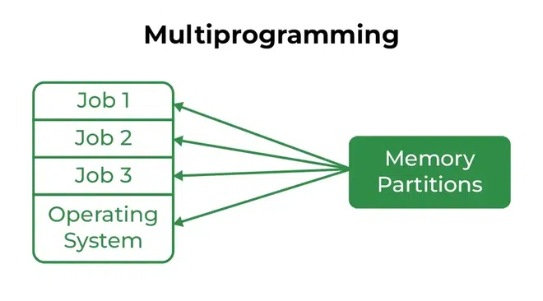
Multiprogramming Operating System
Advantages of Multi-Programming Operating System
Multi Programming increases the Throughput of the System.
It helps in reducing the response time.
Disadvantages of Multi-Programming Operating System
There is not any facility for user interaction of system resources with the system.

Slide 8
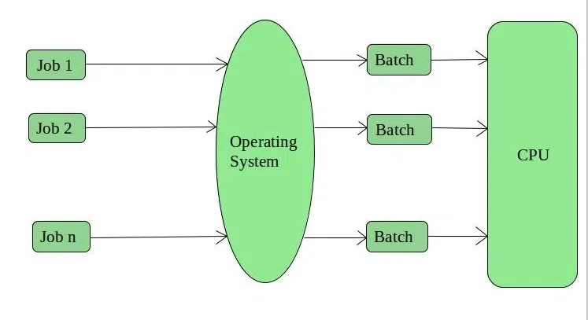
Batch Operating System

Slide 9
Advantages of Batch Operating System
Multiple users can share the batch systems.
The idle time for the batch system is very less.
It is easy to manage large work repeatedly in batch systems.
Disadvantages of Batch Operating System
The computer operators should be well known with batch systems.
Batch systems are hard to debug.
It is sometimes costly.
The other jobs will have to wait for an unknown time if any job fails.
In batch operating system the processing time for jobs is commonly difficult to accurately predict while they are in the queue.
It is difficult to accurately predict the exact time required for a job to complete while it is in the queue.

Slide 10
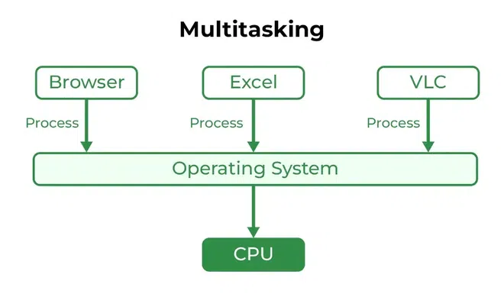
Multitasking Operating System
Multitasking Operating System is simply a multiprogramming Operating System with having facility of a Round-Robin Scheduling Algorithm. It can run multiple programs simultaneously.
Advantages of Multi-Tasking Operating System
Multiple Programs can be executed simultaneously in Multi-Tasking Operating System.
It comes with proper memory management.
Disadvantages of Multi-Tasking Operating System
The system gets heated in case of heavy programs multiple times.

