Slide 1
Transfer Learning For Bangladeshi Vehicles
Classification

Slide 2
Group Members
Tanvir Hasan Emon 011181077
Roshidul Islam 011173019

Slide 3
Introduction
Bangladeshi vehicle
Convolutional Neural Network, Transfer Learning
Different Transfer Learning Models
VGG16
ResNet 152 V2
DenseNet 201
Efficient Net B7
Efficient Net V2L
Compare Different Transfer Learning Models
Performance, Accuracy, Loss.

Slide 4
Proposed Method
Dataset Details :
Paribahan BD
Large collection of Bangladeshi vehicle data
It has 9058 Images
16 Classes

Slide 5
Transfer Learning Models
VGG16
Total 14,845,776 parameters from them 131,088 are trainable parameters and 14,714,688 are non trainable parameters.
ResNet 152 V2
Total 59,150,864 parameters. From them 819,216 are trainable parameters and 58,331,648 are non trainable parameters.
DenseNet 201
Total 18,813,520 parameters. From them 491,536 are trainable parameters and 18,321,984 are non trainable

Slide 6
Transfer Learning Models
Efficient Net B7
Total 65,121,703 parameters from them 1,024,016 are trainable parameters and 64,097,687 are non trainable parameters.
Efficient Net V2L
Total 118,258,864 parameters. From them 512,016 are trainable parameters and 117,746,848 are non trainable parameters.

Slide 7
Epoch
Limited Computational Power
10 Epoch
228 Steps per Epoch

Slide 8
Preprocessing
Split data in train, validation and test.
Image size = 150
Batch size = 32
Rescale image
Load data from directory
Label Mapping

Slide 9
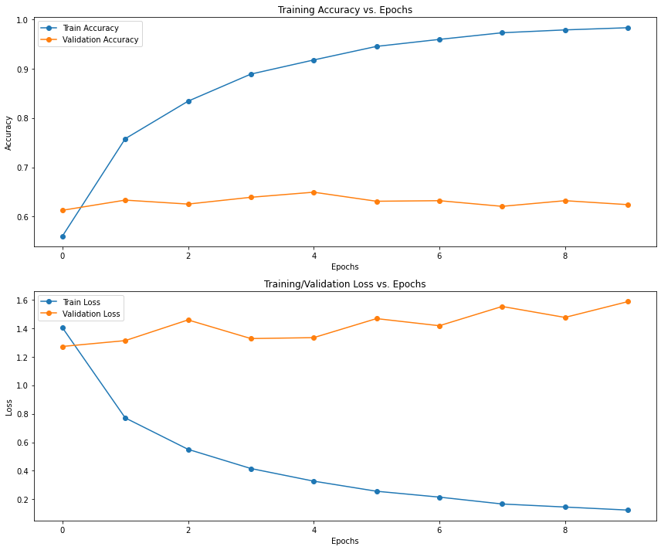
Result Analysis
VGG16

Slide 10
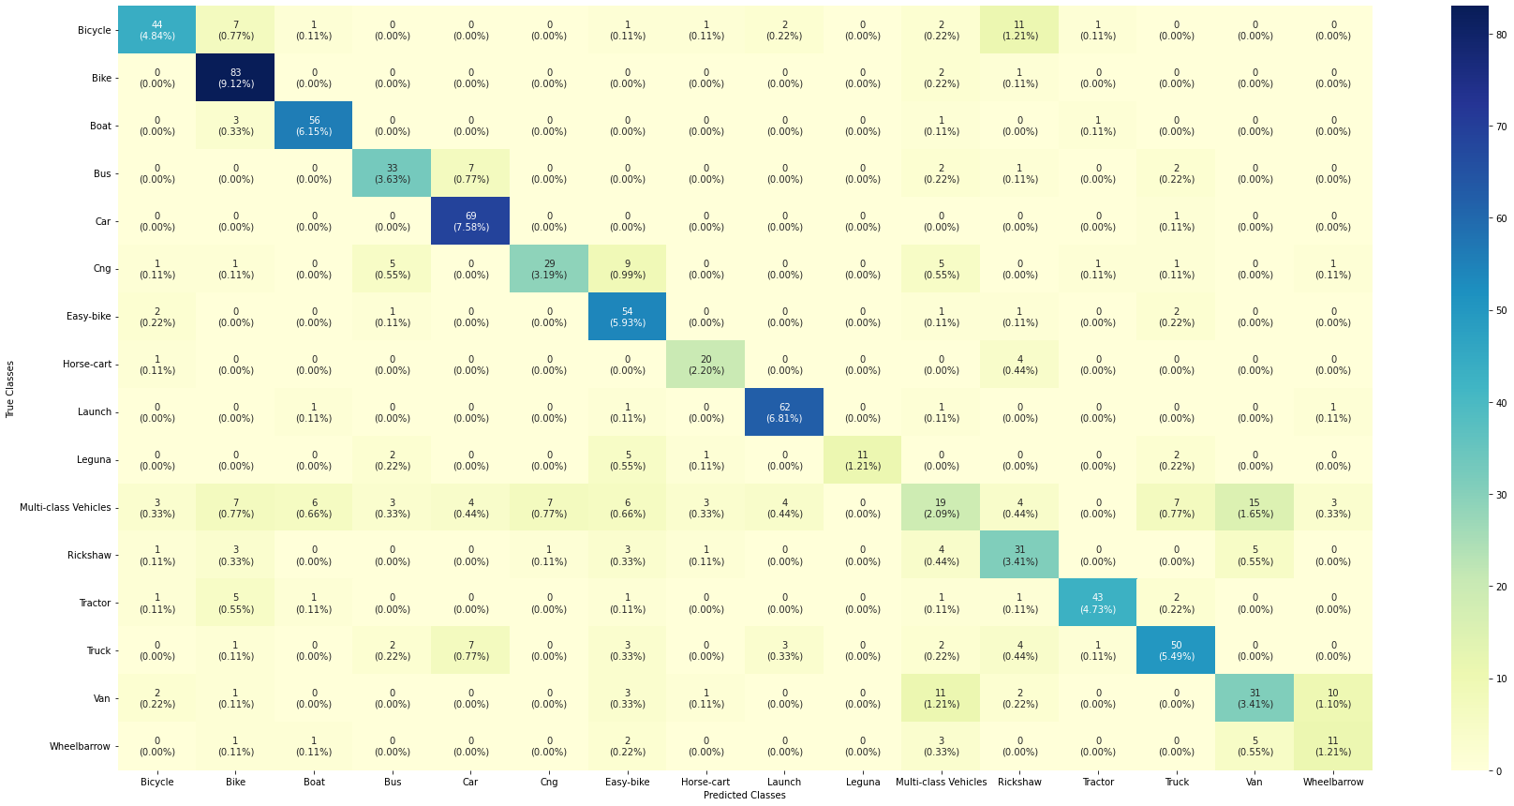
Result Analysis
VGG16

Slide 11
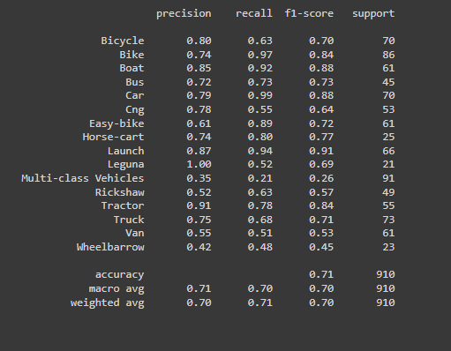
Result Analysis
VGG16

Slide 12
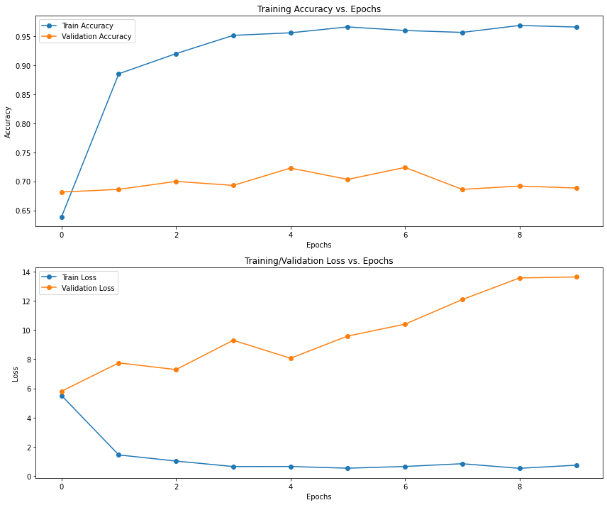
Result Analysis
ResNet 152 V2

Slide 13
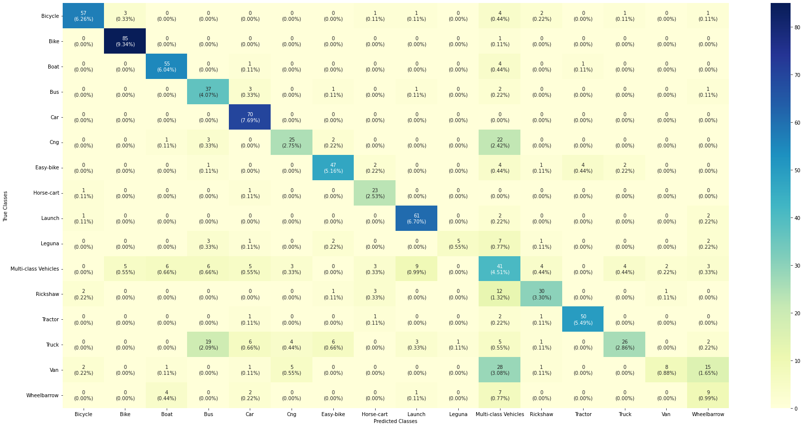
Result Analysis
ResNet 152 V2

Slide 14
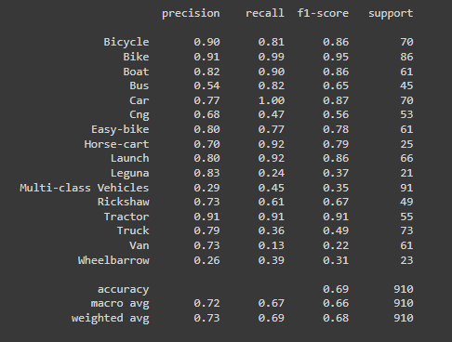
Result Analysis
ResNet 152 V2

Slide 15
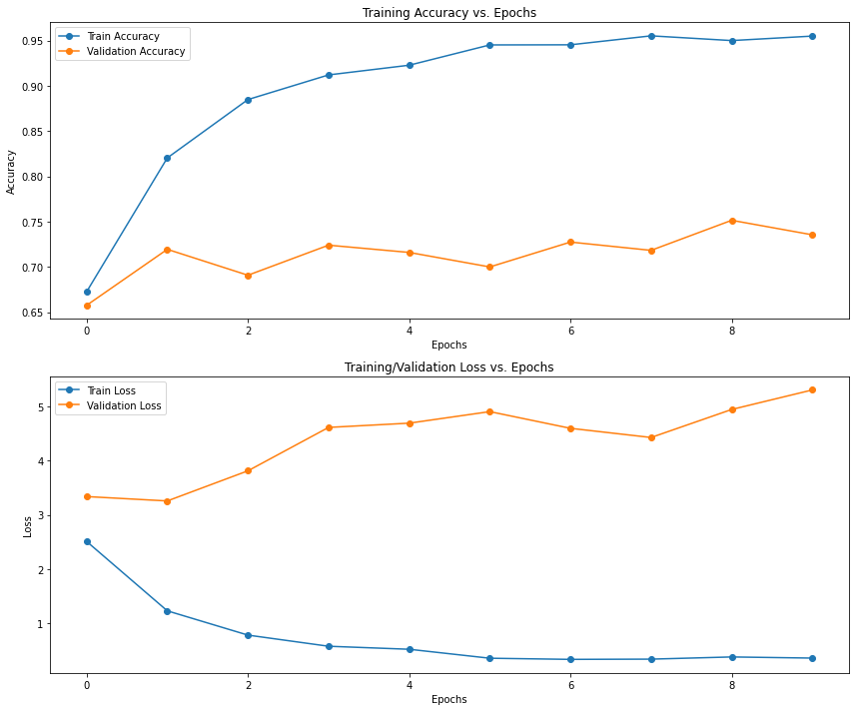
Result Analysis
DenseNet 201

Slide 16
Result Analysis
DenseNet 201

Slide 17
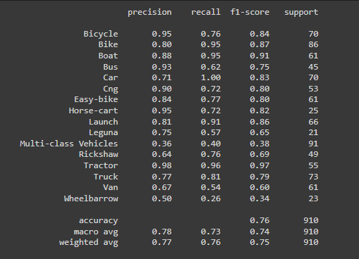
Result Analysis
DenseNet 201

Slide 18
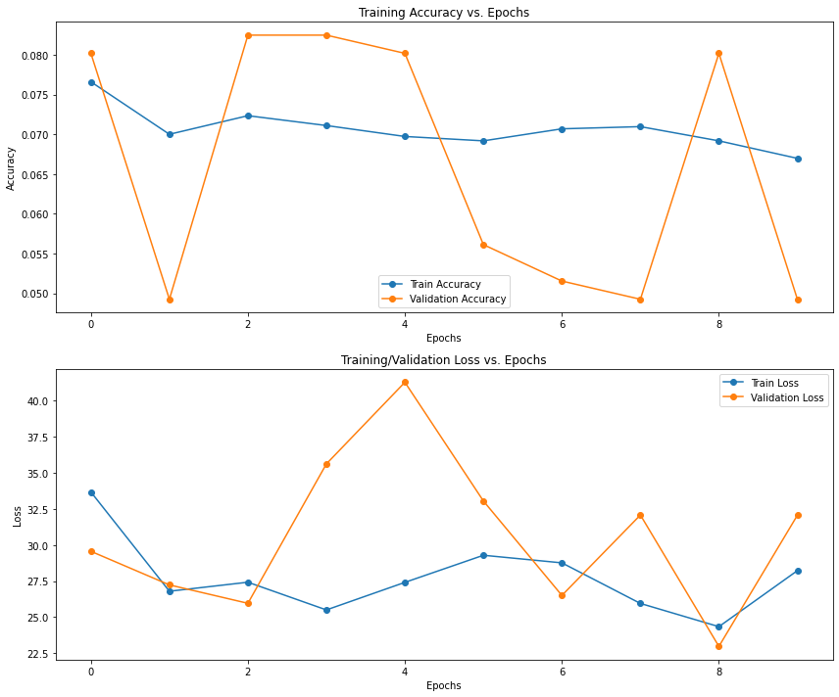
Result Analysis
Efficient Net B7

Slide 19
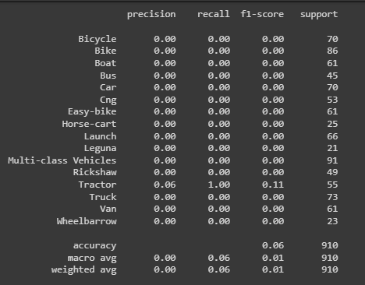
Result Analysis
Efficient Net B7

Slide 20
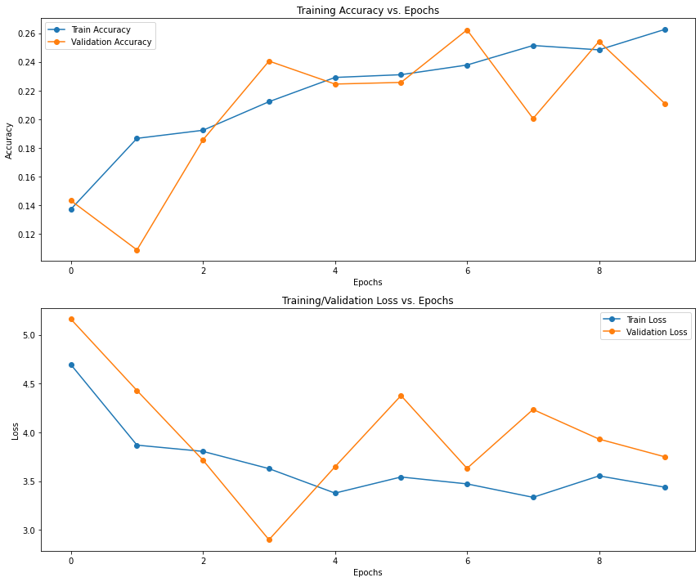
Result Analysis
Efficient Net V2L

Slide 21
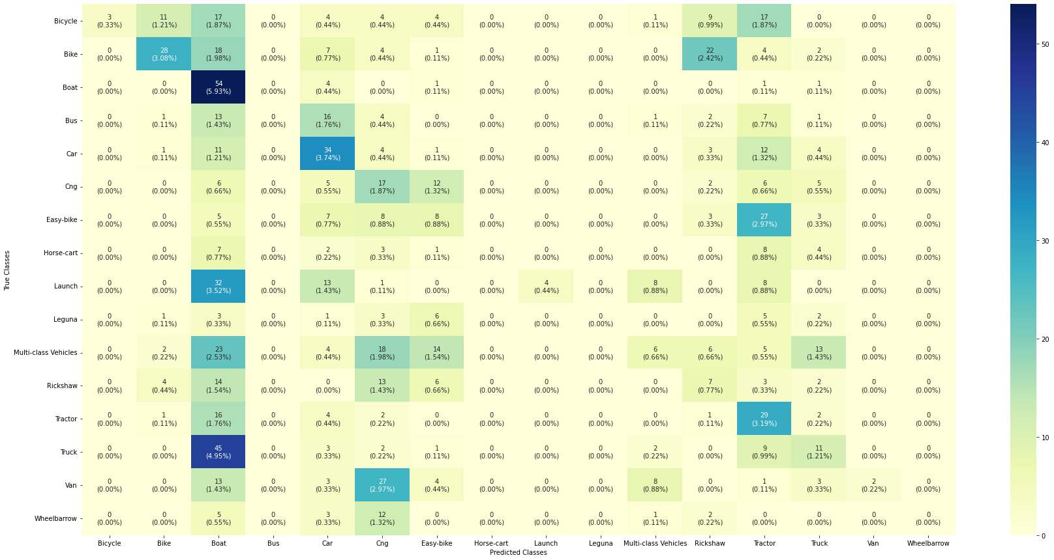
Result Analysis
Efficient Net V2L

Slide 22
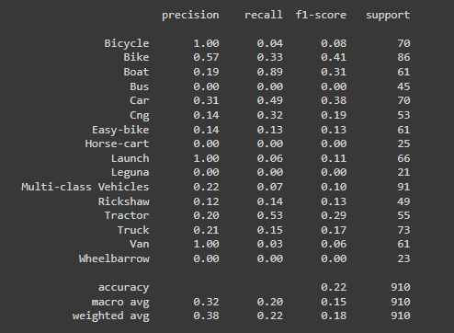
Result Analysis
Efficient Net V2L

Slide 23
Conclusion
DenseNet 201 Model Perform Best
Accuracy 0.7354 Loss 0.530
Paribahan BD

Slide 24
Thank You

