Slide 1
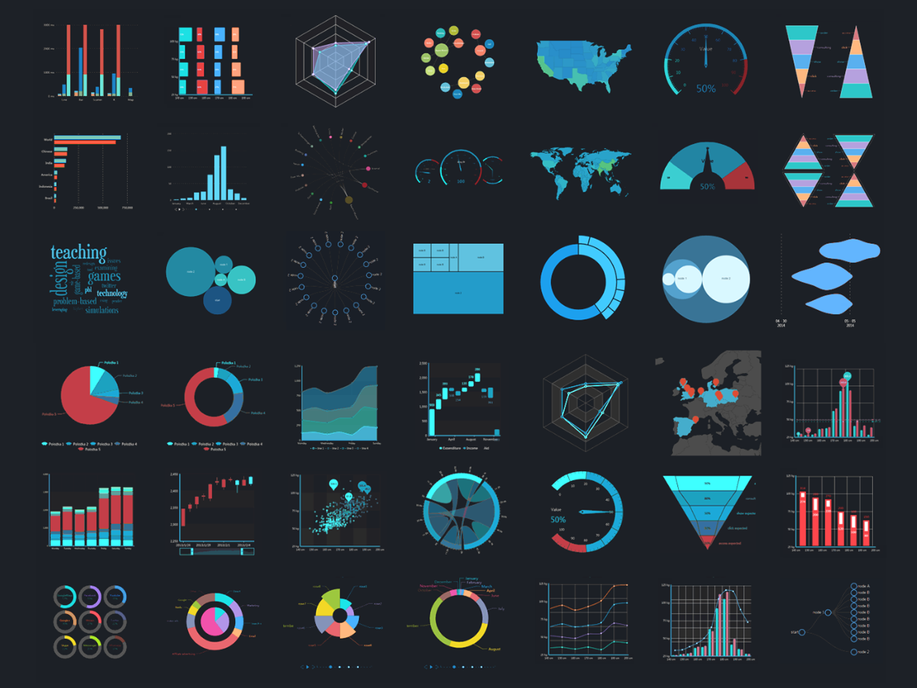
introduction to data science
Mini-Project

Slide 2

Telco customer churn
Team: The Standard Deviators
Darshana Upadhyay
Tanvir Husain

Slide 3

about the dataset
TELCO CUSTOMER CHURN
Customers who left within the last month – the column is called Churn.
Services that each customer has signed up for – phone, multiple lines, internet, online security, online backup, device protection, tech support, and streaming TV and movies.
Customer account information – how long they’ve been a customer, contract, payment method, paperless billing, monthly charges, and total charges.
Demographic info about customers – gender, age range, and if they have partners and dependents.

Slide 4
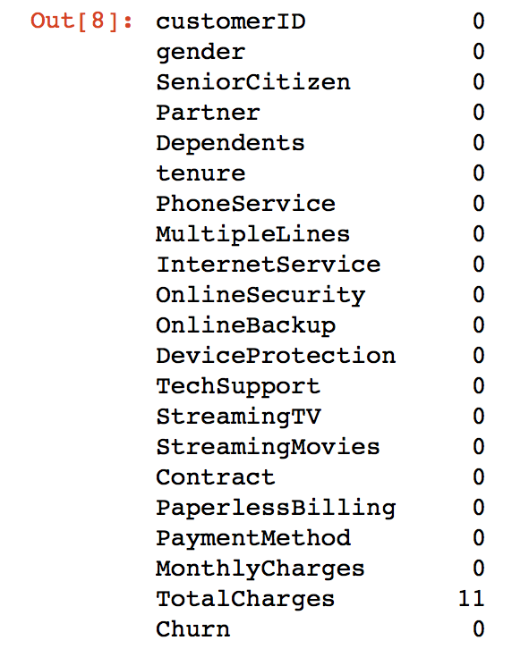
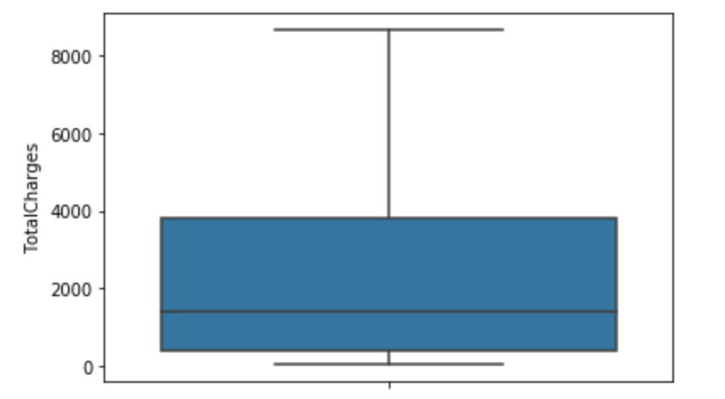
DATA CLEANING
Data Before Cleaning:
The ‘Total Charges’ column contains 11 missing values.
The box plot is drawn to check if ‘Total Charges’ contain any outliers.
The data is cleaned by replacing the missing values by the median.

Slide 5
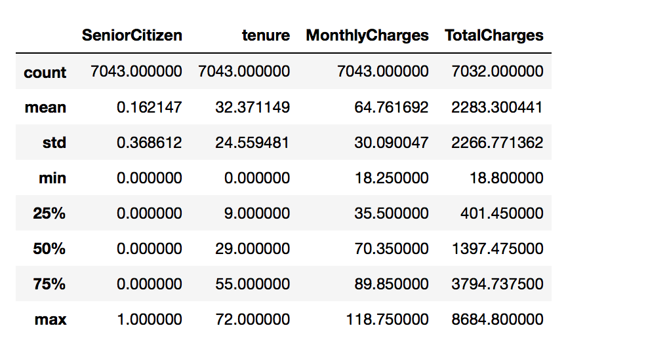
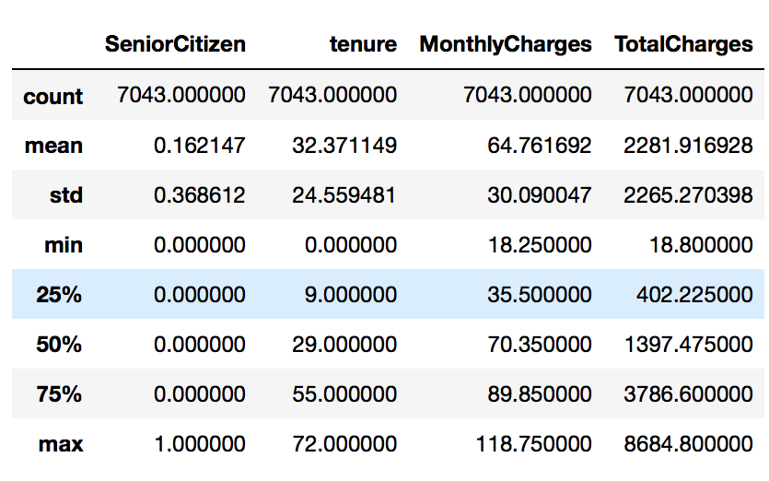
DATA CLEANING
Data Before Cleaning:
Data After Cleaning:
The column of ‘Total Charges’ that contained 11 missing values has been cleaned by replacing them with the median.

Slide 6
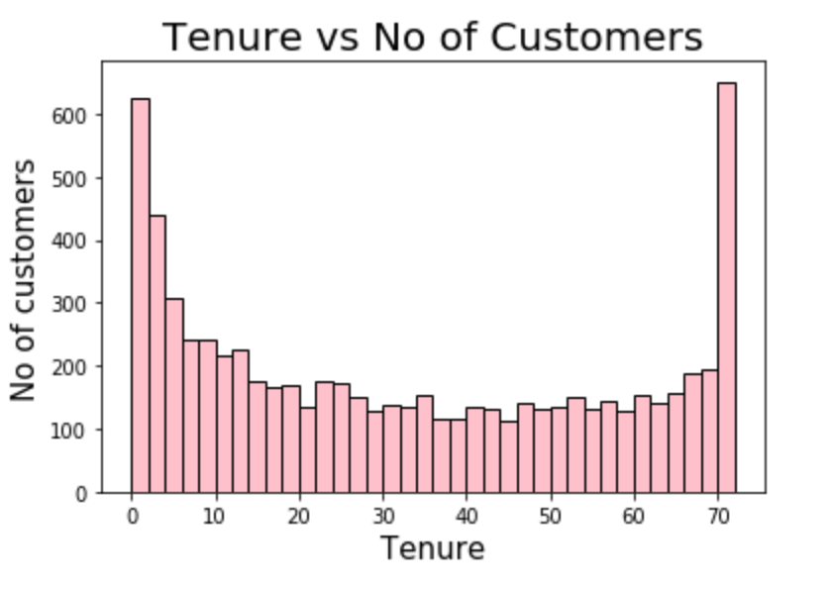
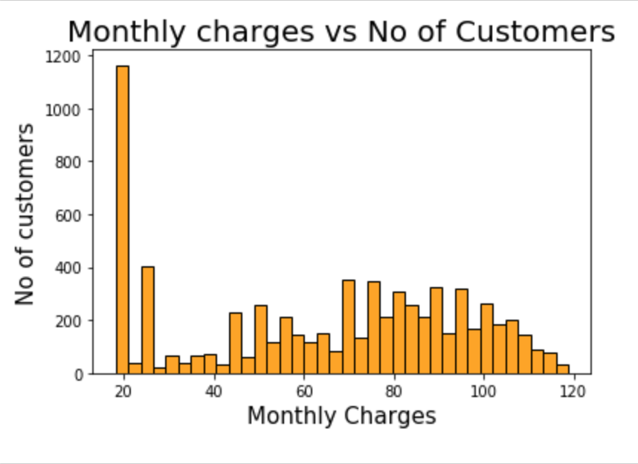
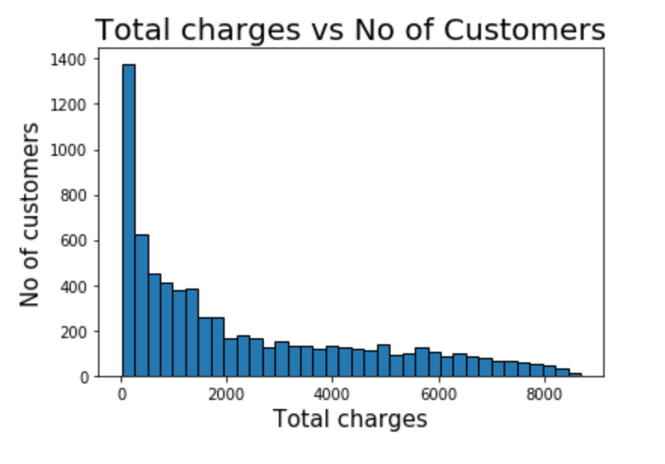
histogram
From the 1st graph we can conclude that a lot of customers have been with the telecom company for just a month, while quite a many are there for about 72 months.
From the 2nd graph we can conclude that a lot of customers have been with the telecom company for just a month, while quite a many are there for about 72 months.
The 3rd graph is positively skewed.

Slide 7
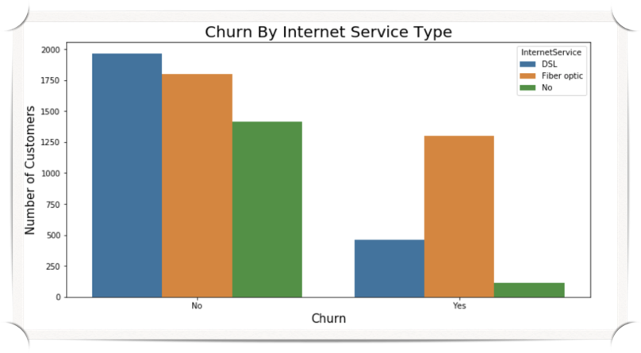
count-plot
The above graph shows if the customers opting for a particular internet service type churn or not.
Out of the three services, the customers opting for Fiber Optic churn in higher numbers.

Slide 8

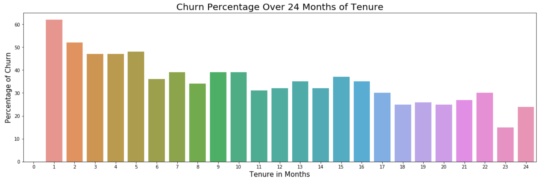
BAR-GRAPH
Over 60% of customers who complete one month of tenure churn.
Churn reduces to about 25 percent at 24 months.
Thus from the graph it can be seen, as the tenure increases churn reduces.

Slide 9
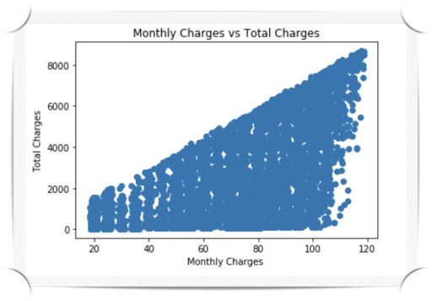
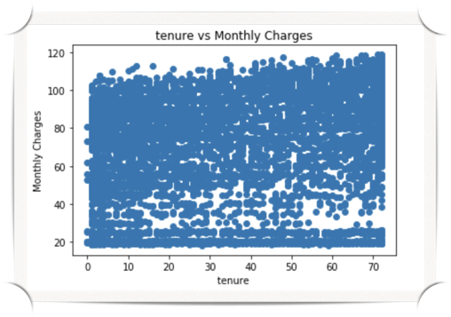
CORRELATION
Positively Correlated
Least Correlated

Slide 10

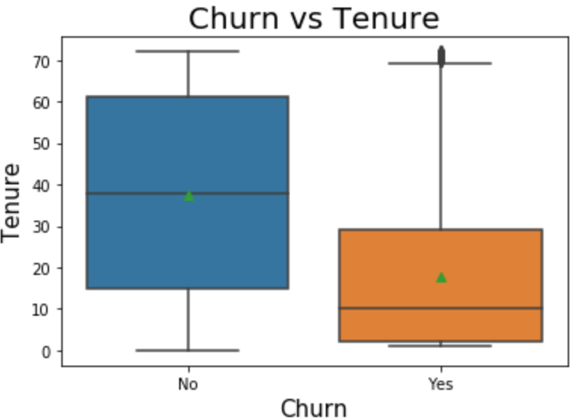
box-plot
From the below boxplot it is clearly evident that shorter is the tenure, higher is the possibility of churn.

Slide 11

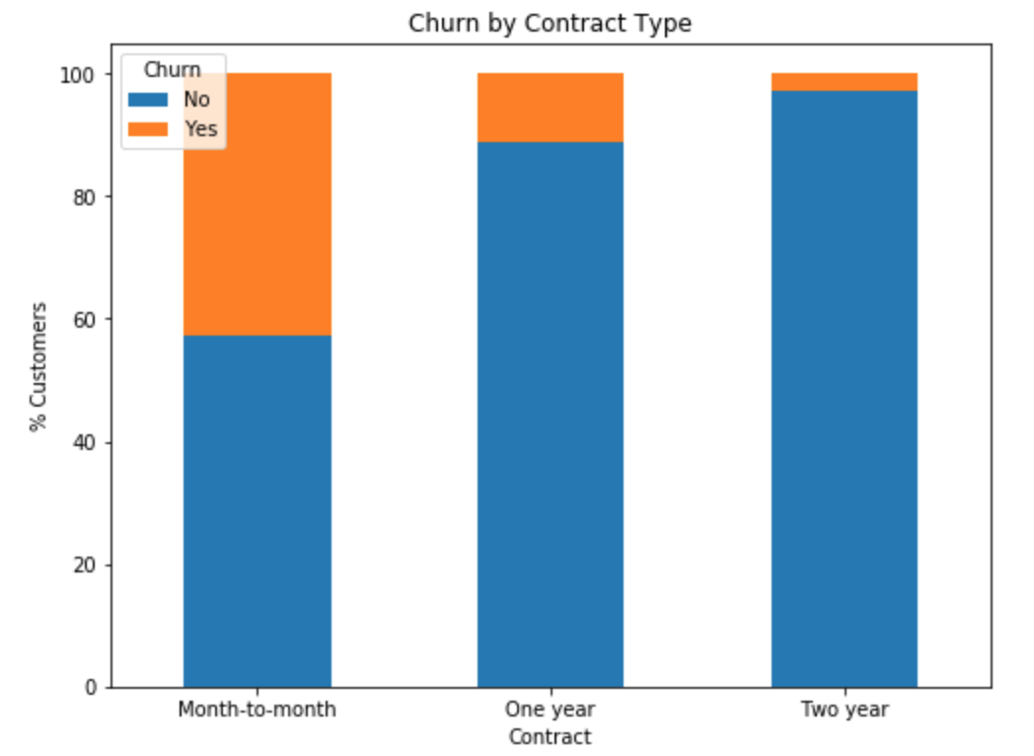
grouped bar-graph
The customers who have availed Month-to-Month Contract churn the most, while those of Two-Year seem to be loyal to the company.

Slide 12
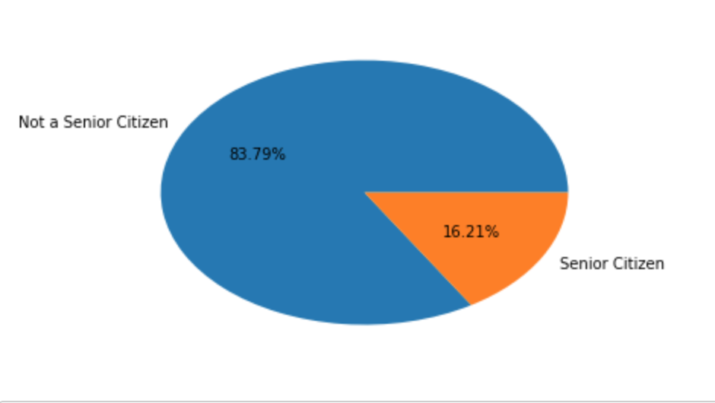
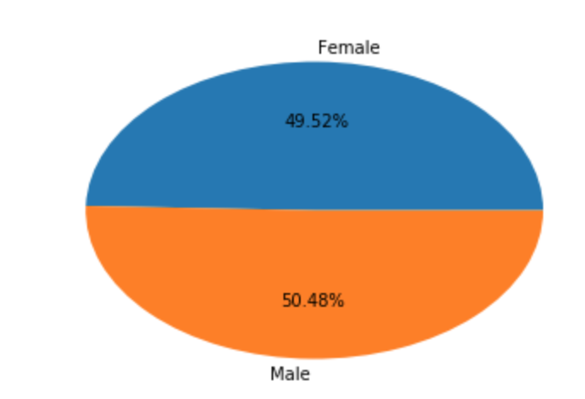
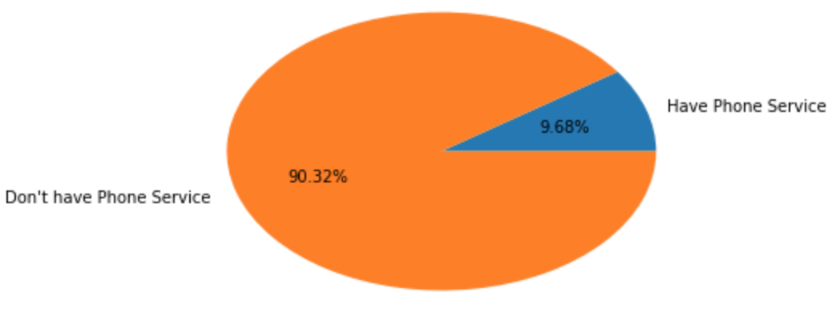
pie chart
The pie charts among the categorical data attributes are shown.

Slide 13
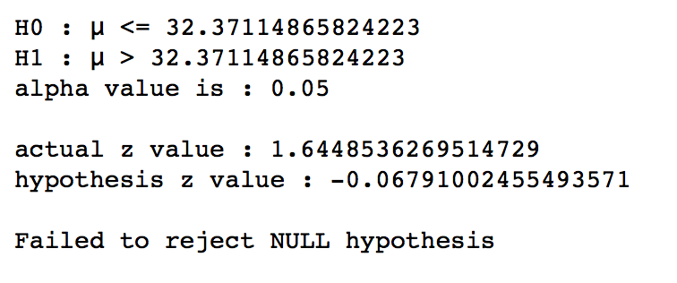
hypothesis testing
The function generates a sample of size 100.
We find the mean and compute the Z-score.
If this value is less than the actual Z-value we fail to reject the null hypothesis, else we reject it.

